Slide 1
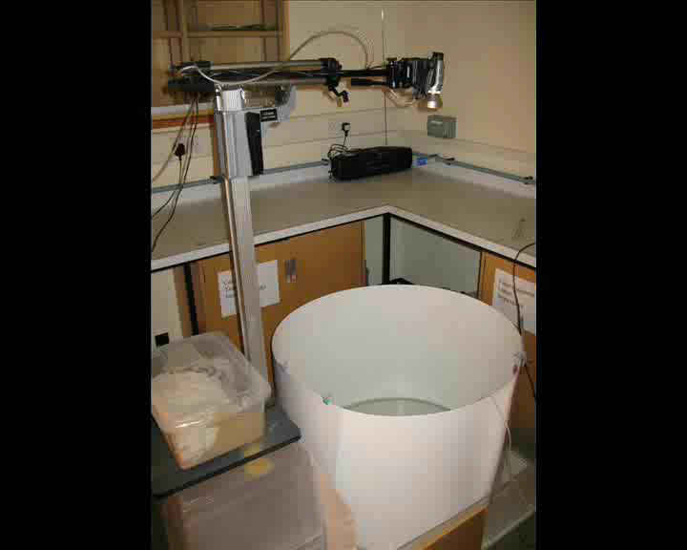
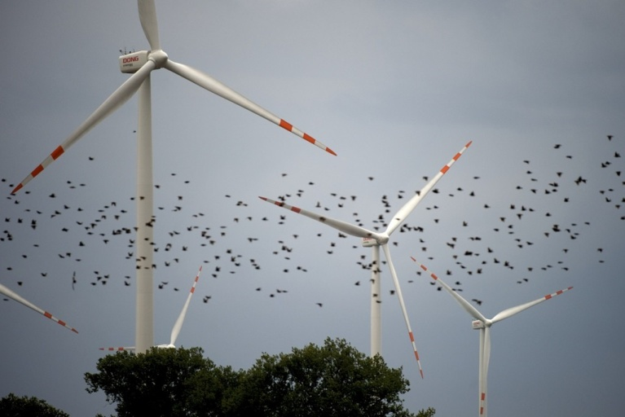
Shoaling Fish
Incorporation of Social Networks
The Project would be lab based and involve capturing and maintaining 3 spined sticklebacks and running them through different trials for either object avoidance or social interactions.
Some statistical techniques
Early start is to collect the fish – late September
Applications to Wind Farms
The impact of social networks on animal collective motion: a conceptual model. N. W. F. Bode, A. Jamie Wood and D. W. Franks. Animal Behaviour 82 29-38 (2011).
Perceived threat increases synchronization in collectively moving animal groups. N. W. F. Bode, Jolyon J. Faria, Jens Krause, D. W. Franks and A. Jamie Wood. Proc. R. Soc. B doi:10.1098/rspb.2010.0855 277 3065-3070

Slide 2
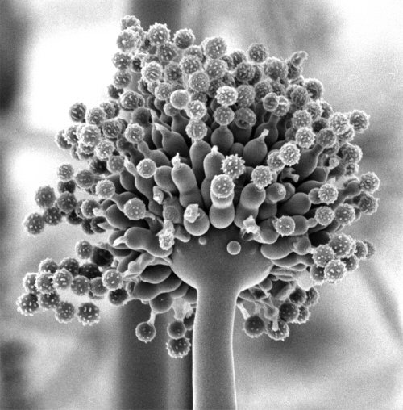
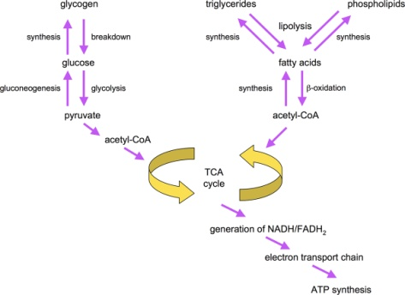
Aspergillus Niger
Metabolic modelling of Aspergillus niger for industrial use.
The project will involve modifying an existing organism model to one that is strain specific. Involve genetic comparison and use of bioinformatics tools. Metabolic model code is already implemented and can be used as is
Bioinformatics skills required
Some computer knowledge needed, scope for as much as wanted
Dr. Nick Read, Fungal Cell Biology Group
Mikael Rørdam Andersen, Michael Lynge Nielsen and Jens Nielsen (2008) "Metabolic model integration of the bibliome, genome,metabolome and reactome of Aspergillus niger", Molecular Systems Biology,4:178, pages 1-13
What is flux balance analysis? Jeffrey D. Orth, Ines Thiele, and Bernhard Ø. Palsson. Nat Biotechnol. 2010 March; 28(3): 245–248. doi: 10.1038/nbt.1614

Slide 3
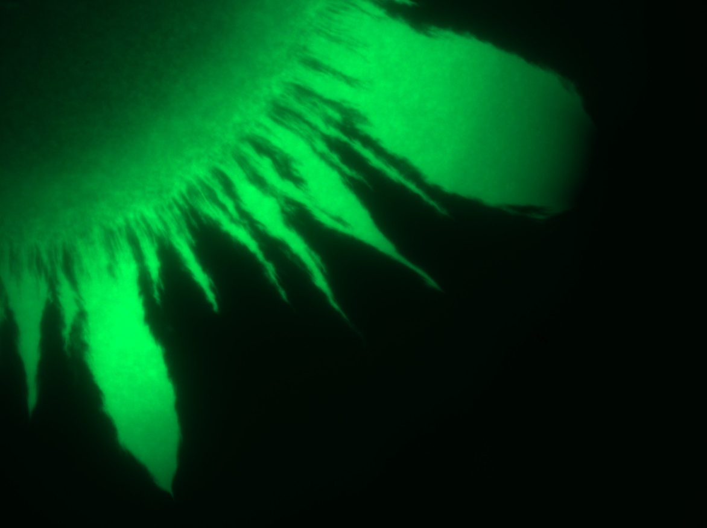
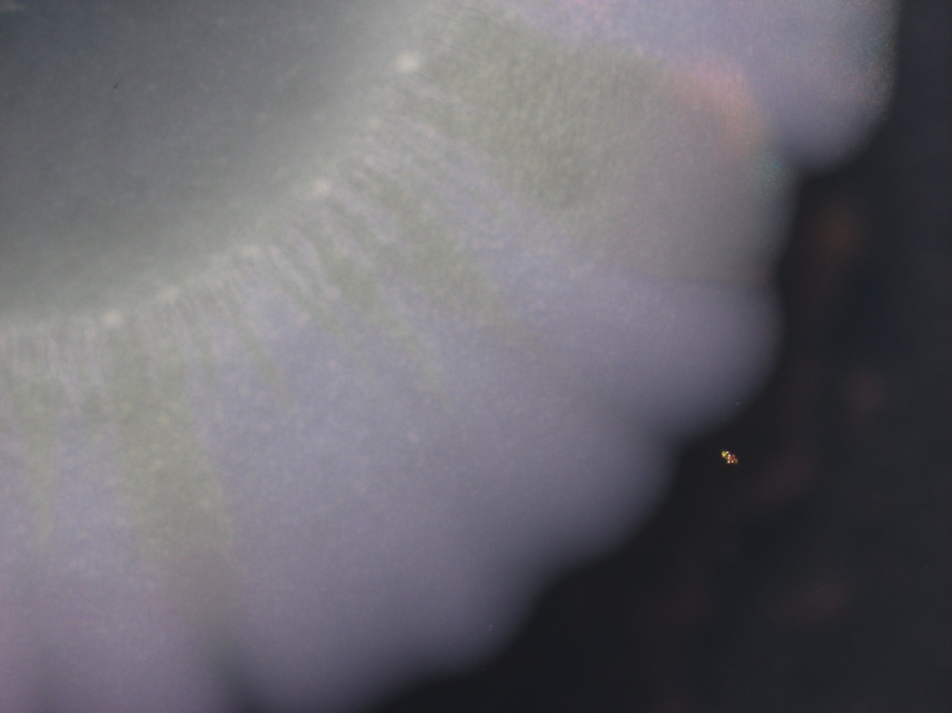
Swarming and Quorum Sensing
I have access to a strain of the plant pathogen Erwinia Carotovara which has GFP labels on its QS circuits. I am interested in the interaction of QS and swarming over an agar plate and this project will involve microscopy and microbiological techniques to explore this. The student will need to work independently during this project
Microbiology
Microscopy
MULTISCALE MODELING OF PSEUDOMONAS AERUGINOSA SWARMING, Du et al.. Math Models Methods Appl Sci. 2011;
Merging mythology and morphology: the multifaceted lifestyle of Proteus mirabilis. Chelsie E. Armbruster & Harry L. T. Mobley, Nature Reviews Microbiology 10, 743-754

Slide 4
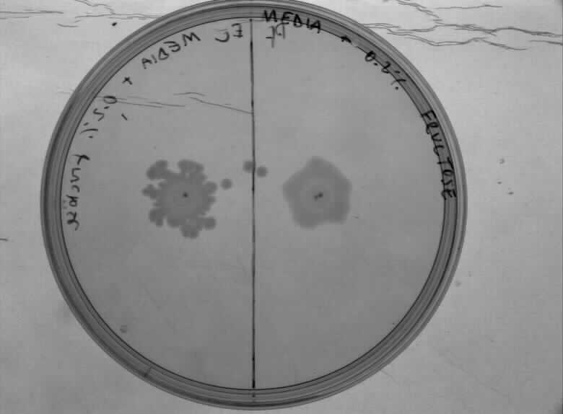
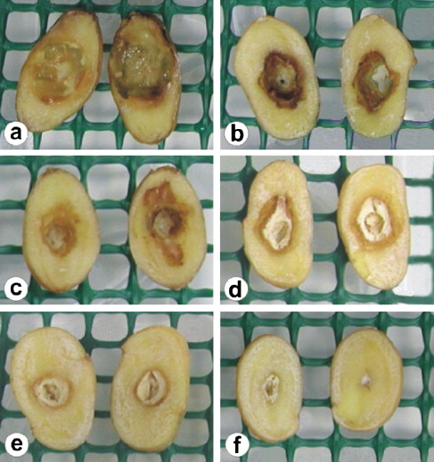
Metabolic Interdependency
I have access to a strain of the plant pathogen Erwinia Carotovara, but it has unusual activity where it secretes exo-enzymes to degrade starch, but requires a secondary infection to process the result. We are going to investigate this interaction with pseudomonas fluorescens.
Quorum sensing, virulence and secondary metabolite production in plant soft-rotting bacteria. Anne M. L. Barnard et al. Phil. Trans. R. Soc. B (2007) 362, 1165–1183 doi:10.1098/rstb.2007.2042

