Slide 1
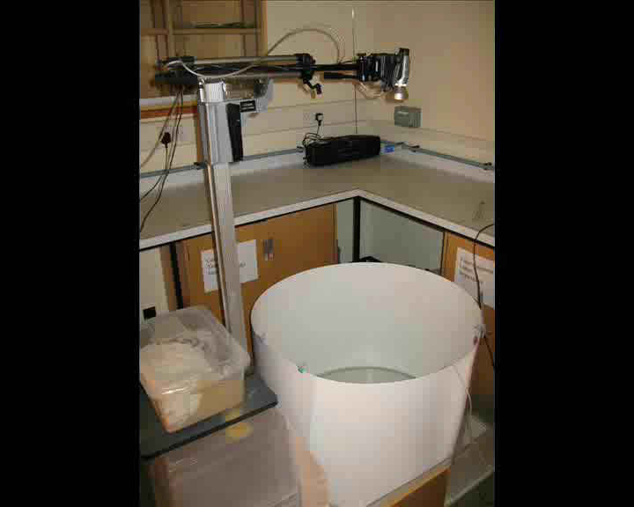
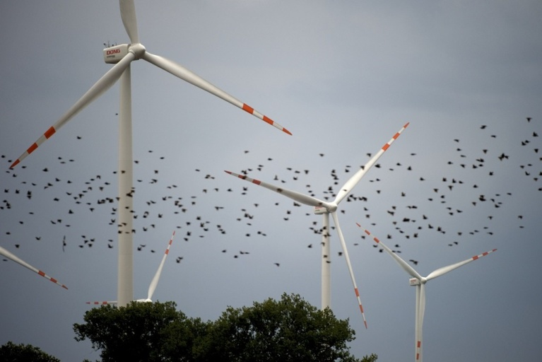
Shoaling Fish
Incorporation of Social Networks
The Project would be lab based and involve capturing and maintaining 3 spined sticklebacks and running them through different trials for either object avoidance or social interactions.
Some statistical techniques
Early start is to collect the fish – late September
Applications to Wind Farms
The impact of social networks on animal collective motion: a conceptual model. N. W. F. Bode, A. Jamie Wood and D. W. Franks. Animal Behaviour 82 29-38 (2011).
Perceived threat increases synchronization in collectively moving animal groups. N. W. F. Bode, Jolyon J. Faria, Jens Krause, D. W. Franks and A. Jamie Wood. Proc. R. Soc. B doi:10.1098/rspb.2010.0855 277 3065-3070

Slide 2
FAQ: Fish Shoaling
What mathematics and programming do I need?
Similar to a standard ecology based project – e.g. Statistics and some use of computer programs for fish tracking.
How early is early?
We say early start for this project so in case of bad weather (i.e. really cold) then fish can be collected early, but in previous years this has not been a problem. Prompt start is probably more accurate.

Slide 3
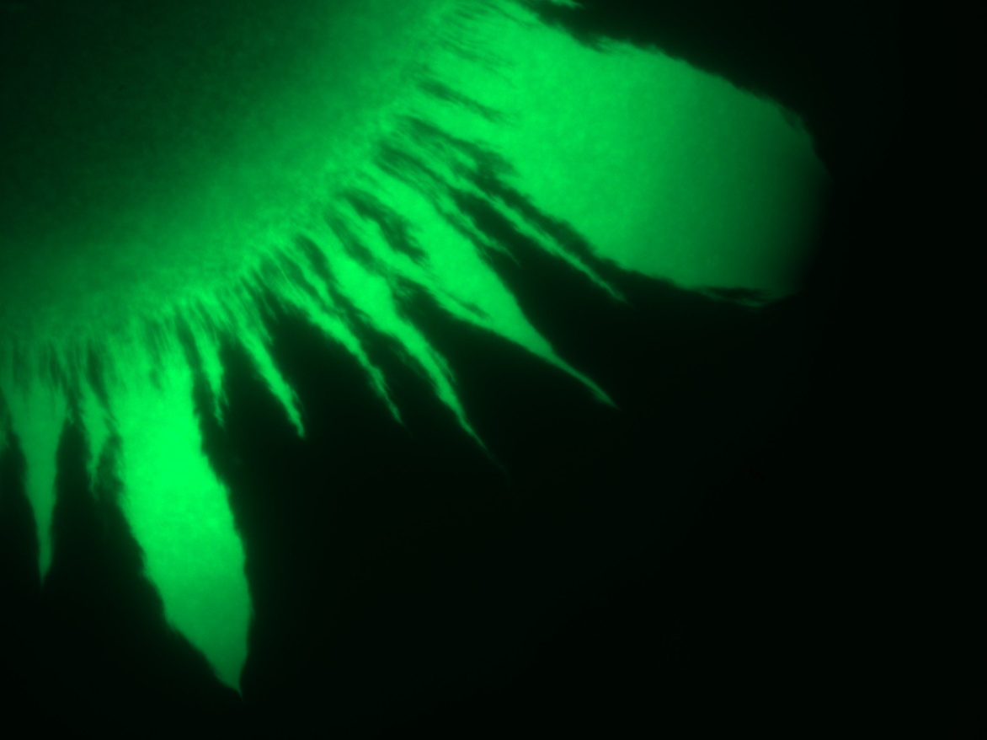
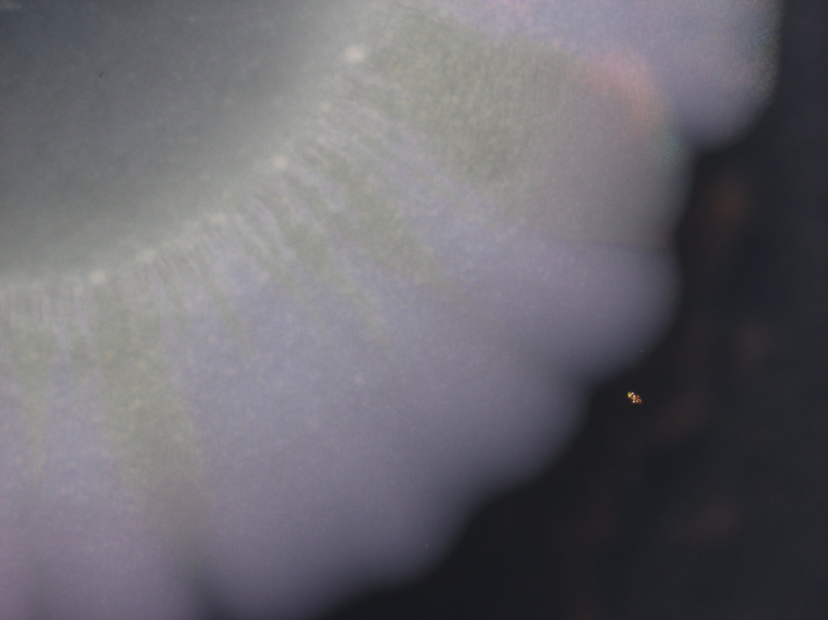
Swarming and Quorum Sensing
I have access to a strain of the plant pathogen Erwinia Carotovara which has GFP labels on its QS circuits. I am interested in the interaction of QS and swarming over an agar plate and this project will involve microscopy and microbiological techniques to explore this. The student will need to work independently during this project
Microbiology
Microscopy
MULTISCALE MODELING OF PSEUDOMONAS AERUGINOSA SWARMING, Du et al.. Math Models Methods Appl Sci. 2011;
Merging mythology and morphology: the multifaceted lifestyle of Proteus mirabilis. Chelsie E. Armbruster & Harry L. T. Mobley, Nature Reviews Microbiology 10, 743-754

Slide 4
FAQ: Swarming and Quorum sensing

