Slide 1
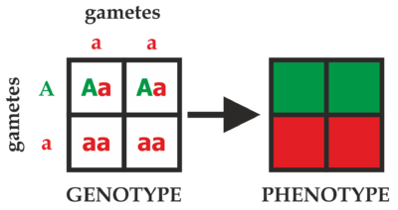
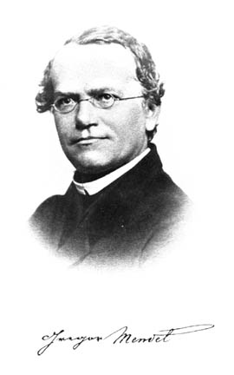
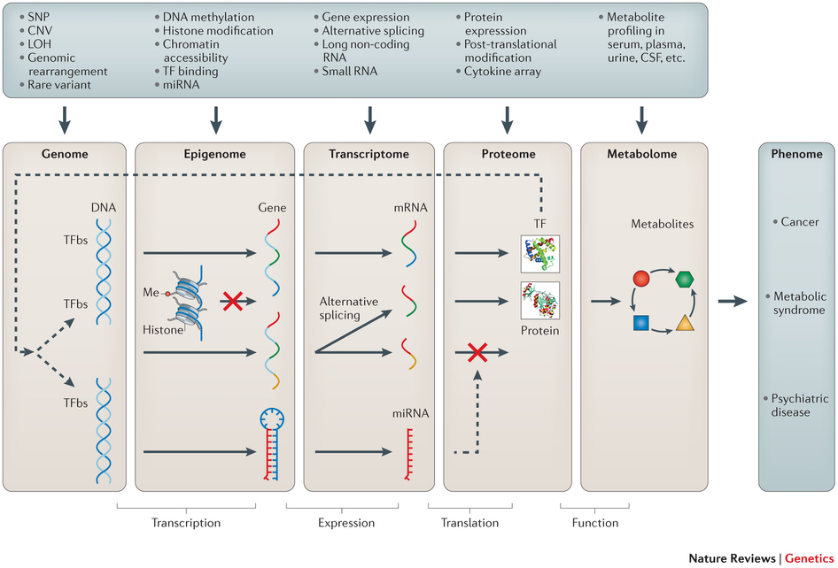
Genetics is complex
oh …
BIO00056I. GWAS workshop introduction.

Slide 2
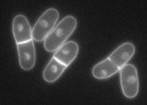
One approach: model organisms
The S. pombe model:
Excellent annotation
Genetically tractable
Genome-wide data:
  gene expression studies
  knockout library
  overexpression library
  genetic interaction screens
Genome facts
12 Mb genome
~5,000 protein coding genes
~1500 non-coding RNAs
Haploid
Excellent model
BIO00056I. GWAS workshop introduction.

Slide 3
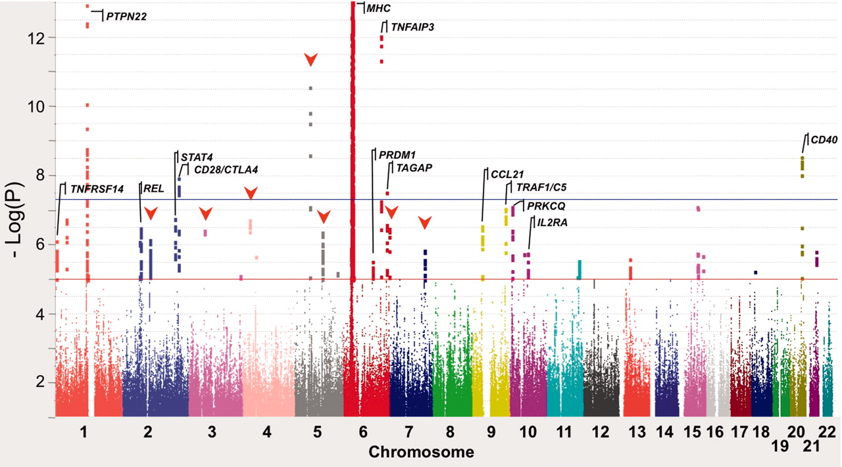
Another approach: quantitative genetics
GWAS signal for Rheumatoid arthritis (Stranger 2001)
Quantitative genetics can describe how genetic diversity influences
within-species trait variation, evolution, disease, drug resistance.
BIO00056I. GWAS workshop introduction.

Slide 4
Part 1: Genetic diversity
Fission yeast is found in all continents (except Antarctica)
We probably carried it (eg: Dispersal to S. America: ~1623 AD)
BIO00056I. GWAS workshop introduction.
Jeffares, Yeast 2017

Slide 5
Fission yeast ecology
BIO00056I. GWAS workshop introduction.
Jeffares, Yeast 2017

Slide 6
Fission yeast population genomics
Previously:
Sequenced all known wild Schizosaccharomyces pombe strains (161)
π = 3 x10⁻³ (similar to human diversity)
BIO00056I. GWAS workshop introduction.
Jeffares et. al., Nature Genetics 2015

Slide 7
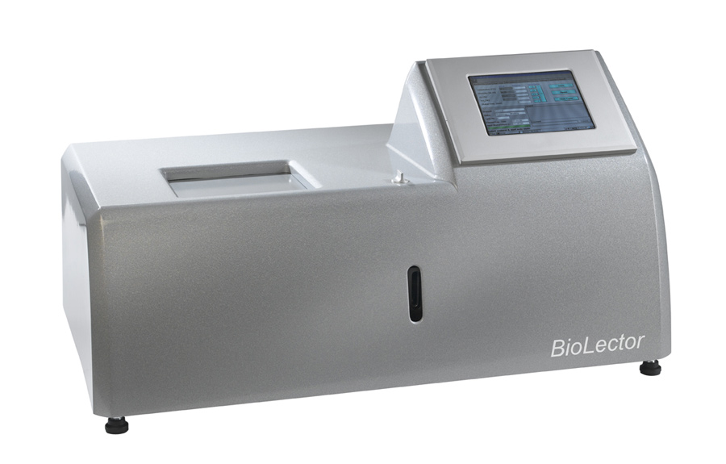
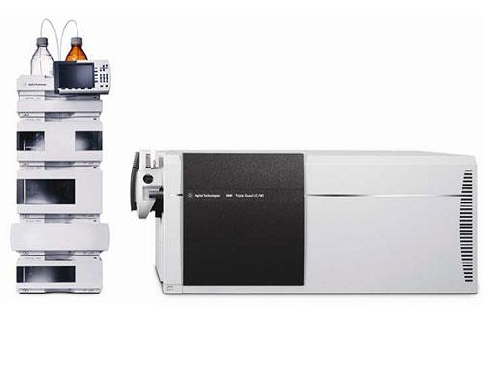
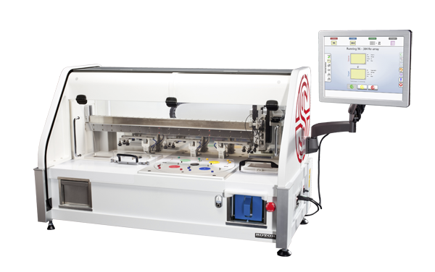
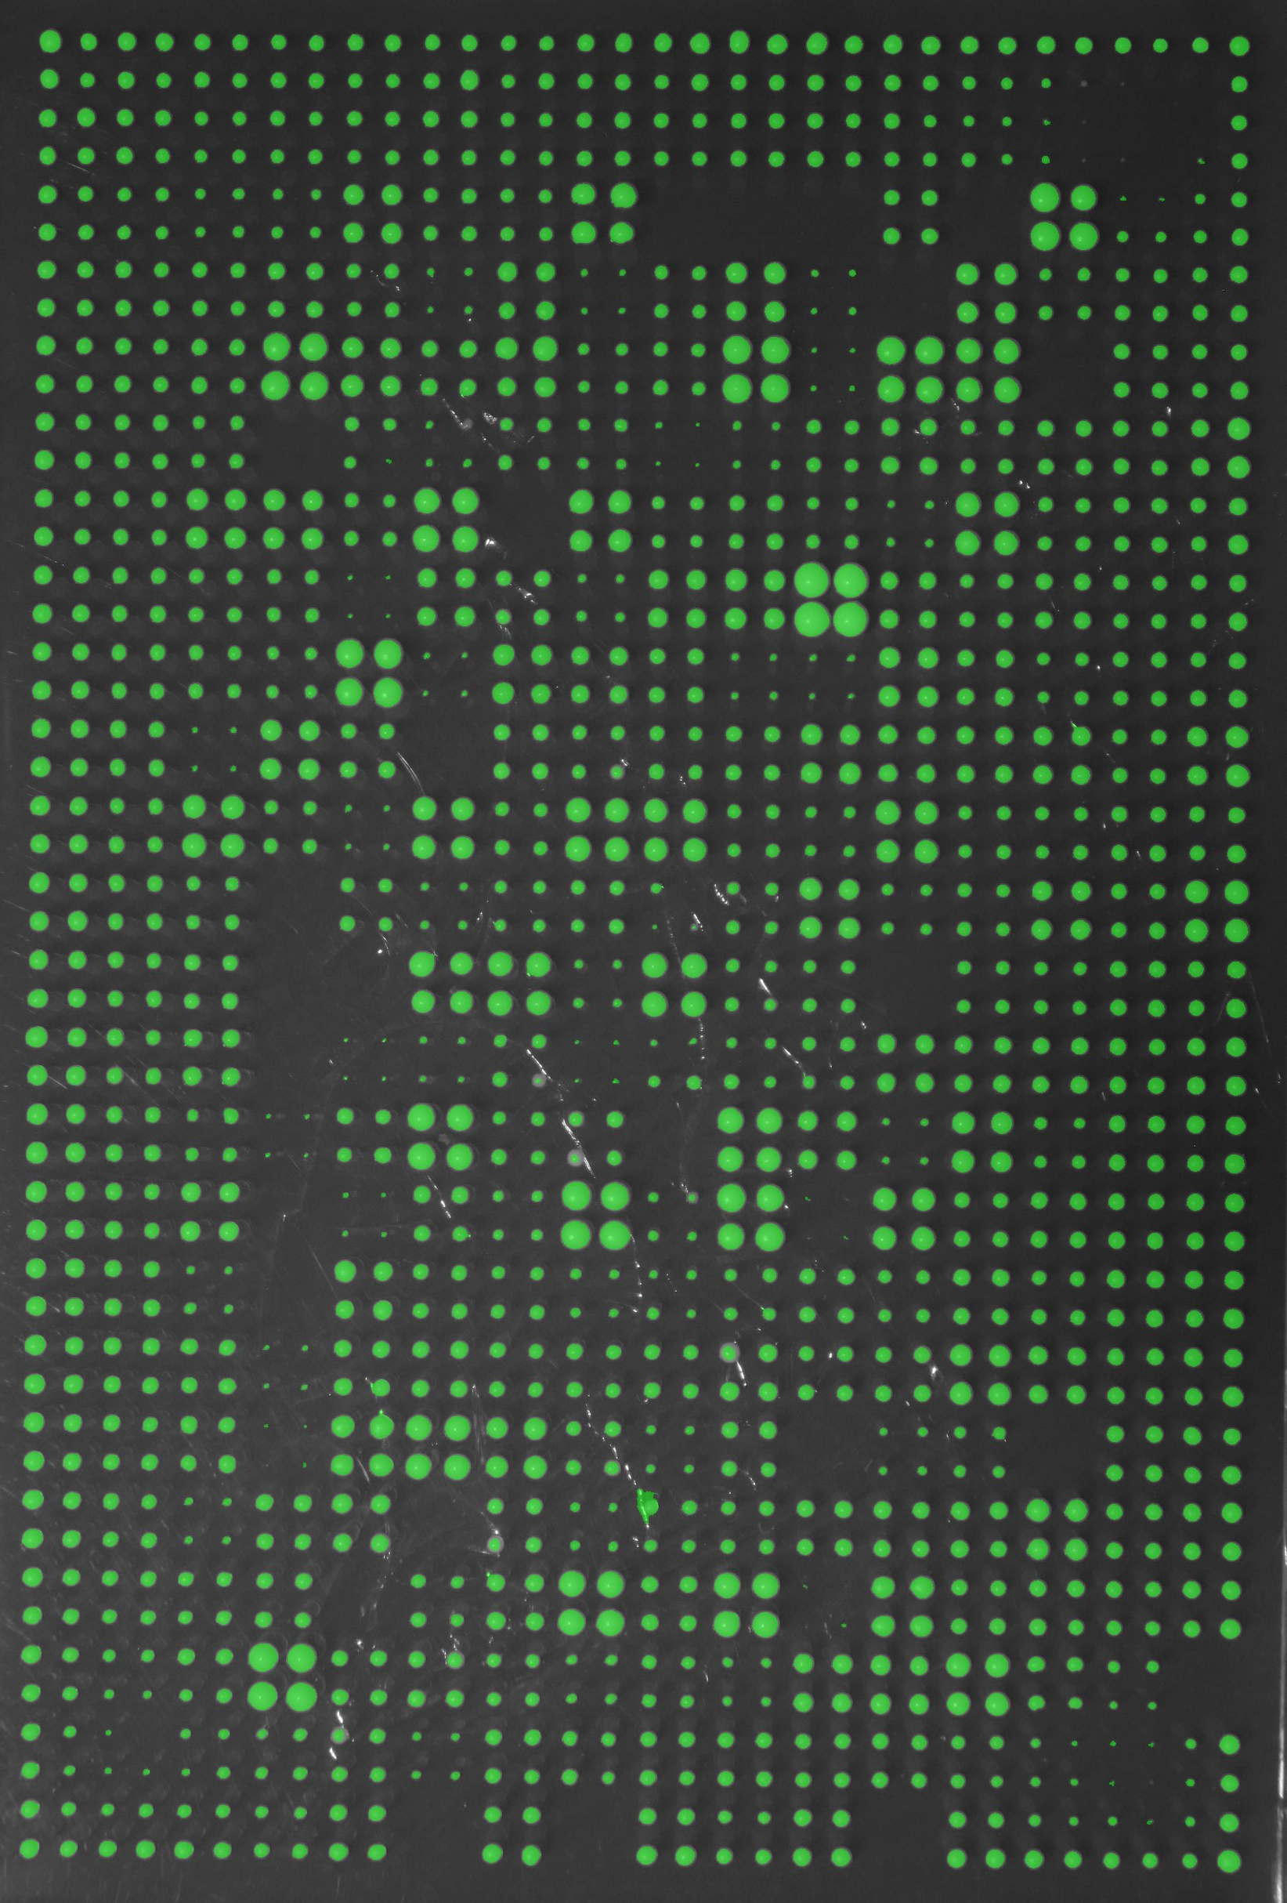
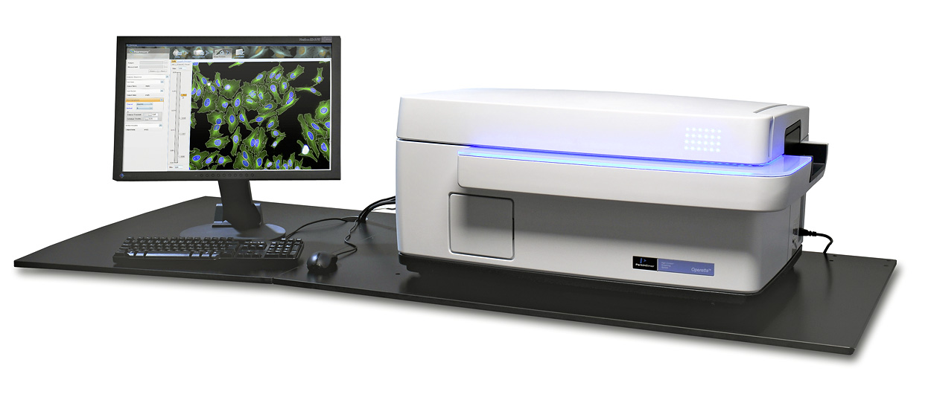
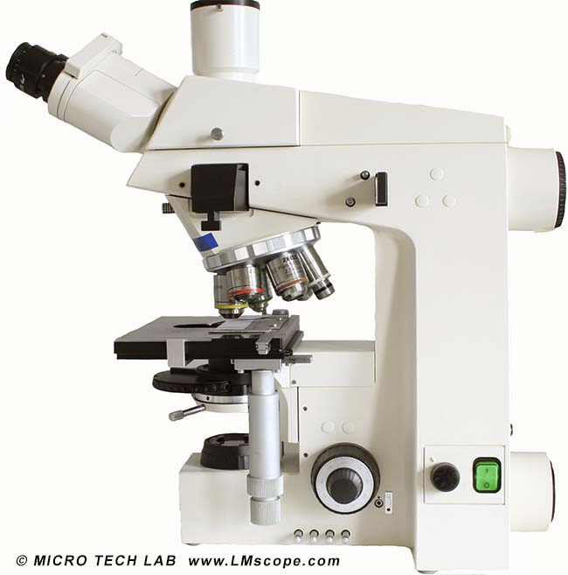
Phenotypic analysis
We measured more than 100 quantitative traits for each strain.
With pre-existing data we collected >220 traits.
growth in liquid media (n=14)
free amino acids concentrations (n=19)
(LC-MS/MS)
cell shape parameters (n=24)
colony size in different solid media (n=42)
BIO00056I. GWAS workshop introduction.

Slide 8
Phenotypic analysis
all these methods discovered heritable traits
BIO00056I. GWAS workshop introduction.

Slide 9
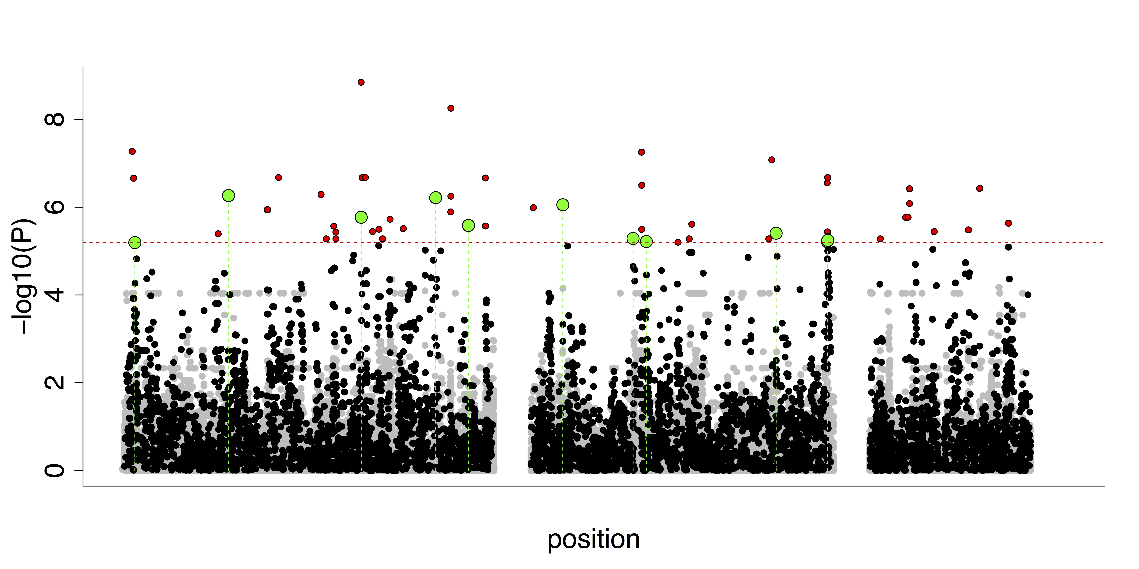
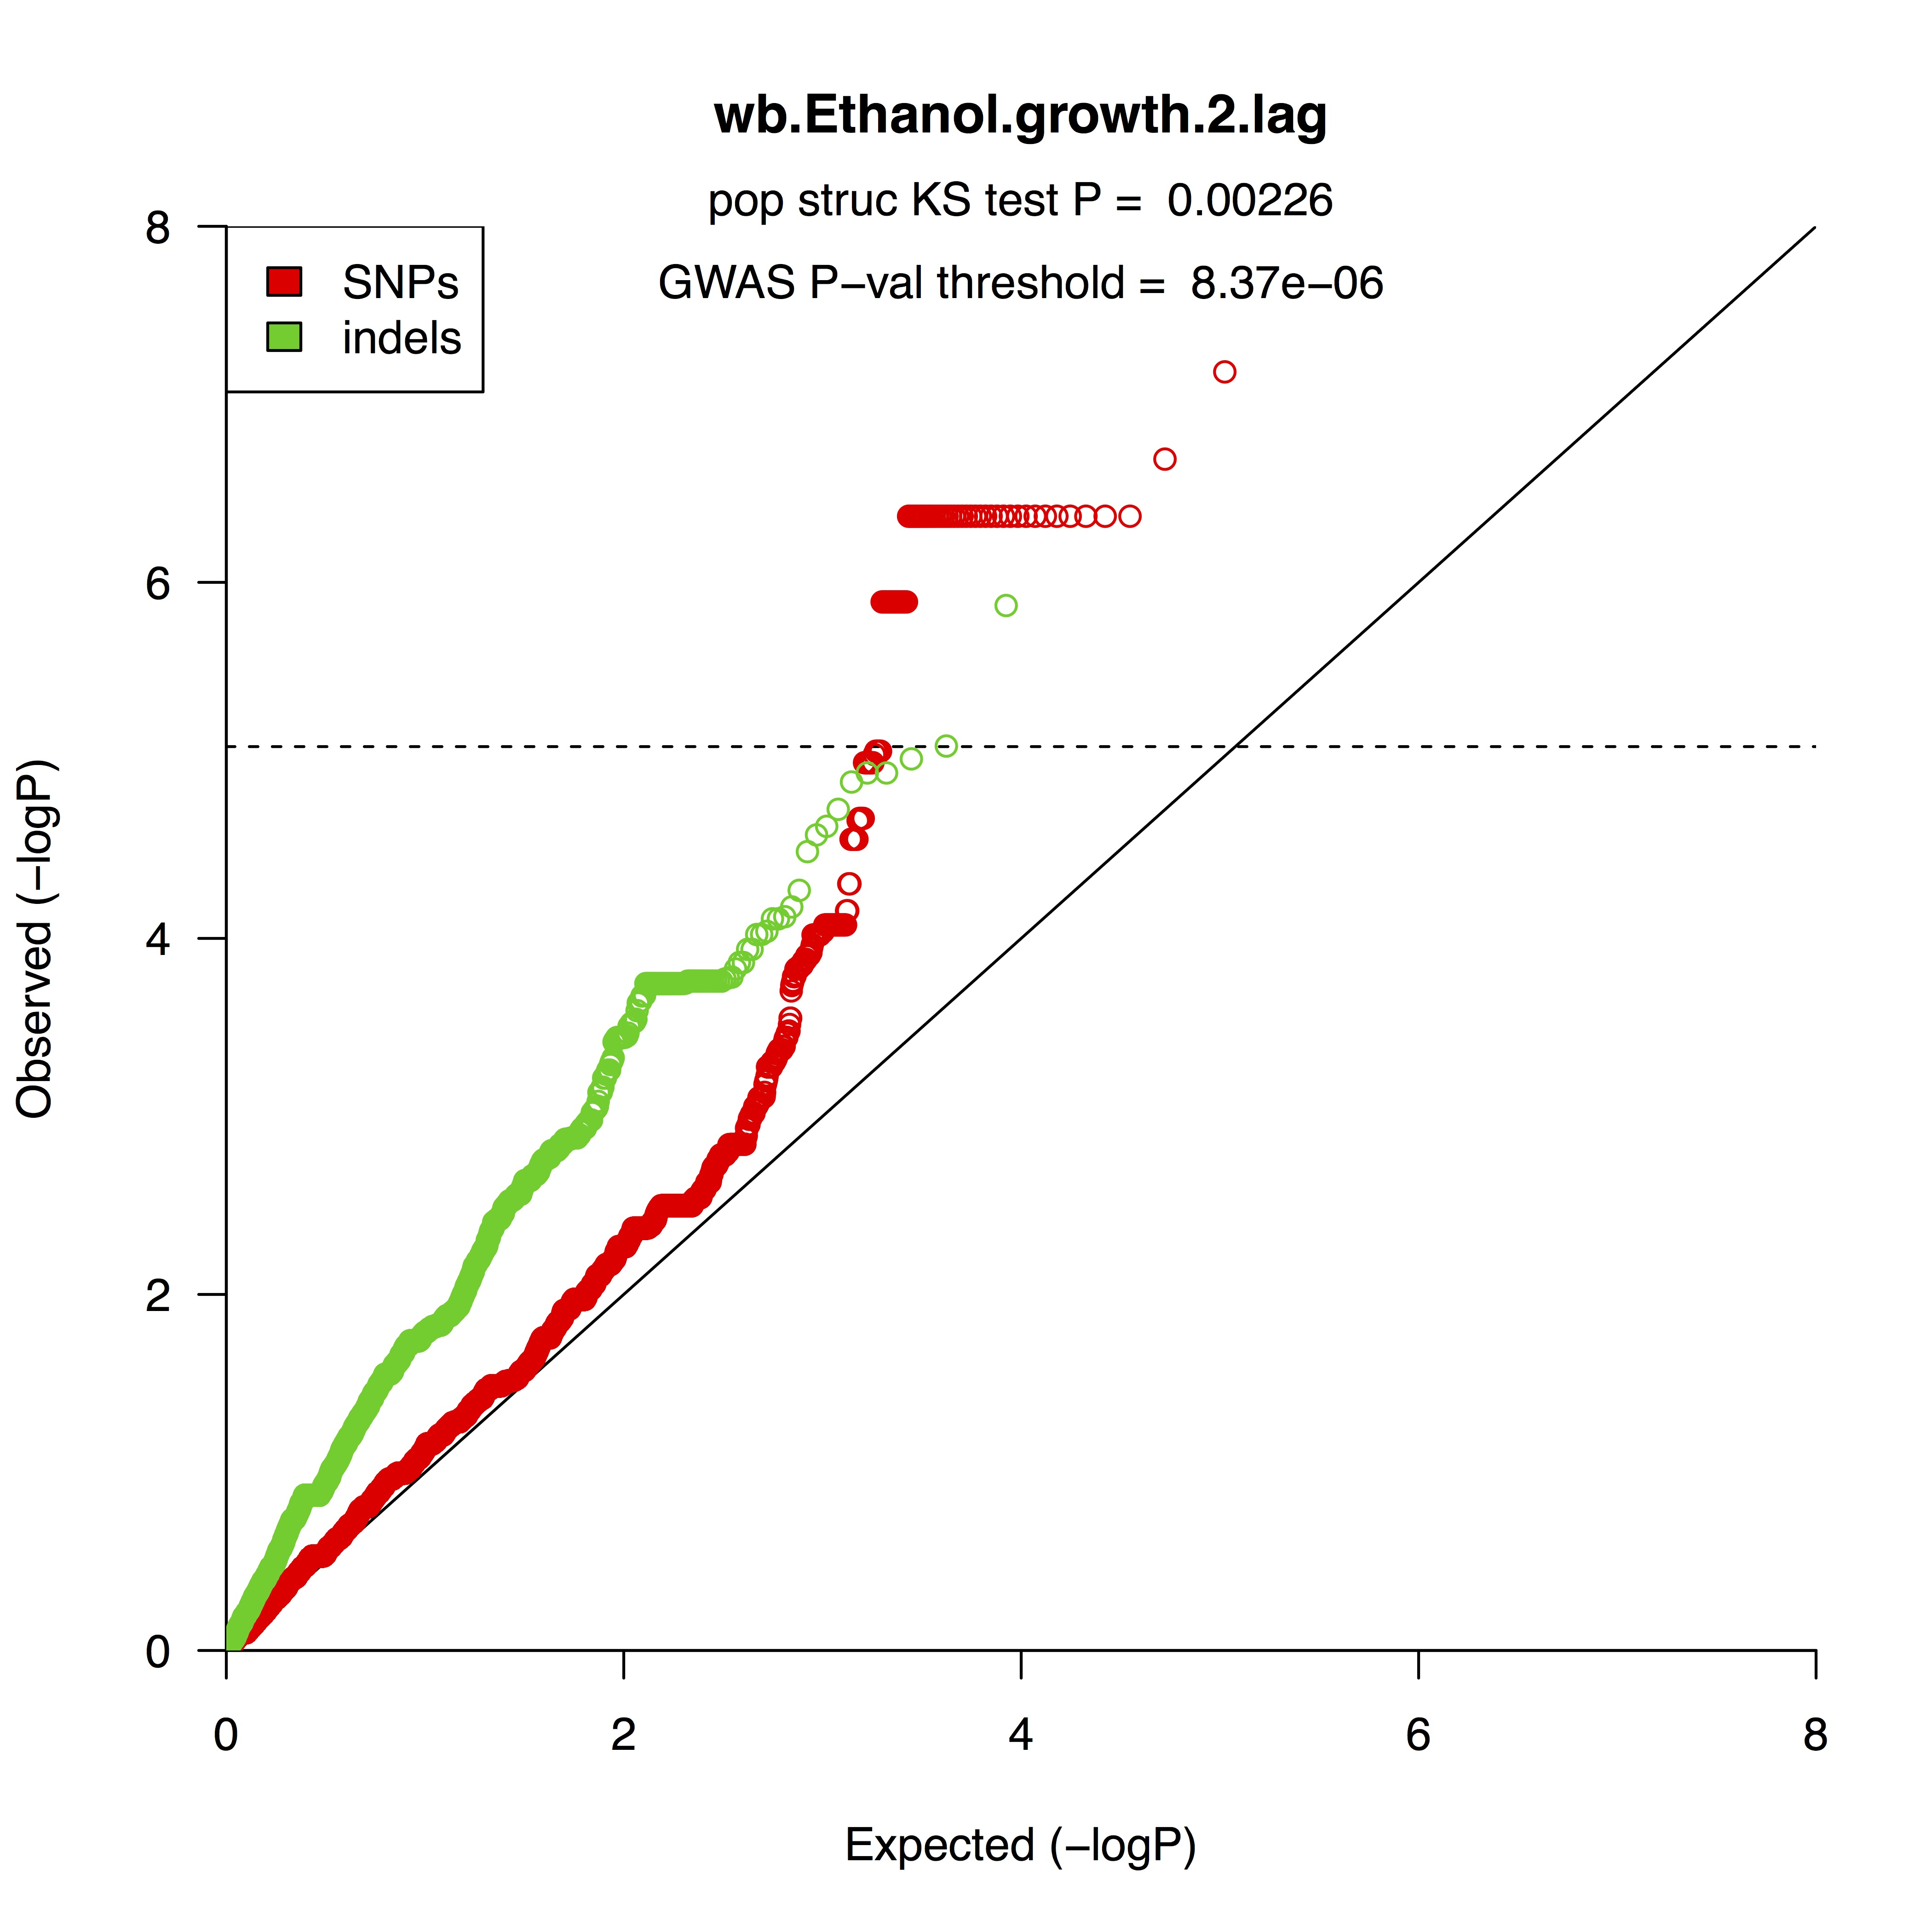
Fission yeast GWAS
ethanol tolerance GWAS
We conducted the 223 GWAS with yeast
GWAS was feasible because:
  trait measures are accurate
  environments controlled
  genomes are small
  genotyping is accurate
BIO00056I. GWAS workshop introduction.

Slide 10
What does this mean for evolution?
BIO00056I. GWAS workshop introduction.

Slide 11

Selective sweeps: the ‘classic’ signal of selection
John Maynard Smith
BIO00056I. GWAS workshop introduction.

Slide 12
How much do mutations affect fitness?
Even if we ‘knock out’ (delete) an entire gene, fitness usually doesn’t change much. Caveat: about 30% of the genes are essential.
Malecki 2016
https://doi.org/10.1186/s13059-016-1101-2
BIO00056I. GWAS workshop introduction.

Slide 13
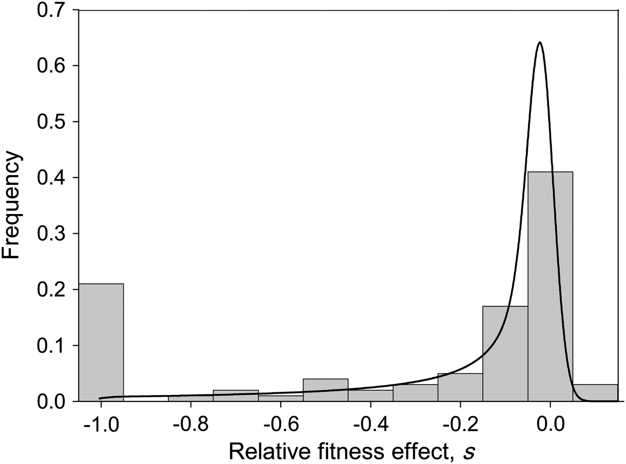
The ‘distribution of fitness effects’ (DFE)
What about small mutations, like single nucleotide changes (SNPs)?
How much do they affect fitness?
DFE studies conclude that:
Most mutations are deleterious neutral (or effectively so, depending on the population size).
Advantageous mutation are very rare.
advantageous (helpful)
selection coefficient greater than zero
Deleterious (harmful)
selection coefficient (s) less than zero
approximately neutral (no effect)
selection coefficient ~0
BIO00056I. GWAS workshop introduction.
See: Eyre-Walker and Keightley 2007

Slide 14
Summary
We can conduct GWAS with yeast (or any recombing eukaryote)
This locates alleles that have affects on traits
Most naturally exiting alleles have very small affects on traits.
This has implications for how we think about evolution.
BIO00056I. GWAS workshop introduction.

