Slide 1
Systematicity in Language Learning
Gareth Gaskell
University of York, UK

Slide 2
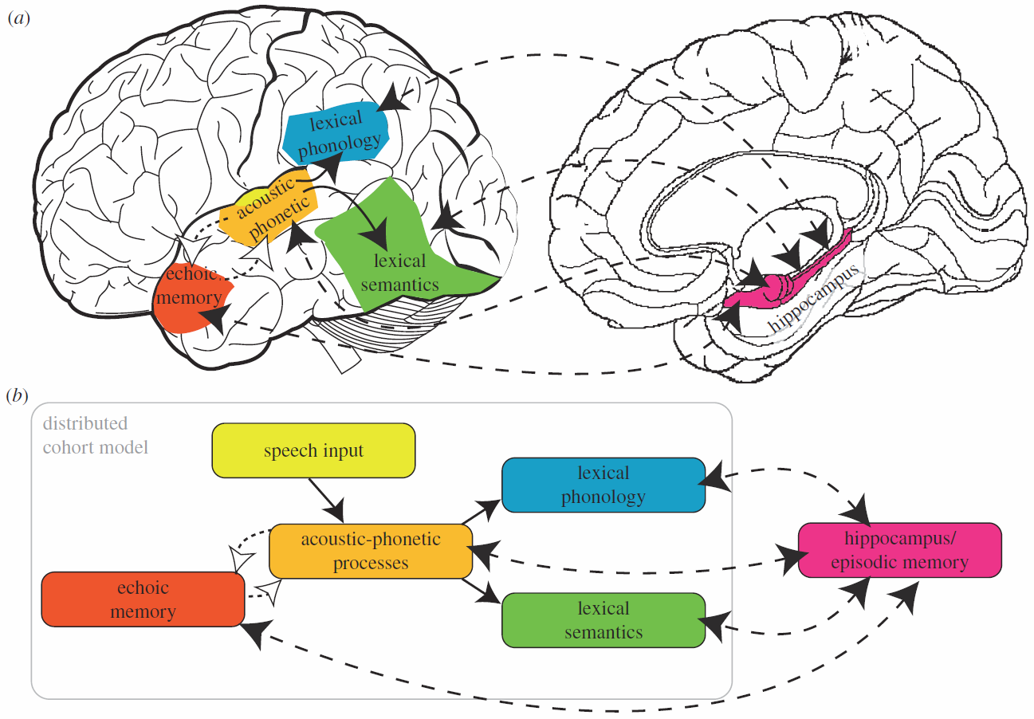
Systems consolidation in language (Davis & Gaskell, 2009; cf. Marr; 1970; McClelland, McNaughton & O’Reilly, 1995)
New items (e.g., vocabulary) involve hippocampal mediation
Permanent linguistic knowledge retained in neocortex
Sleep represents ideal medium for hippocampal transfer
Integrating new words into the permanent lexicon?
Notes:
Highly relevant general model. Talk about problem associated with my favoured model.

Slide 3
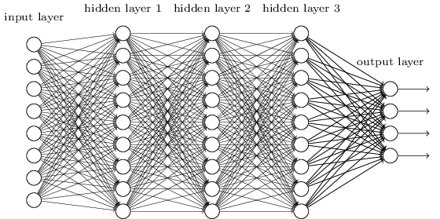
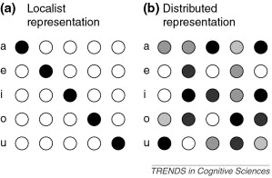
Why do we need complementary learning systems? (CLS; McClelland et al., 1995)
Catastrophic interference (McCloskey & Cohen, 1989; Merhav et al., 2014)
Swift distributed cortical learning of new associations leads to interference
The hippocampus steps in to separate these patterns (at least in adults, Darby & Sloutsky, 2015)
But catastrophic interference is less of a problem for:
Slower, interleaved learning
Less arbitrary mappings with overlapping representations
Does sleep have less of a role to play in these cases?
Notes:
Merhav et al present evidence of this interference using fast mapping (see next talk)

Slide 4
Three tests of a complementary systems/consolidation account
Slower, interleaved learning
Massed vs spaced incorporation in word learning
Less arbitrary mappings …
Vary systematicity/arbitrariness of new mapping
Artificial language learning
…with overlapping representations
Vary overlap between new words and existing language
Novel English past tenses

Slide 5
Three tests of a complementary systems/consolidation account
Slower, interleaved learning
Massed vs spaced incorporation in word learning
Less arbitrary mappings …
Vary systematicity/arbitrariness of new mapping
Artificial language learning
…with overlapping representations
Vary overlap between new words and existing language
Novel English past tenses

Slide 6
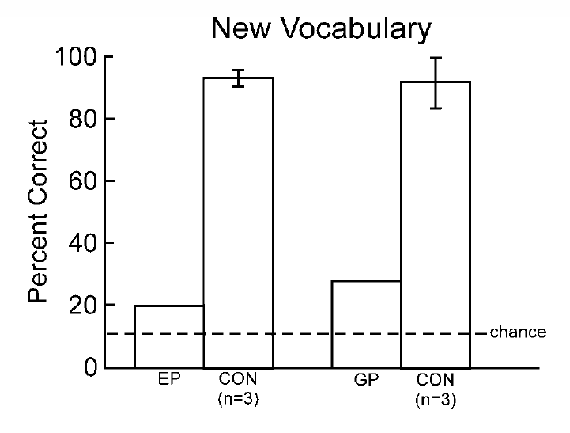
Can we learn new words without a hippocampus? (Bayley et al, 2008)
Which of the following is a word?
Fooble Foozle Tooble Google Toozle Gooble Foogle Goozle Toogle
p = .08 p < .05
Notes:
Key point about O’Kane HM study – intact MTL tissue in parahippcampal gyrus, perirhinal cortex?

Slide 7

Spaced learning and testing
Can interleaved learning lead to lexical engagement?
Session | Time
Session 1 | 09:00 |  |  | Train (12 reps)
Session 2 | 11:30 | Test |  | Train (12 reps)
Session 3 | 14:00 | Test |  | Train (12 reps)
Session 4 | 16:30 | Test
Session 5 | 16:30 | Test
Pre-sleep
Post-sleep

Slide 8
Results – Spaced learning and testing
(Error bars are confidence intervals)
Post-sleep
Pre-sleep
Lindsay & Gaskell (2013, JEPLMC)
Notes:
8

Slide 9
Spaced learning
What about when testing is not repeated through the day?
Session | Time
Session 1 | 09:00 |  |  | Train (12 reps)
Session 2 | 11:30 | Test |  | Train (12 reps)
Session 3 | 14:00 | Test |  | Train (12 reps)
Session 4 | 16:30 | Test
Session 5 | 16:30 | Test
Pre-sleep
Post-sleep

Slide 10
Results – Spaced Learning
Post-sleep
Pre-sleep
Notes:
10

Slide 11
Spaced testing
What about when only testing is repeated through the day?
Session | Time
Session 1 | 09:00 |  |  | Train (12 reps)
Session 2 | 11:30 | Test |  | Train (12 reps)
Session 3 | 14:00 | Test |  | Train (12 reps)
Session 4 | 16:30 | Test
Session 5 | 16:30 | Test
36
۸
Pre-sleep
Post-sleep

Slide 12
Results – Spaced Testing
Post-sleep
Pre-sleep
Notes:
12

Slide 13
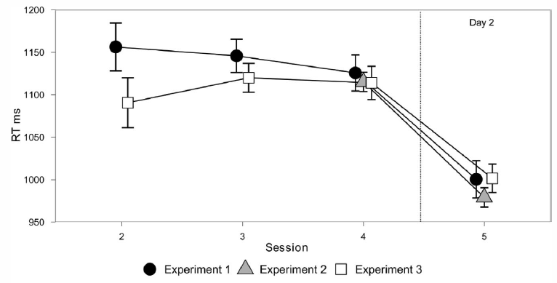
Novel words – Familiarity Decision

Slide 14
Three tests of a complementary systems/consolidation account
Slower, interleaved learning
Massed vs spaced incorporation in word learning
Less arbitrary mappings …
Vary systematicity/arbitrariness of new mapping
Artificial language learning
…with overlapping representations
Vary overlap between new words and existing language
Novel English past tenses

Slide 15
Test 1
Slower, interleaved learning can lead to integration of new words, prior to sleep
Spaced testing (or retrieval practice) is particularly useful
Can be explained in terms of learning properties of cortical network in a complementary systems account (McClelland et al., 1995)
Although recent model argues that retrieval practice is a form of consolidation (Antony et al., 2017)

Slide 16
Three tests of a complementary systems/consolidation account
Slower, interleaved learning
Massed vs spaced incorporation in word learning
Less arbitrary mappings …
Vary systematicity/arbitrariness of new mapping
Artificial language learning
…with overlapping representations
Vary overlap between new words and existing language
Novel English past tenses

Slide 17






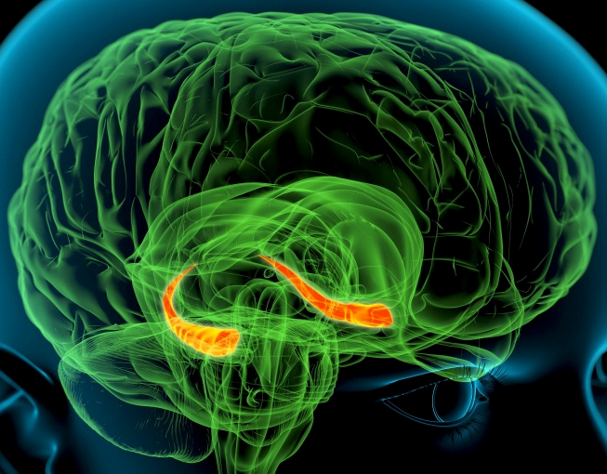
Output Space
(e.g., semantics)
Arbitrary mapping = strong hippocampal involvement
Input Space
(e.g., phonology)
Notes:
Potential confusion re the use of same object in each domain

Slide 18


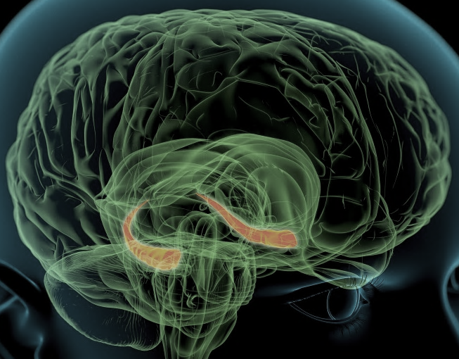

Output Space
(e.g., semantics)
Systematic mapping = weak hippocampal involvement
Input Space
(e.g., phonology)

Slide 19
Predictions of complementary systems approach
Hippocampal reliance will depend on level of systematicity (high systematicity = low reliance)
Consolidation effects depending on hippocampal replay will also depend on systematicity
Unsystematic or arbitrary associations will show the strongest sleep effects
Test these predictions in linguistic domain
Learning of a new artificial language
Notes:
, Make the point that this issue is relevant to a wide range of domains, (e.g., face processing, semantics etc). Language has some well-established paradigms that can be exploited. Ex 1 = tabula rasa, Ex. 2 = consistency with existing mapping

Slide 20

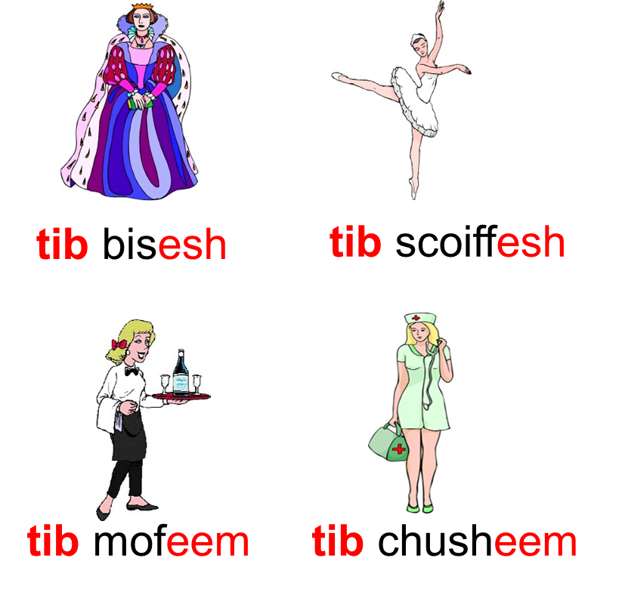
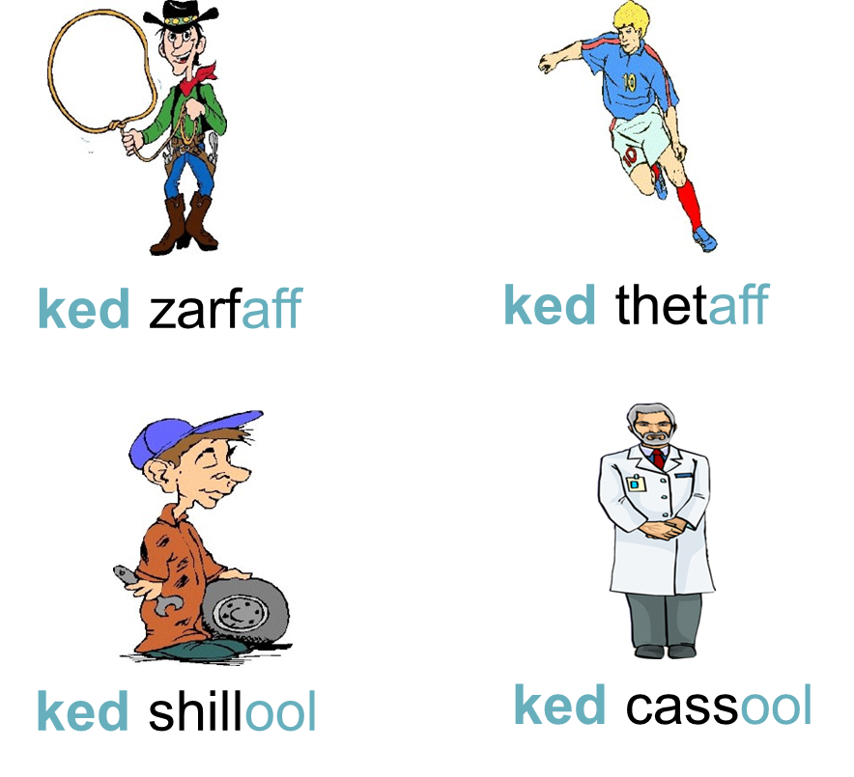
Systematicity (Mirković & Gaskell, 2016)
Participants learned associations between Determiner+inflected noun and pictured referents
Feminine
Masculine

Slide 21
Systematic components
Determiner and suffix represent more systematic aspects of new mapping
Female
Feminine

Slide 22
Unsystematic (arbitrary) components
Stems have an arbitrary (one-to-one) mapping to the individual occupations
Feminine

Slide 23
Experiment Design
Wake group N=23 | Language Training | Video | Testing
12 pm
1 pm
2 pm
3 pm
4 pm
5 pm
Sleep group N=23 | Language Training | Sleep | Testing
Notes:
Avoids issue of circadian confounds. Mention semantic priming

Slide 24
Tests of arbitrary components
Wake group N=23 | Language Training | Video | Testing
Translation recognition
Cued recall (picture with or without first phoneme)
12 pm
1 pm
2 pm
3 pm
4 pm
5 pm
Sleep group N=23 | Language Training | Sleep | Testing
Notes:
Avoids issue of circadian confounds.

Slide 25
Sleep benefits translation recognition
Examples:
“queen” – “bisesh”: Y/N (match)
“nurse” – “bisesh”: Y/N (mismatch)
***
Notes:
Mismatch trial has same suffix as match

Slide 26
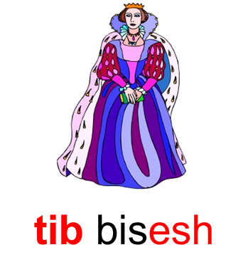
…and cued recall
*
b
Notes:
One close to ceiling the other close to floor…

Slide 27
Tests of systematic components
Wake group N=23 | Language Training | Video | Testing
Generalization
12 pm
1 pm
2 pm
3 pm
4 pm
5 pm
Sleep group N=23 | Language Training | Sleep | Testing
Notes:
Avoids issue of circadian confounds.

Slide 28
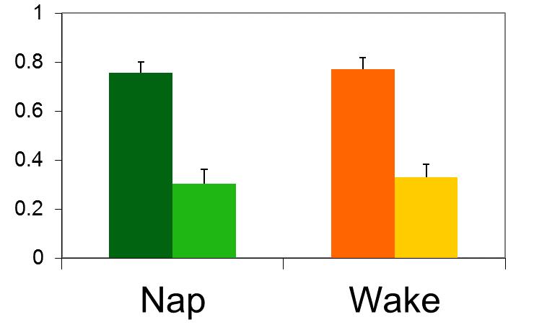
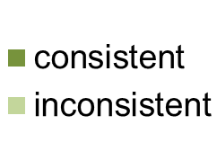
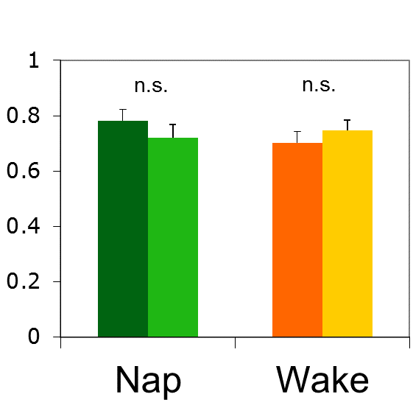
No benefit of sleep for systematic components
Generalization (new items)
Suffixes Determiners
Proportion “match” response
Notes:
Determiner selection could be based on individual memories or generalised knowledge. Consistent vs inconsistent is the key here

Slide 29
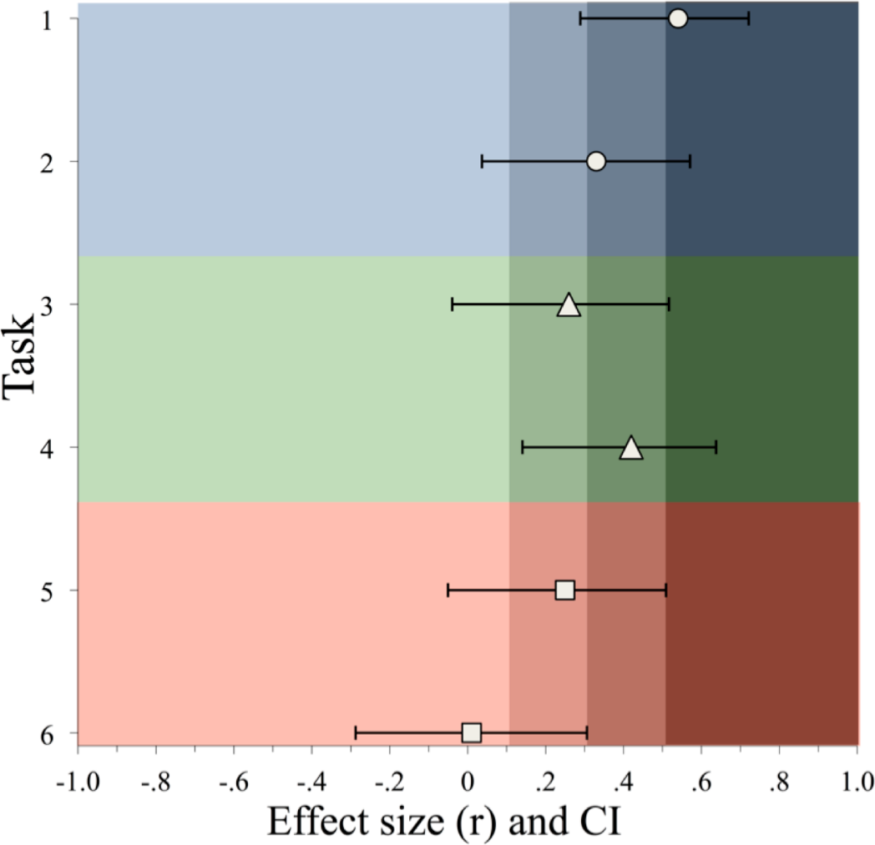
Sleep effects (nap vs wake)
Summary, systematicity
Clear benefit of sleep over wake in memory of arbitrary components
But no effect for the more systematic aspects
Arbitrary
Systematic

Slide 30

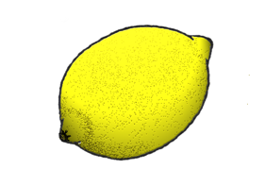
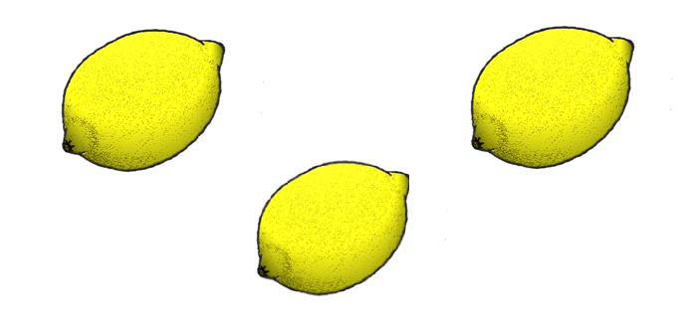
Morphological Generalization: Types vs. Tokens (Mirković, Vinals & Gaskell, 2018)
Day 1:
word repetition
rish
Day 8:
word repetition
rish
rishaff

Slide 31
Language Structure (cf. English past tense)
Majority low frequency regulars (spread out across phonological space)
Few high frequency irregulars (clustered in phonological space)
Does generalization to new items depend on regular type (more systematic) or irregular tokens (less systematic)?
How does this change over time?
 | Regular (n = 12) | Irregular (n = 6)
 | norkaff plassaff thiltaff heefaff grollaff shilnaff dowthaff frakaff rishaff | jispeem slispeem tispeem
Inconsistent | farbaff clarbaff yarbaff | harbesh blarbesh varbesh
Generalization examples:
no cue: clim
irregular consistent: shisp
ambiguous: darb

Slide 32
Generalization performance
irregular consistent
no cue
Immediate
ambiguous
12 hr sleep
12 hr wake
24 hr
Regular
Irregular

Slide 33
Three tests of a complementary systems/consolidation account
Slower, interleaved learning
Massed vs spaced incorporation in word learning
Less arbitrary mappings …
Vary systematicity/arbitrariness of new mapping
Artificial language learning
…with overlapping representations
Vary overlap between new words and existing language
Novel English past tenses

Slide 34
Test 2
As predicted by a complementary systems account:
Consolidation tends to favour the arbitrary over the systematic
Be careful when interpreting the results of artificial language learning paradigms
Performance on newly learned material may not reflect final state

Slide 35
Three tests of a complementary systems/consolidation account
Slower, interleaved learning
Massed vs spaced incorporation in word learning
Less arbitrary mappings …
Vary systematicity/arbitrariness of new mapping
Artificial language learning
…with overlapping representations
Vary overlap between new words and existing language
Novel English past tenses

Slide 36
Consistency: overlap between new words and existing language
Existing language
Novel language
Sleep benefit, and possibly hippocampal involvement, depends on overlap between new material and existing knowledge
present
tense
Past tense
Local Neighborhoods
Strong overlap No Sleep Benefit
share care stare
Regular dominant
PLARE
PLARED
PLORE
Weaker overlap Sleep Benefit
sleep keep sweep
Irregular dominant
FLEEP
FLEEPED
FLEPT
Less overlap (locally)
Less overlap (globally)
Mirkovic & Gaskell, in prep
Notes:
Introduce with the pool balls? Need to provide examples of neighbourhood; first the global consistency then the local.

Slide 37
Test 3
Overlap with existing knowledge provides support for cortical learning
Consolidation effects stronger for more novel, harder to integrate material

Slide 38

Conclusions
To explain the time-course of language learning, we need to understand the nature of the mapping and its implications for memory systems:
Fast/massed, arbitrary learning and new incompatible knowledge require hippocampal intervention, and so benefit from consolidation
Slower, spaced, systematic learning and compatible knowledge engage more with cortical networks, sleep/consolidation effects are less dramatic

Slide 39

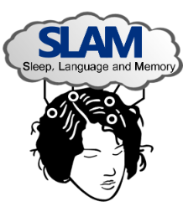






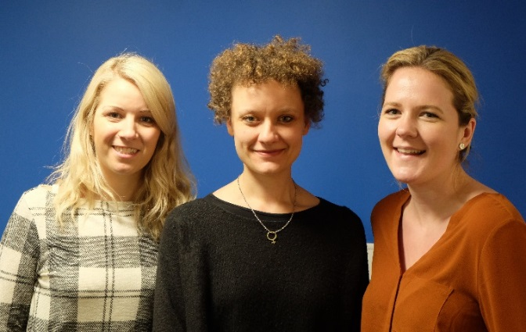











Thanks to...
Lisa Henderson
Jenni Rodd
Justyna Sobczak
Matt Davis
Nicolas Dumay
Jill Warker
Jakke Tamminen
Sarah Walker Vic Knowland Fay Fletcher
Meesha Warmington
Anna Weighall
Hua-Chen Wang
Shane Lindsay
Faye Smith
Courtenay Norbury
Jelena Mirkovic

