Slide 1
Hard Real-Time Systems and Many-Core Platforms Alan Burns Real-Time Systems Group Department of Computer Science University of York United Kingdom

Slide 2
Motivation
Temporal predictability is getting increasing difficult with multi- and many-core platforms
Advice to ‘use only one core’ in avionics white papers
How to bound interference across the hardware platform?

Slide 3
Temporal Requirements
General task/thread model
Mixed criticality sporadic tasks
Released by events or the passage of time
Given any interval of time t the maximum number of releases of each task within t is known
Tasks synchronise and communicate as required
i.e. not constrained
It follows that a time-triggered static schedule is not the solution

Slide 4
Outline
Allocation
Networks-on-Chip
Wormhole networks
Real-Time Analysis
A tale of mistakes, corrections, errors and plagiarism
Predictability as an emergent property

Slide 5
Allocation
Most theoretical results assume homogeneous architectures
Some work on
Two processor types, e.g. big and small
Variable speed processors
FPGAs, GPUs
More general heterogeneous models beginning to appear in literature

Slide 6
Dynamic Allocation/Partitioning
Dhall effect, from 1978
For single processor systems EDF or DMPA for fixed priority scheduling are optimal
BUT
50 tasks needing 2ms every 100
1 task requires 100 in 101
EDF and DMPA leads to unschedulable on 50 cores
Clearly schedulable on 2 cores

Slide 7
Dynamic Allocation/Partitioning
Later theoretical results indicate benefits from global (dynamic) task scheduling
But
These results ignore overheads (migration costs)
They make modelling of inter-task communication more problematic
Hence Partitioned task allocation is main focus of more practical research
Semi-partitioned gets most of the benefits
C=D scheme, moves just one task per core

Slide 8
Communication
Bus-based architectures are problematic
In effect unbounded interference
Need a resource that can be scheduled (managed)
Hence Networks

Slide 9
Networks – key characteristics
topology
mesh, star, torus…
routing protocol
deterministic, adaptive…
arbitration
round-robin, priority preemptive, priority non-preemptive, TDM…
buffering
FIFO, SAFC, SAMQ, DAMQ, hot potato…
flow control protocol
handshake, credit-based…
switching protocol
store-and-forward, circuit, wormhole

Slide 10
Networks – key characteristics
topology
mesh, star, torus…
routing protocol
deterministic, adaptive…
arbitration
round-robin, priority preemptive, priority non-preemptive, TDM…
buffering
FIFO, SAFC, SAMQ, DAMQ, hot potato…
flow control protocol
handshake, credit-based…
switching protocol
store-and-forward, circuit, wormhole

Slide 11
Wormhole switching
Packet is routed and forwarded as soon the header flit has arrived
payload flits follow header
Input ports does not need to buffer a complete packet
flits of a packet can be stored across multiple routers
Trade-off between buffer overheads and network contention

Slide 12
Wormhole Switching
Switch
Switch
Switch
Switch
Switch
Switch
Packet Header
Terminal
Packet Data

Slide 13
Wormhole Switching
Switch
Switch
Switch
Switch
Switch
Switch
Packet Header
Terminal
Packet Data

Slide 14
Wormhole Switching
Switch
Switch
Switch
Switch
Switch
Switch
Packet Header
Terminal
Packet Data

Slide 15
Wormhole Switching
Switch
Switch
Switch
Switch
Switch
Switch
Packet Header
Terminal
Packet Data

Slide 16
Wormhole Switching
Switch
Switch
Switch
Switch
Switch
Switch
Packet Header
Terminal
Packet Data

Slide 17
Wormhole Switching
Switch
Switch
Switch
Switch
Switch
Switch
Packet Header
Terminal
Packet Data

Slide 18
Wormhole Switching
Switch
Switch
Switch
Switch
Switch
Switch
Packet Header
Terminal
Packet Data

Slide 19
Wormhole Networks-on-Chip
Small buffering overheads of wormhole networks is particularly attractive to a special class of resource-constrained networks: Networks-on-Chip (NoCs)
small buffers mean smaller area and lower energy dissipation
PE
PE
PE
R
R
R
PE
PE
PE
R
R
R
PE
PE
PE
R
R
R

Slide 20
Wormhole Networks-on-Chip
PE
PE
PE
Router
R
R
R
Core
PE
PE
PE
R
R
R
Link
PE
PE
PE
R
R
R

Slide 21
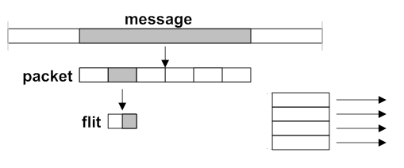
Wormhole Networks-on-Chip
PE
PE
PE
R
R
R
PE
PE
PE
R
R
R
Link
PE
PE
PE
R
R
R

Slide 22
Wormhole Networks-on-Chip
arbitration
PE
PE
PE
data in
data out
R
R
R
routing
PE
data in
routing
data out
PE
PE
&
&
transmission
transmission
control
data in
control
data out
R
R
R
data in
data out
PE
PE
PE
data in
data out
R
R
R

Slide 23


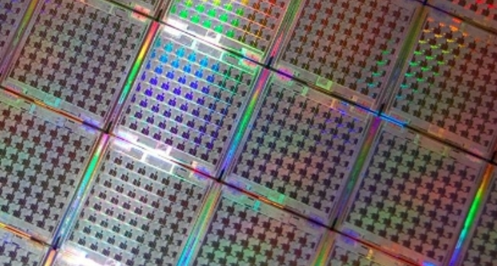
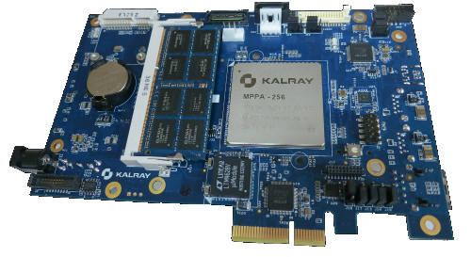
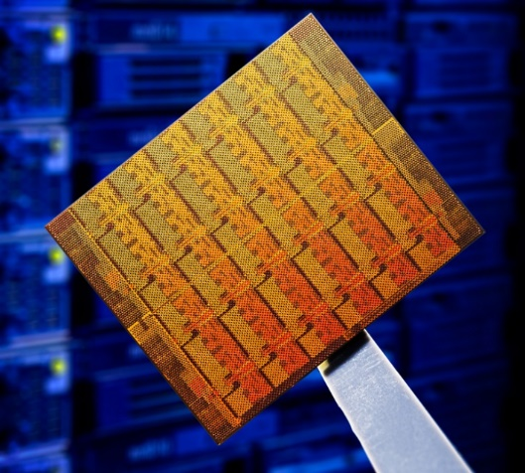
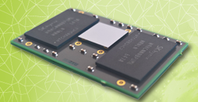



Wormhole Networks-on-Chip

Slide 24
NoC parallelism and scalability
Multiple connections simultaneously
Notes:
24

Slide 25
NoC performance
task contention leads to latency variability
link contention leads to latency variability
Notes:
25

Slide 26
Task Scheduling
Priority Based scheduling
Each task has a priority derived from its temporal characteristics
Required WCET for each task
Response-Time analysis enables the worst-case completion time (R) to be calculated
This can then be compared with task deadline to ensure R <= D

Slide 27
Priority preemptive virtual channels
Wormhole NoCs using virtual channels with priority preemptive arbitration can discriminate packets of different levels of urgency

Slide 28
Priority preemptive virtual channels
PE
PE
PE
highest priority
priority ID
highest priority
with remaining credit
with remaining credit
R
R
R
PE
PE
PE
data_in
…
data_out
…
routing
R
R
R
routing
credit_out
&
credit_in
&
transmission
PE
PE
PE
transmission
control
control
R
R
R
…
…

Slide 29
NoC Performance Evaluation
Many approaches to evaluate NoC performance
full system prototyping
cores + NoC in FPGA, running OS + application
extremely costly setup time, can only explore few design alternatives
accurate system simulation
cycle-accurate model of cores + NoC, running OS + application
extremely long simulation time, can only explore few design alternatives
approximately-timed system simulation
approximately-timed model of cores + NoC, executing an abstract model of the OS + application
analytical system performance models
worst-case latency estimation for restricted application characteristics

Slide 30
Real-Time Analysis
A packet flow t_{i} is a potentially unbounded sequence of packets, characterised by
priority P_{i}
period T_{i} - smallest inter-arrival interval
no-load latency C_{i} – deterministic, function of # flits, # hops, router latency and link latency
release jitter J^{R}_{i}
deadline D_{i}
Analysis aims to calculate worst case response time R_{i} for every t_{i}, and check if R_{i} ≤ D_{i}

Slide 31
Real-Time Analysis
First approaches to analyse priority-preemptive wormhole networks came during the 90s
Mutka (Workshop Parallel Distr Real-Time Sys 1994)
Hary and Ozguner (IEE Proc CDT 1997)
Key idea is to consider the entire path of a packet as a single shared resource
worst-case latency bound of a packet flow can be found by analysing the higher priority packet flows that share at least one link of its route
assumes that interference from higher priority flows will be bounded by the number of “hits”, and each hit bounded by the no-load latency of the interfering flow

Slide 32
Real-Time Analysis
t4
t2
interference graph
t1
t1
PE
PE
PE
t3
R
R
R
t2
PE
PE
PE
t3
R
R
R
PE
PE
PE
t4
R
R
R
P₁ > P₂ > P₃ > P₄

Slide 33
Real-Time Analysis
t2
Kim et al (Conf Parallel Proc 1998) recognised that upstream indirect interference can also affect latency upper bounds
Shi&Burns (NOCS 2008) produced a response time formulation that conservatively models upstream indirect interference
t1
PE
PE
PE
t3
R
R
R
PE
PE
PE
R
R
R
PE
PE
PE
R
R
R
P₁ > P₂ > P₃

Slide 34
Real-Time Analysis
Several lines of work were derived from Shi and Burns 2008
well cited: 158 (Google Scholar)
many works on priority assignment and task mapping
a few on analysis improvement, aiming to make it tighter
Nikolic et al (arxiv 2016) considered that the interference should not be calculated based on the full path, but the contention domain
Kashif et al (IEEE Trans Comp 2015) attempted to analyse packet paths on a link-by-link manner, but assumed infinite buffering (i.e. did not consider backpressure)
Kashif and Patel (RTAS 2016) attempted to consider buffering and backpressure effects
all of them upper-bounded by Shi and Burns 2008

Slide 35
Real-Time Analysis
Xiong et al (GLSVLSI 2016) made two key contributions
new formulation to the downstream indirect interference problem, aiming to capture a previously unseen issue: multi-point blocking
showed that Shi and Burns 2008 is optimistic and unsafe (and so are all the analyses upper-bounded by it)
new formulation to the upstream indirect interference problem, aiming to be tighter than Shi and Burns 2008
was shown to be flawed by Indrusiak et al (arxiv 2016)

Slide 36
Real-Time Analysis
Xiong et al published a corrected analysis in IEEE Trans Comp in 2017
including the fix from Indrusiak at al (arxiv 2016) for the upstream indirect interference
accounting downstream indirect interference as if it is direct interference, making worst-case response times safe even under multi-point blocking scenarios

Slide 37
Newer Analysis – DATE 2018 (Best Paper)
Aims to reduce the pessimism when accounting for downstream indirect interference
Key ideas
buffered interference: multi-point blocking is only caused by flits buffered over the routers shared between the flow under analysis and the flow causing interference
buffered interference will reoccur for every downstream indirect interference hit suffered by the flow causing interference

Slide 38
Proposed Analysis
Key ideas
buffered interference: multi-point blocking is only caused by flits buffered over the routers shared between the flow under analysis and the flow causing interference
upper-bounding buffer interference bi_{ij} caused by t_{j} on t_{i}:
buffer spaces per router
link latency
number of hops shared between t_{i} and t_{j}

Slide 39
Proposed Analysis
Key ideas
buffered interference will reoccur for every downstream indirect interference hit suffered by the flow causing interference
upper-bounding number of downstream indirect interference hits
for every flow that can cause downstream indirect interference on t_{i} via t_{j}
maximum number of hits that t_{j} can suffer, causing buffered interference to be replenished

Slide 40
Proposed Analysis
Caveat
there are cases when the amount of downstream indirect interference is not enough to fill up the buffers up to the maximum possible amount of buffered interference
in that case, revert to Xiong et al 2017 and consider downstream indirect interference instead

Slide 41
Evaluation
Large-scale evaluation using synthetic scenarios
4x4 and 8x8 NoCs
each experiment has 100 randomly generated scenarios with N packet flows
packet flows have periods between 0.5s and 0.5ms, packet length between 128 and 4096 flits, rate-monotonic priority and random source and destination PEs
multiple experiments were performed by increasing N and checking how many of the 100 scenarios are fully schedulable, i.e. all its flows have R ≤ D
for each analysis: Xiong et al (XLWX), Shi&Burns (SB), proposed (IBN)

Slide 42
Evaluation – 4x4

Slide 43
Evaluation – 8x8

Slide 44
How can we improve this situation?
Mixed Criticality view
Change the wormhole protocol
Force the world to behave according to the analysis
Can temporal predictability become an emergent property of platform?

Slide 45
Randomise Behaviour
Allow instruction times to be random
But not necessarily iid, so weakly-independent (e.g. modelled as a Markov chain)
Assumes timing requirements are at the task level (e.g. milliseconds)
Assume task contains a large number of instructions
Can we derive WCET as a simple function of average-case execution time?

Slide 46
Example with probability of failure 10^-9
1.06
Bayesian (I)
Bayesian (P)
1.04
Simple (I)
Simple (P)
1.02
K
1.00
0.98
0.96
1000
10000
100000
1000000
10000000

Slide 47
Real Hardware
Can a real platform behave randomly?
Yes if overall behaviour is the sum of many minor effects
In this sense COTS and complex platforms are better!
Consider a 4-core R Pi: contains a number of unmodelled non-deterministic features

Slide 48
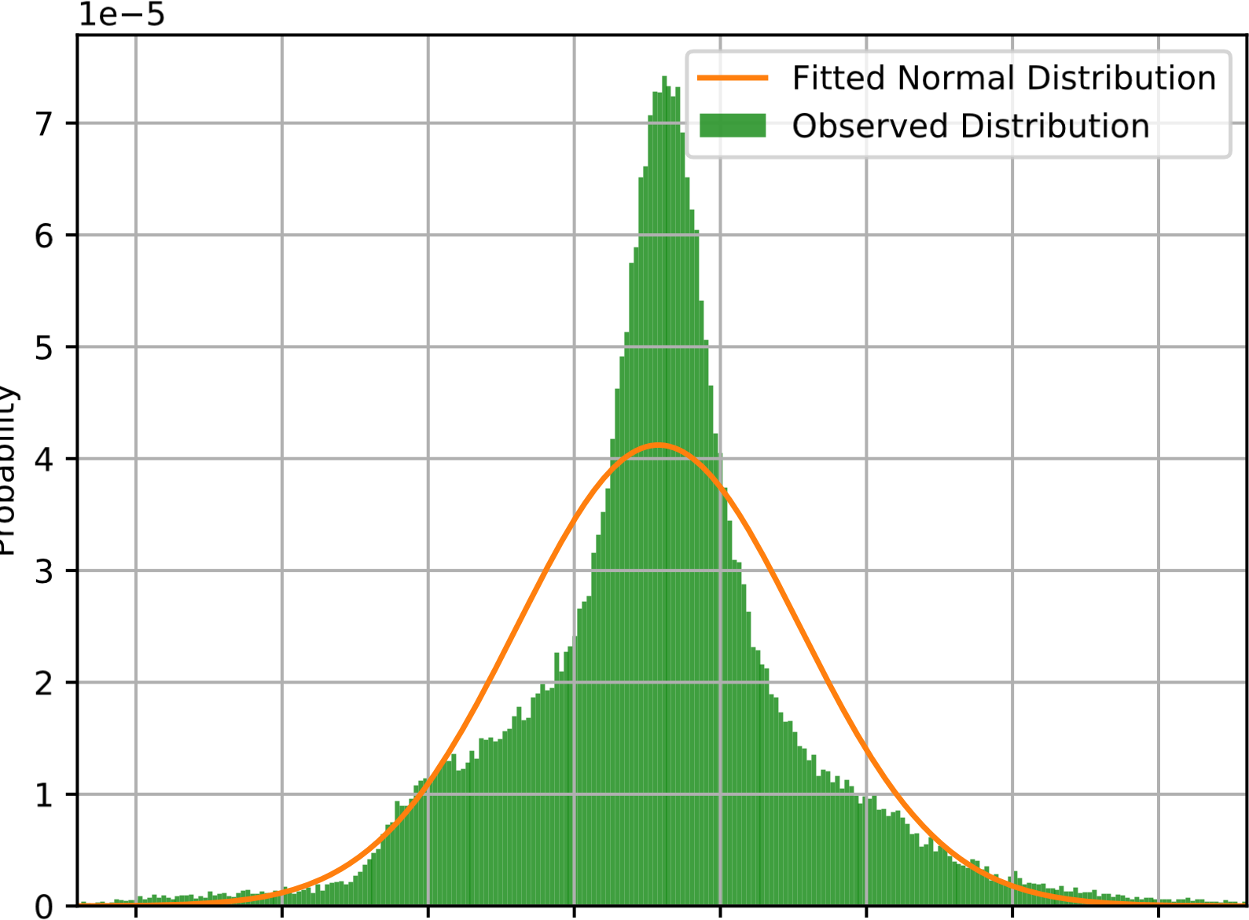
Example

Slide 49
Conclusions
Modeling the temporal behaviour of modern many-core platforms is hard
Two routes forward:
Provide managed resource at all levels
Provide unmanaged resources at all levels
For the former Wormhole routing is an important technology, although changes to the protocol could improve schedulability

Slide 50
Conclusions
Modeling the temporal behaviour of modern many-core platforms is hard
Two routes forward:
Provide managed resource at all levels
Provide unmanaged resources at all levels
For the former Wormhole routing is an important technology, although changes to the protocol could improve schedulability
For the latter a change in mind-set is required!

