Slide 1
How to Do a Project
Alistair D N Edwards
http://www-users.cs.york.ac.uk/~alistair/

Slide 2
Why do you do a project?
…or ISM (Independent Study Module)?

Slide 3
On-line help
http://www.cs.york.ac.uk/projects/howtodo.html

Slide 4
Learning
What do you expect to learn by doing a project?
- as well as getting a good mark
Make the most of your supervisor
The structure of project work
Research
Donkey-work
Writing-up

Slide 5
Plan your project
Have 2 projects in mind
the one you can do
finish on time
sufficient to get a good mark
the one you would like to do
…if you have time
Have a timetable
which you can use to monitor progress
which includes writing up time

Slide 6
Compulsory elements
Report
Literature review
Statement of ethics
Short paper
…err, that’s it
Other elements depend on the kind of project

Slide 7
Lifecycle
The project should show an engineering approach
apply a lifecycle
Spiral is a good one
suits the kinds of projects I do
fits the 2-plans approach above
Boehm, B. W. (1988). A spiral model of software development and enhancement. IEEE Computer 21(5): pp.61-72.

Slide 8
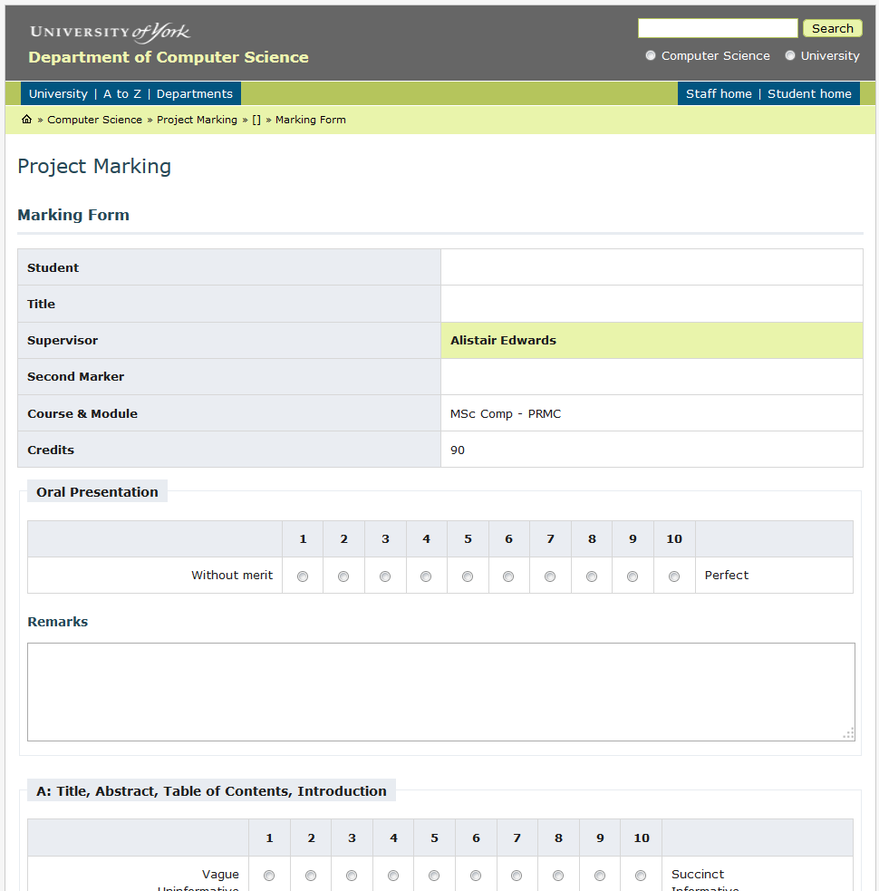
Marking
More later but here’s the form

Slide 9
Start a notebook

Slide 10
What are the ethical implications of your project?

Slide 11
Meetings
45 minutes per week
additional meeting as required
progress forms
mid-term review

Slide 12
Weekly reports
Google form
We can both contribute

Slide 13
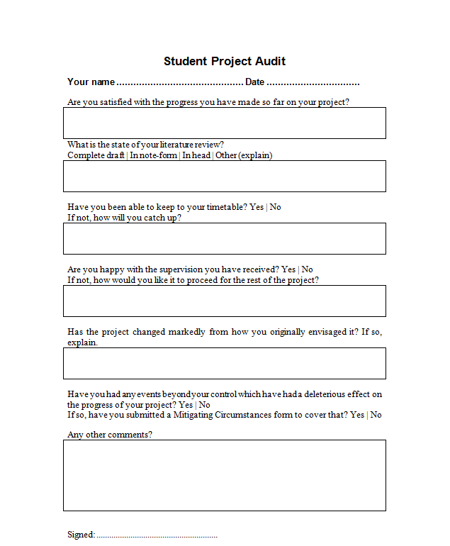
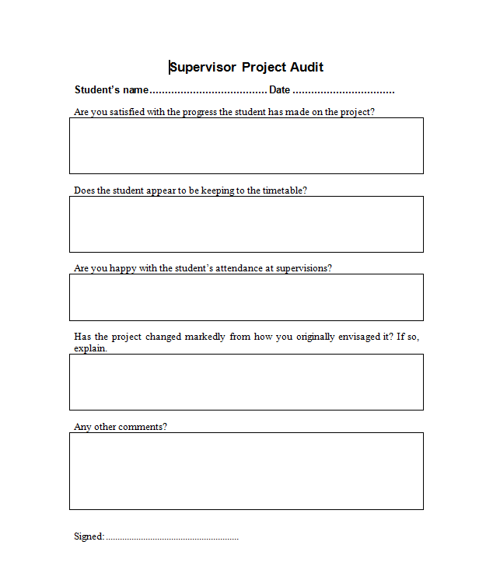
End of term progress check

Slide 14
It is the report which gets marked
Do plenty of background reading
take notes
do a good job
leave yourself sufficient time to write up
Attend MPB!
Read ‘How to write up a project’
http://www.cs.york.ac.uk/projects/howtowrt.html
Be aware of the length limitations:
20,000 words and 70 pages
Except Shuyi: 16,000 words (60 credits)

Slide 15
…and the presentation
Credit for the work done
and proof of the work done
Video
Marked by the same markers
Two days after report hand-in
Compulsory

Slide 16
Administration
Budgets
in writing
approved by me
asap

Slide 17


Further reading

Slide 18
Now
Concentrate on the literature review

Slide 19
When to meet?

Slide 20
Questions?

