Slide 1
These slides are best viewed if downloaded for PowerPoint

Slide 2
Ownership
Browser
Water
in
out
Stopwatch
😁

Slide 3
AI and the Future of Programming
Dr Alistair Edwards
Honorary Fellow, University of York
alistair.edwards@york.ac.uk

Slide 4
Outline
Introductions
AI
Programming
Future careers

Slide 5
Introductions
You
Me

Slide 6
Introductions: You
Year 9 or 10
Studying IT?
Do you know what job you hope to do when you leave education?

Slide 7
Careers?
It’s okay not to know
Predictions:
Many (most?) of you will do jobs that don’t exist now
You will probably undertake many different jobs
I’ll be mentioning jobs that didn’t exist when I was your age
…and jobs that are only just coming into existence

Slide 8
Introductions: Me
Honorary Fellow in Computer Science at University of York
Retired as Senior Lecturer

Slide 9
Introductions: Me
Did not know what job I wanted to do
Nine O-Levels (GCSEs)
Unsure which A-Levels
‘Do sciences’
Maths, physics and Chemistry
Read a lot of Russian Literature

Slide 10
Introductions: Me
A-Levels (Maths, Physics & Chemistry)
Did not know what I wanted to do at university
‘Do a science’
Physics
At a ‘new’ university
More flexible

Slide 11
Introductions: Me
University of Warwick
Second year – programming (in Algol)
Transferred to a joint honours programme in Physics and Computer Science

Slide 12
Introductions: Me
Gap year in a children’s home

Slide 13
Introductions: Me
MSc in Computer Science from Penn State
Module on AI

Slide 14
Introductions: Me
Software engineer at University of Manchester

Slide 15
Introductions: Me
PhD in Educational Technology at the Open University
Adapting user interfaces for visually disabled users
Lecturer

Slide 16
Introductions: Me
Lecturer at the University of York
Teaching
Programming, human-computer interaction
Research
Human-computer interaction – mainly for people with particular needs

Slide 17
AI and the Future of Programming
Dr Alistair Edwards
Honorary Fellow, University of York
alistair.edwards@york.ac.uk

Slide 18
What is AI?
Using technology to do something previously only done by people

Slide 19
What is programming?
Input
Output

Slide 20
What is programming?
Generating the required output for the given input
What is the required output?
Input
Output

Slide 21
What is the required output?
Customer provides a specification
Programmer turns this into a program
Programmer tests the program and checks it meets the specification

Slide 22
What is programming?
Simple example:
Write a program which takes in a temperature in degrees Celsius and outputs the equivalent in Fahrenheit
Input
Output

Slide 23

What is programming?

Slide 24
What is programming?
Is that the output I want for the given input?
What if I input -280°C?

Slide 25
Is that the output I want for the given input?
Absolute zero = -273.15°C
Should it be an error to enter a temperature less than -273.15°C?
If so, how should the error be handled?

Slide 26
The lesson
It is often not easy to be precise as to what output you want
Even in a simple case like this.

Slide 27
Aside
Programming / programmer
or
Coding / coder
?

Slide 28
The real picture
Customer
Specification
Coder
Program

Slide 29


Is the customer happy?

Slide 30
Customer not happy
Program does not work as expected
Why?
Program does not meet specification
Specification was wrong/incomplete

Slide 31
Specification
Write a program which takes in a temperature in degrees Celsius and outputs the equivalent in Fahrenheit
Incomplete

Slide 32
Program does not work as expected
Should not happen
Testing

Slide 33
Testing
Often-neglected but vital part of the process
Should be done by a specialist not the programmer

Slide 34
Testing
The temperature program should be tested on as many inputs as possible
Large range of integers
Positive and negative
Non-numeric inputs

Slide 35
Specification was wrong
Customer did not really know what they wanted
Should be helped by a Requirements Engineer

Slide 36
Customer +
Requirements Engineer
Specification
Coder
Program
Testing

Slide 37
Who can be a coder?
Anyone
…who has been trained

Slide 38
AI and programming
AI
(LLM)
Specification
Program
Testing

Slide 39
AI and programming
Draw up specification
AI generates a program
Check against specification
Refine specification

Slide 40
AI
(LLM)
Specification
Program
Testing

Slide 41
ChatGPT
write a java function which takes a floating point number as a celsius temperature as input and returns the equivalent in fahrenheit

Slide 42
ChatGPT generates
public class TemperatureConverter {
public static float celsiusToFahrenheit(float celsius) {
return (celsius * 9.0f / 5.0f) + 32.0f;
}
public static void main(String[] args) {
float celsius = 25.0f;
float fahrenheit = celsiusToFahrenheit(celsius);
System.out.println(celsius +
"°C is equivalent to " + fahrenheit + "°F");
}
}

Slide 43
Notes on ChatGPT solution
Good code
Probably copied from one website
Does not deal with temperatures <273.15°C
public class TemperatureConverter {
public static float celsiusToFahrenheit(float celsius) {
return (celsius * 9.0f / 5.0f) + 32.0f;
}
public static void main(String[] args) {
float celsius = 25.0f;
float fahrenheit = celsiusToFahrenheit(celsius);
System.out.println(celsius +
"°C is equivalent to " + fahrenheit + "°F");
}
}

Slide 44
AI and the Future of Programming
Will programmers be redundant?
No, but roles will change
Requirements/prompt engineer
vibe coding
Testers

Slide 45
Vibe coding
‘A new way of coding where you don’t write a line of code. You use your voice. You Tell AI exactly what you want built and it builds it for you.’
Matthew Berman

Slide 46
Vibe coding
‘You don’t even look at the code’
But has the task changed that much?

Slide 47
Routes into coding
Routes into coding
?
What should we can this new job?

Slide 48
Routes into coding
Computer science degree
Computer bootcamp
Apprenticeships
‘Work experience’

Slide 49
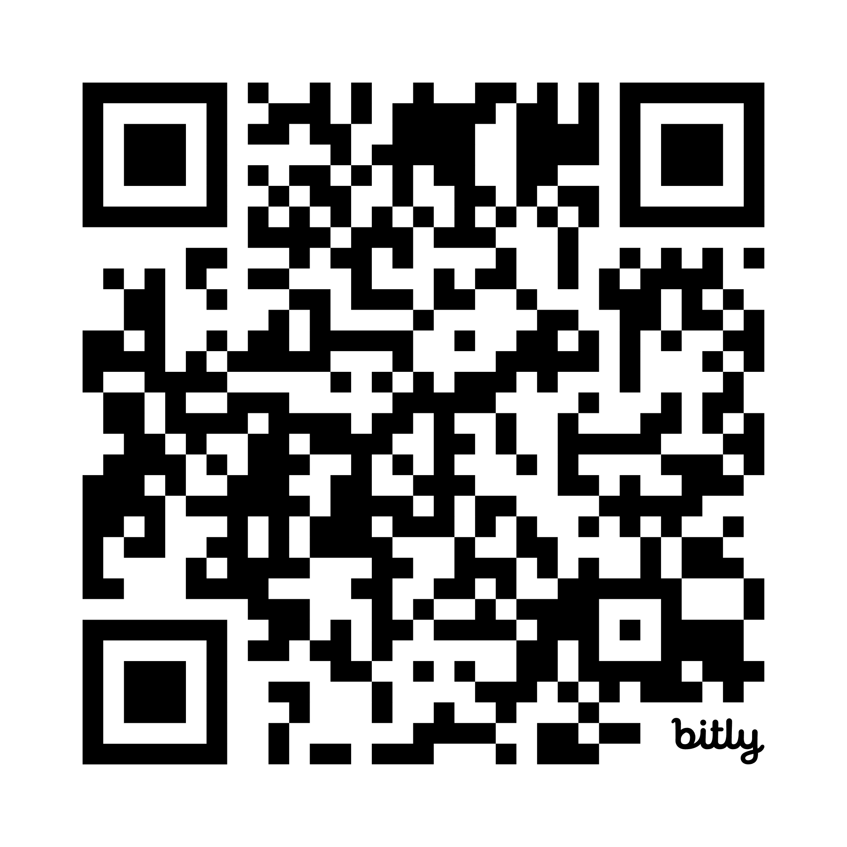
Computer bootcamp
Intensive programme learning software development
Usually online
Period of months
Have to be paid for
https://www.forbes.com/uk/advisor/education/best-coding-bootcamps/

Slide 50
Work experience
Internships
Unpaid

Slide 51
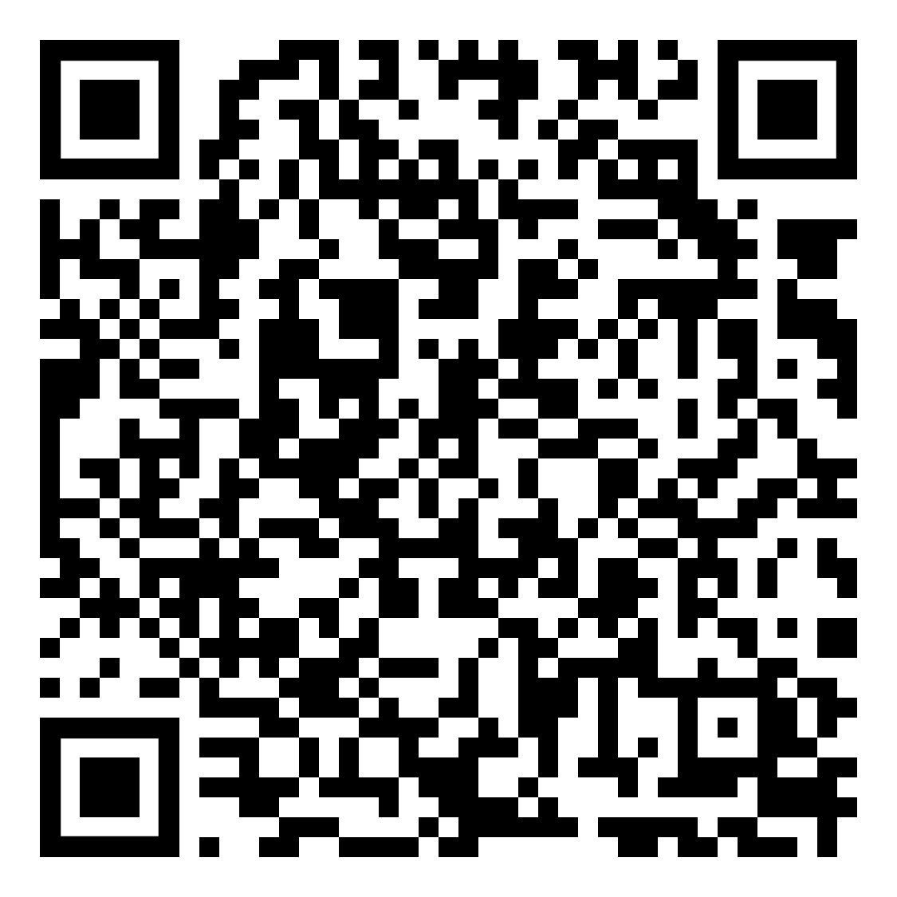

Apprenticeships
Apply (online) as for a job
Paid (minimum wage)
Different levels
On- and off-the-job training
12 months or more
prospects.co.uk
www.gov.uk

Slide 52
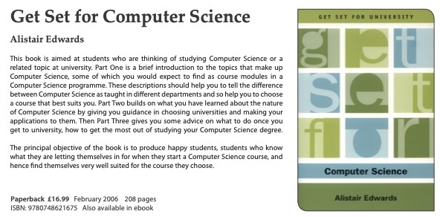
Computer Science degree
https://edinburghuniversitypress.com/book-get-set-for-computer-science.html
Addendum: Student fees and Loans

Slide 53
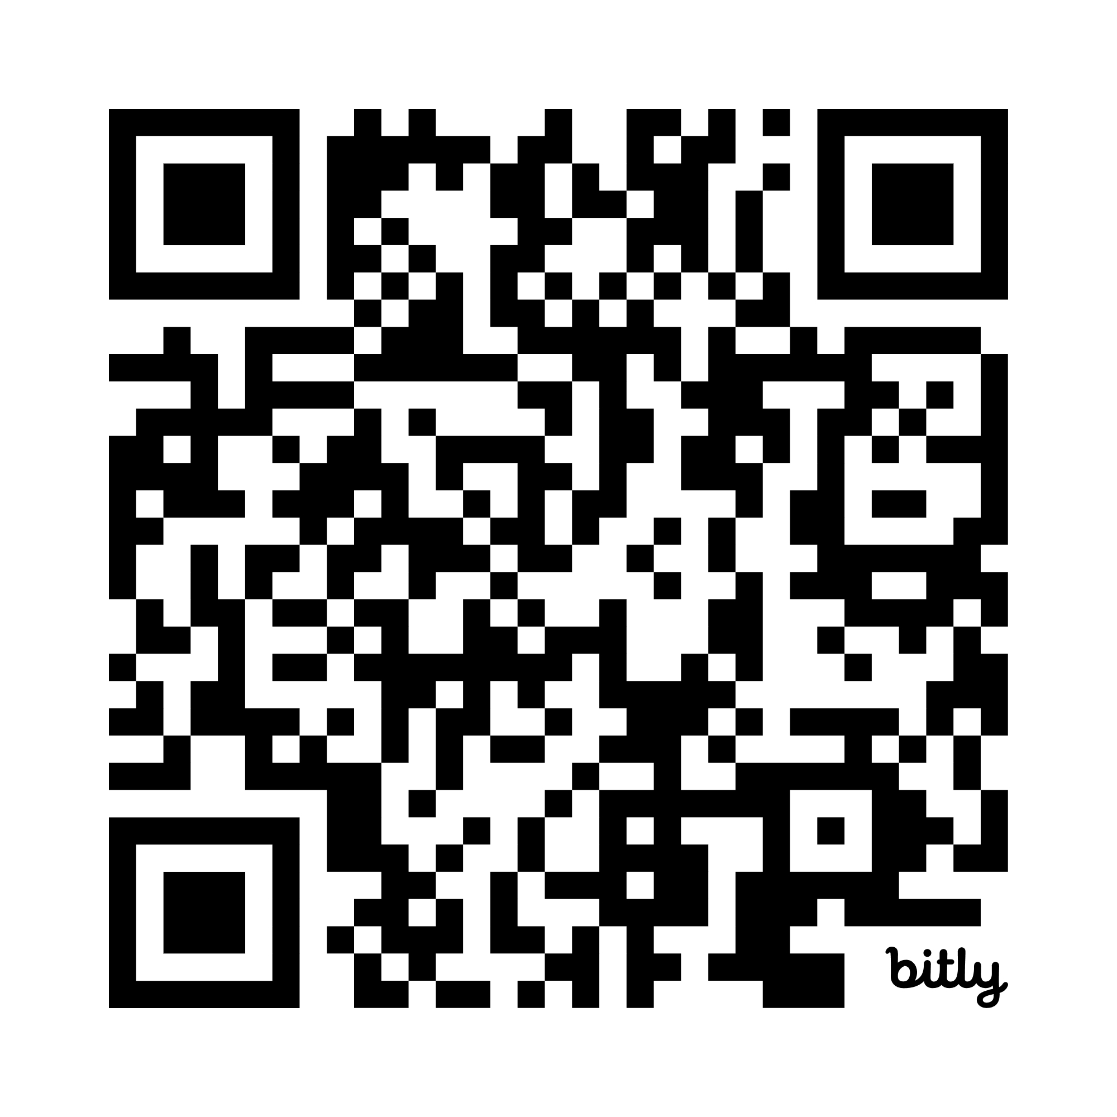
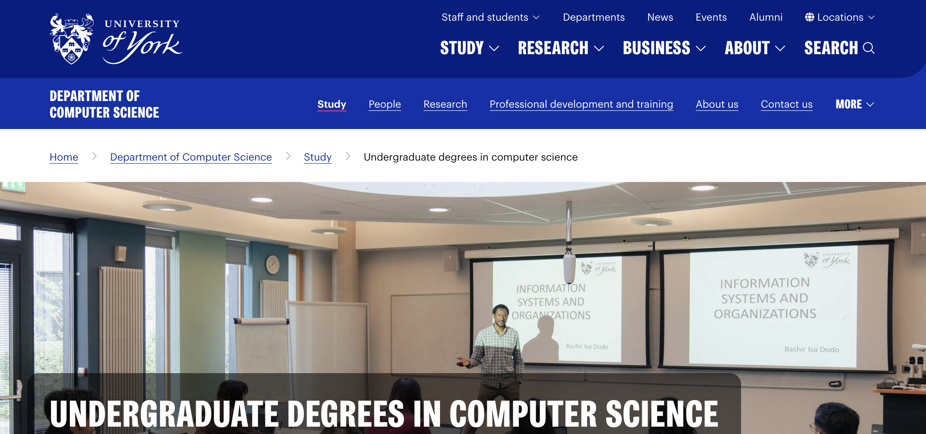
Computer Science at York
https://www.york.ac.uk/computer-science/study/undergraduate/

Slide 54
Computer Science at York
Variations:
Sandwich courses
Combined programmes
with AI
with Cyber Security
and Mathematics

Slide 55
Computer Science at York
Contextual offers
not just York

Slide 56
Contextual offers
Students whose circumstances may have impacted on their educational achievement
Postcode +application information
Offers up to two grades lower

Slide 57
Discussion – and questions
Please do ask any questions
There are no stupid questions
Only stupid answers
There are probably 6 others with the same question
There are questions I know I should have asked

Slide 58
Discussion – and questions
Would you like to be a vibe coder?
What is the essential role of a vibe coder?
Are there any dangers to relying on AI coders?
Do you know what job you would like to do?

Slide 59
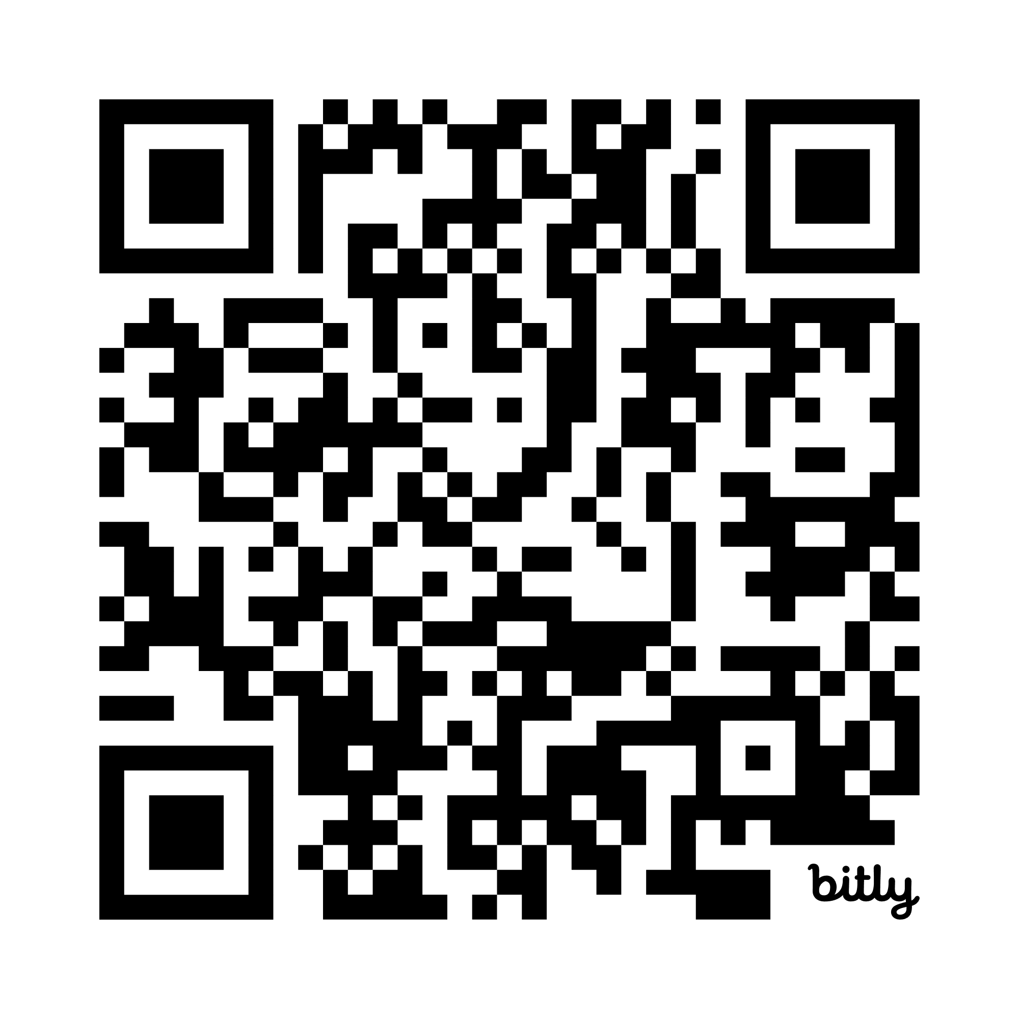
Ask questions online
https://bit.ly/4qM8LOy

Slide 60
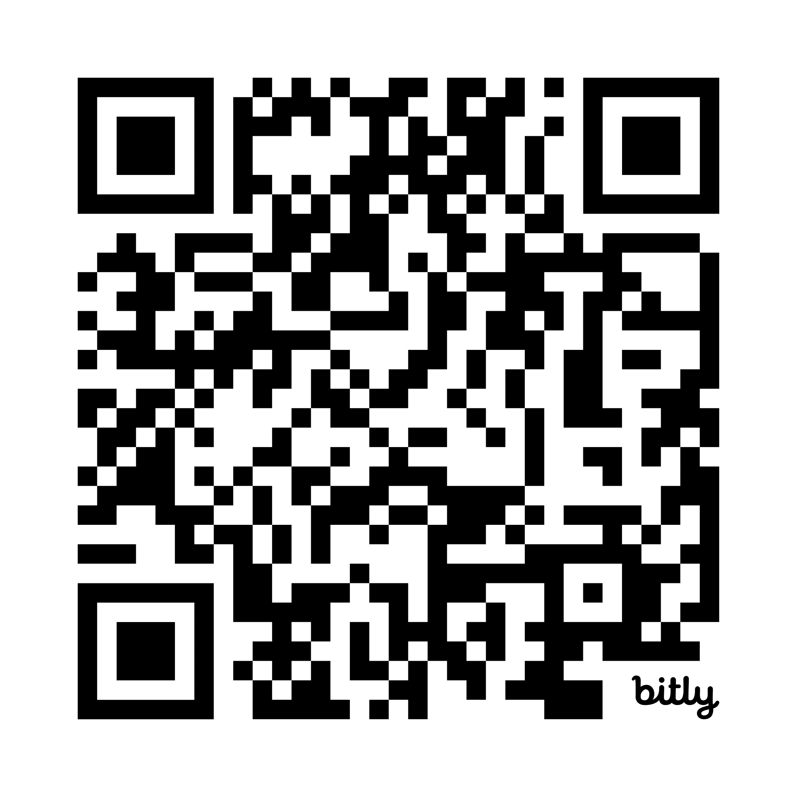
Try temperature conversion
http://bit.ly/4pCyoQC

Slide 61
Thank you
Alistair Edwards
alistair.edwards@york.ac.uk

Slide 62
Additional slides
…that may be useful in answering questions

Slide 63
ChatGPT
Can you modify that code to give a warning message if the user enters a celsius number less than -273.15
Certainly! Here's the modified Java code that includes a warning message if the user enters a Celsius temperature less than -273.15°C, which is absolute zero—the lowest possible temperature:

Slide 64
import java.util.Scanner;
public class TemperatureConverter {
public static float celsiusToFahrenheit(float celsius) {
return (celsius * 9.0f / 5.0f) + 32.0f;
}
public static void main(String[] args) {
Scanner scanner = new Scanner(System.in);
System.out.print("Enter a temperature in Celsius: ");
float celsius = scanner.nextFloat();
if (celsius < -273.15f) {
System.out.println("Warning: The entered temperature is below absolute zero (-273.15°C).");
} else {
float fahrenheit = celsiusToFahrenheit(celsius);
System.out.println(celsius + "°C is equivalent to " + fahrenheit + "°F");
}
}
}

Slide 65
What is AI?
Using technology to do something previously only done by people

Slide 66
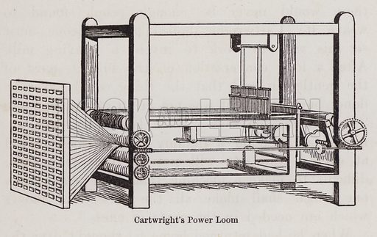
Using technology to do something previously only done by people
A long history?
Edmund Cartwright’s Power Loom, 1784

Slide 67
Power loom
Putting people out of jobs
Luddites / Sabboteurs

Slide 68
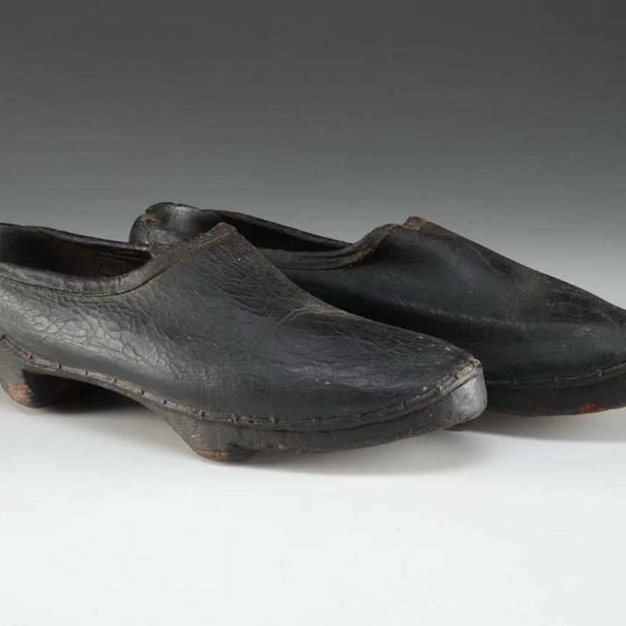
Aside: Sabboteurs

Slide 69
Power loom
Putting people out of jobs
Luddites / Sabboteurs
…or allowing them to do more interesting jobs?

Slide 70


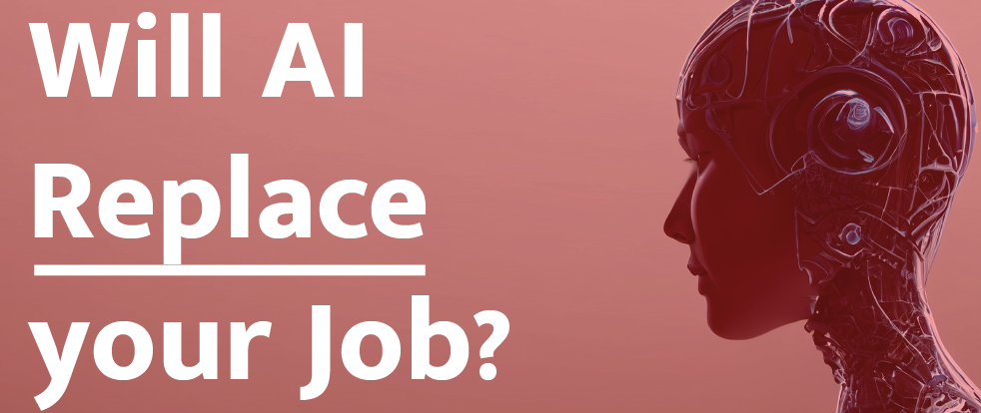



Slide 71
AI and the Future of Programming
ChatGPT

Slide 72
What Even Is Programming?
At its core, programming is telling computers what to do using instructions. Until a few years ago, you had to be very precise: one missing semicolon and your entire program could fall apart. Programmers spent a lot of time fixing tiny mistakes.
But AI is changing that. Instead of speaking the computer’s language, we can now speak in our own.

Slide 73
What AI Can Do Today
Write code from plain-language instructions
Help debug mistakes
Explain complex concepts
Generate entire apps, websites, and games
Suggest improvements to human-written code
If programming used to be like carving with a chisel, AI makes it feel more like sculpting with clay—you can shape ideas faster.

Slide 74
The New Skills That Matter
The future programmer won’t just write code. They will:
• Be great problem-solvers You’ll describe what you want, break it into steps, and check AI’s work.

Slide 75
The New Skills That Matter
• Understand how AI works Not necessarily the math behind it, but what it can do, what it can’t do, and how to use it responsibly.

Slide 76
The New Skills That Matter
Work with AI like a teammate You’ll give instructions, ask questions, and guide the AI rather than doing everything manually.

Slide 77
But Humans Are Still Needed
AI still struggles with context, ethics, creativity, and real-world understanding. It doesn’t know your goals unless you tell it. It can produce code that seems correct but actually breaks everything.
That’s why the future needs:
Human judgment
Human imagination
Human responsibility

Slide 78
What You Can Do Today
Learn the basics of coding (Python, JavaScript—anything)
Experiment with AI tools like code assistants
Build small projects: games, apps, websites
Focus on creativity—what can you dream up that AI can help you build?
Be curious, ask questions, break things, rebuild them
Your generation will create apps we haven’t even imagined yet.

Slide 79
Final Message
AI isn’t the end of programming—it’s the evolution of it. Instead of spending hours typing every line of code, you’ll have more time to create, invent, and solve problems that actually matter.
Programming used to be about talking to machines. In the future, it will be about teaching machines to help you build the world you want to see.
And that future starts with young thinkers like you.

Slide 80
Why is programming fun?
Fred Brooks, The Mythical Man-Month

Slide 81
Why is programming fun?
First is the sheer joy of making things. As the child delights in his mud pie, so the adult enjoys building things, especially things of his own design. I think this delight must be an image of God’s delight in making things, a delight shown in the distinctness and newness of each leaf and each snowflake.

Slide 82
Why is programming fun?
Second is the pleasure of making things that are useful to other people. Deep within, we want others to use our work and to find it helpful. In this respect the programming system is not essentially different from the child’s first clay pencil holder “for Daddy’s office”.

Slide 83
Why is programming fun?
Third is the fascination of fashioning complex puzzle-like objects of interlocking moving parts and watching them work in subtle cycles, playing out the consequences of principles built in from the beginning. The programmed computer has all the fascination of the pinball machine or the jukebox mechanism, carried to the ultimate.

Slide 84
Why is programming fun?
Fourth is the joy of always learning, which springs from the nonrepeating nature of the task. In one way or another the problem is ever new, and its solver learns something: sometimes practical, sometimes theoretical, and sometimes both.

Slide 85
Why is programming fun?
Finally, there is the delight of working in such a tractable medium. The programmer, like the poet, works only slightly removed from pure thought-stuff. He builds castles in the air, creating by exertion of the imagination. Few media of creation are so flexible, so easy to polish and rework, so readily capable of realizing grand conceptual structures.

