Slide 1
These slides are best viewed downloaded for PowerPoint
Version 1, 16 April 2026

Slide 2
The Turing Machine
Alistair Edwards
Honorary Fellow
University of York

Slide 3
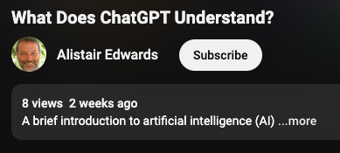
Origins
Talk on AI: What Does ChatGPT Understand?
That’s going viral, isn’t it?

Slide 4
Origins
Talk on AI: What Does ChatGPT Understand?
My definition of AI
Getting a machine to do something that previously could only be done by a person
What is a machine?

Slide 5
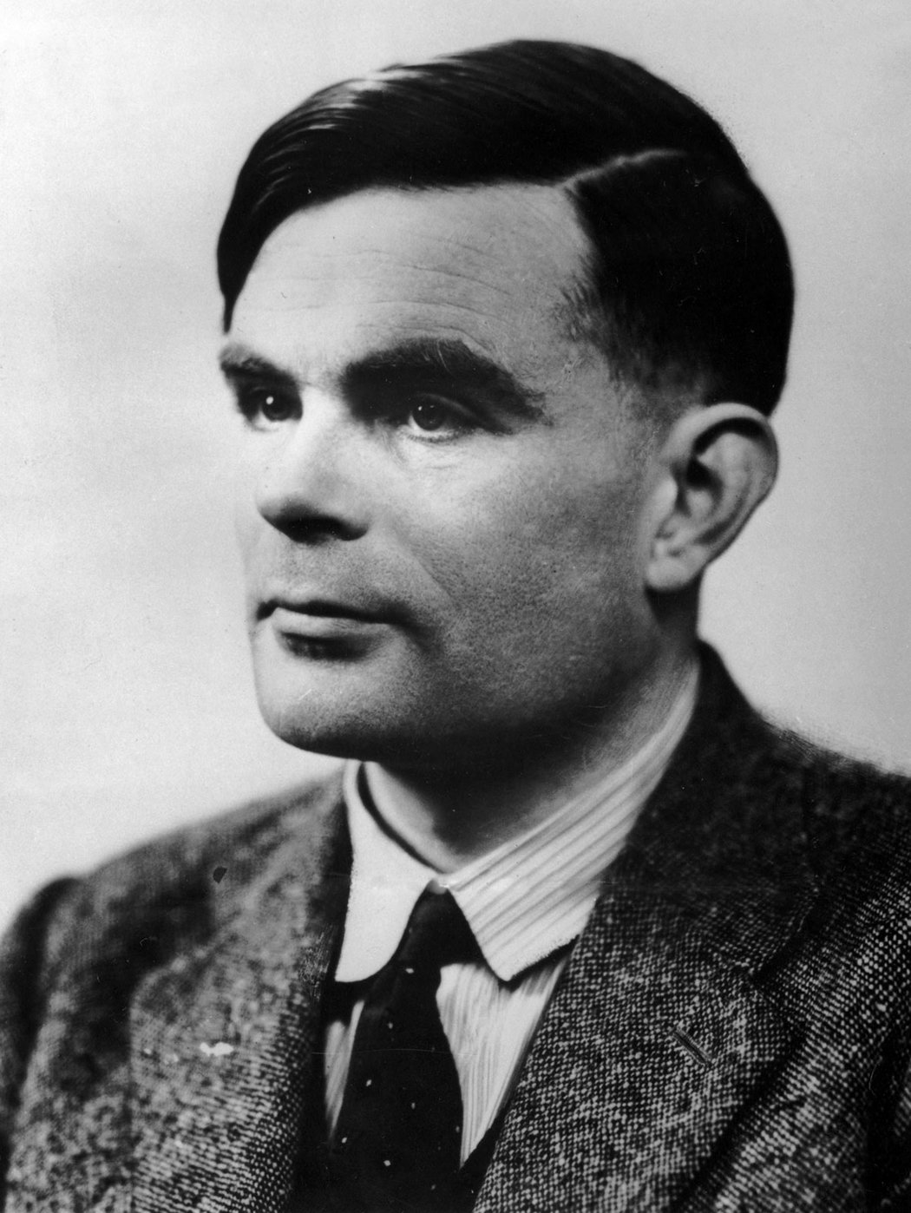
Alan Turing

Slide 6
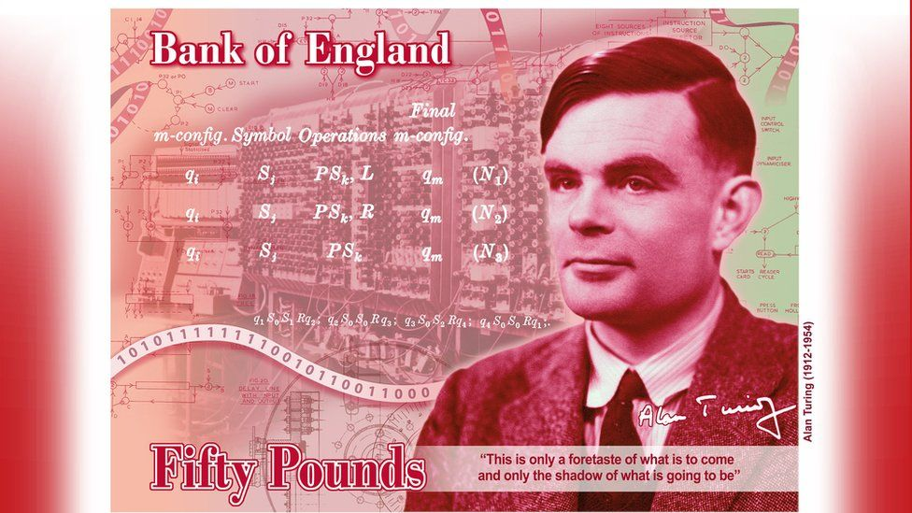
Alan Turing

Slide 7
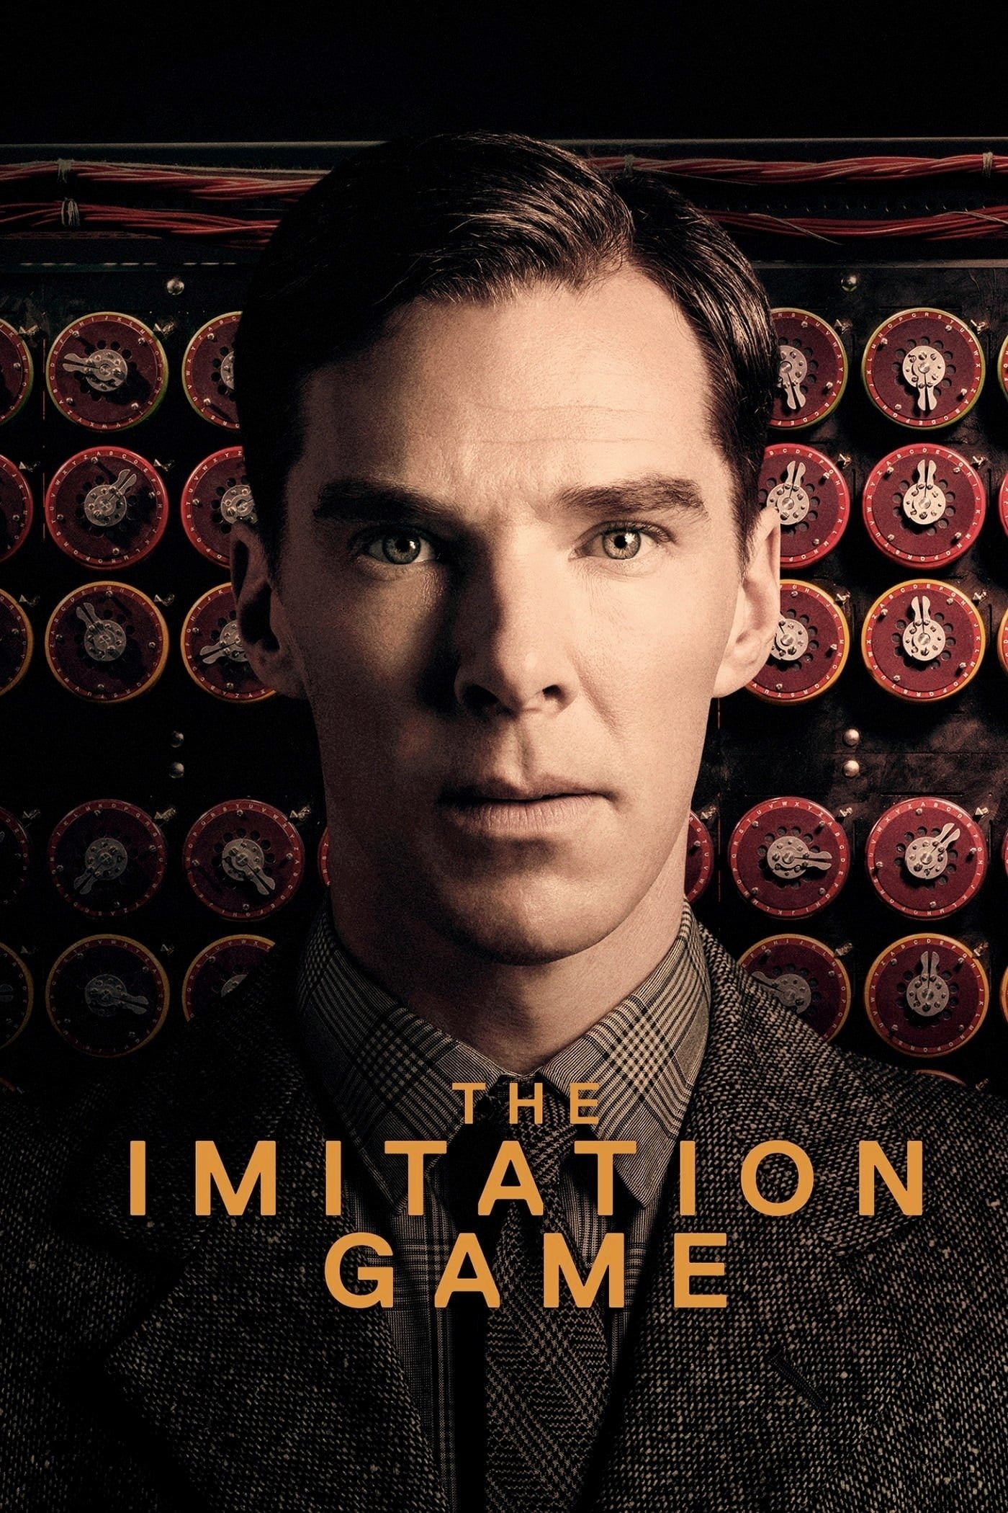

Slide 8
Alan Turing invented the computer
The Turing Machine

Slide 9
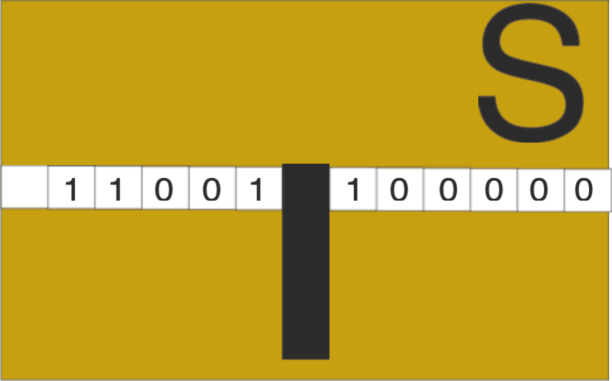
A thought experiment

Slide 10
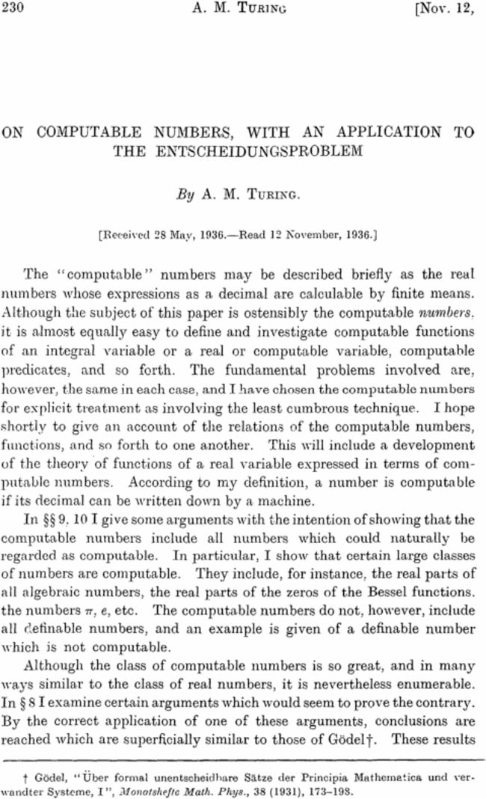
1937

Slide 11
‘Entscheidungsproblem’
Decision problem

Slide 12
A thought experiment
Much cheaper than the other kind of experiment
Allows you to ask ‘What if’ questions
Used a lot in other disciplines (e.g. Einstein)

Slide 13
A thought experiment
‘What if…’
…we had a machine that could do mathematics?
What would it look like?
What could it do?
What could it not do?

Slide 14



Turing Machine
Machine
State
Paper tape
0s and 1s
Read/write head

Slide 15
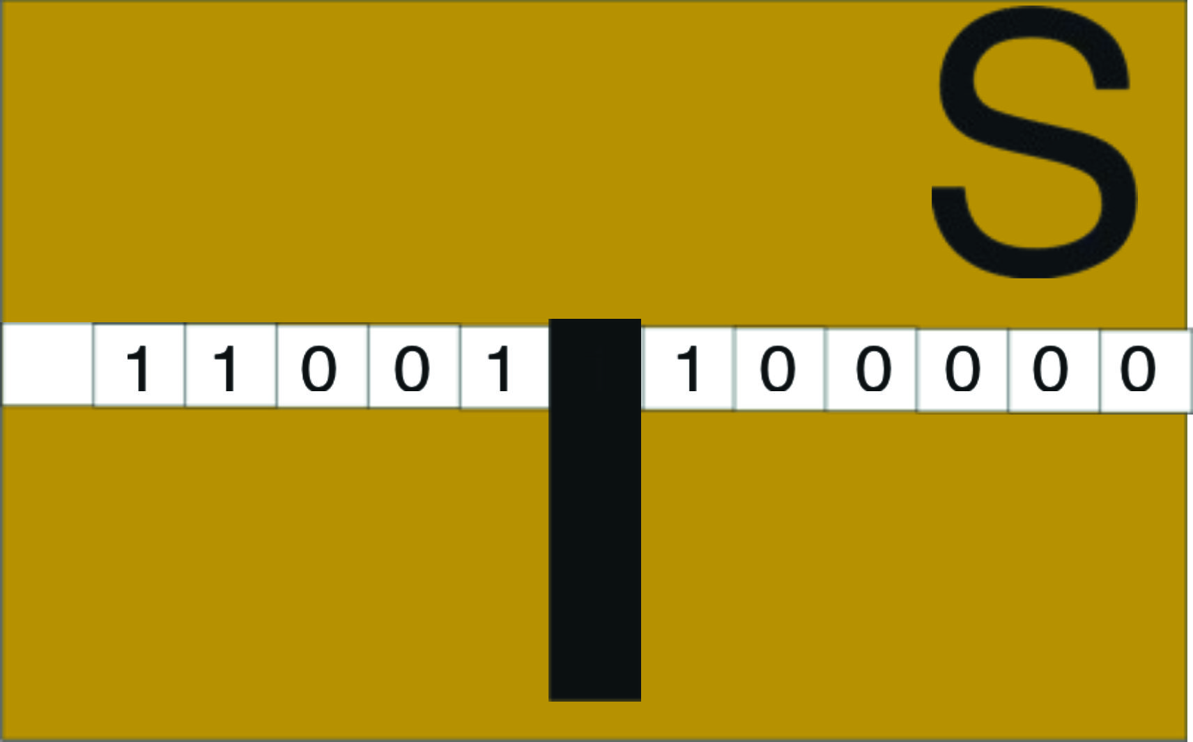
Turing Machine program
Current state
Current symbol
Write new symbol
Move tape left or right
Shift to new state
S_{i}
1
0
Left
S_{j}

Slide 16
Turing Machine program
S_{i,} 1, 0, Left, S_{j}
Example
Add 2 numbers
Unary numbers
1₁₀ = 1
2₁₀ = 11
3₁₀ = 111
°°°

Slide 17


Add 2 + 3
1: S₀, 0, 0, R, S₀
2
+
3
0

Slide 18

Add 3 + 2
1: S₀, 0, 0, R, S₀
2: S₀, 1, 0, L, S₁
0

Slide 19
Add 3 + 2
1: S₀, 0, 0, R, S₀
2: S₀, 1, 0, L, S₁
3: S₁, 0, 0, L, S₁
1

Slide 20
Add 3 + 2
1: S₀, 0, 0, R, S₀
2: S₀, 1, 0, L, S₁
3: S₁, 0, 0, L, S₁
4: S₁, 1, 1, L, S₂
1

Slide 21
Add 3 + 2
1: S₀, 0, 0, R, S₀
2: S₀, 1, 0, L, S₁
3: S₁, 0, 0, L, S₁
4: S₁, 1, 1, L, S₂
5: S₂, 1, 1, L, S₂
2

Slide 22
Add 3 + 2
1: S₀, 0, 0, R, S₀
2: S₀, 1, 0, L, S₁
3: S₁, 0, 0, L, S₁
4: S₁, 1, 1, L, S₂
5: S₂, 1, 1, L, S₂
2

Slide 23
Add 3 + 2
1: S₀, 0, 0, R, S₀
2: S₀, 1, 0, L, S₁
3: S₁, 0, 0, L, S₁
4: S₁, 1, 1, L, S₂
5: S₂, 1, 1, L, S₂
6: S₂, 0, 1, R, S₃
3 + 1 = 4
2

Slide 24
Add 3 + 2
1: S₀, 0, 0, R, S₀
2: S₀, 1, 0, L, S₁
3: S₁, 0, 0, L, S₁
4: S₁, 1, 1, L, S₂
5: S₂, 1, 1, L, S₂
6: S₂, 0, 1, R, S₃
7: S₃, 1, 1, R, S₃
3

Slide 25
Add 3 + 2
1: S₀, 0, 0, R, S₀
2: S₀, 1, 0, L, S₁
3: S₁, 0, 0, L, S₁
4: S₁, 1, 1, L, S₂
5: S₂, 1, 1, L, S₂
6: S₂, 0, 1, R, S₃
7: S₃, 1, 1, R, S₃
3

Slide 26
Add 3 + 2
1: S₀, 0, 0, R, S₀
2: S₀, 1, 0, L, S₁
3: S₁, 0, 0, L, S₁
4: S₁, 1, 1, L, S₂
5: S₂, 1, 1, L, S₂
6: S₂, 0, 1, R, S₃
7: S₃, 1, 1, R, S₃
3

Slide 27

Add 3 + 2
1: S₀, 0, 0, R, S₀
2: S₀, 1, 0, L, S₁
3: S₁, 0, 0, L, S₁
4: S₁, 1, 1, L, S₂
5: S₂, 1, 1, L, S₂
6: S₂, 0, 1, R, S₃
7: S₃, 1, 1, R, S₃
8: S₃, 0, 0, R, S₀
3

Slide 28
Add 3 + 2
1: S₀, 0, 0, R, S₀
2: S₀, 1, 0, L, S₁
3: S₁, 0, 0, L, S₁
4: S₁, 1, 1, L, S₂
5: S₂, 1, 1, L, S₂
6: S₂, 0, 1, R, S₃
7: S₃, 1, 1, R, S₃
8: S₃, 0, 0, R, S₀
0

Slide 29
Add 3 + 2
1: S₀, 0, 0, R, S₀
2: S₀, 1, 0, L, S₁
3: S₁, 0, 0, L, S₁
4: S₁, 1, 1, L, S₂
5: S₂, 1, 1, L, S₂
6: S₂, 0, 1, R, S₃
7: S₃, 1, 1, R, S₃
8: S₃, 0, 0, R, S₀
0

Slide 30
Add 3 + 2
1: S₀, 0, 0, R, S₀
2: S₀, 1, 0, L, S₁
3: S₁, 0, 0, L, S₁
4: S₁, 1, 1, L, S₂
5: S₂, 1, 1, L, S₂
6: S₂, 0, 1, R, S₃
7: S₃, 1, 1, R, S₃
8: S₃, 0, 0, R, S₀
1

Slide 31
Add 3 + 2
1: S₀, 0, 0, R, S₀
2: S₀, 1, 0, L, S₁
3: S₁, 0, 0, L, S₁
4: S₁, 1, 1, L, S₂
5: S₂, 1, 1, L, S₂
6: S₂, 0, 1, R, S₃
7: S₃, 1, 1, R, S₃
8: S₃, 0, 0, R, S₀
1

Slide 32
Add 3 + 2
1: S₀, 0, 0, R, S₀
2: S₀, 1, 0, L, S₁
3: S₁, 0, 0, L, S₁
4: S₁, 1, 1, L, S₂
5: S₂, 1, 1, L, S₂
6: S₂, 0, 1, R, S₃
7: S₃, 1, 1, R, S₃
8: S₃, 0, 0, R, S₀
1

Slide 33
Add 3 + 2
1: S₀, 0, 0, R, S₀
2: S₀, 1, 0, L, S₁
3: S₁, 0, 0, L, S₁
4: S₁, 1, 1, L, S₂
5: S₂, 1, 1, L, S₂
6: S₂, 0, 1, R, S₃
7: S₃, 1, 1, R, S₃
8: S₃, 0, 0, R, S₀
2

Slide 34
Add 3 + 2
1: S₀, 0, 0, R, S₀
2: S₀, 1, 0, L, S₁
3: S₁, 0, 0, L, S₁
4: S₁, 1, 1, L, S₂
5: S₂, 1, 1, L, S₂
6: S₂, 0, 1, R, S₃
7: S₃, 1, 1, R, S₃
8: S₃, 0, 0, R, S₀
2

Slide 35
Add 3 + 2
1: S₀, 0, 0, R, S₀
2: S₀, 1, 0, L, S₁
3: S₁, 0, 0, L, S₁
4: S₁, 1, 1, L, S₂
5: S₂, 1, 1, L, S₂
6: S₂, 0, 1, R, S₃
7: S₃, 1, 1, R, S₃
8: S₃, 0, 0, R, S₀
2

Slide 36
Add 3 + 2
1: S₀, 0, 0, R, S₀
2: S₀, 1, 0, L, S₁
3: S₁, 0, 0, L, S₁
4: S₁, 1, 1, L, S₂
5: S₂, 0, 1, R, S₃
6: S₃, 1, 1, R, S₃
7: S₃, 0, 0, R, S₀
5
= 3 + 2
2

Slide 37
Add 3 + 2
1: S₀, 0, 0, R, S₀
2: S₀, 1, 0, L, S₁
3: S₁, 0, 0, L, S₁
4: S₁, 1, 1, L, S₂
5: S₂, 0, 1, R, S₃
6: S₃, 1, 1, R, S₃
7: S₃, 0, 0, R, S₀
3

Slide 38
Add 3 + 2
1: S₀, 0, 0, R, S₀
2: S₀, 1, 0, L, S₁
3: S₁, 0, 0, L, S₁
4: S₁, 1, 1, L, S₂
5: S₂, 0, 1, R, S₃
6: S₃, 1, 1, R, S₃
7: S₃, 0, 0, R, S₀
3

Slide 39
Add 3 + 2
1: S₀, 0, 0, R, S₀
2: S₀, 1, 0, L, S₁
3: S₁, 0, 0, L, S₁
4: S₁, 1, 1, L, S₂
5: S₂, 0, 1, R, S₃
6: S₃, 1, 1, R, S₃
7: S₃, 0, 0, R, S₀
3

Slide 40
Add 3 + 2
1: S₀, 0, 0, R, S₀
2: S₀, 1, 0, L, S₁
3: S₁, 0, 0, L, S₁
4: S₁, 1, 1, L, S₂
5: S₂, 0, 1, R, S₃
6: S₃, 1, 1, R, S₃
7: S₃, 0, 0, R, S₀
3

Slide 41
Add 3 + 2
1: S₀, 0, 0, R, S₀
2: S₀, 1, 0, L, S₁
3: S₁, 0, 0, L, S₁
4: S₁, 1, 1, L, S₂
5: S₂, 0, 1, R, S₃
6: S₃, 1, 1, R, S₃
7: S₃, 0, 0, R, S₀
3

Slide 42
Add 3 + 2
1: S₀, 0, 0, R, S₀
2: S₀, 1, 0, L, S₁
3: S₁, 0, 0, L, S₁
4: S₁, 1, 1, L, S₂
5: S₂, 0, 1, R, S₃
6: S₃, 1, 1, R, S₃
7: S₃, 0, 0, R, S₀
0

Slide 43
Add 3 + 2
1: S₀, 0, 0, R, S₀
2: S₀, 1, 0, L, S₁
3: S₁, 0, 0, L, S₁
4: S₁, 1, 1, L, S₂
5: S₂, 0, 1, R, S₃
6: S₃, 1, 1, R, S₃
7: S₃, 0, 0, R, S₀
0

Slide 44

Add 3 + 2
1: S₀, 0, 0, R, S₀
2: S₀, 1, 0, L, S₁
3: S₁, 0, 0, L, S₁
4: S₁, 1, 1, L, S₂
5: S₂, 0, 1, R, S₃
6: S₃, 1, 1, R, S₃
7: S₃, 0, 0, R, S₀
8: S₀,◻︎, HALT
0

Slide 45
Add 3 + 2
1: S₀, 0, 0, R, S₀
2: S₀, 1, 0, L, S₁
3: S₁, 0, 0, L, S₁
4: S₁, 1, 1, L, S₂
5: S₂, 0, 1, R, S₃
6: S₃, 1, 1, R, S₃
7: S₃, 0, 0, R, S₀
8: S0,◻︎, HALT
2 + 3 = 5
0

Slide 46
Add 3 + 2
1: S₀, 0, 0, R, S₀
2: S₀, 1, 0, L, S₁
3: S₁, 0, 0, L, S₁
4: S₁, 1, 1, L, S₂
5: S₂, 0, 1, R, S₃
6: S₃, 1, 1, R, S₃
7: S₃, 0, 0, R, S₀
8: S0,◻︎, HALT
0

Slide 47
Code and data
2 tapes
…but not necessary
Code
0
Data

Slide 48
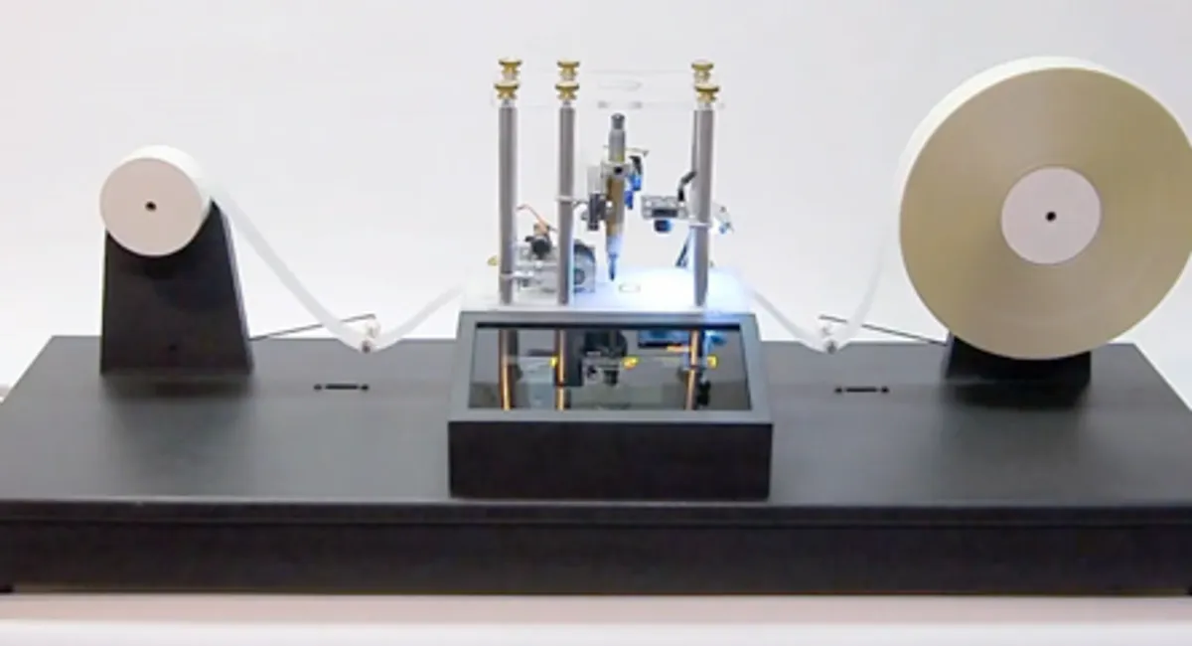
A Turing Machine
People have built them
But that’s missing the point
A thought experiment
‘What if’ – but a realistic machine
https://spectrum.ieee.org/032610-diy-turing-machine

Slide 49
Church-Turing Thesis
All computers are equivalent to the Turing Machine
Anything you can do on a computer you can do on a Turing Machine
Anything you can do on a Turing Machine you can do on a computer

Slide 50
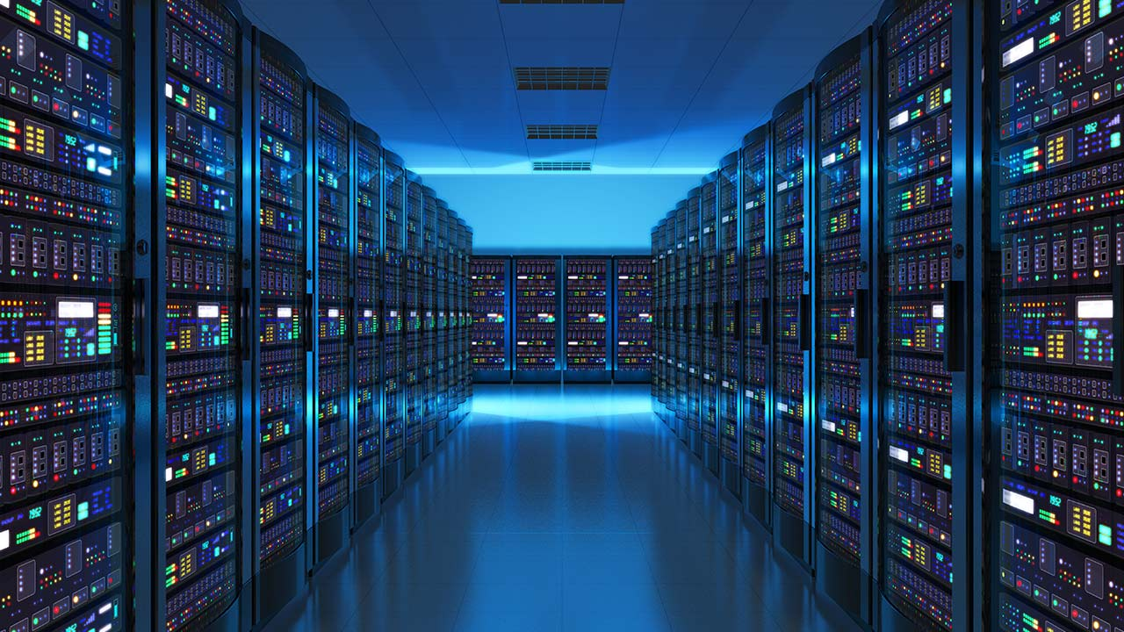
Church-Turing Thesis

Slide 51
Church-Turing Thesis
Difference is the speed
Paper tapes flying around versus millions of instructions per second

Slide 52
Church-Turing Thesis
If you can do it on a Turing Machine you can do it on a computer
If you can do it on a computer you can do it on a Turing Machine
If you cannot do it on a Turing Machine you cannot do it on a computer

Slide 53
Operations
✓
Addition
Subtraction
3 – 2
= 111₁ – 11₁
= 001₁
Multiplication
3 x 2 = 2 + 2 + 2
Division
Logical operations
All you need

Slide 54
What computers do
Calculate payroll
Play music
Clever AI stuff
All just high-level interpretations of computer data

Slide 55
Church-Turing Thesis
If you can do it on a Turing Machine you can do it on a computer
If you can do it on a computer you can do it on a Turing Machine
If you cannot do it on a Turing Machine you cannot do it on a computer
If you cannot do it on a Turing Machine you cannot do it on a computer

Slide 56
Church-Turing Thesis
What (if anything) can you not calculate on a Turing machine?
(Or hence not on any computer)
The Halting Problem

Slide 57
The Turing Machine
Turing did not build one
Although in a way he did
Colossus and every other computer he helped design and build was a Turing Machine

Slide 58
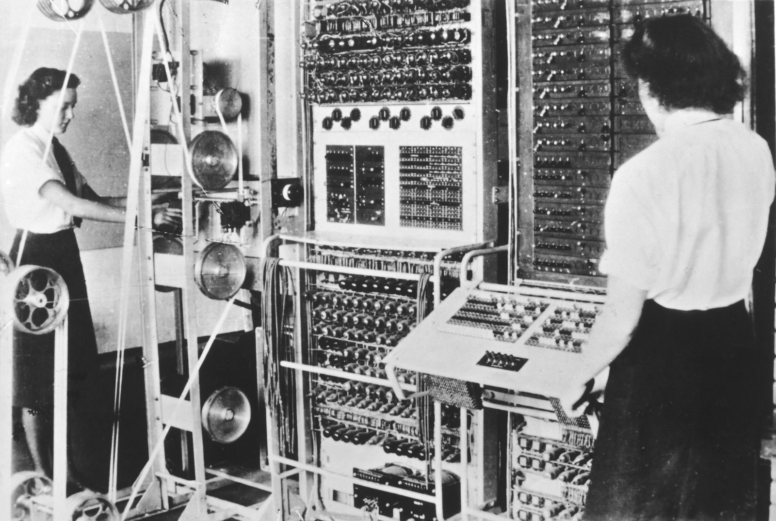
Colossus
http://www.thehistoryblog.com/archives/21186

Slide 59
The Halting Problem
Your program hangs
Probably not stopped
but stuck in an infinite loop
Which programs are going to get stuck in a loop?
Wouldn’t it be good to know in advance
A program that uses other programs as data and says whether they will stop or not

Slide 60
The Halting Problem
Another thought experiment
What if such a program existed

Slide 61
The Halting Problem
What if you have such a program, H
Run H on a program, P
H(P) tells us whether P will halt

Slide 62
The Halting Problem
Somewhere in H will be a statement
if (- - - - -) then
print (’Program halts’);

Slide 63
The Halting Problem
Modify H to H’, replacing the statement
if (- - - - -) then
print (’Program halts’);
loop_for_ever

Slide 64
The Halting Problem
Run H’(H’)
If H’ halts, then H’ loops for ever
Impossible
Where is the flaw in the logic?
What if you have such a program, H

Slide 65
The Halting Problem
H cannot exist
Therefore the Halting Problem cannot be solved
One problem that cannot be solved by computer
At least one

Slide 66
Summary
Alan Turing invented the computer
The Turing Machine
A thought experiment
He proved it could not solve every problem
He also helped to build real computers
He also thought about ‘artificial intelligence’

Slide 67
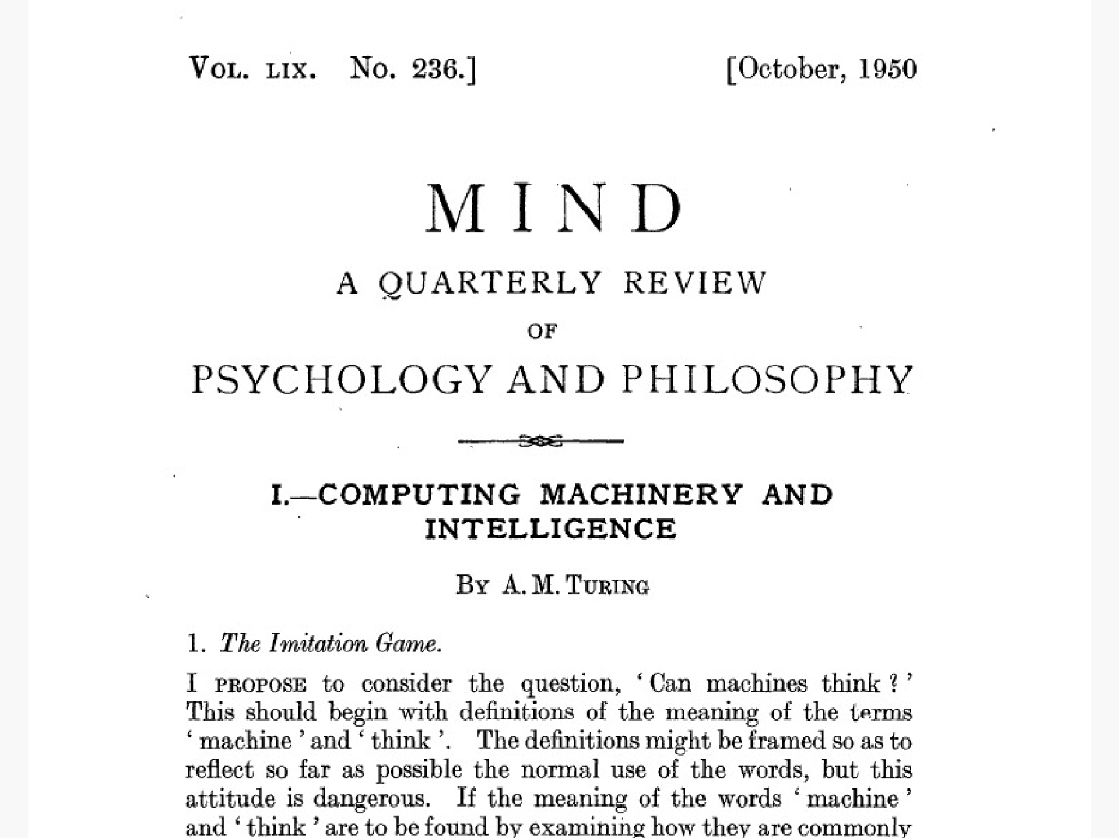
Question
Is the human brain a Turing Machine?

Slide 68
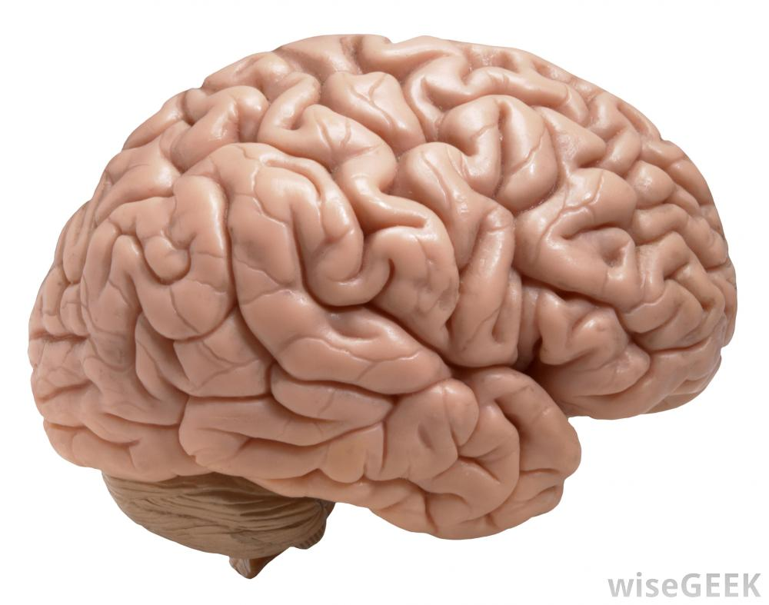
Is the human brain a Turing Machine?

Slide 69
References
Turing, A. M. (1936). On computable numbers, with an application to the Entscheidungsproblem. J. of Math, 58(345-363), 5.
A. M. Turing (1950) Computing Machinery and Intelligence. Mind 49: 433-460

