Slide 1


What Does ChatGPT Understand?
Alistair Edwards
Ownership
Water out
Water in
😀
https://www-users.york.ac.uk/~ade1/

Slide 2
What Does ChatGPT Understand?
Alistair Edwards
Honorary Fellow, University of York
https://www-users.york.ac.uk/~ade1/

Slide 3
What does ChatGPT understand?
Nothing

Slide 4
The End
Questions?

Slide 5
No, seriously
We will look at artificial intelligence (AI)
How it developed leading to things like ChatGPT
Question ‘understanding’ and AI

Slide 6
But first…
A bit of background

Slide 7
Dr Alistair Edwards
Honorary Fellow of the University of York
Retired lecturer
Gives talks to schools

Slide 8
Dr Alistair D N Edwards
Education
Wilmslow Grammar School
  Maths, physics & chemistry
University of Warwick
  BSc Physics & Computer Science
Pennsylvania State University
  MSc Computer Science
Open University
  PhD Educational Technology
Notes:
First, a little bit more about me. I did A-Levels at a Grammar school. Then I did a BSc degree in Physics and Computer Science at Warwick University, followed by an MSc in Computer Science at Pennsylvania State University (Penn State) in America. Later I completed a PhD in Educational Technology at the Open University – and that is why I can call myself ‘Dr’.

Slide 9
Dr Alistair D N Edwards
Career
University of Manchester Institute of Science & Technology (UMIST)
  Computer Officer
Open University
  Lecturer
University of York
  Senior Lecturer
  Honorary Fellow
Notes:
I have worked mostly in universities. First at Umist, which is now part of the University of Manchester, then at the Open University. Then I was a lecturer in Computer Science at the University of York. I retired about 3 years ago, but I retain a position as an Honorary Fellow - ‘honorary’ meaning I don’t get paid for it.

Slide 10
Career – all in universities
But also ‘real-world’ experience through consultancies
Toby Churchill Ltd
BT
Orange
William Hill

Slide 11

Honorary Fellow
Retired in 2018
An active retirement

Slide 12
‘Lecturer’
Teaching
…and research
Notes:
When you hear ‘lecturer’ you probably think that’s like a teacher, and teaching is an important part of the job, but we are also expected to do research.

Slide 13
Teaching
Algorithms and data structures
Human aspects of Computer Science
Web design
Advanced topics in interactive technologies
Crash course on C programming
IT as an enabling technology
Lexical and syntax analysis of programming languages
…
Notes:
With regards to teaching, these are some of the modules which I have taught. They are mostly related to human-computer interaction or programming.

Slide 14
Research
Human-computer interaction
Multimodal interaction
  speech
  non-speech sounds
  tactile interaction
Users with particular needs
  blind people
  older people
Usable security
Culture and interaction
Notes:
Most of my research is also around human-computer interaction, particularly novel forms of interaction, such as speech and tactile interaction. These are often motivated by users with particular needs, such as blind people and older people. I am also interested in ‘usable security, and that is what today’s talk is really about.

Slide 15
What is Artificial Intelligence (AI)?

Slide 16
AI
?
To me:
Getting a machine to do something that previously could only be done by a person

Slide 17
Getting a machine to do something that previously could only be done by a person
A moving target
It soon becomes a thing that computers do
  and we move on

Slide 18
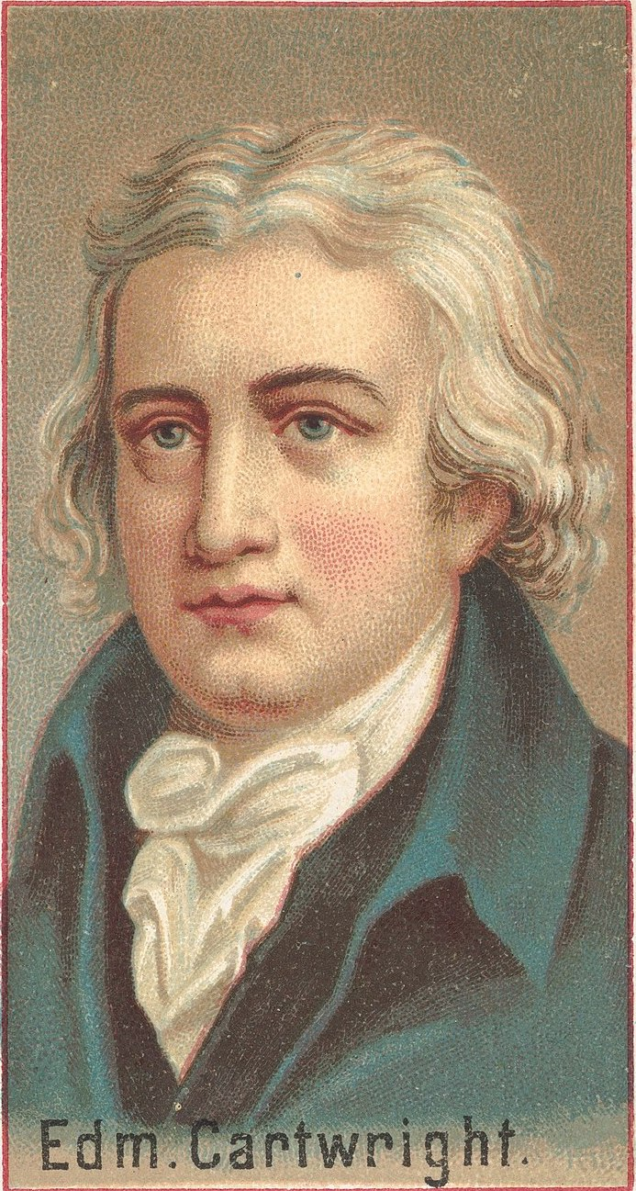
Getting a machine to do something that previously could only be done by a person
A long history
1785 Edmund Cartwright invented the power loom

Slide 19
Power Loom
Familiar responses:
Taking away jobs from people

Slide 20
AI Timeline

Slide 21
1950s
Compilers
Translate ‘high-level’ code to machine code

Slide 22
Programming
Do you write programs?
What languages do you use?
‘High-level’ languages

Slide 23
Compilers
function main(void)
{
printf(“Hello world!\n”);
}

Slide 24
1950s
LOAD 100
ADD 101
STORE 103
01000 1100100
01011 1100101
01101 1100111

Slide 25
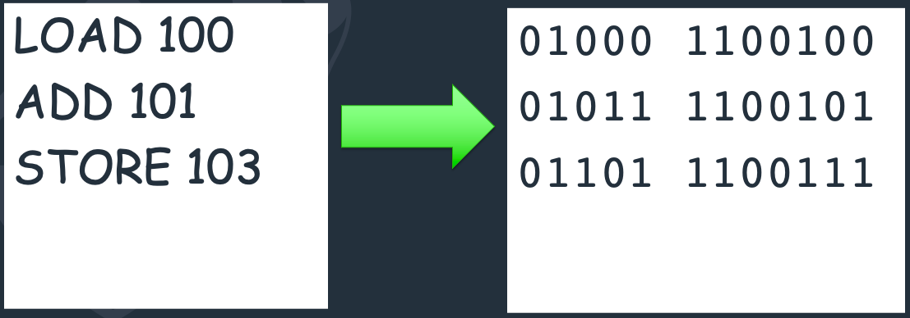
1950s
ADD | 01011 | STORE | 01101
JUMP | 10100 | SUB | 01110
LOAD | 01000 | TEQ | 10010
STOP | 00000 | TEST | 10001

Slide 26
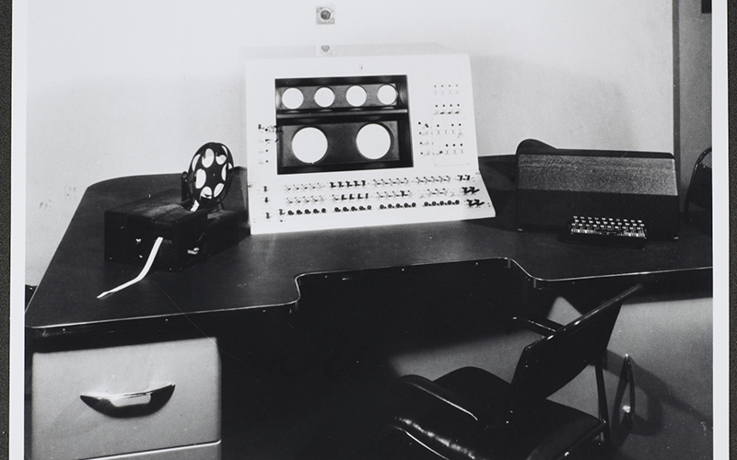
1950s
Manchester Mark 1

Slide 27
1950s
Compilers
  Doing something previously only done by people
AI?
  or just a thing that computers do?

Slide 28
AI has experienced highs and lows
Highs
  A lot promised, hyped?
Lows
  Just the things that computers do?
  …and not quite all that was promised?

Slide 29

1950s
AI is started
Largely thanks to this man
Alan Turing

Slide 30
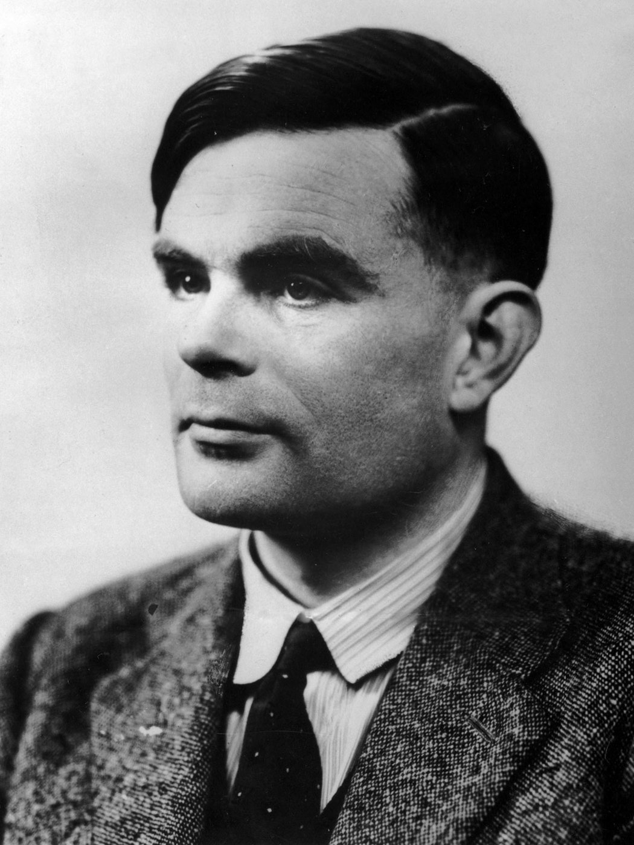
1950s
AI is born
Alan Turing

Slide 31
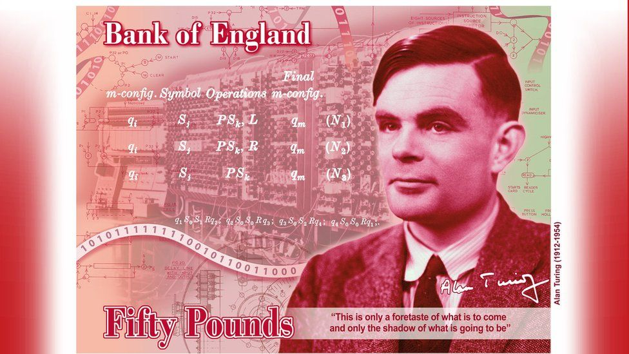
“This is only a foretaste of what is to come, and only the shadow of what is going to be. We have to have some experience with the machine before we really know its capabilities. It may take years before we settle down to the new possibilities, but I do not see why it should not enter any one of the fields normally covered by the human intellect, and eventually compete on equal terms.”
“This is only a foretaste of what is to come, and only the shadow of what is going to be. We have to have some experience with the machine before we really know its capabilities. It may take years before we settle down to the new possibilities, but I do not see why it should not enter any one of the fields normally covered by the human intellect, and eventually compete on equal terms.”

Slide 32
AI God

Slide 33
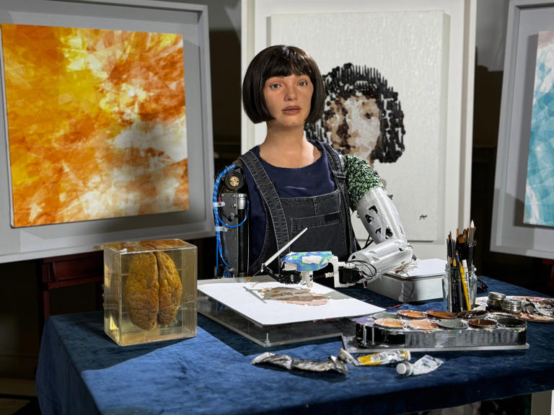
Aida

Slide 34
1950s
AI is born
Alan Turing
  practically invents the computer
  but also thinks about AI

Slide 35
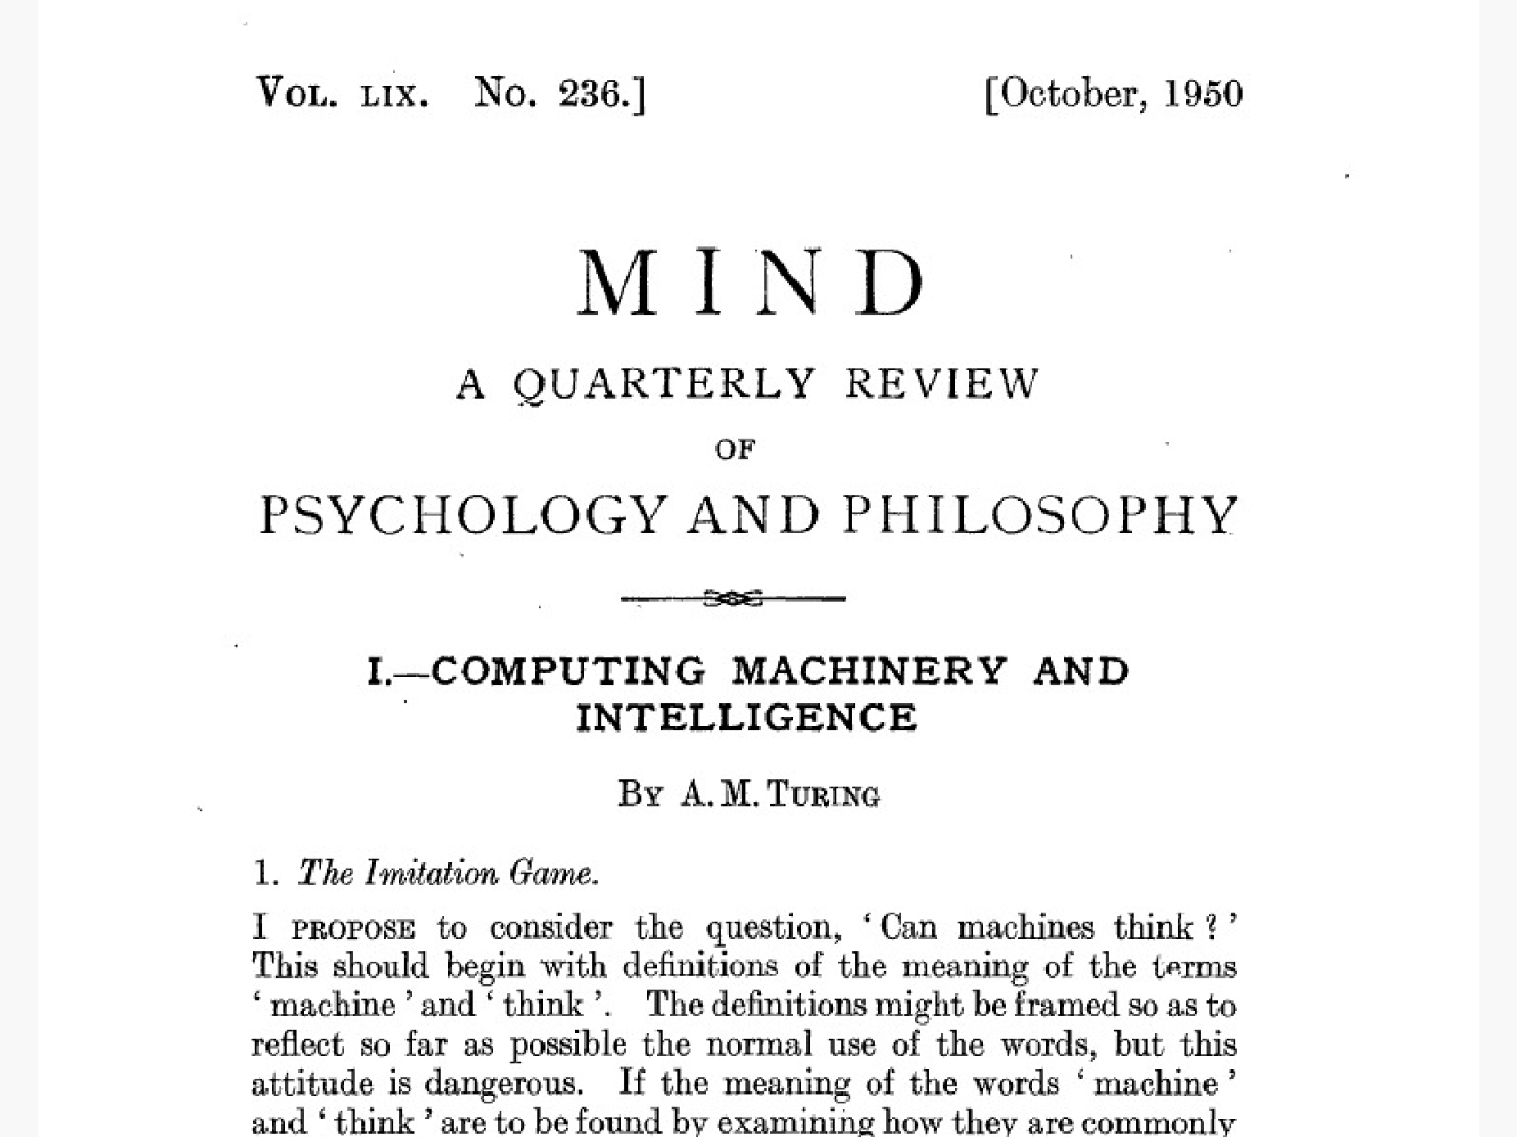

Slide 36


Slide 37
AI and chess
Playing chess
  something only (clever) people could do
Turing wrote the first chess playing ‘program’

Slide 38
1950s
Computers start to be available
Turing speculates about intelligence
1956 ‘Artificial intelligence’ coined

Slide 39
1960s
Eliza
  First chatbot
MacHack
  Class C chess program
    ‘average club player’

Slide 40
1960s
AI promises much
  hype?

Slide 41
1970s
Mycin developed – medical diagnosis
‘AI winter’
  a low

Slide 42
1980s
‘Computer will never beat a chess grand master’

Slide 43
1980s
Japanese Fifth Generation Project
UK Alvey Programme
A high?
Expert systems and production rules

Slide 44
1990s
1996: Deep Blue defeats Garry Kasparov

Slide 45
2000s
ChatGPT etc

Slide 46
ChatGPT is an LLM
Large language model
How does that work?

Slide 47
Predictive text
‘The boy hits the ball’

Slide 48
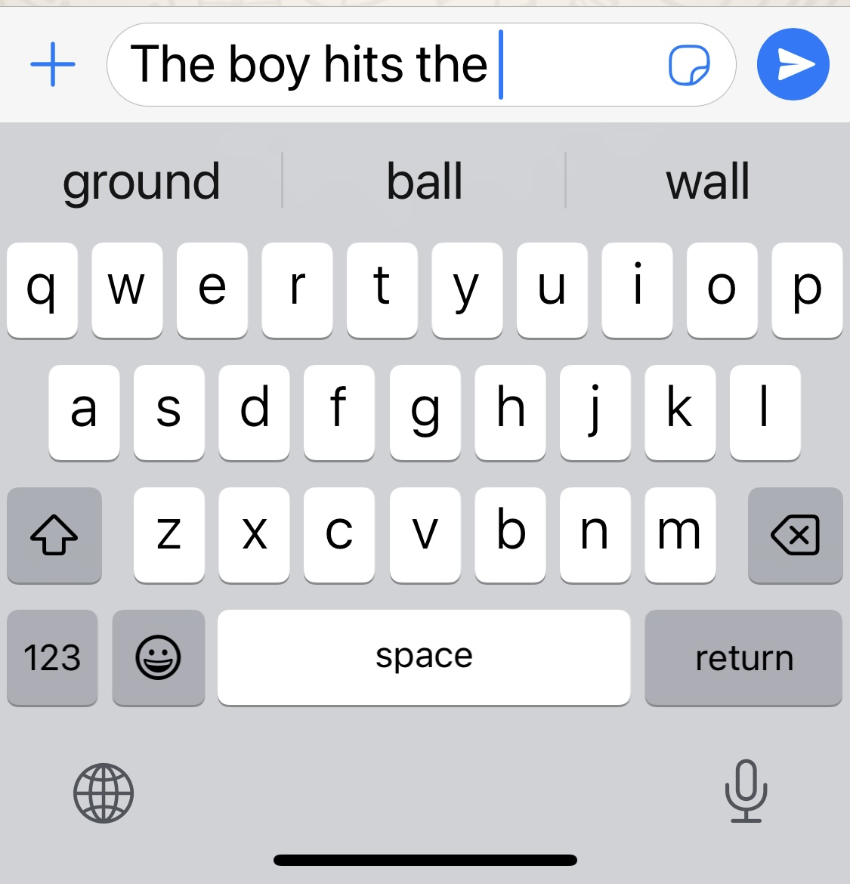
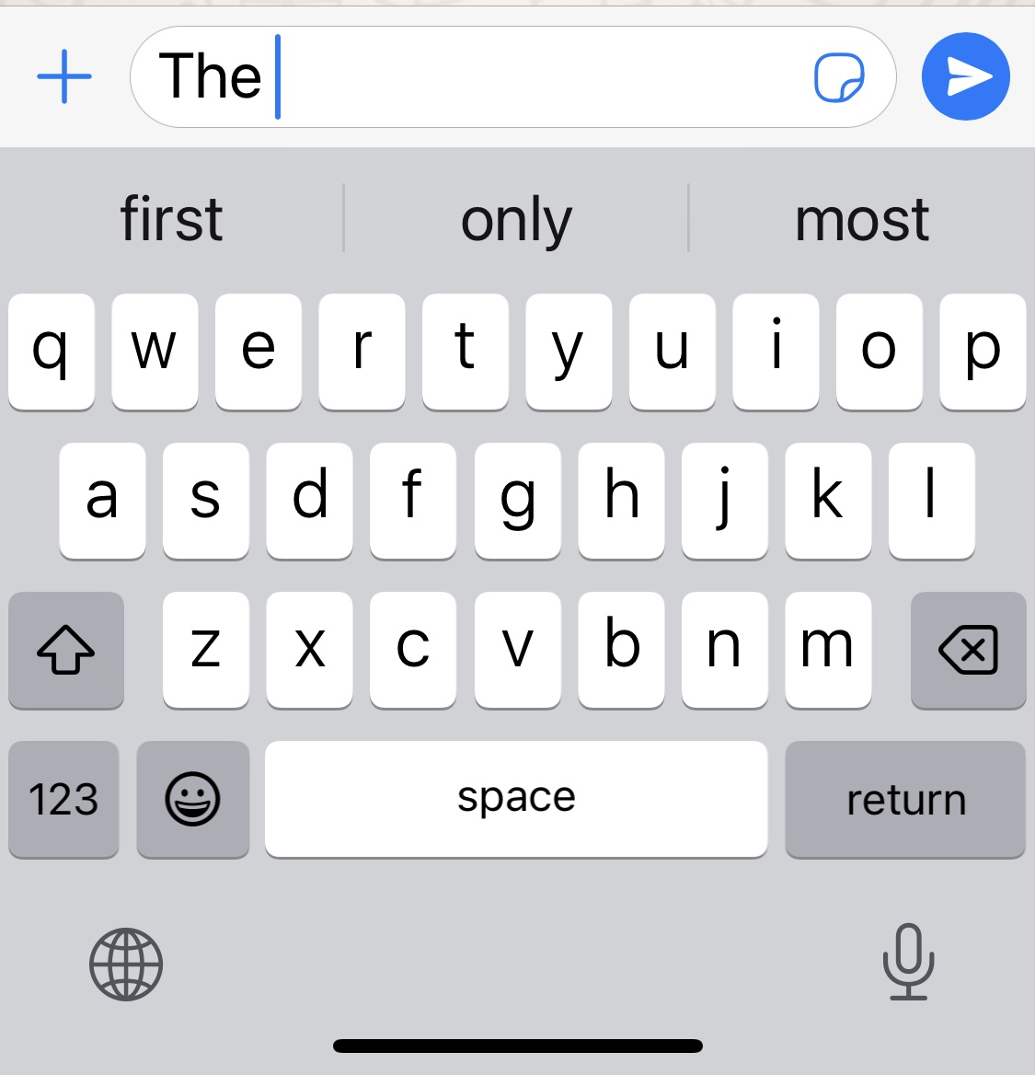
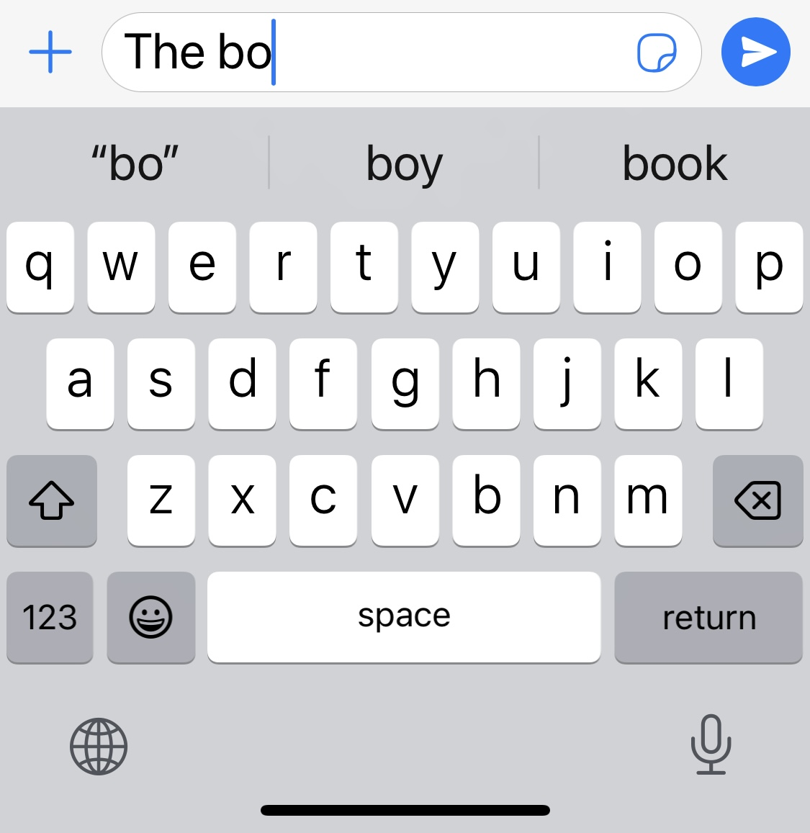
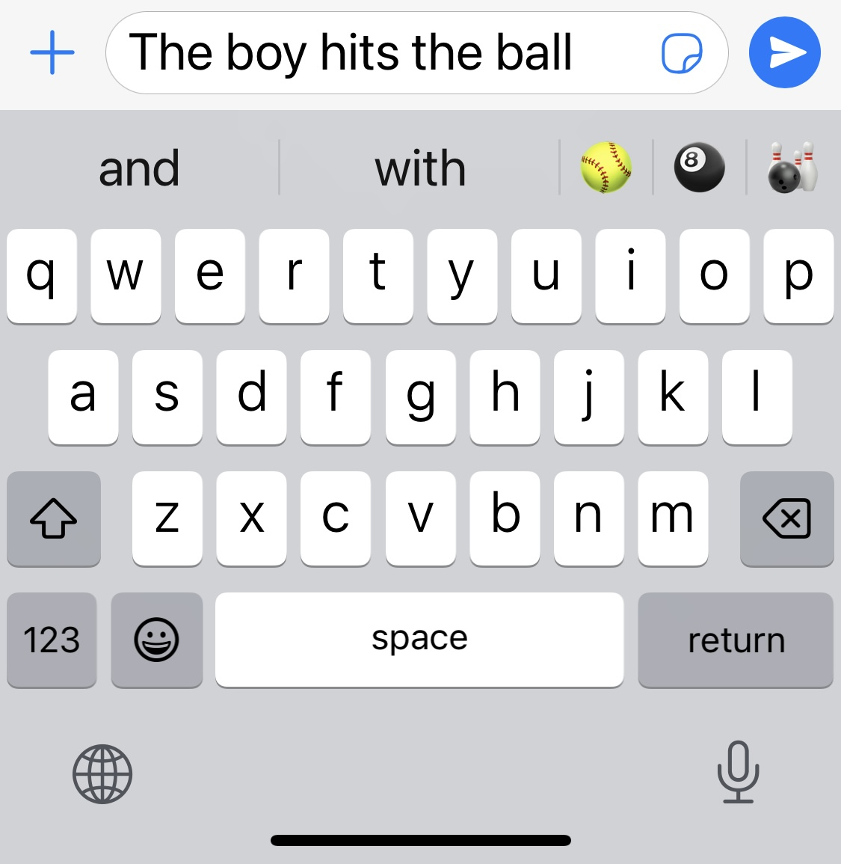
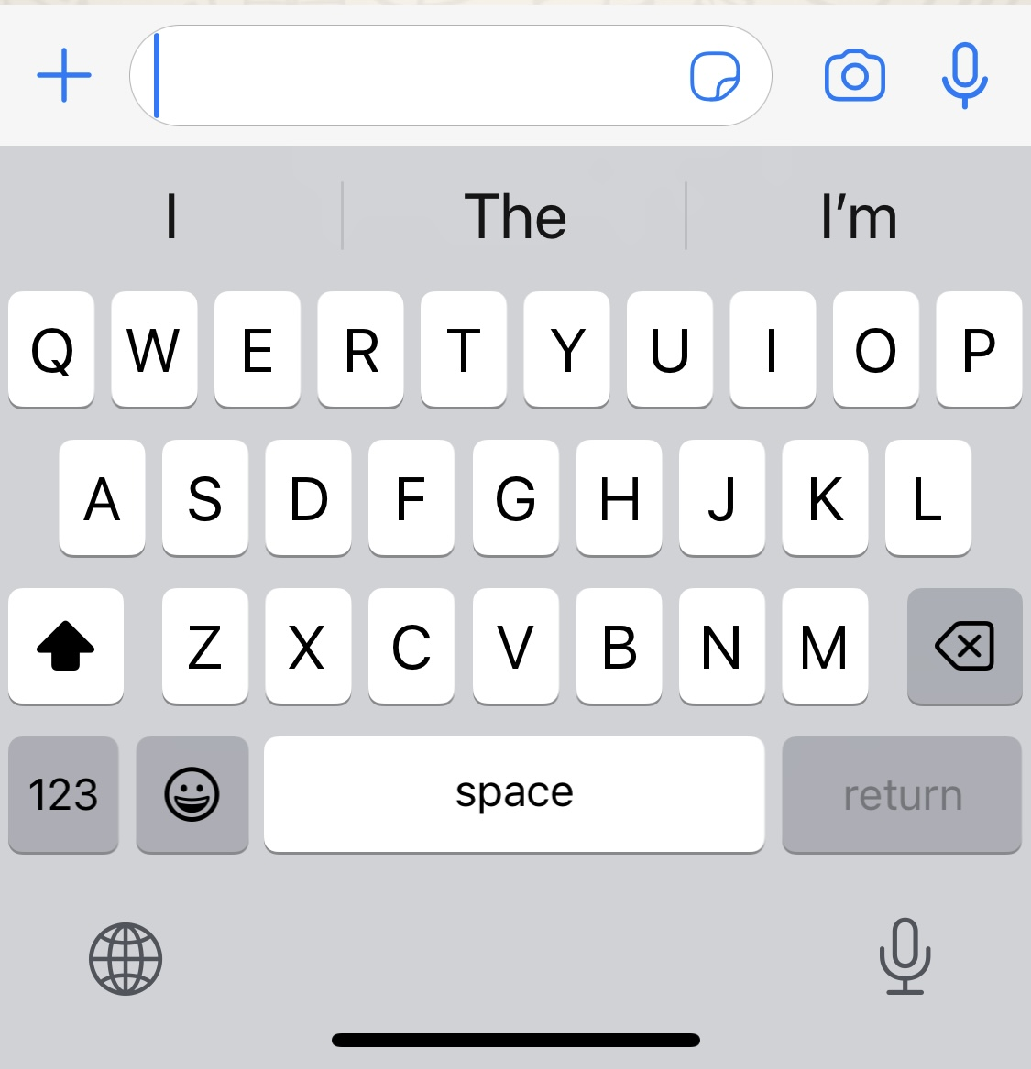
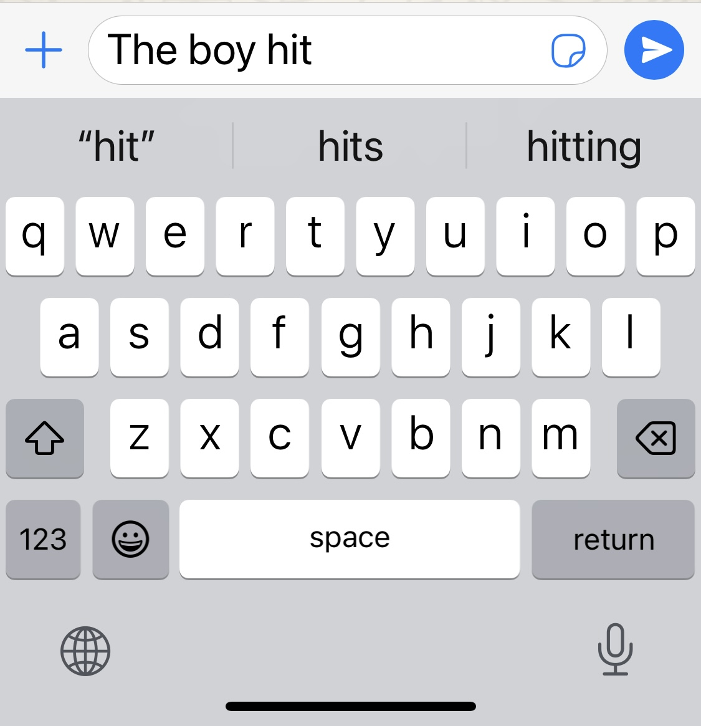
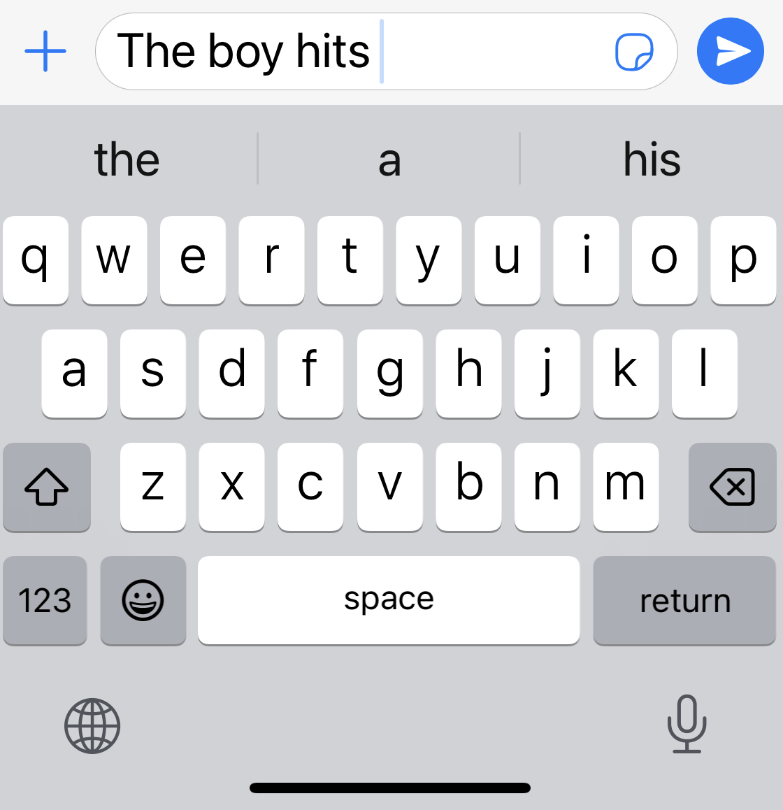
The boy hits the ball

Slide 49
How does predictive text work?
Statistics on how words are used
  by me
  and everyone else

Slide 50
LLMs are much the same
Based on millions of examples of text on the internet

Slide 51
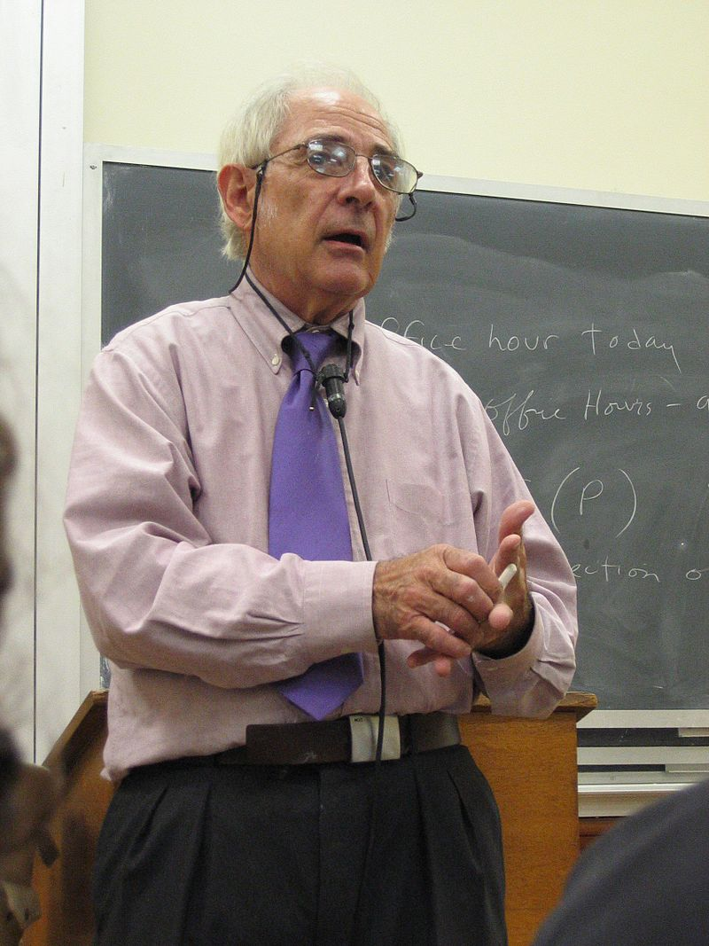
The Chinese Room
A thought experiment
John Searle
1980

Slide 52
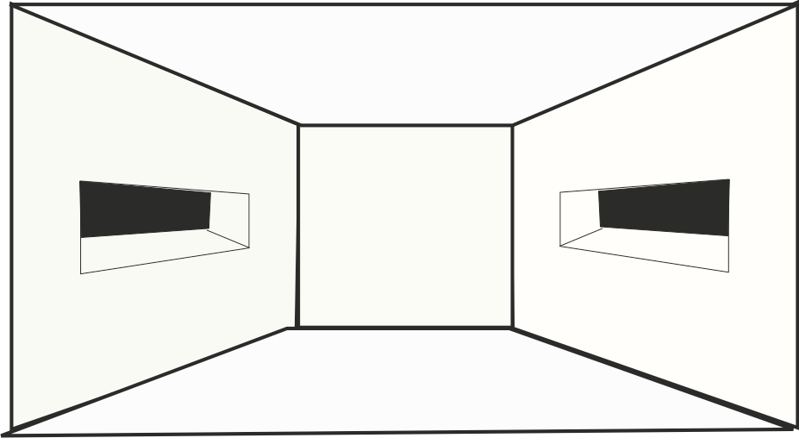

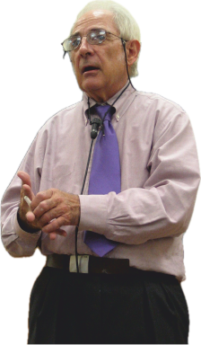
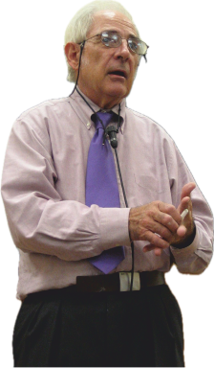



Chinese Room

Slide 53
Chinese Room
Searle understands nothing
But to external observers the room appears to understand

Slide 54
1950s
ADD | 01011 | STORE | 01101
JUMP | 10100 | SUB | 01110
LOAD | 01000 | TEQ | 10010
STOP | 00000 | TEST | 10001

Slide 55
Chinese Room
Searle understands nothing
But to external observers the room appears to understand

Slide 56
ChatGPT is like the Chinese room
It takes inputs and generates outputs
Its ‘book’ is the whole Internet
It understands nothing

Slide 57
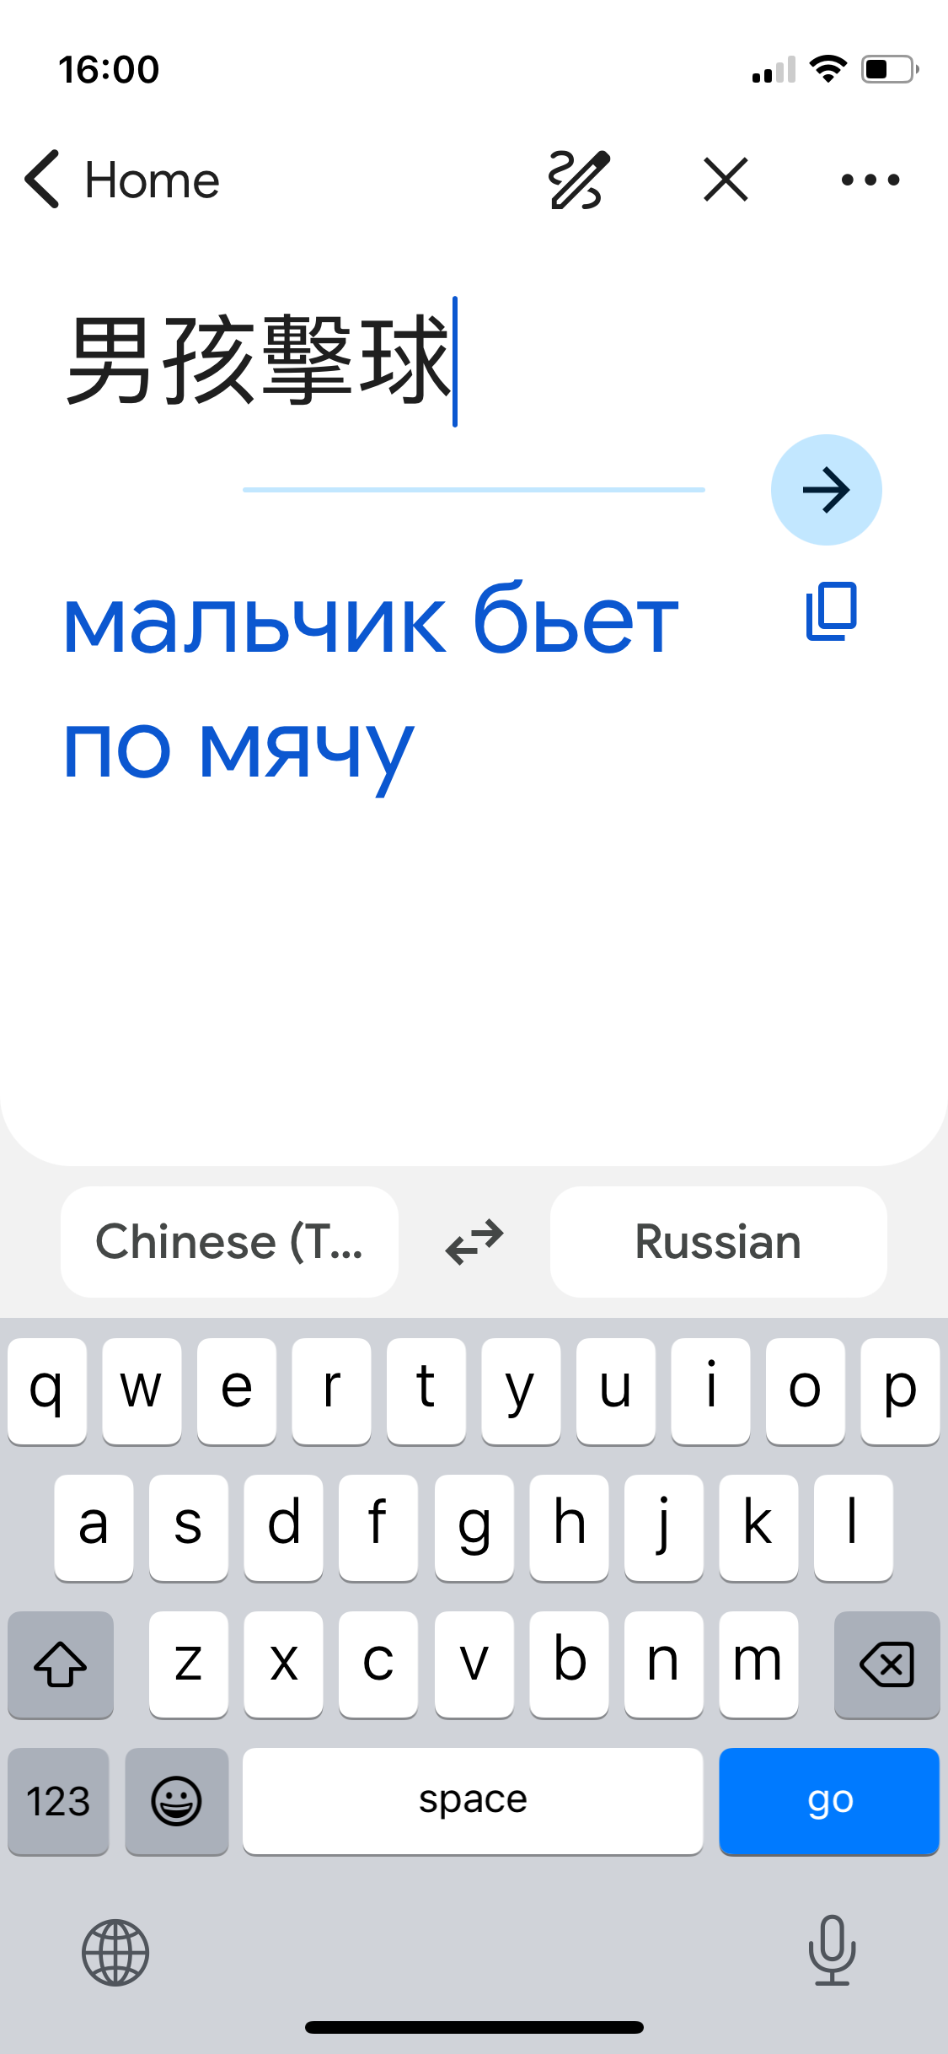
Google Translate
Also understands nothing
It works like ChatGPT
  compares writing in different languages
  Wikipedia is very useful

Slide 58
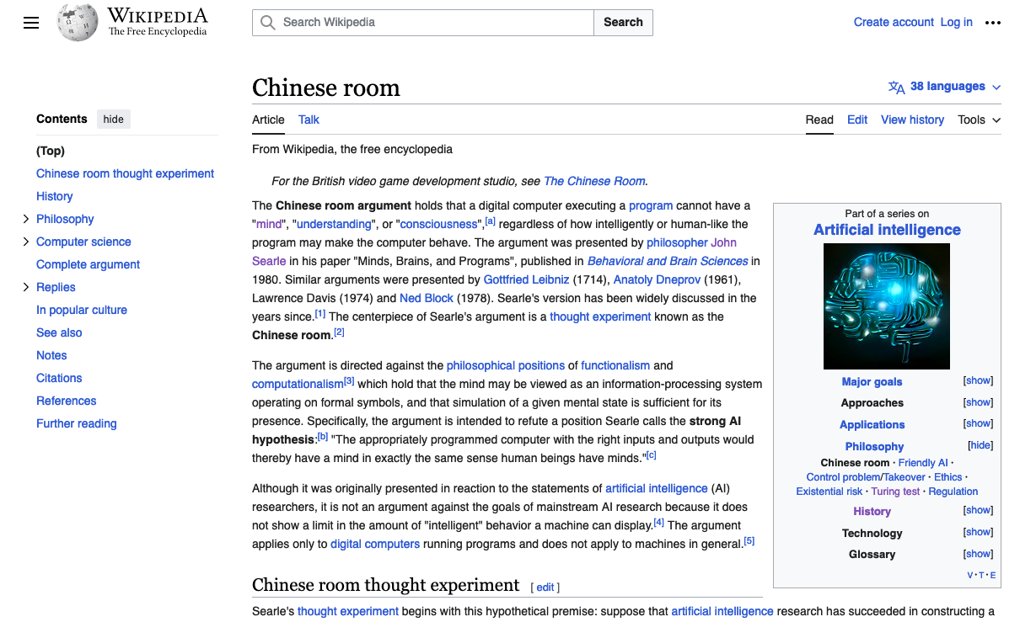
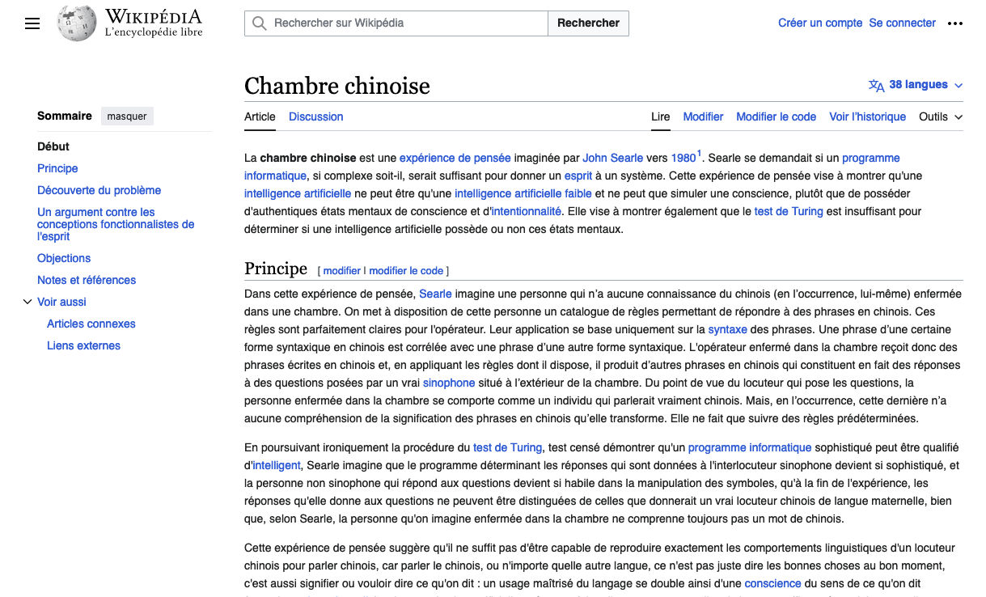

Slide 59
It understands nothing
Does it matter?

Slide 60
Statistical AIs are good
…but they cannot explain their reasoning

Slide 61
Other AI technologies can give explanations
Is that important?

Slide 62
What about a medical AI?
AI diagnoses condition A
  and corresponding treatment
Why did it not diagnose similar condition B?

Slide 63
If a medical AI can explain its reasoning does it understand medicine?

Slide 64
Summary
AI is Getting a machine to do something previously only done by people
We have had a quick run through some historical examples

Slide 65
Conclusions
ChatGPT understands nothing
Will computers ever understand anything?
Does it matter if they do?

Slide 66
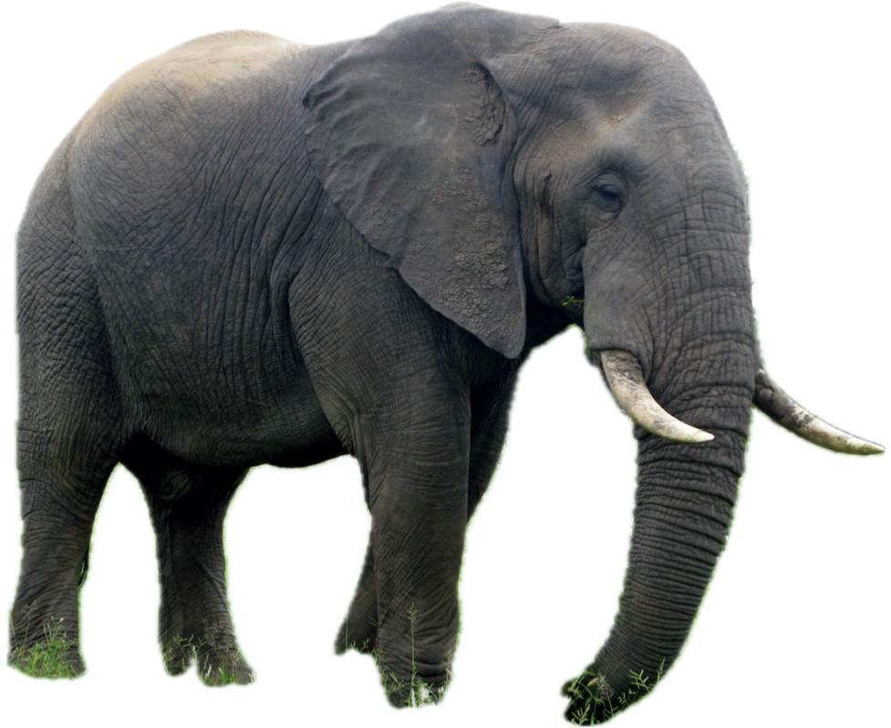
Question

Slide 67
Question
What does it mean ‘to understand’?

Slide 68
Questions
alistair.edwards@york.ac.uk

Slide 69
Questions and discussion
AI
  or anything else I can help with

Slide 70
Careers
Careers of some of our graduates

Slide 71
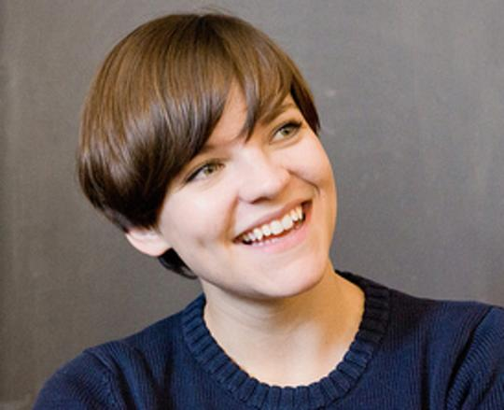
Careers
Principal Engineer in the Customer Products Team at the FT
Alice Bartlett

Slide 72
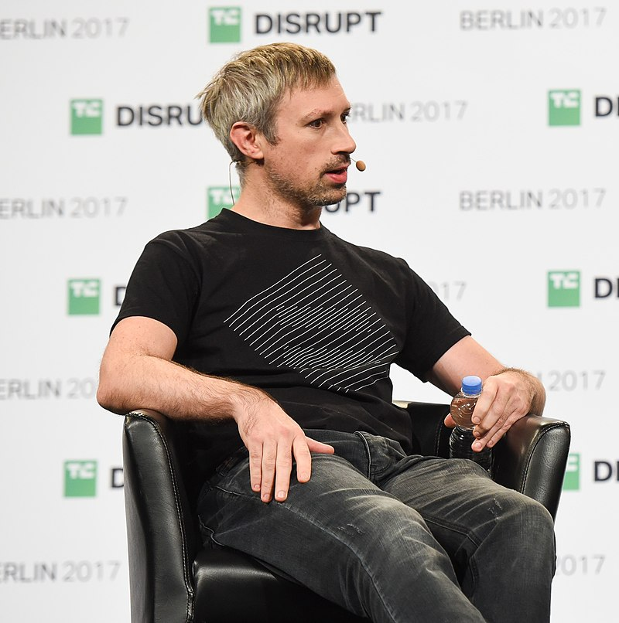
Careers
Co-founder of Ethereum and creator of Polkadot and Kusama - cryptocurrencies
Gavin Wood

Slide 73
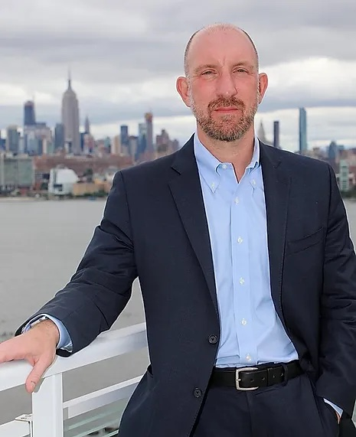
Careers
Vice-President for security at Google Cloud
Phil Venables

Slide 74
Careers
Web design and development
Professors/Lecturers
Research students
Teachers
Social media
UX (including Lego!)
Software engineering
Quality Assurance
Risk Advisor
Computer Support
Analysts
Consultant
Vicar
Sake evangelist

Slide 75
Understanding?

Slide 76
Understanding = comprehension?
Comprehension tests
Read a passage
Answer questions on it
Demonstrate you understood…

Slide 77
11+ comprehension question
Edward was forty-nine. He was a small, thin, stunted man, with a look of narrow cunning, of petty shrewdness. He had been a clerk to Lawyer Ford for thirty-five years and has also furtively practised for himself. At the age of fourteen he sat in a grimy room with an old man on one side of him, a copying-press on the other, and a law-stationer’s almanac in front, and he earned half a crown a week. At the age of forty-nine he still sat in the same grimy room and he earned thirty shillings a week. But now he, Edwards, was an old man, and the indispensable lad of fourteen, who had once been himself, was another lad, perhaps thirtieth of the dynasty of office boys. Throughout this interminable period he had written the same letters, kept the same accounts, lied the same lies, and thought the same thoughts. In the eyes of the townspeople he was a decent fellow, a confirmed bachelor, an excellent clerk and a thrifty individual.

Slide 78
Question 1
How old was Edward when he started work with Lawyer Ford, and how long had he been at the job?

Slide 79
3 answers
Mine
Model answer
Chat GPT’s
Can you tell which is which?

Slide 80
Answer A
Edward was fourteen when he started work with Lawyer Ford, and had been in the job for thirty-five years.

Slide 81
Answer B
Edward started working with Lawyer Ford at the age of fourteen, and he had been at the job for thirty-five years. Therefore, when the passage describes him at the age of forty-nine, it implies that he began working with Lawyer Ford when he was 49 - 35 = 14 years old.

Slide 82
Answer C
He was fourteen when he started work and had worked for thirty-five years.

Slide 83
Which was which?
A
B
C
Model answer
ChatGPT
Alistair Edwards

Slide 84
Question 2
‘Interminable’ means ‘endless’. What do you think made this period seem endless to Edward?

Slide 85
Answer A
Edward’s job was repetitive and monotonous.

Slide 86
Answer B
The use of the word ‘interminable’ suggests that Edward perceived his years of working with Lawyer Ford as seemingly endless or never-ending. The passage provides some insights into why this period might have felt that way for Edward. Throughout the thirty-five years, he engaged in repetitive and monotonous tasks, writing the same letters, keeping the same accounts, and thinking the same thoughts. The lack of variety and progression in his daily work might have contributed to a sense of monotony and the feeling that time was dragging on. Additionally, the description of Edward as a ‘small, thin, stunted man’ with a look of ‘narrow cunning’ and ‘petty shrewdness’ suggests that he may have felt trapped in a mundane and unfulfilling existence, contributing to the perception of an endless and dreary routine.

Slide 87
Answer C
This period seemed endless to Edward because he was working with only one other person so did not have people to talk to; he earned a low wage; the room he sat in was ‘grimy’; his work was repetitive/monotonous.

Slide 88
Which was which?
A
B
C
Alistair Edwards
ChatGPT
Model answer

Slide 89
Question 3
How do you know Edward lived before the present-day?

Slide 90
Answer A
You know Edward lived before the present day because of the reference to ‘shillings’ and ‘half a crown’.

Slide 91
Answer B
There are several clues. Firstly, money is expressed in shillings, and shillings ceased to be used from the 1970s. Furthermore the amounts are small by modern standards. Evidently at the time, thirty shillings was sufficient to live on for a week. Finally, the language and descriptions are dated.

Slide 92
Answer C
The passage doesn't explicitly mention the time period or the present-day, so any assertion about when Edward lived is an inference based on the information provided. However, certain phrases and descriptions in the passage may give clues that the setting is not in the present-day, at least as of my knowledge cutoff in January 2022.
For example, the mention of earning ‘half a crown a week’ and ‘thirty shillings a week’ suggests a time when British currency included crowns and shillings. The use of these older British currency units was more common in the past, and they are not part of the contemporary currency system. Additionally, phrases like ‘a lad of fourteen’ and the overall tone of the passage may evoke a sense of a bygone era.
It's important to note that the passage itself doesn't provide a clear time frame, and any conclusion about the time period is speculative based on contextual cues.

Slide 93
Which was which?
A
B
C
Model answer
Alistair Edwards
ChatGPT

Slide 94
Conclusions?
All answers would have got full marks?
ChatGPT’s answers are long
  Too long?
    Exam was timed

Slide 95
Conclusions?
Did ChatGPT understand/comprehend the passage?

