Slide 1
Genes and Genomes in Populations and Evolution
Population genomics and comparative genomics
molecular evolution
what happens at the level of DNA
when organisms change and evolve
Daniel Jeffares

Slide 2
Population genomics and comparative genomics
Part 1 (last lecture): Population genomics
Understanding genetic differences within a species.
Relates to topics from Autumn: GWAS, population genetics
mutation, genetic drift and molecular evolution
selection, maintenance of genetic variation
population structure
Part 2 (this lecture): Comparative genomics
Understanding differences between species

Slide 3
Review of concepts in population genomics
From last lecture
All the articles that I mention can be found here: https://paperpile.com/shared/RYh93p

Slide 4
Theta 𝚯 (from last lecture)
In the last lecture I showed this formula:
𝚯 = 4N_{e}μ
𝚯 is the population-scaled mutation rate (the product of the effective population size and the neutral mutation rate)
N_{e} is the effective population size
μ is the mutation rate
NB: 𝚯 (pronounced ‘theta’) and μ (pronounced ‘mu’) are Greek letters that are often used in population genetics. But not always! Tajima used M rather than 𝚯…
Notes:
Population-scaled mutation rate (the product of the effective population size and the neutral mutation rate)
from the observed nucleotide diversity of a population.

Slide 5
Why is 𝚯 important?
𝚯 = 4N_{e}μ
𝚯 can be estimated from population genomic data in two ways:
Watterson’s estimator of 𝚯 (𝚯_{W}): uses sample-size adjusted counts the number of polymorphic sites to estimate 𝚯.
Nucleotide diversity is another estimator (π, or 𝚯_{π}): uses the average pairwise difference to estimate 𝚯.
Because 𝚯 = 4N_{e}μ if we know 𝚯 and μ we can work out N_{e} the population size - just from DNA sequence data!
PS: Tajima’s uses the difference between these two estimators

Slide 6
Summary of important points
Population genomics methods are:
  Hypothesis/query
  Sample collection, DNA extraction
  Sequencing, read mapping, variant calling
  Analysis
Genome wide summary statistics:
  π (average pairwise diversity)
  Two measures of allele frequencies (MAF, DAF)
  Tajima’s D
  𝚯 = 4N_{e}μ
Population structure can be inferred from sequencing data
Linkage of alleles on chromosomes
Purifying selection: expectations and observations
Adaptive selection: expectations and observations
Polygenetic selection and genome-scale data

Slide 7
pause point 1
Next: comparative genomics

Slide 8
Comparative genomics

Slide 9
Part 2: Comparative genomics
This lecture: comparative genomics
  What is comparative genomics?
  How we gather the data.
  What can we find out from comparative genomics
  Concepts:
    Diversity within species gives rise to divergence between species
    Evolutionary rates
    Purifying selection (constraint): expectations and observations
    Adaptive evolution: expectations and observations, tests for selection
    Polygenetic selection and genome-scale data
  Case studies:
    Evolutionary constraint in mammalian genomes
    The McDonald-Kreitman test and evolution in the human genome
All the articles that I mention can be found here: https://paperpile.com/shared/RYh93p

Slide 10
What is comparative genomics?
Comparative genomics is the comparison of genomes between species
(population genomics looks at differences within species).
This involves analysis of:
gene orthologs/paralogs, gene family expansions
gene loss/gain
evolutionary rates of genes (fast/slow evolving genes)
conserved genic and non-genic regions
conservation/changes in synteny (gene order)

Slide 11
How we gather comparative genomics data
Sequence and assemble a genome
  assembly: connecting all short/long sequencing reads into continuous sequences (contigs), longer ‘scaffolds’ and perhaps chromosomes
Annotate your genome (identify gene starts, ends, exons, and identify gene types by homology)
Align/compare your genome to others:
  Whole genome alignment
  Using BLAST to locate similar genes (Basic Local Alignment Search Tool)
All of this work is produced on a linux server – not a PC/laptop.

Slide 12
What we can find out from comparative genomics
Which genes have been lost in a lineage
Which genes have been gained
Which are the fastest evolving genes
Conserved genic and non-genic regions
How a species may have evolved to adapt to some new niche
Nygaard 2010

Slide 13
Concepts in comparative genomics

Slide 14
Concept: Diversity and divergence are related
Genetic diversity is: differences within a species
Divergence is: differences between species
Genetic diversity within species gives rise to divergence between species.
mutation arises
fixed in population
*
*
mutation arises
fixed in population
*
mutation arises
fixed in population
Two populations separated
Gene flow much more limited
Graduation ‘fixation’ of polymorphisms
gradually makes the two populations different
*
mutation arises
fixed in population
*
mutation arises
fixed in population
one species
(contains some genetic variation)
Only a few mutations become fixed in the population.
Most are lost by drift or purifying selection.
Fixation: when a polymorphism become present in all individuals in a species (or population)

Slide 15
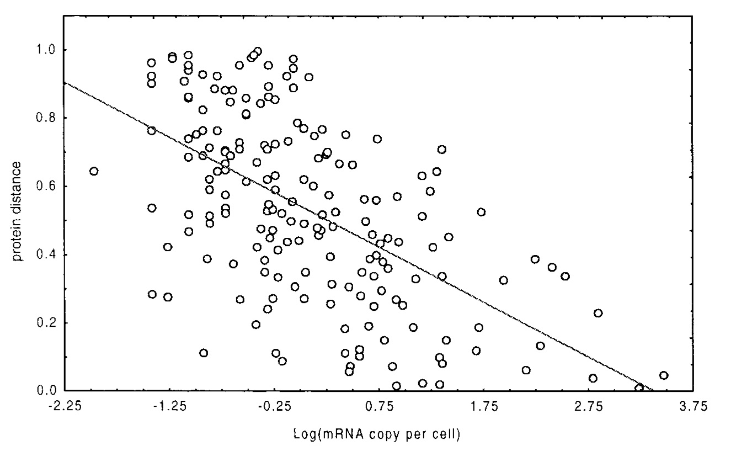
Concept: Evolutionary rates
The evolutionary rate is the number of differences that occur over time.
Or: how many mutations are ‘fixed’ in a population over time.
Measured via alignments.
Different genes have different evolutionary rates.
Rates of change differ within a protein too: important domains of proteins evolve more slowly than less-important domains.
Evolutionary rates can be affected by:
How important a gene is to the cell (essential genes evolve slowly)
The expression level of the gene
The structure of the protein (the outsides of proteins evolve fast, insides slow)
Highly expressed gene evolve more slowly.
Substitutions = number of mutational changes, same as number of fixed polymorphisms
Pal 2001

Slide 16
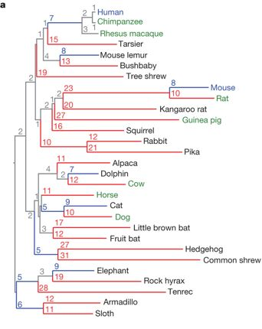
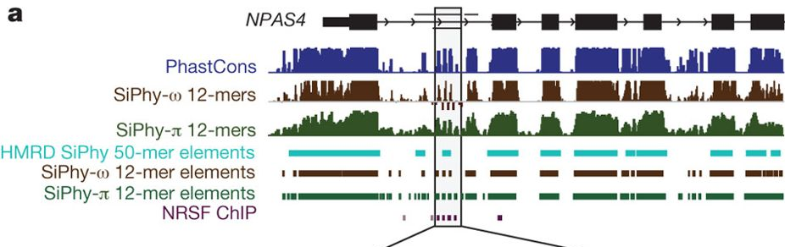
Concept: Purifying selection (sometimes called negative selection)
Selection to remove deleterious (bad, harmful) mutations
Over time, this will result in slower rates of evolution in regions of genomes with more essential functions
This can be detected in genome alignment by look for regions that remain the same between species
(remember that this signal comes from the population genetic process of removal of deleterious mutations)
Slower rates of evolution result in more important regions being conserved (more similar).
These slow rates of evolution can be detected in genome alignments using various methods.
Lindblad-Toh 2011 aligned the genomes of all the mammals in this tree.

Slide 17
Genetic code and synonymous or nonsynonymous changes
Synonymous change
Does not change the amino acid encoded for
TCT -> TCC
SER -> SER
Nonsynonymous change
Does change the amino acid encoded for
TCT -> TTC
SER -> PHE
Nonsynonymous change are more likely to have functional consequences, and these will generally be deleterious.
They are therefore removed from populations more rapidly.
So the the rate of nonsynonymous change will be slower than the rate of synonymous change.

Slide 18
Concept: Adaptive evolution (sometimes called positive selection)
Some genes/genomic regions evolve to have new/improved functions.
This is one path to adaptation.
Such genes change faster than we expect by chance.
Various tests have been designed to detect such regions from genome/gene data.
The dN/dS test (or Ka/Ks test):
  dN: the rate of non-synonymous changes (change the amino-acid coding of a gene)
  dS: the rate of synonymous changes (do not change the amino-acid coding of a gene)
  Genes that change their function rapidly may have a higher dN than dS (so dN/dS > 1)
McDonald-Kreitman test:
  Use for detecting adaptive change between species
  And for detecting balancing selection within a species

Slide 19
Synonymous or nonsynonymous change: dN/dS
Synonymous change
Does not change the amino acid encoded for
TCT -> TCC
SER -> SER
Nonsynonymous change
Does change the amino acid encoded for
TCT -> TTC
SER -> PHE
The dN/dS measure
dS is the rate of synonymous change (eg: per gene)
Because synonymous changes do not affect the protein produced, most will have little or no effect on the fitness of the organism. They are selectively neutral. They will accumulate with a constant rate per time (clock-like)
If the species are far apart, this rate will need to be corrected for ‘multiple hits’, using a statistical model of sequence change*.
dN is the rate of nonsynonymous change (eg: per gene)
Nonsynonymous changes do affect the protein produced. Most will be deleterious, and so lost. So the dN rate will generally be slower than dS.
Hence dN/dS is generally less than 1.
If dN is > dS, there has been many nonsynonymous changes.
This is rare and is a signature of adaptive evolution.
*There are other corrections, for example nucleotide content and the possible number of possible synonymous changes given the gene sequence.
What if dN/dS = 1?

Slide 20
Concept: Polygenic selection and genome-scale data
In the Quantitative genetics and GWAS workshop we saw that SNPs in many genes can affect a trait
So adaptation may cause gradual/subtle changes in many genes.
We can detect such changes by looking for concerted signals over certain categories of genes that work together.
Evolutionary rates (the dN/dS) of Plasmodium genes are differ between cellular compartments.
Exported proteins evolve the most rapidly.
Jeffares 2007

Slide 21
pause point 2
Next: case studies

Slide 22
Case study: The McDonald-Kreitman test
Bustamante 2005
All the articles that I mention can be found here: https://paperpile.com/shared/RYh93p

Slide 23
The McDonald-Kreitman test
The McDonald-Kreitman test explicitly tests the assumption that diversity within a species gives rise to divergence between species.
It assumes that each gene has a stable ratio of:
  Synonymous (non-amino acid altering) polymorphisms
  Non-synonymous (amino acid altering) polymorphisms
That gives rise to the same ratio of:
  Synonymous (non-amino acid altering) fixed mutations
  Non-synonymous (amino acid altering) fixed mutations
We test this assumption using a chi-squared test, like so:
time
 | Polymorphic | Fixed
Synonymous | P_{s} | D_{s}
Nonsynonymous | P_{n} | D_{n}
See: McDonald-Kreitman test entry in Wikipedia

Slide 24
The McDonald-Kreitman test
Short time scale
Polymorphisms are mostly transient
Long time scale
Between species.
For a gene that is evolving neutrally, the ratio will be consistent, eg:
 | Polymorphic | Fixed
Synonymous | 10 | 100
Nonsynonymous | 2 | 20
The test has two interpretations when the ratios are not consistent
 | Polymorphic | Fixed
Synonymous | 10 | 100
Nonsynonymous | 2 | 50
When there are excess nonsynonymous fixed differences:
The interpretation is: adaptive evolution between species.
When there are excess nonsynonymous polymorphisms within a species.
The interpretation is: balancing selection to maintain different nonsynonymous differences within the species.
 | Polymorphic | Fixed
Synonymous | 10 | 100
Nonsynonymous | 20 | 20

Slide 25
The McDonald-Kreitman test and adaptation in the human genome
Bustamante et al 2005 Conducted MK tests for all human genes, using:
Divergence data between human and chimp
Polymorphism data from humans.
They found that 304 (9.0%) out of 3,377 potentially informative genes
showed evidence of rapid amino acid evolution.
They estimate the population genetic selection parameter (𝛾) from the MK tables.
𝛾 is negative if a gene shows an excess of amino acid polymorphism and positive if a gene has an excess of amino acid divergence relative to the genomic average for synonymous sites.
Bold text= positively selected genes
Non bold: balancing/weak selection.

Slide 26


Case study: The Impact of Protein Architecture on Adaptive Evolution
Using the MK test (and other calculations) it is possible to estimate:
  the nonsynonymous* substitutions (NSS) the rate of nonadaptive NSS’s
  the rate of adaptive NSS’s
  the proportion of adaptive substitutions
Arabidopsis thaliana
Drosophila melanogaster
substitution: a change in sequence between one species and another
nonsynonymous substitutions change the amino acid sequence of the protein
See Moutinho 2013 here: https://paperpile.com/shared/RYh93p

Slide 27
Case study: The Impact of Protein Architecture on Adaptive Evolution

Slide 28
Case study: The Impact of Protein Architecture on Adaptive Evolution
rate of protein change (ω)
rate of
non-adaptive protein change (ω_{na})
rate of
adaptive protein change (ω_{a})
more exposed parts of proteins evolve faster
and
have more adaptive changes

Slide 29
Case study: The Impact of Protein Architecture on Adaptive Evolution
rate of protein change (ω)
rate of
non-adaptive protein change (ω_{na})
rate of
adaptive protein change (ω_{a})
highly expressed proteins evolve faster
but
do not have more adaptive changes
By looking at evolutionary rates genome-wide we can start to see the principles and trends of molecular evolution

Slide 30
Summary of important points
Methods in comparative genomics:
  Hypothesis or clade (species group) of interest
  Obtain high quality DNA from multiple species
  Sequence, de novo assemble and annotate genomes (+extra data, like RNAseq)
  Align genomes
  Analyse
Important concepts
  Diversity and divergence are related
  Evolutionary rates vary between genes
  Purifying selection (constraint): expectations and observations
  Adaptive evolution: expectations and observations, tests for selection
  Polygenetic selection and genome-scale data
  With genome-scale data, we can observe principles of molecular adaptation

