Slide 1
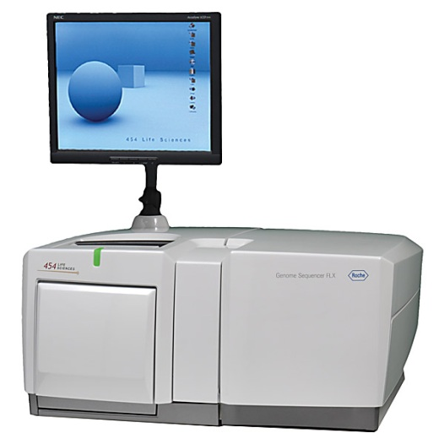
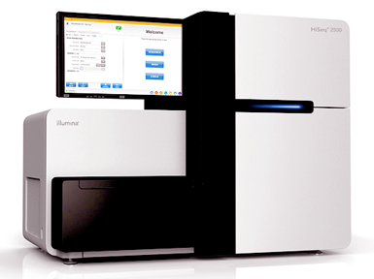
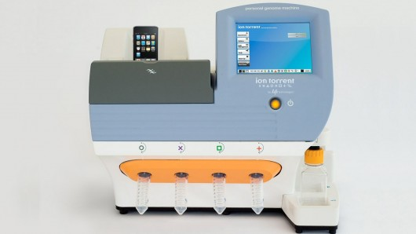
BIO00058M: Sequence Analysis
Lecture 2
High-throughput sequencing Part 1
Daniel Jeffares

Slide 2
Confused?
Here’s what to do
First, check the workshop manuals.
Then use google: bioinformatics problems/solutions are very well documented on the internet (bioinformatics geeks love the internet)
Then, use the discussion board on the VLE:
(called the sequence analysis forum).
  Feel free to reply to comments to help each other out.
  Teaching staff will reply to questions posted here – but NOT 24/7, so please be patient with replies.
Then, email/come and see me: daniel.jeffares@york.ac.uk
All the primary literature that I mention are in a Paperpile collection.
See the Articles tab in the VLE for the link

Slide 3
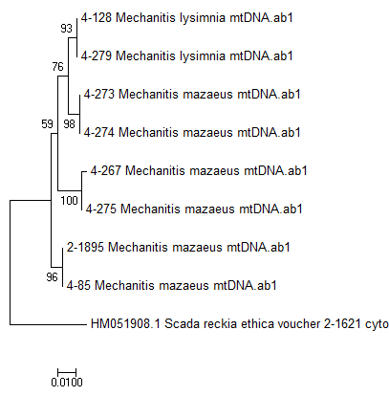
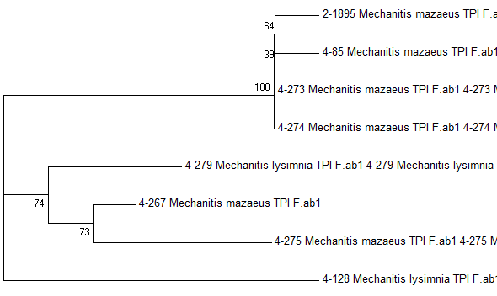
Workshop 1 trees
a) Are there differences between the mtDNA and nuclear trees?
b) Why might there be differences between these trees
c) Is there any evidence for cryptic species? If so, how many cryptic species do you think there are?
d) What evidence would you need to determine whether or not these were truly different species?
mtDNA NJ tree
TPI NJ tree

Slide 4
L2 + W2: Learning objectives
Be aware of the current main Next Generation Sequencing technologies
Be aware of the advantages and disadvantages of each technologies
Understand the FastQ sequence output from these technologies
Know how to quality check and clean FastQ files
Have an understanding of de novo assembly
Have an understanding of resequencing genomes

Slide 5
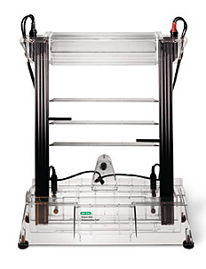
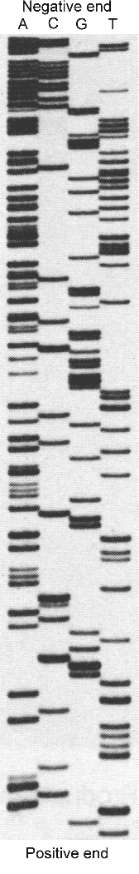
A brief history of sequencing: 1977-1988
First generation
A
C
G
T
G
T
T
A
T
C
A
G
T
A
C
A
T
A
C
G
T
Sanger sequencing
(radioactive chain-termination)
“Just a guy who messed about in a lab.”
Fred Sanger

Slide 6
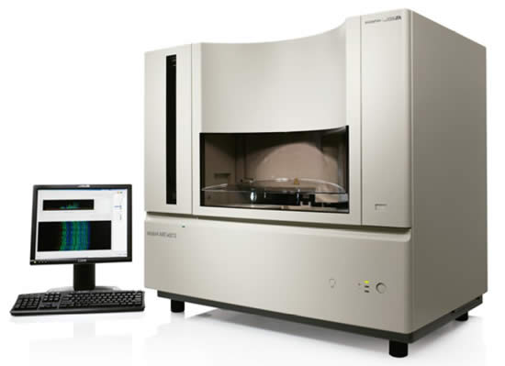
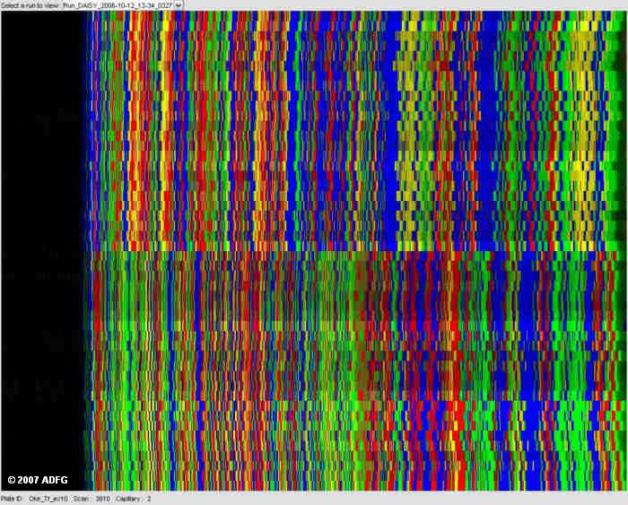
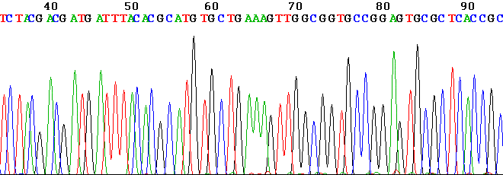
A brief history of sequencing: 1988-2002
First generation
Sanger sequencing
(fluorescent chain-termination)
3 hours for 100kb

Slide 7
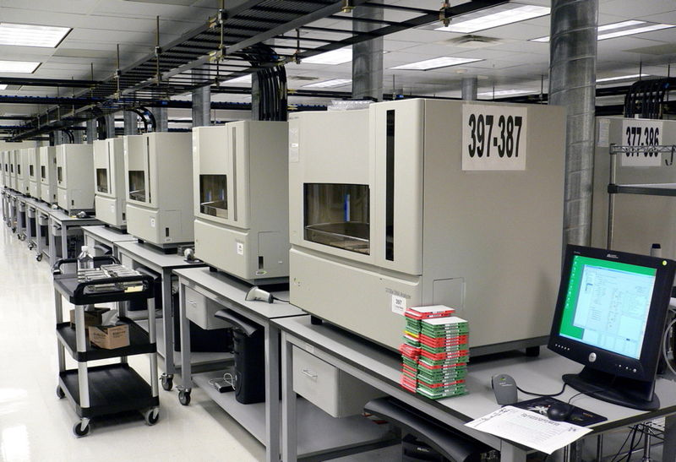
Sequencing Centre of the past.
First generation

Slide 8
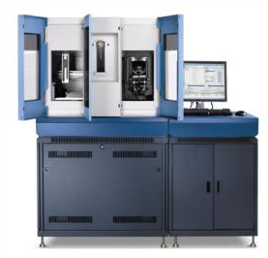

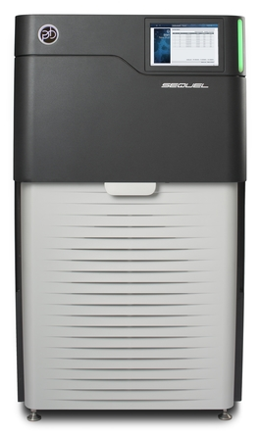


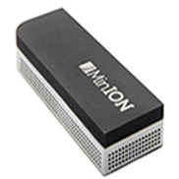
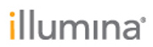

A brief history of sequencing: 2002-2016
ABI SOLiD
Long ‘reads’,
More base-call errors
HiSeq
Short ‘reads’,
Least base-call errors
Longest ‘reads’,
Most base-call errors

Slide 9
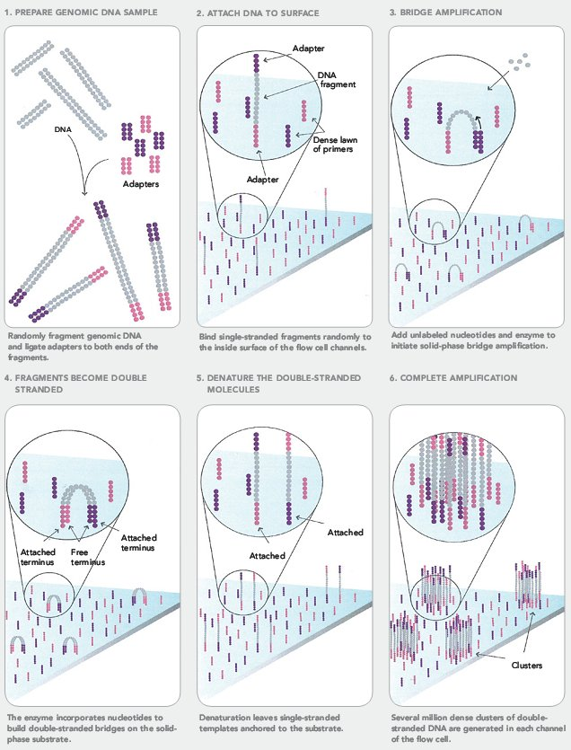
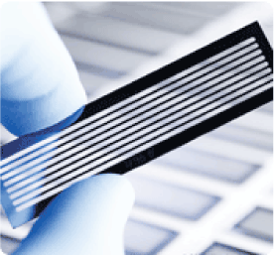
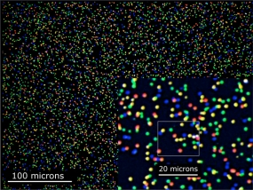
Illumina sequencing
‘next’ generation sequencing (NGS)
https://www.youtube.com/watch?v=womKfikWlxM

Slide 10
Illumina sequencing
‘next’ generation sequencing (NGS)
Illumina sequencing is currently the workhorse of most genomic and functional genomic projects.
Advantages
Very cheap per bp
Huge output: 600Gb/day
Low error rate
Disadvantages
Short read lengths: 2 x 150bp
Sequencer machine is very expensive
Main uses:
Re-sequencing genomes of populations (people, mice, bacteria, viruses, yeast, fish, fruit flies, Plasmodium, Leishmania*)
de novo assembly of small genomes (bacteria etc)
polishing (correcting) long-read assemblies (PACBIO, ONT)
Many other uses in functional genomics: RNAseq, ChipSeq, 3C, BarSeq, TnSeq
Metagenomics
* You will get your hands on some Leishmania data

Slide 11
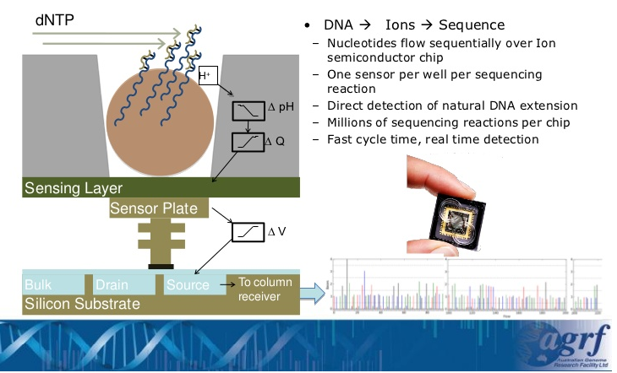
IonTorrent
‘next’ generation sequencing (NGS)
IonTorrent works by detecting the voltage (pH) change in wells as bases are sequentially washed over immobilised fragments, and then incorporated into a complementary DNA strand. It is similar to Illumina, and old-school Sanger sequencing in that it uses ‘sequencing by synthesis’

Slide 12
IonTorrent
‘next’ generation sequencing (NGS)
Ion Torrent is seldom used now
(I have never used it).
But the market changes all the time.
Advantages
Sequencer relatively cheap
Relatively fast (4-7 hrs)
Disadvantages
Homopolymer errors
400bp sequence length
1.2 – 2 Gb
Main uses: Small sequencing projects. Microbial genome sequencing. Metagenomics
Watch an ad from Thermo Fisher Scientific, about IonTorrent https://www.youtube.com/watch?v=WYBzbxIfuKs

Slide 13
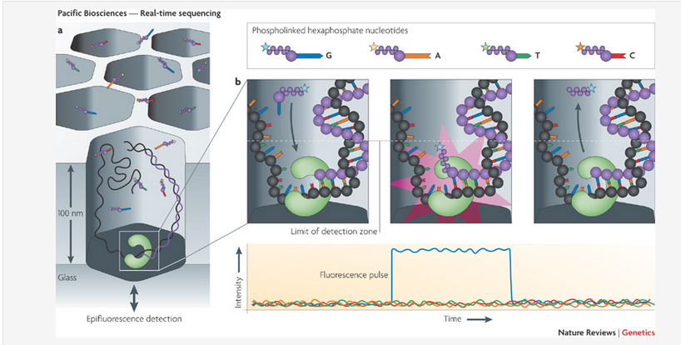
PacBio sequencing
Third generation sequencing
PacBio sequencing works by incorporating modified, fluorescently labelled, DNA bases in un-fragmented DNA, and detecting the flash of light.
See an advert from Pacific Biosciences:
https://www.youtube.com/watch?v=v8p4ph2MAvI

Slide 14
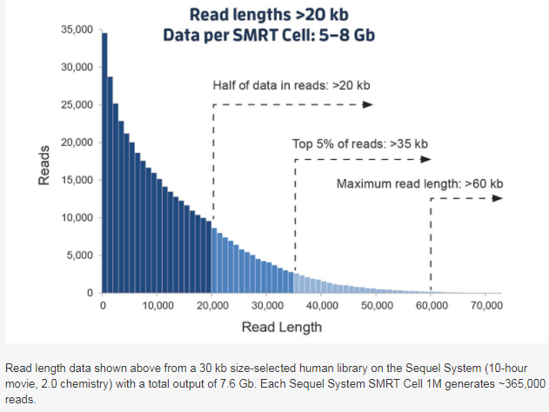
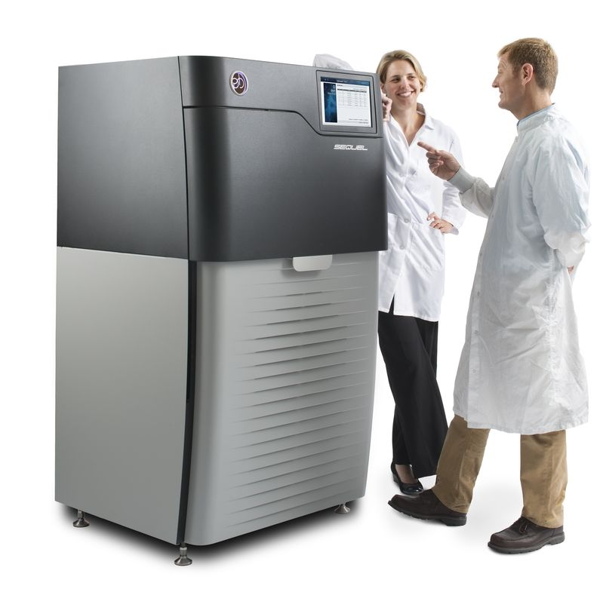
PacBio sequencing
Third generation sequencing
Advantages
Long read lengths
10-15 kb; 40 kb
Disadvantages
High error rates: 1.7%
Sequencer is expensive
Modest sequence output
Main uses: Genome assembly, transcriptomes

Slide 15
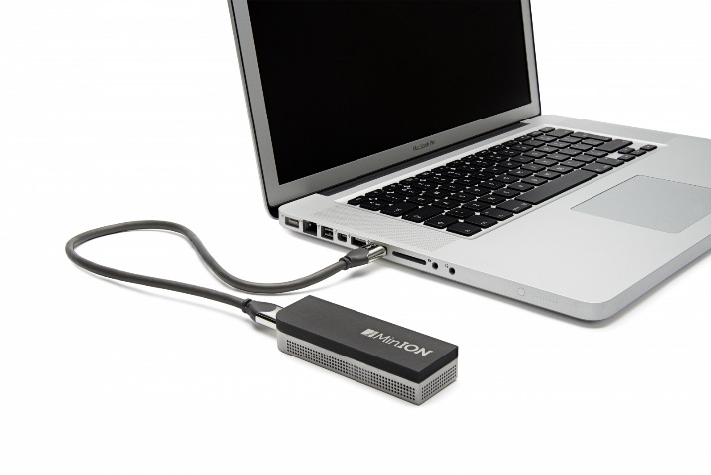
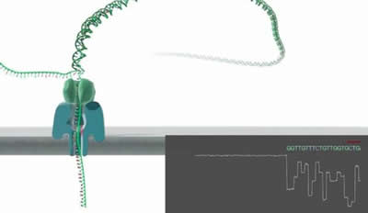
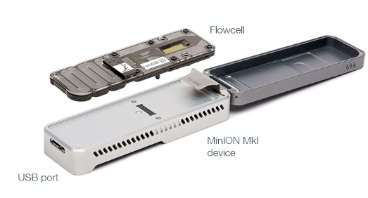
Nanopore sequencing
Third generation sequencing
Oxford Nanopore Technology
See: https://nanoporetech.com/how-it-works

Slide 16
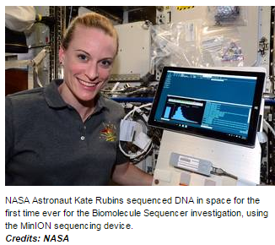
Nanopore sequencing
Third generation sequencing
Oxford Nanopore Technology (ONT) is in very rapid development right now. Sequencing is being transformed (again!).
Advantages
Very long read lengths
3 kb; 28 kb (2015)
7.5 kb; 117 kb (2016)
Portable (has been used in caves)
Sequencer is cheap
In rapid development now
Disadvantages
High error rates: 2-13%
Expensive per bp of sequence (but coming down, close to Illumina)
Main uses:
Microbial genomics
Genome assemblies
Transcriptomes

Slide 17
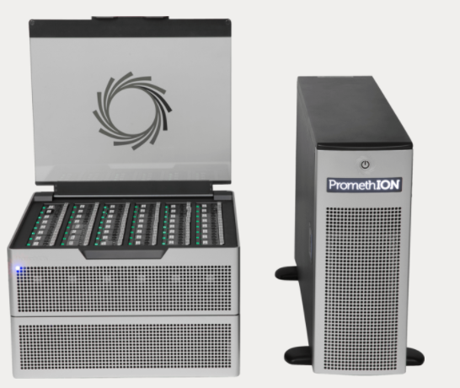
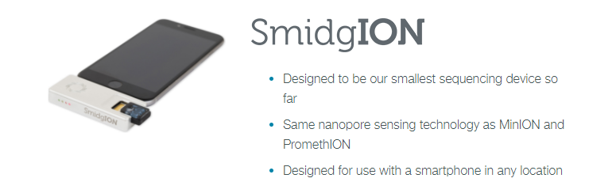
Nanopore sequencing. What next?
The PromethION machine
48 flow cells
3000 nanopores per flow cell
Huge output promised, almost delivering.
See Weirather et al. in the reading list on the VLE for a comparison of ONT and PACB.
And also: van Dijk et al. for a summary or 3rd gen.
At the moment Nanopore technology is developing very fast.
Output is increasing, error rates decreasing.

Slide 18
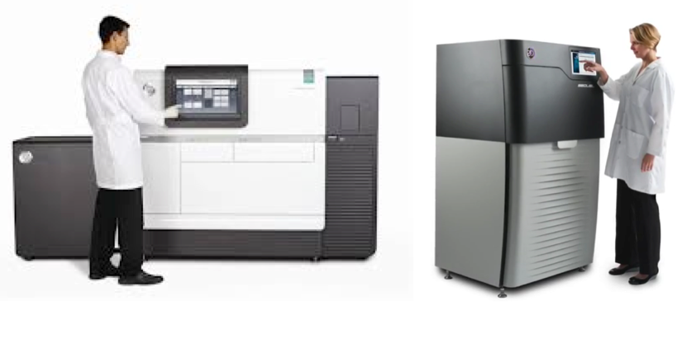
Sequencing now
At this point in time this is what we do:
Sanger sequencing Using ABI machines.
Technology of choice for low- to medium output sequencing
Eg: checking plasmids, small-scale population surveys
Illumina:
Technology of choice for genome re-sequencing (of populations)
Widely used for small de novo genome assemblies, RNA-seq (sequencing transcriptomes), chip-seq, 3C, metagenomics
Pacific BioSciences (PACBIO)
One technology of choice for genome assemblies.
Produces fairly long, fairly accurate reads
Oxford Nanopore
One of the technologies of choice for genome assemblies.
Produces the longest reads
Has the worst error rate
Is developing very fast
Next year this slide will be different!

Slide 19
Read more.
Read more about the ultra-competitive world of NGS here:
https://labiotech.eu/medical/ngs-dna-sequencing-illumina-qiagen/
And about long read sequencing here:
https://doi.org/10.1016/j.tig.2018.05.008
(Also in the Paperpile collection, see the VLE)

Slide 20
Fastq files and FastQC
Next/3rd gen sequence produce ‘fastq’ files
  Bases and a measure of the quality of each base
Quality scores enable users to check the quality their reads, and get rid of bad quality data
Information about the fastq format and Phred-scores at:
http://en.wikipedia.org/wiki/FASTQ_format
http://en.wikipedia.org/wiki/Phred_quality_score

Slide 21
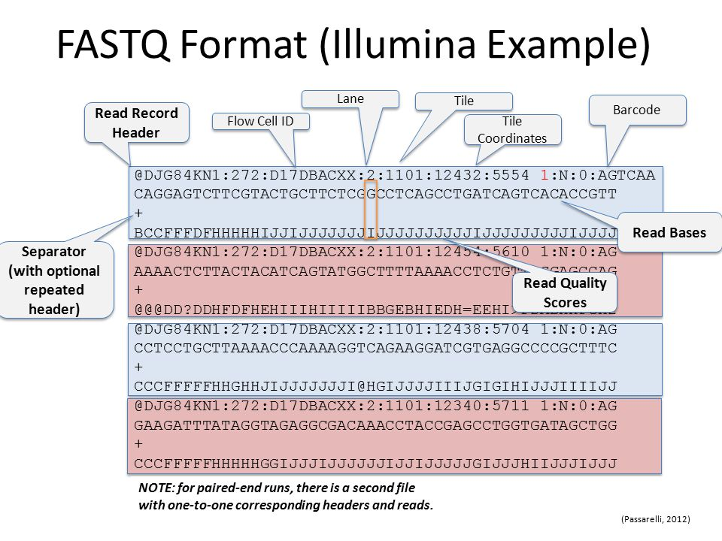
Fastq file ‘anatomy’
NB: Each ASCI letter is assigned a phred score, see here: https://support.illumina.com/help/BaseSpace_OLH_009008/Content/Source/Informatics/BS/QualityScoreEncoding_swBS.htm

Slide 22
40 billion bases….what do I do with them?
Fastq files (reads) are not useful by themselves.
They are generally either used for:
de novo assembly:
  reads are assembled (joined together) into longer sequences, using the short sub-sequences that match.
  This is less common with short reads
Mapping to a reference genome
A reference genome is a completed, annotated genome
For analysis of genetic diversity
For analysis of transcriptomes (called RNA-seq)
For many many other things.
These analyses often need multiple steps (’pipelines’) to get to the biologically-relevant data. The next slide shows one such pipeline, for analysis of genetic diversity.

Slide 23
40 billion bases….what do I do with them?
Clean/trim
sequences
cutadapt, Reaper, Trimmotomatic
Check average
quality statistics
FastQC
Fastq files
(reads)
de novo assembly
SGA
Velvet
CLCbio
Compare to other sequences/genomes
BLAST, Cactus Genome-alignment
Annotate (locate and mark up the genes)
Augustus
Align to a
reference genome or
transcriptome
BWA
NextGenMap
Novoalign
Structural variant ‘calling’
Delly, GenomeSTRiP, Lumpy
Remove
PCR
Duplicates
Picardtools
Samtools
SNP and indel ‘calling’
GATK, Samtools, Freebayes
Make vcf files (variant call format)
Makes a sam or bam file
Sam: sequence alignment map
Bam: a binary sam
VCF filtering
vcftools, GATK
Biological analysis
vcftools, Admixture
Many, many others

Slide 24
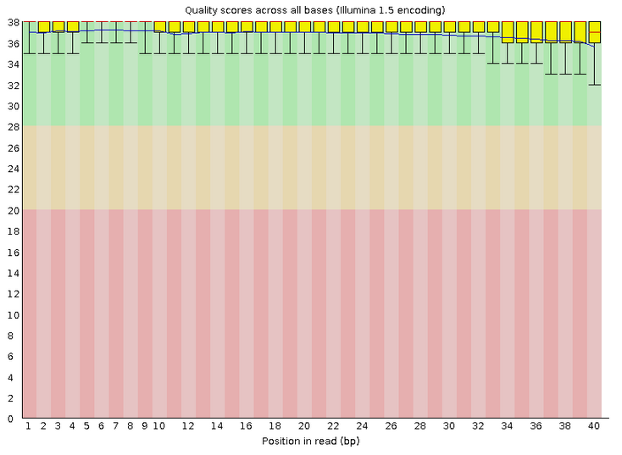
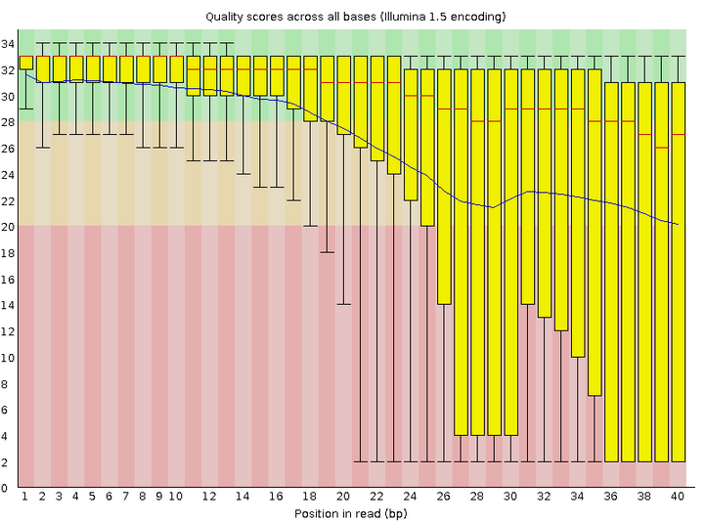
FastQC: quality filtering
GOOD SEQUENCES BAD SEQUENCES
How long are these reads?
What the phred score?

Slide 25
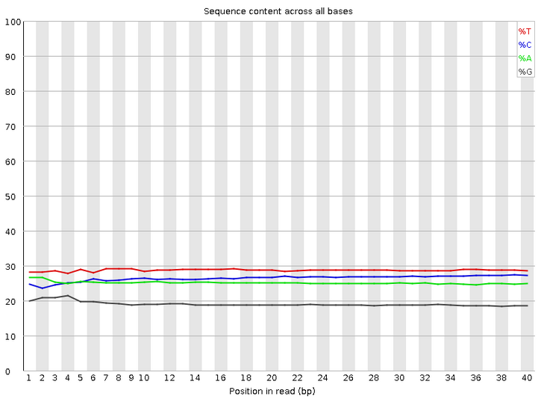
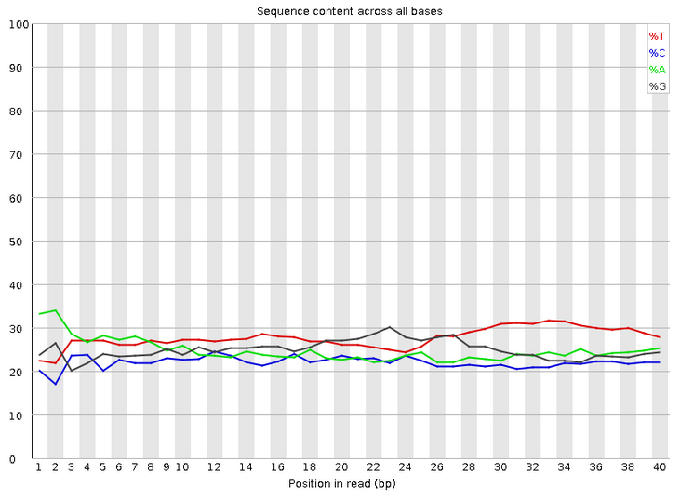
FastQC: quality filtering
GOOD SEQUENCES BAD SEQUENCES

Slide 26
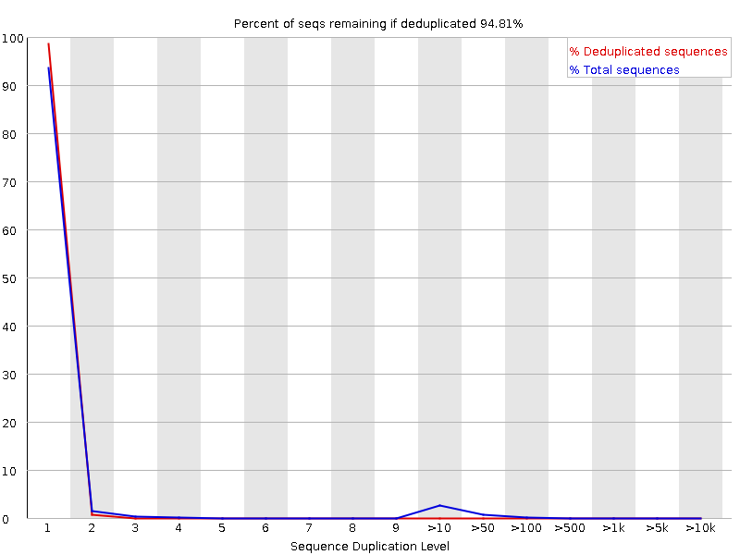
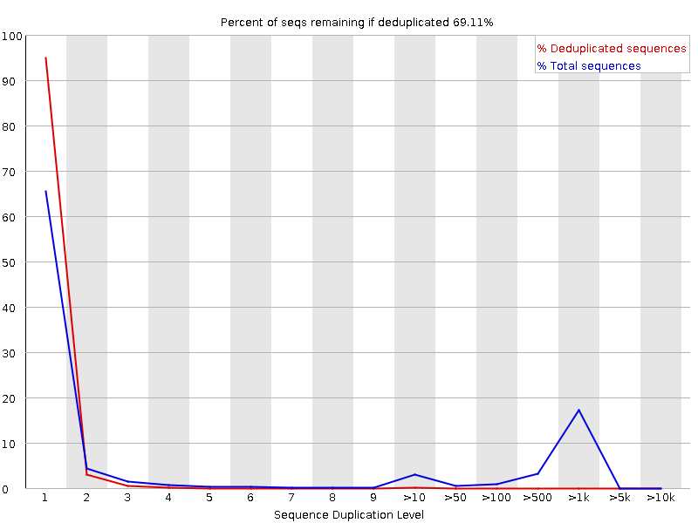
FastQC: quality filtering
GOOD SEQUENCES BAD SEQUENCES
Info about fastqc
http://www.bioinformatics.babraham.ac.uk/projects/fastqc/Help/3%20Analysis%20Modules/

Slide 27
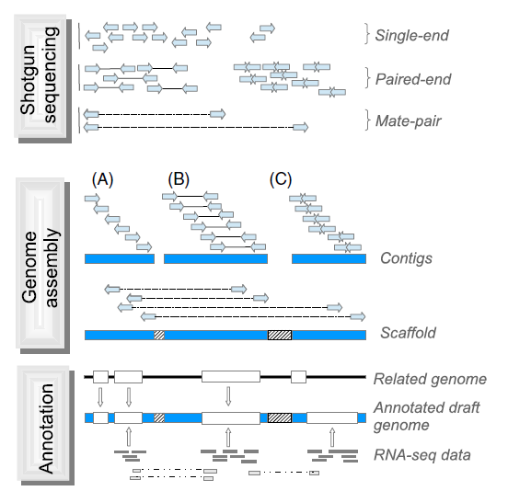
genome sequencing, assembly and annotation
These days whole genome assembly is done with long reads.
PACBIO (Pacific Biosciences)
ONT (Oxford Nanopore Technologies)
Ekblom & Wolf (2014) A field guide to whole-genome sequencing, assembly and annotation.
Evolutionary Applications 7: 1026-1042.

Slide 28
Whole genome ‘resequencing’
Usually used to collect information about diversity within a species (other uses also possible)
Mapping/aligning to an existing reference genome
Computationally easier than de novo assembly
Much cheaper than de novo assembly
These projects can have impressive scales:
The 100,000 Genomes Project will sequence 100,000 genomes from around 70,000 people. Participants are NHS patients with a rare disease, plus their families, and patients with cancer.
See:
https://www.genomicsengland.co.uk/the-100000-genomes-project/
In workshops and group projects we will use some population sequencing data from the parasite Leishmania infantum.
This data is unpublished – please do not share it.
Read about this species here: https://en.wikipedia.org/wiki/Leishmania_infantum

Slide 29
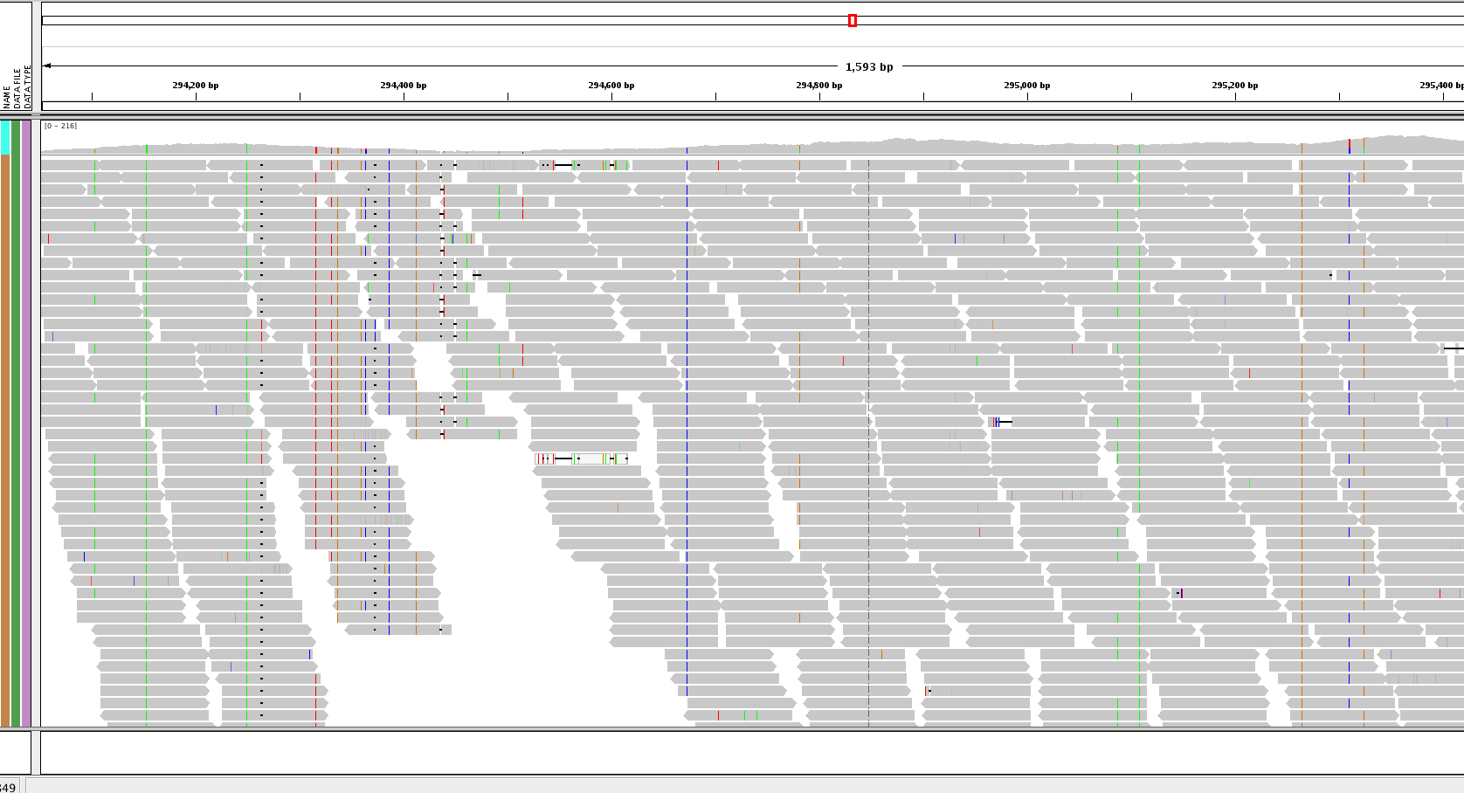
Whole-genome resequencing
When it goes well

Slide 30
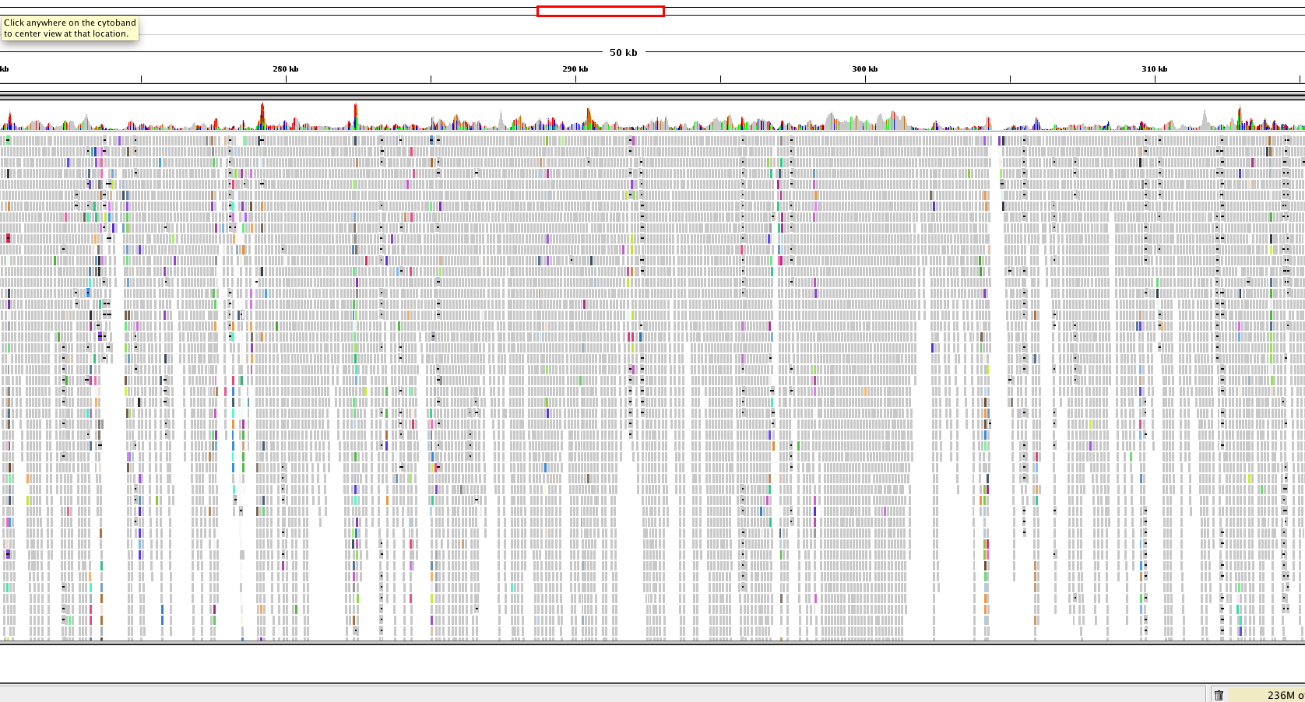
Whole-genome resequencing
When it goes badly
Why?

Slide 31
Aligning to a reference genome
Many aligners available
  BWA: for less divergent sequences (fast)
  NextGenMap: for more divergent sequences
SAM: Sequence Alignment/Map format
BAM (binary, compressed SAM)
The SAM file format
See: https://samtools.github.io/hts-specs/SAMv1.pdf

Slide 32
@SQ SN:chr1 LN:278268
@SQ SN:chr2 LN:356299
@SQ SN:chr3 LN:389660
@SQ SN:chr4 LN:466506
@SQ SN:chr5 LN:467711
@SQ SN:chr6 LN:525234
@SQ SN:chr7 LN:592865
@SQ SN:chr8 LN:515744
@SQ SN:chr9 LN:581921
@SQ SN:chr10 LN:588571
@SQ SN:chr11 LN:568610
@SQ SN:chr12 LN:593479
@SQ SN:chr13 LN:659809
@SQ SN:chr14 LN:656122
@SQ SN:chr15 LN:650312
@SQ SN:chr16 LN:688194
@SQ SN:chr17 LN:690898
@SQ SN:chr18 LN:720421
@SQ SN:chr19 LN:706116
@SQ SN:chr20 LN:731246
@SQ SN:chr21 LN:764851
@SQ SN:chr22 LN:782138
@SQ SN:chr23 LN:786675
@SQ SN:chr24 LN:863800
@SQ SN:chr25 LN:895070
@SQ SN:chr26 LN:1055294
@SQ SN:chr27 LN:1175405
@SQ SN:chr28 LN:1205018
@SQ SN:chr29 LN:1272412
@SQ SN:chr30 LN:1353282
@SQ SN:chr31 LN:1529233
@SQ SN:chr32 LN:1544753
@SQ SN:chr33 LN:1532280
@SQ SN:chr34 LN:1852060
@SQ SN:chr35 LN:2019666
@SQ SN:chr36 LN:2743046
@RG ID:S3 SM: S3 PL:Illumina
@PG ID:bwa PN:bwa VN:0.7.17-r1188 CL:bwa mem -t 2 -R @RG\tID:S3\tSM: S3\tPL:Illumina LinJ_cbm_v1.fasta Sample3_R1_fastq.q20.gz Sample3_R2_fastq.q20.gz
J00125:7:HJ772BBXX:5:1101:3437:1332 83 chr31 361505 0 151M = 361476 -180 TCACCCACGACGCCACACCGCATCGCGTCCACTCGGTAGGAAGAGGGAGAGACGCAAGGGGGAGGGGGGAGGCGGCGAGGAAGGGAGGACACCGGGCGCAAGAGACGACGCAGAAGATAAGCCACAAACAAGAGGGAGAGAGGAGGAGNAG 7AJAF<FFFJJJFJJJ<JJJJJJJJJJJJFFAFJJFJJJJJJJJJFJJJJJJJJJJJJJJJJJJJJJJJJFJJJAFJJJAJJJJJJJJJAJJJJJJFF<JJJJJJJJJJJJJJJJJJJJJJJJJJJJJJJJJJJJJJJJFFF7JFJFF#AA NM:i:1 MD:Z:148G2 MC:Z:151M AS:i:149 XS:i:149 RG:Z:S3 XA:Z:chr31,-353856,151M,1;chr31,-369151,151M,1;
J00125:7:HJ772BBXX:5:1101:3437:1332 163 chr31 361476 0 151M = 361505 180 CTCGGCGTGATTGCGTTTGCTCCGTCCCTTCACCCACGACGCCACACCGCATCGCGTCCACTCGGTAGGAAGAGGGAGAGACGCAAGGGGGAGGGGGGAGGCGGCGAGGAAGGGAGGACACCGGGCGCAAGAGACGACGCAGAAGATAAGC AAFFFJ<AJJJJJJJJJJJJJJJJJJFJJJJJJJJJJJJJJJJJJJJJJJJJJJJJJJJJJJJJJJJJJJJFFJ-FJFFJJJFFJJJ7F<FAFAJF-<A<JFFAAAJJJJ<FJ<AA-AAJAAF--<-<JJJJ-F-AF7-7AAAFJJ<FJ-7 NM:i:0 MD:Z:151 MC:Z:151M AS:i:151 XS:i:151 RG:Z:S3 XA:Z:chr31,+353827,151M,0;chr31,+369122,151M,0;
J00125:7:HJ772BBXX:5:1101:5203:1332 99 chr22 572045 60 150M = 572202 307 AANCCGGAAGGCAGTGTATGGACGAAGCACCTGAGCTGTCGAGTAGGTACAGAGAAAGACAGACACACAGAGGGCGGAGGGAAGGGGGAGGCACGCGCGTGCTGTTGCTGATTATACCGCCTTTGTTTTCTGGCTTCTCTTATTCGCTTT AA#FFJJJJJJJJJJJJJJJJJJJJJJJJJJJJJJJJJJJJJJJJJJJJJJJJJJJJJJJJJJJJJJJJJJJJJJJFJJJJJJJJJFFJJJJJJFFJJJJJJJJJJJJJJJJJJJFJAAFFFFJJJJJJJJAAA7FJFFFFJFFA<F7<F NM:i:1 MD:Z:2G147 MC:Z:150M AS:i:148 XS:i:0 RG:Z:S3
J00125:7:HJ772BBXX:5:1101:5203:1332 147 chr22 572202 60 150M = 572045 -307 GTTGTTTGATGTGCGTGTGTGCTTGTGCGGCTCCCGGCATGTGCCACCGTGATAATGGTGGTGGTAGTGGTGGTACGTGCGAAGAGCAGCACCGACGAACGTGTACGGATGTCAAGAGGGCAAGAAAAGGGAAGCGATGGAGGGGATAGG 7JJJFAJA-)JFFAJFFA-<A-F-A-7))<AF<FJJFJFJJF<)))FFJAJJJJJJJJJJJFFJJJJJJJJJJJJJJJJJJJJJJJJJJ<JJJJJFJJJFJJJJJJJJJJJJJJJJJJJJFJJJJJJJJJJJJJJJJJJJJJJJJFFFAA NM:i:0 MD:Z:150 MC:Z:150M AS:i:150 XS:i:20 RG:Z:S3
J00125:7:HJ772BBXX:5:1101:30492:1332 99 chr10 189007 0 72M79S = 189006 75 GANCGGCCCGCTCGCGGATGCCGGGAAGCCGCAGATCAGCATCTTCGTGTCTGCCGCGCTGCAGGCCATCACATGAGATCGGAAGAGCACACGTCTGAACTCCAGTCACATTCAGAAATCTCGTATGCCGTCTTCTGCTTGAAAAAAAAAA <A#FFJAFJJJJAAJJF<JJJJJJJJJJJJJJJJFJJJJJF7FFAJJJJFAAJ<JJJJJJJFAJFFJ-<FAJ-AJJ<--FJJFAF7JJJJFJFJJFFF<F7<AAFFFFJJ<<JFJF<A-AAA<AFF<F-7)A)-77AJ--<F-7<A----< NM:i:1 MD:Z:2A69 MC:Z:75S76M AS:i:70 XS:i:70 RG:Z:S3 XA:Z:chr10,+182916,72M79S,1;chr10,+168748,72M79S,1;chr10,+174884,72M79S,1;chr10,+162463,64M87S,1;
J00125:7:HJ772BBXX:5:1101:30492:1332 147 chr10 189006 0 75S76M = 189007 -75 TTTTTTAATGATCCGGCGACCACCGAGATCTACACCCTATCCTACACTCTTTCCCTACACGACGCTCTTCCGATCTGAACGGCCCGCTCGCGGATGCCGGGAAGCCGCAGATCAGCATCTTCGTGTCTGCCGCGCTGCAGGCCATCACCTG JJFFA--JFA7))7-)A77FA)7A-7A<<--<7<FFA7-FAFA7--F7FFA<FAF7JA-A77JJFAJA<FAFJFFFFF-F7AJJJ7JJJJJJJAFJF<JJAFJJJJJAF<<FJJJJJJJFJJJJJ<JJJJJJJJJJJJJAJJFAF7-FAAA NM:i:0 MD:Z:76 MC:Z:72M79S AS:i:76 XS:i:76 RG:Z:S3 XA:Z:chr10,-182915,75S76M,0;chr10,-168747,75S76M,0;chr10,-174883,75S76M,0;chr10,-162462,75S76M,2;
J00125:7:HJ772BBXX:5:1101:1783:1349 83 chr36 331249 60 11S140M = 331249 -140 TCTTCCGATCTCAGCGCAGAAGTCTGCCAATGCACCAGGCACGGGAGGAGCTGGTGAAGCTCATTCGCGACAATCGCGTGGTGATCATTGTGGGTGAGACCGGATCGGGCAAGACGACGCAGCTGCTTCAGTATCTCTATGAGGAGGGCTT <FFAJF<<7<JA--AFJFAJJFFJAFJFF7)JFJJJJJJFJJJJJJJJAAFFFFFJJJJJJJFFJJJAFFFFJFAAJAJAJFAAJJJFJJJFJJJJ<A-JJJ<JJJJFJJJJA<<FFFFJAF<JJJJJJJFJFFJJ7JJJFJJJJAFFFAA NM:i:0 MD:Z:140 MC:Z:140M11S AS:i:140 XS:i:0 RG:Z:S3

Slide 33
@SQ SN:chr1 LN:278268
@SQ SN:chr2 LN:356299
@SQ SN:chr3 LN:389660
@SQ SN:chr4 LN:466506
@SQ SN:chr5 LN:467711
@SQ SN:chr6 LN:525234
@SQ SN:chr7 LN:592865
@SQ SN:chr8 LN:515744
@SQ SN:chr9 LN:581921
@SQ SN:chr10 LN:588571
@SQ SN:chr11 LN:568610
@SQ SN:chr12 LN:593479
@SQ SN:chr13 LN:659809
@SQ SN:chr14 LN:656122
@SQ SN:chr15 LN:650312
@SQ SN:chr16 LN:688194
@SQ SN:chr17 LN:690898
@SQ SN:chr18 LN:720421
@SQ SN:chr19 LN:706116
@SQ SN:chr20 LN:731246
@SQ SN:chr21 LN:764851
@SQ SN:chr22 LN:782138
@SQ SN:chr23 LN:786675
@SQ SN:chr24 LN:863800
@SQ SN:chr25 LN:895070
@SQ SN:chr26 LN:1055294
@SQ SN:chr27 LN:1175405
@SQ SN:chr28 LN:1205018
@SQ SN:chr29 LN:1272412
@SQ SN:chr30 LN:1353282
@SQ SN:chr31 LN:1529233
@SQ SN:chr32 LN:1544753
@SQ SN:chr33 LN:1532280
@SQ SN:chr34 LN:1852060
@SQ SN:chr35 LN:2019666
@SQ SN:chr36 LN:2743046
@RG ID:S3 SM: S3 PL:Illumina
@PG ID:bwa PN:bwa VN:0.7.17-r1188 CL:bwa mem -t 2 -R @RG\tID:S3\tSM: S3\tPL:Illumina LinJ_cbm_v1.fasta Sample3_R1_fastq.q20.gz Sample3_R2_fastq.q20.gz
J00125:7:HJ772BBXX:5:1101:3437:1332 83 chr31 361505 0 151M = 361476 -180 TCACCCACGACGCCACACCGCATCGCGTCCACTCGGTAGGAAGAGGGAGAGACGCAAGGGGGAGGGGGGAGGCGGCGAGGAAGGGAGGACACCGGGCGCAAGAGACGACGCAGAAGATAAGCCACAAACAAGAGGGAGAGAGGAGGAGNAG 7AJAF<FFFJJJFJJJ<JJJJJJJJJJJJFFAFJJFJJJJJJJJJFJJJJJJJJJJJJJJJJJJJJJJJJFJJJAFJJJAJJJJJJJJJAJJJJJJFF<JJJJJJJJJJJJJJJJJJJJJJJJJJJJJJJJJJJJJJJJFFF7JFJFF#AA NM:i:1 MD:Z:148G2 MC:Z:151M AS:i:149 XS:i:149 RG:Z:S3 XA:Z:chr31,-353856,151M,1;chr31,-369151,151M,1;
J00125:7:HJ772BBXX:5:1101:3437:1332 163 chr31 361476 0 151M = 361505 180 CTCGGCGTGATTGCGTTTGCTCCGTCCCTTCACCCACGACGCCACACCGCATCGCGTCCACTCGGTAGGAAGAGGGAGAGACGCAAGGGGGAGGGGGGAGGCGGCGAGGAAGGGAGGACACCGGGCGCAAGAGACGACGCAGAAGATAAGC AAFFFJ<AJJJJJJJJJJJJJJJJJJFJJJJJJJJJJJJJJJJJJJJJJJJJJJJJJJJJJJJJJJJJJJJFFJ-FJFFJJJFFJJJ7F<FAFAJF-<A<JFFAAAJJJJ<FJ<AA-AAJAAF--<-<JJJJ-F-AF7-7AAAFJJ<FJ-7 NM:i:0 MD:Z:151 MC:Z:151M AS:i:151 XS:i:151 RG:Z:S3 XA:Z:chr31,+353827,151M,0;chr31,+369122,151M,0;
J00125:7:HJ772BBXX:5:1101:5203:1332 99 chr22 572045 60 150M = 572202 307 AANCCGGAAGGCAGTGTATGGACGAAGCACCTGAGCTGTCGAGTAGGTACAGAGAAAGACAGACACACAGAGGGCGGAGGGAAGGGGGAGGCACGCGCGTGCTGTTGCTGATTATACCGCCTTTGTTTTCTGGCTTCTCTTATTCGCTTT AA#FFJJJJJJJJJJJJJJJJJJJJJJJJJJJJJJJJJJJJJJJJJJJJJJJJJJJJJJJJJJJJJJJJJJJJJJJFJJJJJJJJJFFJJJJJJFFJJJJJJJJJJJJJJJJJJJFJAAFFFFJJJJJJJJAAA7FJFFFFJFFA<F7<F NM:i:1 MD:Z:2G147 MC:Z:150M AS:i:148 XS:i:0 RG:Z:S3
J00125:7:HJ772BBXX:5:1101:5203:1332 147 chr22 572202 60 150M = 572045 -307 GTTGTTTGATGTGCGTGTGTGCTTGTGCGGCTCCCGGCATGTGCCACCGTGATAATGGTGGTGGTAGTGGTGGTACGTGCGAAGAGCAGCACCGACGAACGTGTACGGATGTCAAGAGGGCAAGAAAAGGGAAGCGATGGAGGGGATAGG 7JJJFAJA-)JFFAJFFA-<A-F-A-7))<AF<FJJFJFJJF<)))FFJAJJJJJJJJJJJFFJJJJJJJJJJJJJJJJJJJJJJJJJJ<JJJJJFJJJFJJJJJJJJJJJJJJJJJJJJFJJJJJJJJJJJJJJJJJJJJJJJJFFFAA NM:i:0 MD:Z:150 MC:Z:150M AS:i:150 XS:i:20 RG:Z:S3
J00125:7:HJ772BBXX:5:1101:30492:1332 99 chr10 189007 0 72M79S = 189006 75 GANCGGCCCGCTCGCGGATGCCGGGAAGCCGCAGATCAGCATCTTCGTGTCTGCCGCGCTGCAGGCCATCACATGAGATCGGAAGAGCACACGTCTGAACTCCAGTCACATTCAGAAATCTCGTATGCCGTCTTCTGCTTGAAAAAAAAAA <A#FFJAFJJJJAAJJF<JJJJJJJJJJJJJJJJFJJJJJF7FFAJJJJFAAJ<JJJJJJJFAJFFJ-<FAJ-AJJ<--FJJFAF7JJJJFJFJJFFF<F7<AAFFFFJJ<<JFJF<A-AAA<AFF<F-7)A)-77AJ--<F-7<A----< NM:i:1 MD:Z:2A69 MC:Z:75S76M AS:i:70 XS:i:70 RG:Z:S3 XA:Z:chr10,+182916,72M79S,1;chr10,+168748,72M79S,1;chr10,+174884,72M79S,1;chr10,+162463,64M87S,1;
J00125:7:HJ772BBXX:5:1101:30492:1332 147 chr10 189006 0 75S76M = 189007 -75 TTTTTTAATGATCCGGCGACCACCGAGATCTACACCCTATCCTACACTCTTTCCCTACACGACGCTCTTCCGATCTGAACGGCCCGCTCGCGGATGCCGGGAAGCCGCAGATCAGCATCTTCGTGTCTGCCGCGCTGCAGGCCATCACCTG JJFFA--JFA7))7-)A77FA)7A-7A<<--<7<FFA7-FAFA7--F7FFA<FAF7JA-A77JJFAJA<FAFJFFFFF-F7AJJJ7JJJJJJJAFJF<JJAFJJJJJAF<<FJJJJJJJFJJJJJ<JJJJJJJJJJJJJAJJFAF7-FAAA NM:i:0 MD:Z:76 MC:Z:72M79S AS:i:76 XS:i:76 RG:Z:S3 XA:Z:chr10,-182915,75S76M,0;chr10,-168747,75S76M,0;chr10,-174883,75S76M,0;chr10,-162462,75S76M,2;
J00125:7:HJ772BBXX:5:1101:1783:1349 83 chr36 331249 60 11S140M = 331249 -140 TCTTCCGATCTCAGCGCAGAAGTCTGCCAATGCACCAGGCACGGGAGGAGCTGGTGAAGCTCATTCGCGACAATCGCGTGGTGATCATTGTGGGTGAGACCGGATCGGGCAAGACGACGCAGCTGCTTCAGTATCTCTATGAGGAGGGCTT <FFAJF<<7<JA--AFJFAJJFFJAFJFF7)JFJJJJJJFJJJJJJJJAAFFFFFJJJJJJJFFJJJAFFFFJFAAJAJAJFAAJJJFJJJFJJJJ<A-JJJ<JJJJFJJJJA<<FFFFJAF<JJJJJJJFJFFJJ7JJJFJJJJAFFFAA NM:i:0 MD:Z:140 MC:Z:140M11S AS:i:140 XS:i:0 RG:Z:S3
General information about the mapping proceedure

Slide 34
@SQ SN:chr1 LN:278268
@SQ SN:chr2 LN:356299
@SQ SN:chr3 LN:389660
@SQ SN:chr4 LN:466506
@SQ SN:chr5 LN:467711
@SQ SN:chr6 LN:525234
@SQ SN:chr7 LN:592865
@SQ SN:chr8 LN:515744
@SQ SN:chr9 LN:581921
@SQ SN:chr10 LN:588571
@SQ SN:chr11 LN:568610
@SQ SN:chr12 LN:593479
@SQ SN:chr13 LN:659809
@SQ SN:chr14 LN:656122
@SQ SN:chr15 LN:650312
@SQ SN:chr16 LN:688194
@SQ SN:chr17 LN:690898
@SQ SN:chr18 LN:720421
@SQ SN:chr19 LN:706116
@SQ SN:chr20 LN:731246
@SQ SN:chr21 LN:764851
@SQ SN:chr22 LN:782138
@SQ SN:chr23 LN:786675
@SQ SN:chr24 LN:863800
@SQ SN:chr25 LN:895070
@SQ SN:chr26 LN:1055294
@SQ SN:chr27 LN:1175405
@SQ SN:chr28 LN:1205018
@SQ SN:chr29 LN:1272412
@SQ SN:chr30 LN:1353282
@SQ SN:chr31 LN:1529233
@SQ SN:chr32 LN:1544753
@SQ SN:chr33 LN:1532280
@SQ SN:chr34 LN:1852060
@SQ SN:chr35 LN:2019666
@SQ SN:chr36 LN:2743046
@RG ID:S3 SM: S3 PL:Illumina
@PG ID:bwa PN:bwa VN:0.7.17-r1188 CL:bwa mem -t 2 -R @RG\tID:S3\tSM: S3\tPL:Illumina LinJ_cbm_v1.fasta Sample3_R1_fastq.q20.gz Sample3_R2_fastq.q20.gz
J00125:7:HJ772BBXX:5:1101:3437:1332 83 chr31 361505 0 151M = 361476 -180 TCACCCACGACGCCACACCGCATCGCGTCCACTCGGTAGGAAGAGGGAGAGACGCAAGGGGGAGGGGGGAGGCGGCGAGGAAGGGAGGACACCGGGCGCAAGAGACGACGCAGAAGATAAGCCACAAACAAGAGGGAGAGAGGAGGAGNAG 7AJAF<FFFJJJFJJJ<JJJJJJJJJJJJFFAFJJFJJJJJJJJJFJJJJJJJJJJJJJJJJJJJJJJJJFJJJAFJJJAJJJJJJJJJAJJJJJJFF<JJJJJJJJJJJJJJJJJJJJJJJJJJJJJJJJJJJJJJJJFFF7JFJFF#AA NM:i:1 MD:Z:148G2 MC:Z:151M AS:i:149 XS:i:149 RG:Z:S3 XA:Z:chr31,-353856,151M,1;chr31,-369151,151M,1;
J00125:7:HJ772BBXX:5:1101:3437:1332 163 chr31 361476 0 151M = 361505 180 CTCGGCGTGATTGCGTTTGCTCCGTCCCTTCACCCACGACGCCACACCGCATCGCGTCCACTCGGTAGGAAGAGGGAGAGACGCAAGGGGGAGGGGGGAGGCGGCGAGGAAGGGAGGACACCGGGCGCAAGAGACGACGCAGAAGATAAGC AAFFFJ<AJJJJJJJJJJJJJJJJJJFJJJJJJJJJJJJJJJJJJJJJJJJJJJJJJJJJJJJJJJJJJJJFFJ-FJFFJJJFFJJJ7F<FAFAJF-<A<JFFAAAJJJJ<FJ<AA-AAJAAF--<-<JJJJ-F-AF7-7AAAFJJ<FJ-7 NM:i:0 MD:Z:151 MC:Z:151M AS:i:151 XS:i:151 RG:Z:S3 XA:Z:chr31,+353827,151M,0;chr31,+369122,151M,0;
J00125:7:HJ772BBXX:5:1101:5203:1332 99 chr22 572045 60 150M = 572202 307 AANCCGGAAGGCAGTGTATGGACGAAGCACCTGAGCTGTCGAGTAGGTACAGAGAAAGACAGACACACAGAGGGCGGAGGGAAGGGGGAGGCACGCGCGTGCTGTTGCTGATTATACCGCCTTTGTTTTCTGGCTTCTCTTATTCGCTTT AA#FFJJJJJJJJJJJJJJJJJJJJJJJJJJJJJJJJJJJJJJJJJJJJJJJJJJJJJJJJJJJJJJJJJJJJJJJFJJJJJJJJJFFJJJJJJFFJJJJJJJJJJJJJJJJJJJFJAAFFFFJJJJJJJJAAA7FJFFFFJFFA<F7<F NM:i:1 MD:Z:2G147 MC:Z:150M AS:i:148 XS:i:0 RG:Z:S3
J00125:7:HJ772BBXX:5:1101:5203:1332 147 chr22 572202 60 150M = 572045 -307 GTTGTTTGATGTGCGTGTGTGCTTGTGCGGCTCCCGGCATGTGCCACCGTGATAATGGTGGTGGTAGTGGTGGTACGTGCGAAGAGCAGCACCGACGAACGTGTACGGATGTCAAGAGGGCAAGAAAAGGGAAGCGATGGAGGGGATAGG 7JJJFAJA-)JFFAJFFA-<A-F-A-7))<AF<FJJFJFJJF<)))FFJAJJJJJJJJJJJFFJJJJJJJJJJJJJJJJJJJJJJJJJJ<JJJJJFJJJFJJJJJJJJJJJJJJJJJJJJFJJJJJJJJJJJJJJJJJJJJJJJJFFFAA NM:i:0 MD:Z:150 MC:Z:150M AS:i:150 XS:i:20 RG:Z:S3
J00125:7:HJ772BBXX:5:1101:30492:1332 99 chr10 189007 0 72M79S = 189006 75 GANCGGCCCGCTCGCGGATGCCGGGAAGCCGCAGATCAGCATCTTCGTGTCTGCCGCGCTGCAGGCCATCACATGAGATCGGAAGAGCACACGTCTGAACTCCAGTCACATTCAGAAATCTCGTATGCCGTCTTCTGCTTGAAAAAAAAAA <A#FFJAFJJJJAAJJF<JJJJJJJJJJJJJJJJFJJJJJF7FFAJJJJFAAJ<JJJJJJJFAJFFJ-<FAJ-AJJ<--FJJFAF7JJJJFJFJJFFF<F7<AAFFFFJJ<<JFJF<A-AAA<AFF<F-7)A)-77AJ--<F-7<A----< NM:i:1 MD:Z:2A69 MC:Z:75S76M AS:i:70 XS:i:70 RG:Z:S3 XA:Z:chr10,+182916,72M79S,1;chr10,+168748,72M79S,1;chr10,+174884,72M79S,1;chr10,+162463,64M87S,1;
J00125:7:HJ772BBXX:5:1101:30492:1332 147 chr10 189006 0 75S76M = 189007 -75 TTTTTTAATGATCCGGCGACCACCGAGATCTACACCCTATCCTACACTCTTTCCCTACACGACGCTCTTCCGATCTGAACGGCCCGCTCGCGGATGCCGGGAAGCCGCAGATCAGCATCTTCGTGTCTGCCGCGCTGCAGGCCATCACCTG JJFFA--JFA7))7-)A77FA)7A-7A<<--<7<FFA7-FAFA7--F7FFA<FAF7JA-A77JJFAJA<FAFJFFFFF-F7AJJJ7JJJJJJJAFJF<JJAFJJJJJAF<<FJJJJJJJFJJJJJ<JJJJJJJJJJJJJAJJFAF7-FAAA NM:i:0 MD:Z:76 MC:Z:72M79S AS:i:76 XS:i:76 RG:Z:S3 XA:Z:chr10,-182915,75S76M,0;chr10,-168747,75S76M,0;chr10,-174883,75S76M,0;chr10,-162462,75S76M,2;
J00125:7:HJ772BBXX:5:1101:1783:1349 83 chr36 331249 60 11S140M = 331249 -140 TCTTCCGATCTCAGCGCAGAAGTCTGCCAATGCACCAGGCACGGGAGGAGCTGGTGAAGCTCATTCGCGACAATCGCGTGGTGATCATTGTGGGTGAGACCGGATCGGGCAAGACGACGCAGCTGCTTCAGTATCTCTATGAGGAGGGCTT <FFAJF<<7<JA--AFJFAJJFFJAFJFF7)JFJJJJJJFJJJJJJJJAAFFFFFJJJJJJJFFJJJAFFFFJFAAJAJAJFAAJJJFJJJFJJJJ<A-JJJ<JJJJFJJJJA<<FFFFJAF<JJJJJJJFJFFJJ7JJJFJJJJAFFFAA NM:i:0 MD:Z:140 MC:Z:140M11S AS:i:140 XS:i:0 RG:Z:S3
Information one read’s mapping

Slide 35
@SQ SN:chr1 LN:278268
@SQ SN:chr2 LN:356299
@SQ SN:chr3 LN:389660
@SQ SN:chr4 LN:466506
@SQ SN:chr5 LN:467711
@SQ SN:chr6 LN:525234
@SQ SN:chr7 LN:592865
@SQ SN:chr8 LN:515744
@SQ SN:chr9 LN:581921
@SQ SN:chr10 LN:588571
@SQ SN:chr11 LN:568610
@SQ SN:chr12 LN:593479
@SQ SN:chr13 LN:659809
@SQ SN:chr14 LN:656122
@SQ SN:chr15 LN:650312
@SQ SN:chr16 LN:688194
@SQ SN:chr17 LN:690898
@SQ SN:chr18 LN:720421
@SQ SN:chr19 LN:706116
@SQ SN:chr20 LN:731246
@SQ SN:chr21 LN:764851
@SQ SN:chr22 LN:782138
@SQ SN:chr23 LN:786675
@SQ SN:chr24 LN:863800
@SQ SN:chr25 LN:895070
@SQ SN:chr26 LN:1055294
@SQ SN:chr27 LN:1175405
@SQ SN:chr28 LN:1205018
@SQ SN:chr29 LN:1272412
@SQ SN:chr30 LN:1353282
@SQ SN:chr31 LN:1529233
@SQ SN:chr32 LN:1544753
@SQ SN:chr33 LN:1532280
@SQ SN:chr34 LN:1852060
@SQ SN:chr35 LN:2019666
@SQ SN:chr36 LN:2743046
@RG ID:S3 SM: S3 PL:Illumina
@PG ID:bwa PN:bwa VN:0.7.17-r1188 CL:bwa mem -t 2 -R @RG\tID:S3\tSM: S3\tPL:Illumina LinJ_cbm_v1.fasta Sample3_R1_fastq.q20.gz Sample3_R2_fastq.q20.gz
J00125:7:HJ772BBXX:5:1101:3437:1332 83 chr31 361505 0 151M = 361476 -180 TCACCCACGACGCCACACCGCATCGCGTCCACTCGGTAGGAAGAGGGAGAGACGCAAGGGGGAGGGGGGAGGCGGCGAGGAAGGGAGGACACCGGGCGCAAGAGACGACGCAGAAGATAAGCCACAAACAAGAGGGAGAGAGGAGGAGNAG 7AJAF<FFFJJJFJJJ<JJJJJJJJJJJJFFAFJJFJJJJJJJJJFJJJJJJJJJJJJJJJJJJJJJJJJFJJJAFJJJAJJJJJJJJJAJJJJJJFF<JJJJJJJJJJJJJJJJJJJJJJJJJJJJJJJJJJJJJJJJFFF7JFJFF#AA NM:i:1 MD:Z:148G2 MC:Z:151M AS:i:149 XS:i:149 RG:Z:S3 XA:Z:chr31,-353856,151M,1;chr31,-369151,151M,1;
J00125:7:HJ772BBXX:5:1101:3437:1332 163 chr31 361476 0 151M = 361505 180 CTCGGCGTGATTGCGTTTGCTCCGTCCCTTCACCCACGACGCCACACCGCATCGCGTCCACTCGGTAGGAAGAGGGAGAGACGCAAGGGGGAGGGGGGAGGCGGCGAGGAAGGGAGGACACCGGGCGCAAGAGACGACGCAGAAGATAAGC AAFFFJ<AJJJJJJJJJJJJJJJJJJFJJJJJJJJJJJJJJJJJJJJJJJJJJJJJJJJJJJJJJJJJJJJFFJ-FJFFJJJFFJJJ7F<FAFAJF-<A<JFFAAAJJJJ<FJ<AA-AAJAAF--<-<JJJJ-F-AF7-7AAAFJJ<FJ-7 NM:i:0 MD:Z:151 MC:Z:151M AS:i:151 XS:i:151 RG:Z:S3 XA:Z:chr31,+353827,151M,0;chr31,+369122,151M,0;
J00125:7:HJ772BBXX:5:1101:5203:1332 99 chr22 572045 60 150M = 572202 307 AANCCGGAAGGCAGTGTATGGACGAAGCACCTGAGCTGTCGAGTAGGTACAGAGAAAGACAGACACACAGAGGGCGGAGGGAAGGGGGAGGCACGCGCGTGCTGTTGCTGATTATACCGCCTTTGTTTTCTGGCTTCTCTTATTCGCTTT AA#FFJJJJJJJJJJJJJJJJJJJJJJJJJJJJJJJJJJJJJJJJJJJJJJJJJJJJJJJJJJJJJJJJJJJJJJJFJJJJJJJJJFFJJJJJJFFJJJJJJJJJJJJJJJJJJJFJAAFFFFJJJJJJJJAAA7FJFFFFJFFA<F7<F NM:i:1 MD:Z:2G147 MC:Z:150M AS:i:148 XS:i:0 RG:Z:S3
J00125:7:HJ772BBXX:5:1101:5203:1332 147 chr22 572202 60 150M = 572045 -307 GTTGTTTGATGTGCGTGTGTGCTTGTGCGGCTCCCGGCATGTGCCACCGTGATAATGGTGGTGGTAGTGGTGGTACGTGCGAAGAGCAGCACCGACGAACGTGTACGGATGTCAAGAGGGCAAGAAAAGGGAAGCGATGGAGGGGATAGG 7JJJFAJA-)JFFAJFFA-<A-F-A-7))<AF<FJJFJFJJF<)))FFJAJJJJJJJJJJJFFJJJJJJJJJJJJJJJJJJJJJJJJJJ<JJJJJFJJJFJJJJJJJJJJJJJJJJJJJJFJJJJJJJJJJJJJJJJJJJJJJJJFFFAA NM:i:0 MD:Z:150 MC:Z:150M AS:i:150 XS:i:20 RG:Z:S3
J00125:7:HJ772BBXX:5:1101:30492:1332 99 chr10 189007 0 72M79S = 189006 75 GANCGGCCCGCTCGCGGATGCCGGGAAGCCGCAGATCAGCATCTTCGTGTCTGCCGCGCTGCAGGCCATCACATGAGATCGGAAGAGCACACGTCTGAACTCCAGTCACATTCAGAAATCTCGTATGCCGTCTTCTGCTTGAAAAAAAAAA <A#FFJAFJJJJAAJJF<JJJJJJJJJJJJJJJJFJJJJJF7FFAJJJJFAAJ<JJJJJJJFAJFFJ-<FAJ-AJJ<--FJJFAF7JJJJFJFJJFFF<F7<AAFFFFJJ<<JFJF<A-AAA<AFF<F-7)A)-77AJ--<F-7<A----< NM:i:1 MD:Z:2A69 MC:Z:75S76M AS:i:70 XS:i:70 RG:Z:S3 XA:Z:chr10,+182916,72M79S,1;chr10,+168748,72M79S,1;chr10,+174884,72M79S,1;chr10,+162463,64M87S,1;
J00125:7:HJ772BBXX:5:1101:30492:1332 147 chr10 189006 0 75S76M = 189007 -75 TTTTTTAATGATCCGGCGACCACCGAGATCTACACCCTATCCTACACTCTTTCCCTACACGACGCTCTTCCGATCTGAACGGCCCGCTCGCGGATGCCGGGAAGCCGCAGATCAGCATCTTCGTGTCTGCCGCGCTGCAGGCCATCACCTG JJFFA--JFA7))7-)A77FA)7A-7A<<--<7<FFA7-FAFA7--F7FFA<FAF7JA-A77JJFAJA<FAFJFFFFF-F7AJJJ7JJJJJJJAFJF<JJAFJJJJJAF<<FJJJJJJJFJJJJJ<JJJJJJJJJJJJJAJJFAF7-FAAA NM:i:0 MD:Z:76 MC:Z:72M79S AS:i:76 XS:i:76 RG:Z:S3 XA:Z:chr10,-182915,75S76M,0;chr10,-168747,75S76M,0;chr10,-174883,75S76M,0;chr10,-162462,75S76M,2;
J00125:7:HJ772BBXX:5:1101:1783:1349 83 chr36 331249 60 11S140M = 331249 -140 TCTTCCGATCTCAGCGCAGAAGTCTGCCAATGCACCAGGCACGGGAGGAGCTGGTGAAGCTCATTCGCGACAATCGCGTGGTGATCATTGTGGGTGAGACCGGATCGGGCAAGACGACGCAGCTGCTTCAGTATCTCTATGAGGAGGGCTT <FFAJF<<7<JA--AFJFAJJFFJAFJFF7)JFJJJJJJFJJJJJJJJAAFFFFFJJJJJJJFFJJJAFFFFJFAAJAJAJFAAJJJFJJJFJJJJ<A-JJJ<JJJJFJJJJA<<FFFFJAF<JJJJJJJFJFFJJ7JJJFJJJJAFFFAA NM:i:0 MD:Z:140 MC:Z:140M11S AS:i:140 XS:i:0 RG:Z:S3
Mapping score, chromosome, and position that read maps

Slide 36
@SQ SN:chr1 LN:278268
@SQ SN:chr2 LN:356299
@SQ SN:chr3 LN:389660
@SQ SN:chr4 LN:466506
@SQ SN:chr5 LN:467711
@SQ SN:chr6 LN:525234
@SQ SN:chr7 LN:592865
@SQ SN:chr8 LN:515744
@SQ SN:chr9 LN:581921
@SQ SN:chr10 LN:588571
@SQ SN:chr11 LN:568610
@SQ SN:chr12 LN:593479
@SQ SN:chr13 LN:659809
@SQ SN:chr14 LN:656122
@SQ SN:chr15 LN:650312
@SQ SN:chr16 LN:688194
@SQ SN:chr17 LN:690898
@SQ SN:chr18 LN:720421
@SQ SN:chr19 LN:706116
@SQ SN:chr20 LN:731246
@SQ SN:chr21 LN:764851
@SQ SN:chr22 LN:782138
@SQ SN:chr23 LN:786675
@SQ SN:chr24 LN:863800
@SQ SN:chr25 LN:895070
@SQ SN:chr26 LN:1055294
@SQ SN:chr27 LN:1175405
@SQ SN:chr28 LN:1205018
@SQ SN:chr29 LN:1272412
@SQ SN:chr30 LN:1353282
@SQ SN:chr31 LN:1529233
@SQ SN:chr32 LN:1544753
@SQ SN:chr33 LN:1532280
@SQ SN:chr34 LN:1852060
@SQ SN:chr35 LN:2019666
@SQ SN:chr36 LN:2743046
@RG ID:S3 SM: S3 PL:Illumina
@PG ID:bwa PN:bwa VN:0.7.17-r1188 CL:bwa mem -t 2 -R @RG\tID:S3\tSM: S3\tPL:Illumina LinJ_cbm_v1.fasta Sample3_R1_fastq.q20.gz Sample3_R2_fastq.q20.gz
J00125:7:HJ772BBXX:5:1101:3437:1332 83 chr31 361505 0 151M = 361476 -180 TCACCCACGACGCCACACCGCATCGCGTCCACTCGGTAGGAAGAGGGAGAGACGCAAGGGGGAGGGGGGAGGCGGCGAGGAAGGGAGGACACCGGGCGCAAGAGACGACGCAGAAGATAAGCCACAAACAAGAGGGAGAGAGGAGGAGNAG 7AJAF<FFFJJJFJJJ<JJJJJJJJJJJJFFAFJJFJJJJJJJJJFJJJJJJJJJJJJJJJJJJJJJJJJFJJJAFJJJAJJJJJJJJJAJJJJJJFF<JJJJJJJJJJJJJJJJJJJJJJJJJJJJJJJJJJJJJJJJFFF7JFJFF#AA NM:i:1 MD:Z:148G2 MC:Z:151M AS:i:149 XS:i:149 RG:Z:S3 XA:Z:chr31,-353856,151M,1;chr31,-369151,151M,1;
J00125:7:HJ772BBXX:5:1101:3437:1332 163 chr31 361476 0 151M = 361505 180 CTCGGCGTGATTGCGTTTGCTCCGTCCCTTCACCCACGACGCCACACCGCATCGCGTCCACTCGGTAGGAAGAGGGAGAGACGCAAGGGGGAGGGGGGAGGCGGCGAGGAAGGGAGGACACCGGGCGCAAGAGACGACGCAGAAGATAAGC AAFFFJ<AJJJJJJJJJJJJJJJJJJFJJJJJJJJJJJJJJJJJJJJJJJJJJJJJJJJJJJJJJJJJJJJFFJ-FJFFJJJFFJJJ7F<FAFAJF-<A<JFFAAAJJJJ<FJ<AA-AAJAAF--<-<JJJJ-F-AF7-7AAAFJJ<FJ-7 NM:i:0 MD:Z:151 MC:Z:151M AS:i:151 XS:i:151 RG:Z:S3 XA:Z:chr31,+353827,151M,0;chr31,+369122,151M,0;
J00125:7:HJ772BBXX:5:1101:5203:1332 99 chr22 572045 60 150M = 572202 307 AANCCGGAAGGCAGTGTATGGACGAAGCACCTGAGCTGTCGAGTAGGTACAGAGAAAGACAGACACACAGAGGGCGGAGGGAAGGGGGAGGCACGCGCGTGCTGTTGCTGATTATACCGCCTTTGTTTTCTGGCTTCTCTTATTCGCTTT AA#FFJJJJJJJJJJJJJJJJJJJJJJJJJJJJJJJJJJJJJJJJJJJJJJJJJJJJJJJJJJJJJJJJJJJJJJJFJJJJJJJJJFFJJJJJJFFJJJJJJJJJJJJJJJJJJJFJAAFFFFJJJJJJJJAAA7FJFFFFJFFA<F7<F NM:i:1 MD:Z:2G147 MC:Z:150M AS:i:148 XS:i:0 RG:Z:S3
J00125:7:HJ772BBXX:5:1101:5203:1332 147 chr22 572202 60 150M = 572045 -307 GTTGTTTGATGTGCGTGTGTGCTTGTGCGGCTCCCGGCATGTGCCACCGTGATAATGGTGGTGGTAGTGGTGGTACGTGCGAAGAGCAGCACCGACGAACGTGTACGGATGTCAAGAGGGCAAGAAAAGGGAAGCGATGGAGGGGATAGG 7JJJFAJA-)JFFAJFFA-<A-F-A-7))<AF<FJJFJFJJF<)))FFJAJJJJJJJJJJJFFJJJJJJJJJJJJJJJJJJJJJJJJJJ<JJJJJFJJJFJJJJJJJJJJJJJJJJJJJJFJJJJJJJJJJJJJJJJJJJJJJJJFFFAA NM:i:0 MD:Z:150 MC:Z:150M AS:i:150 XS:i:20 RG:Z:S3
J00125:7:HJ772BBXX:5:1101:30492:1332 99 chr10 189007 0 72M79S = 189006 75 GANCGGCCCGCTCGCGGATGCCGGGAAGCCGCAGATCAGCATCTTCGTGTCTGCCGCGCTGCAGGCCATCACATGAGATCGGAAGAGCACACGTCTGAACTCCAGTCACATTCAGAAATCTCGTATGCCGTCTTCTGCTTGAAAAAAAAAA <A#FFJAFJJJJAAJJF<JJJJJJJJJJJJJJJJFJJJJJF7FFAJJJJFAAJ<JJJJJJJFAJFFJ-<FAJ-AJJ<--FJJFAF7JJJJFJFJJFFF<F7<AAFFFFJJ<<JFJF<A-AAA<AFF<F-7)A)-77AJ--<F-7<A----< NM:i:1 MD:Z:2A69 MC:Z:75S76M AS:i:70 XS:i:70 RG:Z:S3 XA:Z:chr10,+182916,72M79S,1;chr10,+168748,72M79S,1;chr10,+174884,72M79S,1;chr10,+162463,64M87S,1;
J00125:7:HJ772BBXX:5:1101:30492:1332 147 chr10 189006 0 75S76M = 189007 -75 TTTTTTAATGATCCGGCGACCACCGAGATCTACACCCTATCCTACACTCTTTCCCTACACGACGCTCTTCCGATCTGAACGGCCCGCTCGCGGATGCCGGGAAGCCGCAGATCAGCATCTTCGTGTCTGCCGCGCTGCAGGCCATCACCTG JJFFA--JFA7))7-)A77FA)7A-7A<<--<7<FFA7-FAFA7--F7FFA<FAF7JA-A77JJFAJA<FAFJFFFFF-F7AJJJ7JJJJJJJAFJF<JJAFJJJJJAF<<FJJJJJJJFJJJJJ<JJJJJJJJJJJJJAJJFAF7-FAAA NM:i:0 MD:Z:76 MC:Z:72M79S AS:i:76 XS:i:76 RG:Z:S3 XA:Z:chr10,-182915,75S76M,0;chr10,-168747,75S76M,0;chr10,-174883,75S76M,0;chr10,-162462,75S76M,2;
J00125:7:HJ772BBXX:5:1101:1783:1349 83 chr36 331249 60 11S140M = 331249 -140 TCTTCCGATCTCAGCGCAGAAGTCTGCCAATGCACCAGGCACGGGAGGAGCTGGTGAAGCTCATTCGCGACAATCGCGTGGTGATCATTGTGGGTGAGACCGGATCGGGCAAGACGACGCAGCTGCTTCAGTATCTCTATGAGGAGGGCTT <FFAJF<<7<JA--AFJFAJJFFJAFJFF7)JFJJJJJJFJJJJJJJJAAFFFFFJJJJJJJFFJJJAFFFFJFAAJAJAJFAAJJJFJJJFJJJJ<A-JJJ<JJJJFJJJJA<<FFFFJAF<JJJJJJJFJFFJJ7JJJFJJJJAFFFAA NM:i:0 MD:Z:140 MC:Z:140M11S AS:i:140 XS:i:0 RG:Z:S3
Sequence of read, quality scores of read, flags (RG, etc)

Slide 37
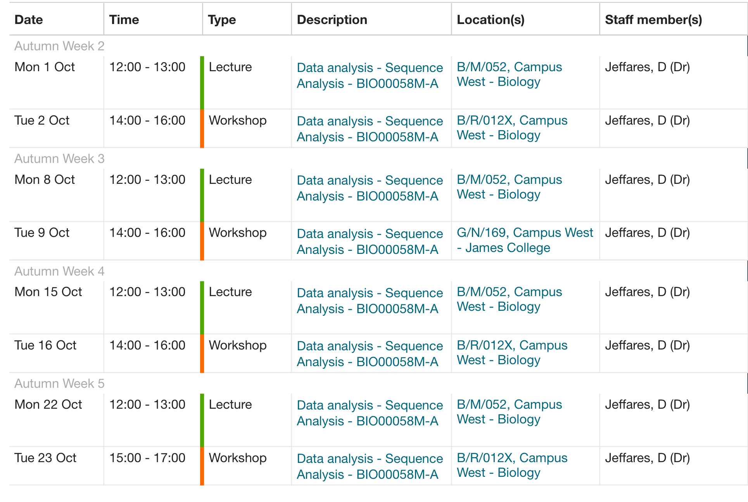
Workshop 2
In workshop 2 (tomorrow) we will start learning how to process some NGS data.
This will be Illumina reads from Leishmania infantum strains.

