Slide 1
BIO00058M: Sequence Analysis
Lecture 3
High-throughput sequencing Part 2
Daniel Jeffares

Slide 2
L3 + W3: Learning objectives
Basic knowledge of genome assembly
PCR duplicates
SNP calling
Assessment: the 1000 word report

Slide 3
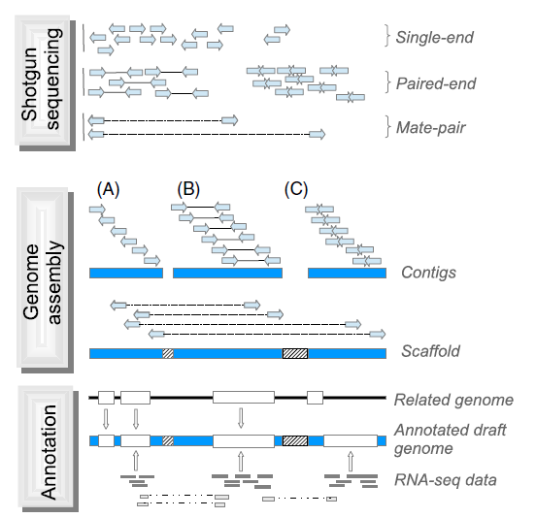
de novo genome assembly
Ekblom & Wolf (2014) A field guide to whole-genome sequencing, assembly and annotation. Evolutionary Applications 7: 1026-1042.

Slide 4
General feature format file (gff)
Describes the annotation of a genome: positions of genes, introns/exons, pseudogenes etc
Hmel200001 HGC gene 1917 3952 . - . ID=HMEL015204
Hmel200001 HGC mRNA 1917 3952 . - . ID=HMEL015204-RA;Parent=HMEL015204
Hmel200001 HGC exon 3827 3952 . - . ID=HMEL015204-RA-E1AAAA;Parent=HMEL015204-RA
Hmel200001 HGC exon 2744 2878 . - . ID=HMEL015204-RA-E2AAAA;Parent=HMEL015204-RA
Hmel200001 HGC exon 1917 1976 . - . ID=HMEL015204-RA-E3AAAA;Parent=HMEL015204-RA
Hmel200001 HGC CDS 3827 3952 . - 0 Parent=HMEL015204-RA
Hmel200001 HGC CDS 2744 2878 . - 0 Parent=HMEL015204-RA
Hmel200001 HGC CDS 1917 1976 . - 0 Parent=HMEL015204-RA
Hmel200004 HGC gene 2916 9864 . + . ID=HMEL013922
Hmel200004 HGC mRNA 2916 9864 . + . ID=HMEL013922-RA;Parent=HMEL013922;Dbxref=goslim_goa:GO:0003674
Hmel200004 HGC exon 2916 3063 . + . ID=HMEL013922-RA-E1AAAA;Parent=HMEL013922-RA
Hmel200004 HGC exon 3349 3440 . + . ID=HMEL013922-RA-E2AAAA;Parent=HMEL013922-RA
Hmel200004 HGC exon 3811 4033 . + . ID=HMEL013922-RA-E3AAAA;Parent=HMEL013922-RA
Hmel200004 HGC exon 4330 4525 . + . ID=HMEL013922-RA-E4AAAA;Parent=HMEL013922-RA
Hmel200004 HGC exon 4803 4895 . + . ID=HMEL013922-RA-E5AAAA;Parent=HMEL013922-RA
Hmel200004 HGC exon 6560 6749 . + . ID=HMEL013922-RA-E6AAAA;Parent=HMEL013922-RA
Hmel200004 HGC exon 8334 9864 . + . ID=HMEL013922-RA-E7AAAA;Parent=HMEL013922-RA
Hmel200004 HGC CDS 2918 3063 . + 0 Parent=HMEL013922-RA
Hmel200004 HGC CDS 3349 3440 . + 1 Parent=HMEL013922-RA
Hmel200004 HGC CDS 3811 4033 . + 2 Parent=HMEL013922-RA
Hmel200004 HGC CDS 4330 4525 . + 1 Parent=HMEL013922-RA
Hmel200004 HGC CDS 4803 4895 . + 0 Parent=HMEL013922-RA
Hmel200004 HGC CDS 6560 6749 . + 0 Parent=HMEL013922-RA
Hmel200004 HGC CDS 8334 8335 . + 2 Parent=HMEL013922-RA
http://gmod.org/wiki/GFF3
https://github.com/The-Sequence-Ontology/Specifications/blob/master/gff3.md

Slide 5
40 billion bases….what do I do with them?
Clean/trim
sequences
cutadapt, Reaper, Trimmotomatic
Check average
quality statistics
FastQC
Fastq files
(reads)
de novo assembly
SGA
Velvet
CLCbio
Compare to other sequences/genomes
BLAST, Cactus Genome-alignment
Annotate (locate and mark up the genes)
Augustus
Align to a
reference genome or
transcriptome
BWA
NextGenMap
Novoalign
Structural variant ‘calling’
Delly, GenomeSTRiP, Lumpy
Remove
PCR
Duplicates
Picardtools
Samtools
SNP and indel ‘calling’
GATK, Samtools, Freebayes
Make vcf files (variant call format)
Makes a sam or bam file
Sam: sequence alignment map
Bam: a binary sam
VCF filtering
vcftools, GATK
Biological analysis
vcftools, Admixture
Many, many others

Slide 6
Check quality of fastq file
Clean if necessary
Align sequence to genome (sam and bam files)
Order the bam file
Remove PCR and optical duplicates
Call SNPs and genotypes

Slide 7
Removing PCR duplicates
Library preparation may involve PCR steps
PCR duplicates can be removed/marked using Picard MarkDuplicates
https://broadinstitute.github.io/picard/

Slide 8
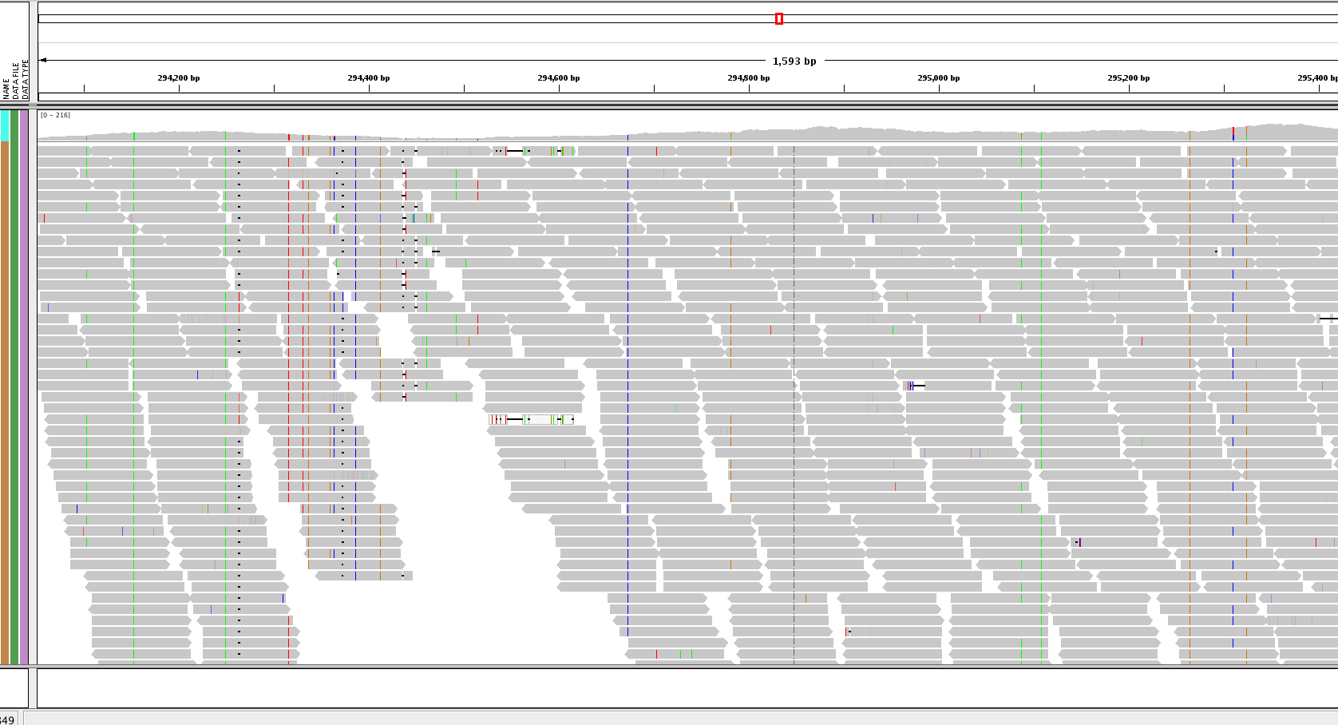
IGV: integrated genome viewer

Slide 9
SNP genotyping
The Genome Analysis Took Kit (GATK)
HaplotypeCaller (superceded the UnifiedGenotyper)
Outputs a vcf file (variant call format)
REF
base
ALT
base
HE670865 400036 . A C 394.38 . AC=5;AF=0.250;AN=20;BaseQRankSum=3.199;DP=254;Dels=0.00;FS=25.982;HaplotypeScore=5.0148;InbreedingCoeff=0.7136;MLEAC=5;MLEAF=0.250;MQ=42.64;MQ0=0;MQRankSum=-4.172;QD=9.39;ReadPosRankSum=2.020 GT:AD:DP:GQ:PL 0/0:51,0:52:99:0,138,1750 1/1:0,6:6:12:131,12,0 0/1:18,6:25:61:61,0,526
https://software.broadinstitute.org/gatk/
https://software.broadinstitute.org/gatk/documentation/tooldocs/current/org_broadinstitute_gatk_tools_walkers_haplotypecaller_HaplotypeCaller.php

Slide 10
ReadGroup information
bwa mem -t 2 -R '@RG\tID:11-569_Hel_mel_agl\tSM:11-569_Hel_mel_agl\tPL:Illumina' Hmel2_mtDNA.fa 11-569_Hel_mel_agl_sample_trimmed.R1.fastq.gz 11-569_Hel_mel_agl_sample_trimmed.R2.fastq.gz
1 sample: DAD
2 libraries: LIB-DAD-1 and LIB-DAD-2
Each library sequenced over two lanes
@RG ID:FLOWCELL1.LANE1 PL:ILLUMINA LB:LIB-DAD-1 SM:DAD
@RG ID:FLOWCELL1.LANE2 PL:ILLUMINA LB:LIB-DAD-1 SM:DAD
@RG ID:FLOWCELL1.LANE3 PL:ILLUMINA LB:LIB-DAD-2 SM:DAD
@RG ID:FLOWCELL1.LANE4 PL:ILLUMINA LB:LIB-DAD-2 SM:DAD
https://software.broadinstitute.org/gatk/guide/article?id=6472

Slide 11
Assessment
Assessment summary
Deadline: Monday 26 November 12:00
A 1000-word report in which you should demonstrate:
  Competent NGS sequence analysis
  Interpretation of the data in a biological context
  Methods used (commands, software) in a supplementary methods section (word count not included in the 1000-word limit).

Slide 12
Assessment
It should contain these sections, in this order:
Summary
Introduction. Explains the background of the report, including references.
Results. With embedded discussion of each result, as for letters (eg: Nature Genetics)
Conclusion. Briefly reiterates the main finding(s), with any caveats, limitations and implications.
Methods. Briefly summarises the data used and main bioinformatic steps employed (this methods section is included in the 1000-word limit).
Supplementary methods. Should detail data sources, genome versions used, software used (including version), parameters used and/or commands, and code written for the analysis (including R). Should be a concise, technical narrative. These supplementary methods are not included in the 1000-word limit.

Slide 13
Collusion or Collaboration?
University guidance on collusion: How do I know what's acceptable and what is not?
Acceptable practice:
talking about books or lectures with another student
comparing essays and feedback after the assignment has been marked
working in the library together
including ideas that another student expressed in a seminar, including a reference and in-text citation
Unacceptable collusion:
writing an essay structure with another student for work that is submitted individually
asking another student to edit your work
rewriting a friends conclusion for them so that they can submit it on time
showing another student your essay before the assignment is due
From the university guidance on collusion:
https://www.york.ac.uk/students/studying/develop-your-skills/study-skills/study/integrity/collusion/

Slide 14
Collusion or Collaboration?
For this course, you may share:
Code/R scripts but if code is not yours, your report must specify which code is not yours
Raw data outputs, again your report must specify which data files were not generated by you
Ideas, but your report must specify which ideas are not yours
You should do these things independently
All plots and statistical tests presented must be produced by yourself.
All writing, report formatting, references etc.
High grades will need to show evidence of independent enquiry.

Slide 15
Assessment: data
Leishmania infantum genome diversity data
Genome sequences of strains of Leishmania infantum, using paired-end Illumina reads.
These strains were all isolated from people/dogs in Brazil (see map)
Data from Rio Grande do Norte were collected and sequenced by Teixeira et al. (2017). We downloaded the data from the short read archive.
Reads have been mapped to the reference genome with BWA (bams will be made available)
SNPs & indels have been called with GATK and Freebayes (using only SNPs that are found in both callers)
Teixeira et al. 2017. International Journal for Parasitology 47 (10-11): 655–65.

Slide 16
Assessment: analysis
There are multiple ways you could analyse this data. All these analyses will need to be performed on the linux server. Some example are:
How does read coverage and mapping quality vary across the genome?
Software: samtools.
How do genetic diversity measures (eg: π) from SNPs and/or indels vary across the genome?
Software: vcftools.
Which strains are more closely related? (population structure analysis)
Software: Admixture.
How does the quality of SNP and/or indel calls vary across the genome?
Which SNPs and/or indel calls can we trust?
Software: vcftools, IGV (integrated genomics viewer).

Slide 17
Assessment: analysis
More examples:
What does read coverage tell us about ploidy in the genome?
Software: samtools.
How does the allele frequency spectrum change with SNPs/indels with different functional annotations?
Software: vcftools.
What structural variants (duplications, deletions, translocations, inversions) exist in these genomes?
Software: delly, amongst others, see:
See: https://figshare.com/articles/Workshop_on_SV_detection_NGSchool_2018/7110728/1
Or: analyse other aspect of the data.
New software can be installed on the server if you need it.

Slide 18
Workshops
Replacement times for workshop 2
Today 4-6pm B/R/012
Tomorrow 12:00 – 2:00pm B/R/012
Scheduled workshop 3
Tomorrow B/R/012
Scheduled workshop 4
Tuesday 23 October 3:00 – 5:00pm B/R/012

