Slide 1
EACCR2 NID Node Training Course: Genomics

Slide 2
Lecture 3
Processing NGS data files and file processing

Slide 3
Overview
Key stages in the generation of NGS data
Sample collection
This could be from tissue/blood/plant/culture
DNA extraction
Dependent on type of NGS you want to perform and sample type
Library preparation
Post sequencing QC
Down stream analysis
We will be focusing on steps 4 and 5 in this workshop

Slide 4
File formats
Within this workshop we will be manipulating several different file types
By the end of this workshop you should be familiar with the following file types
How many of these can anyone recognize already?
Fastq file (.gz)
SAM file (Sequence Alignment Map)
BAM file (binary SAM file)

Slide 5
Fastq format
Well described on wikipedia https://en.wikipedia.org/wiki/FASTQ_format
Similar to fasta format which you may have encountered before
Contains both biological data (nucleotide sequence) and quality score information
Line 1 is the header line and starts with ‘@’
Line 2 is the raw sequence
Line 3 begins with + and can be followed by a sequence identifier and description
Line 4 encodes the quality scores for the bases in line 2

Slide 6
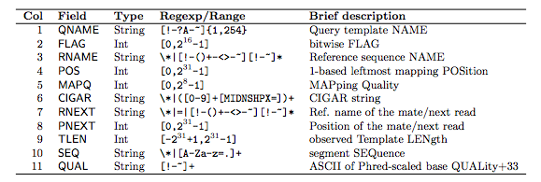
SAM format
Also well described here: https://en.wikipedia.org/wiki/SAM_(file_format)
Is human readable and gives the positions of sequences and where they align against a reference.
Standard format produced by short and long read aligners (e.g. BWA, BLASR)
The samtools suite allows us to edit and convert these SAM files
Two key parts, the header part, which provides lots of information about the alignment, and the alignment part, which provides the coordinates for all the alignments

Slide 7
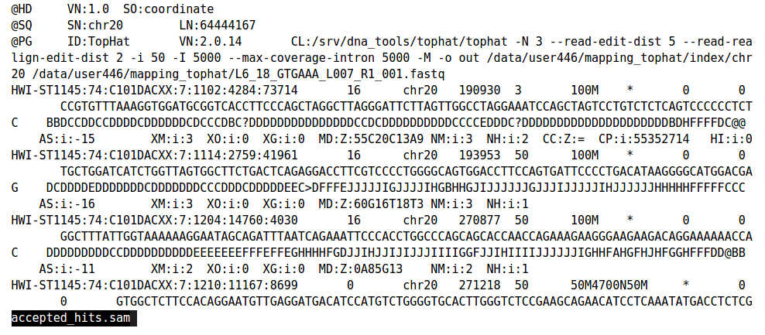
BAM format
Standard compressed form of SAM file
Not human readable, requires samtools suite to open, unlike SAM
Format of columns is the same as SAM
We use the command samtools view to open the BAM file
Each line beginning @ is a header line

Slide 8
NGS data
When you look at each sample you will notice each sample has 2 fastq.gz files
E.g. sample 1 may have two files sample1_R1.fastq.gz and sample1_R2.fastq.gz
This means that we have paired sequences
This means that one fragment has been sequenced in both the forward (5’ -> 3’) and reverse (3’ -> 5’) directions
R1 contains the forward reads
R2 contains the reverse reads
How can we look at the quality of these reads?

Slide 9
NGS data
We will be looking at the quality of these reads using a programme called fastqc
This can give us a indicator of whether sequencing was successful
Look at the GC content of reads sequenced
Look at the number of reads that pair
Look at the base quality for each read
Each base is assigned a quality score called a PHRED score
PHRED Scores
Q10 = 1/10 chance of error
Q20 = 1/100 chance of error
Q30 = 1/1000 chance of error
This is a logged score we used to judge how accurate a read is. We will be filtering on a score of 20

Slide 10
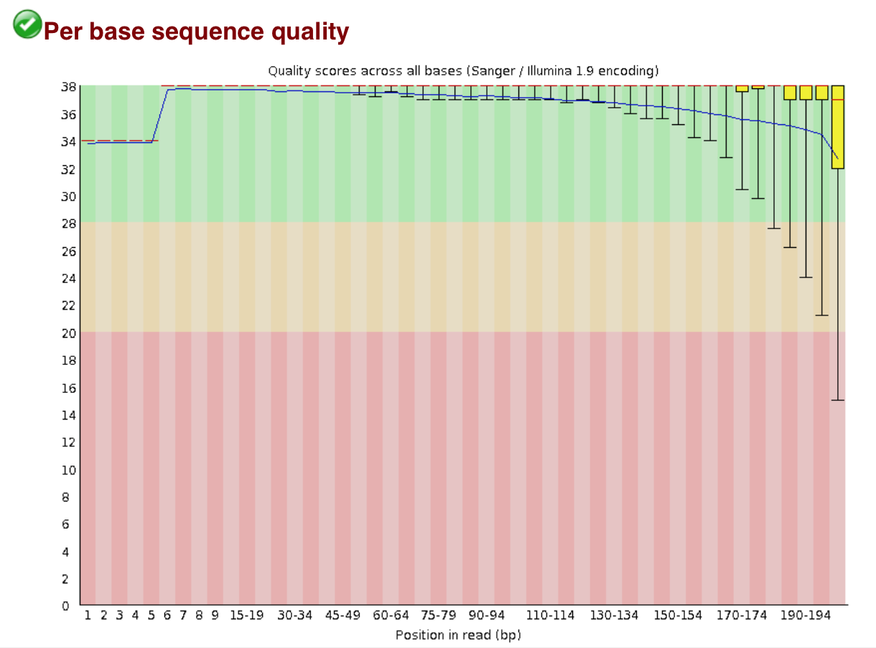
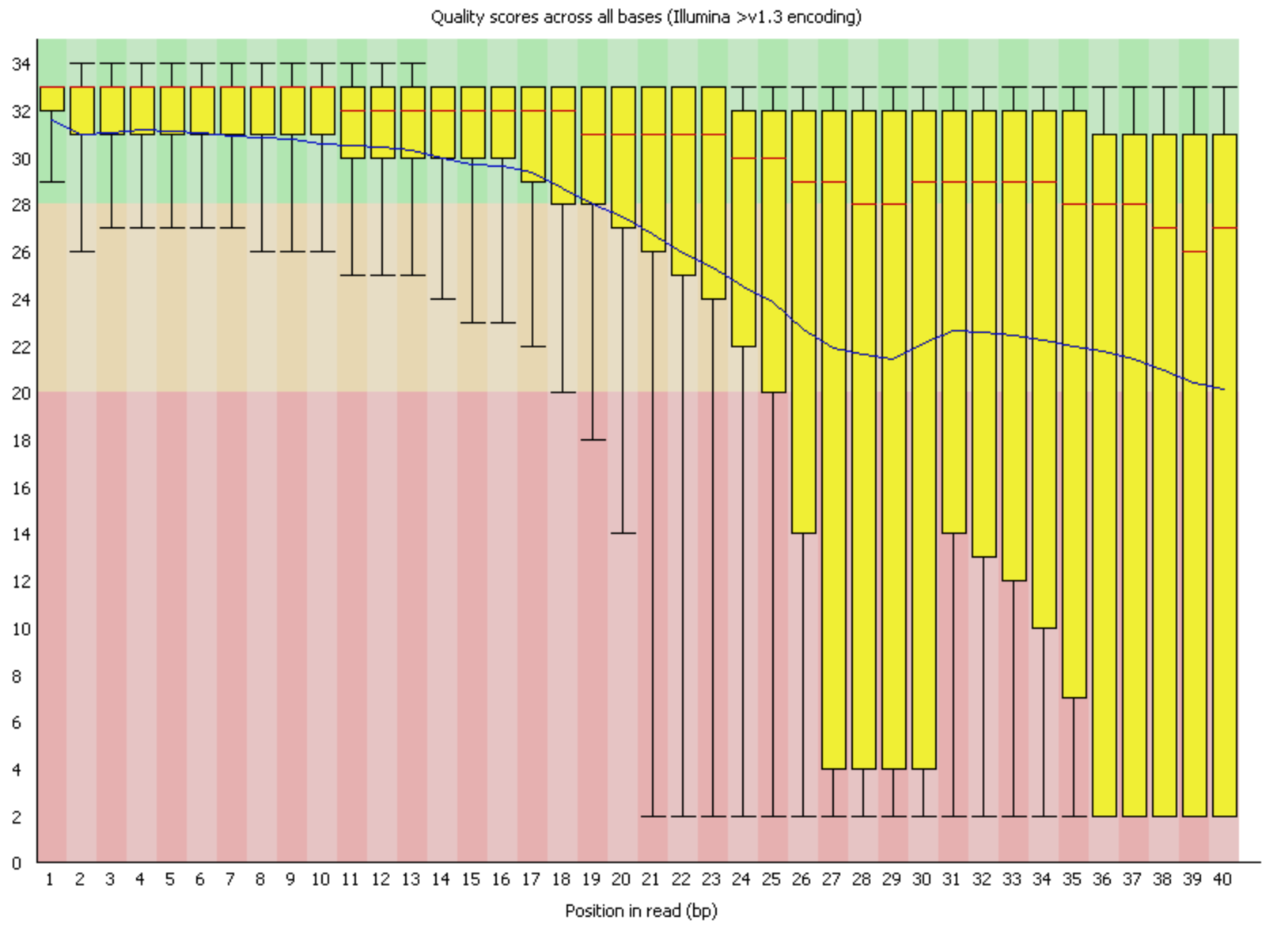
NGS data
PHRED Scores
Q10 = 1/10 chance of error
Q20 = 1/100 chance of error
Q30 = 1/1000 chance of error
This graph gives the average phred score at each position
GOOD PROFILE
BAD PROFILE

Slide 11
Trimming data
We often add barcodes and adaptors to libraries, to help us identify which sample the reads belong to when they are mixed
We know the sequences of these adaptors, which means that we often remove them We can also remove poor quality bases based on their PHRED score because the quality score at the end of reads is often worse than the middle of the read.
We can do this using cutadapt
cutadapt -q 20 --pair-filter=any \
-o Sample1_R1_fastq.q20.gz \
-p Sample1_R2_fastq.q20.gz \
Sample1_R1.fastq.gz \
Sample1_R2.fastq.gz \
> Sample1_R1.fastq.gz.log &
What does this command mean?

Slide 12
Trimming data
What does this command mean?
\ allows the command to run onto the next line
cutadapt -q 20 --pair-filter=any \
-o Sample1_R1_fastq.q20.gz \
-p Sample1_R2_fastq.q20.gz \
Sample1_R1.fastq.gz \
Sample1_R2.fastq.gz \
> Sample1_R1.fastq.gz.log &
& means this command will run in the background
--pair-filter=any
Means that if one read is removed, it’s pair is also removed
-o –p tells us what to call the trimmed outputs of the R1 and R2 files

Slide 13
Short read alignment
We will be aligning our trimmed sequences to a reference using the short read aligner BWA
The manual for this can be found here: http://bio-bwa.sourceforge.net/bwa.shtml
We first need to index the reference:
bwa index reference.fasta &
This generates multiple index files which allow BWA to quickly refer to the reference while it is doing the alignments
We will then perform the alignment using the R1 and R2 read files and generate a SAM file
bwa mem -t 2 -R '@RG\tID:S1\tSM:S1\tPL:Illumina’ reference.fasta Sample1_R1_fastq.q20.gz Sample1_R2_fastq.q20.gz > Sample1.q20.sam &

Slide 14
SAMTOOLS
Samtools is a utilities package that allows us to analyse and edit SAM and BAM files. This is now part of a greater package, htslib, which has additional tools that are useful for sequencing analysis
http://www.htslib.org/doc/#manual-pages
In the workshop we will be using a few of these key tools within the samtools pacakge
We can load the samtools package and look at the manual with the following commands
module load samtools
samtools

Slide 15
SAMTOOLS
Here are some of the key samtools functions we will be using
samtools view
This allows us to open and read a BAM file, it also allows us to look at just a section of the file, such as the header
samtools sort
This allows us to sort the alignments
samtools flagstat
samtools stats
Either of these commands allows us to perform simple summary statistics on the BAM files

