Slide 1




EACCR2 NID Node Training Course: Genomics
EACCR2 Genomics 2019

Slide 2
Lecture 4
Principles of population genomics
EACCR2 Genomics 2019

Slide 3
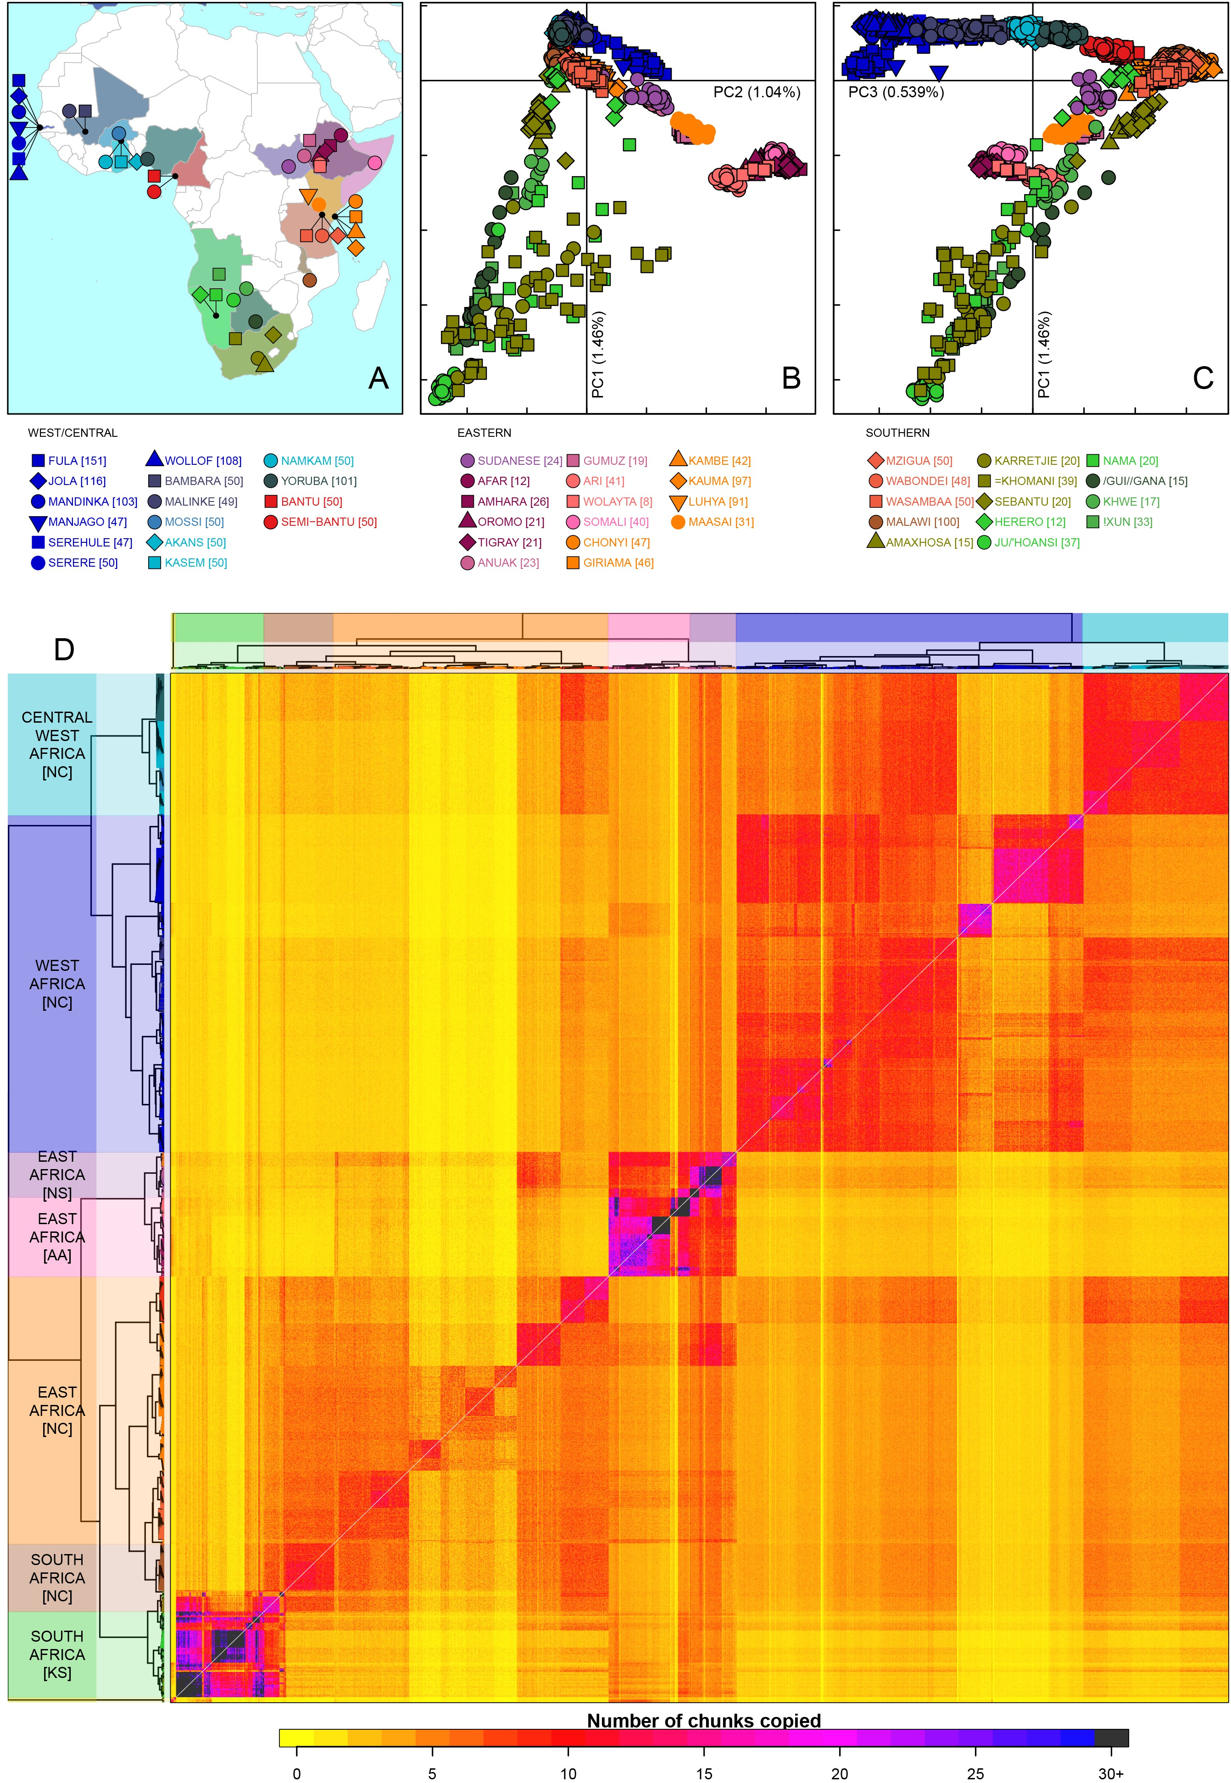
Population genomics
Variants tend to remain within their original population
When people, animals, plants or microbes travel, they carry their DNA with them.
Every individual carries its history within its DNA
Because we know the ‘rules’ (mutation, drift, recombination) population movements can be modelled
Because populations can have small contributions from one/other populations, this can’t always be drawn on a phylogenetic tree.
Busby 2016

Slide 4
Population genomics
Busby 2016

Slide 5
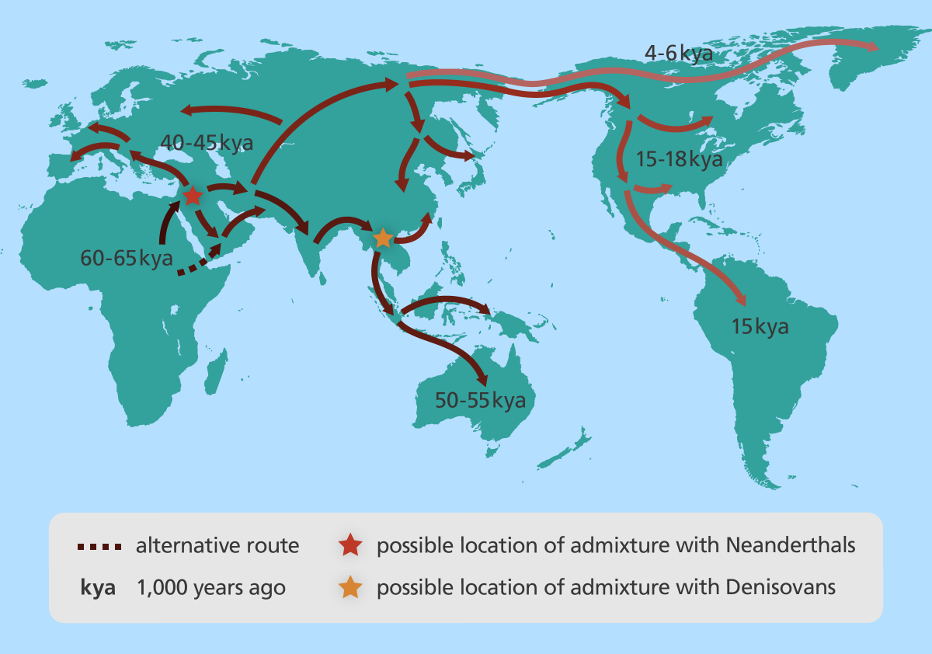
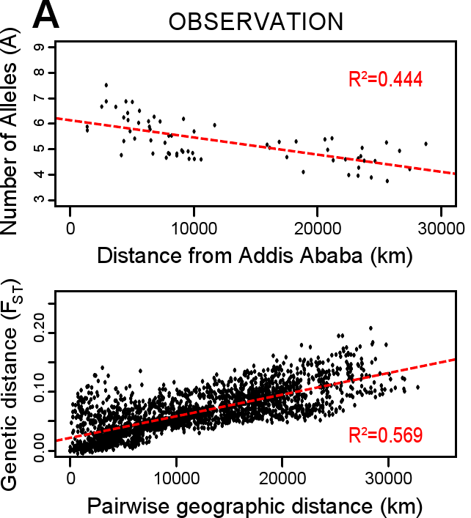
Population genomics
We are, right now, close to our original home.

Slide 6
What is population genomics
Population genetics is the study of genetic variation within species.
Population genomics expands the data to study variation within species using whole genome data.
Population genomics:
  Is more challenging data to gather, more expensive, more challenging to analyse
  Genome-scale data produces a more comprehensive picture
  Demography (population size, migration, population structuring)
  Natural selection (purifying, adaptive, balancing)
Demography, selection and quantitative genetics are intimately related.

Slide 7
Collecting population genomics data
Hypothesis/query
Sample collection and DNA extraction
  Choose geographic/habitat region of interest
  Gather hundreds to thousands of individuals (strains/subjects) from within a species (sometimes tens of thousands)
  Extract genomic DNA from each individual
Genome sequencing
  Aim: to obtain sequence data covering the entire genome 5x to 40x coverage
    Coverage: how many reads per site
  Sequence genome using ‘short read’ technology (usually Illumina)
  Main issue: cost/base
Reads from one individual, aligned to a reference genome
2x coverage
4x coverage

Slide 8
Collecting population genomics data
Read mapping and ‘variant calling’
  Locate genetic variants (sites the genome that differ between individuals, polymorphisms)
    eg: SNPs, indels etc
  By mapping (aligning) sequence reads to a reference genome, and identifying sites the genome that differ
Segregating genetic variants are (usually) the final data set
  A list of positions that vary. Alleles/polymorphisms/variants.
Analysis:
  Describing demography
  Detecting selection
  Quantitative genetics (like GWAS)
Some other strain/individual we are comparing to the reference genome
reference genome
Reads from one individual, aligned to a reference genome

Slide 9
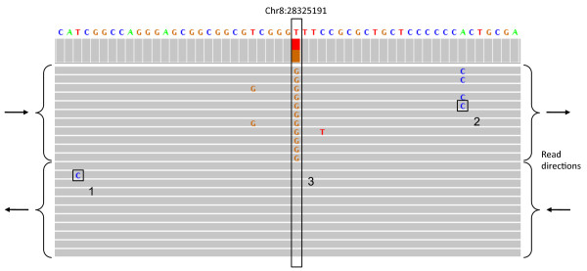
reference genome
Some other strain/individual we are comparing to the reference genome
reference genome
G
G
Some other strain/individual we are comparing to the reference genome
G
T
T
T
Reads from one individual, aligned to a reference genome

Slide 10
Concepts in population genomics
EACCR2 Genomics 2019

Slide 11
Genetic diversity
Polymorphisms/alleles/variants: sites in a genome that differ between individuals of a species
  Single nucleotide polymorphisms (SNPs)
  Small insertion/deletions (indels)
  Transposon insertions
  ‘Structural’ variants: duplications, rearrangements, large insertions/deletions
Initial origin: a mutation in one individual
  All polymorphisms begin their existence in just one individual
Polymorphisms then move through space and time, within the population
Their frequency in the population will change
Rare
Common
individual 1
individual 2
individual 3
individual 4
individual 5
individual 6
A genomic site/gene from many individuals within a species

Slide 12
Concept: genetic diversity
Genetic diversity: the life of a SNP
One population
Another population
A genomic site/gene from many individuals within a species

Slide 13
Concept: genetic diversity
Genetic diversity: the life of a SNP
One population
Another population

Slide 14
Concept: genetic diversity
Genetic diversity: the life of a SNP
One population
Another population

Slide 15
Concept: genetic diversity
Genetic diversity: the life of a SNP
One population
Another population

Slide 16
Concept: genetic diversity
Genetic diversity: the life of a SNP
Variants tend to remain within their original population
Most variants are rare
One population
Physically linked variants tend to travel together
Another population
Many signals can be found within polymorphism data.
The patterns of polymorphism data are complex.
Hence: summary statistics

Slide 17
Genetic diversity summary statistics
Average pairwise similarity (‘diversity’, π):
  If we compare every sequence to every other, what is the average number of differences?
The number of segregating sites (S):
Allele frequencies:
  Minor allele frequency (MAF)
  Derived allele frequency (DAF)
Each of these statistics can be described as:
  A histogram (a distribution)
  Plots along chromosomes
A genomic site/gene
from many individuals within a species
ATCCCG-TAAATTTT AGCCCG-TAAATTTT
AGCCCGTTAAATTTT
AGCCCGTTAAATTTT
Ancestral state
See:
Nucleotide diversity (π) on Wikipedia: https://en.wikipedia.org/wiki/Nucleotide_diversity
Watterson estimator of 𝚯 on Wikipedia https://en.wikipedia.org/wiki/Watterson_estimator

Slide 18
Tajima’s D
Tajima’s D uses summary statistics to detect
selection or demography
The expected number of segregating sites, 𝚯 =
In a neutral site π = 𝚯
Fumio Tajima worked out that π ≠ 𝚯 in certain circumstances
Tajima’s D is approximately = π - 𝚯
When D is negative:
  more rare alleles that expected
  selective sweep (or expanding population)
When D is positive: (too many rare alleles)
  Balancing selection or shrinking population or population structure
S is the number of segregating sites
N is the number of sequences compared
For six sequences:
Sum of: ½ + 1/3 +1/4 +1/5
In theory, 𝚯 = π = 4Nμ
Where N = population size
μ = mutation rate
So π can give us an estimate of population size.
Tajima’s D on Wikipedia https://en.wikipedia.org/wiki/Tajima%27s_D
Excellent explanation of π, 𝚯 and Tajima’s D on Youtube: https://www.youtube.com/watch?v=wiyay4YMq2A

Slide 19
Concept: genome-wide summary statistics: Tajima’s D
Tajima’s D
Tajima’s D = 0
  Neutrally evolving, stable population
When D is negative:
  more rare alleles that expected
  selective sweep
  or expanding population
When D is positive:
  more common alleles than expected
  balancing selection
  shrinking population
  population structure
Tajima’s D on Wikipedia https://en.wikipedia.org/wiki/Tajima%27s_D
Excellent explanation of π, 𝚯 and Tajima’s D on Youtube: https://www.youtube.com/watch?v=wiyay4YMq2A

Slide 20
Concept: Purifying selection – expectations and observations
Purifying selection (negative selection)
Purifying is the loss of deleterious (harmful) variants
This process will
Reduce diversity in regions that are important
Increase the proportion of rare alleles
Cause negative Tajima’s D
Purifying selection is expected to be a common event
Jeffares 2015

Slide 21
Concept: Adaptive evolution – expectations and observations
Positive selection (adaptive evolution)
Adaptive evolution is the the increase in frequency of an adaptive (helpful) variant
This process will
Reduce diversity around the beneficial allele
Increase rare alleles
Cause negative Tajima’s D
Strong adaptive evolution is expected to be a rare event
EACCR2 Genomics 2019

Slide 22
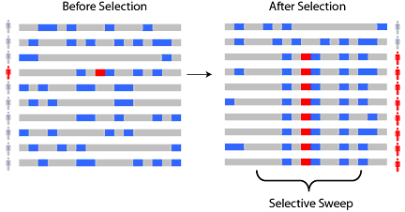
Concept: Linkage of alleles on chromosomes
Linkage
When a strongly beneficial allele arises it will ‘sweep’ through the population.
This will cause strong genetic signatures in the genome:
loss of diversity around the sweep (asses by looking at π)
increase in linkage (look at linkage)
Alleles are referred to as ‘linked’ when they are often found together
linkage is strongest for alleles that site close on the same chromosome
strong linkage
weaker linkage
See: https://en.wikipedia.org/wiki/Selective_sweep
unlinked alleles

Slide 23
Affect of linkage in a sweep

Slide 24
Affect of linkage in a sweep

Slide 25
Recombination
Unlinks alleles
Affect of linkage in a sweep

Slide 26
Recombination
Unlinks alleles
Affect of linkage in a sweep

Slide 27
Very close to advantageous allele: very low diversity (none), all alleles linked
Recombination
Unlinks alleles
Near to advantageous allele:
some loss of diversity, increased linkage
Affect of linkage in a sweep

Slide 28
Questions?
EACCR2 Genomics 2019

