Slide 1




EACCR2 NID Node Training Course: Genomics
EACCR2 Genomics 2019

Slide 2
Lecture 5
Principles of genetic variants and variant calling
EACCR2 Genomics 2019

Slide 3
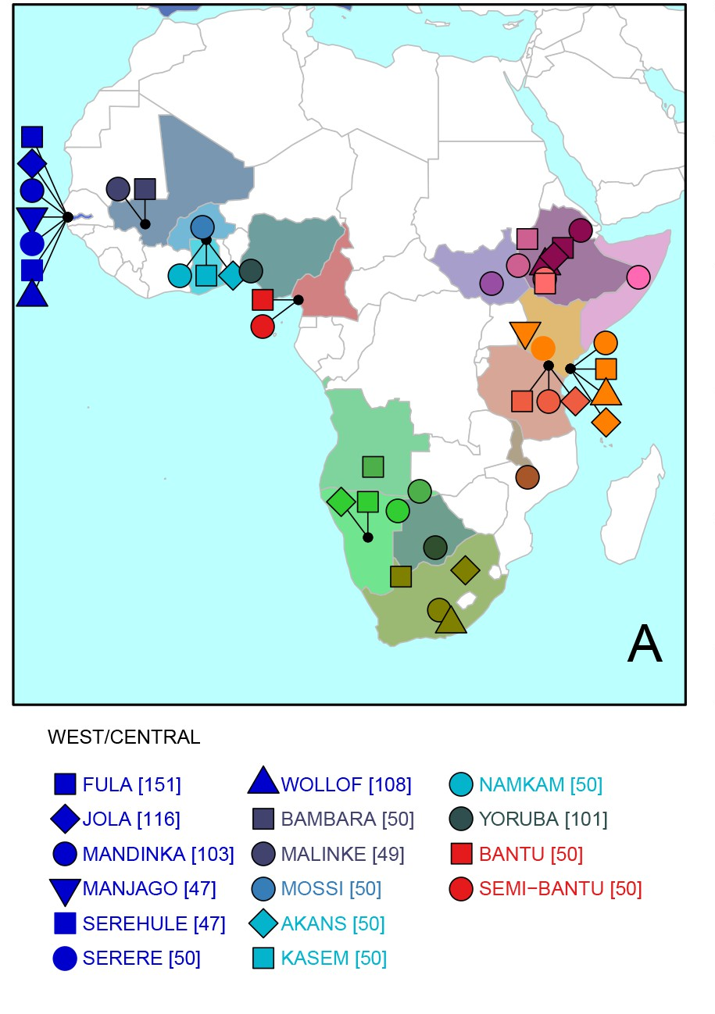
Population genomics
Variants tend to remain within their original population
When people, animals, plants or microbes travel, they carry their DNA with them.
Every individual carries its history within its DNA
Because we know the ‘rules’ (mutation, drift, recombination) population movements can be modelled
Because populations can have small contributions from one/other populations, this can’t always be drawn on a phylogenetic tree.
Busby 2016

Slide 4
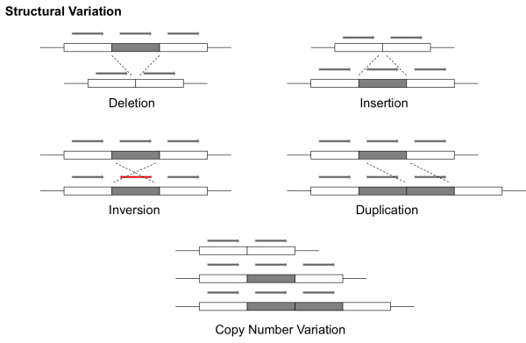
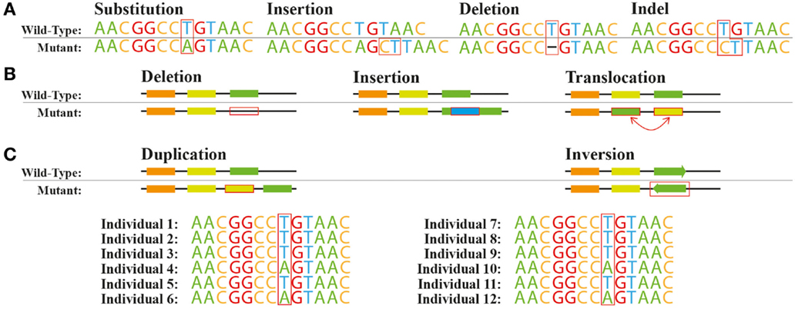
genomic variants
Single nucleotide polymorphism
(SNP)
Insertion/deletion polymorphisms (indels)
Also: transposon insertions
EACCR2 Genomics 2019

Slide 5
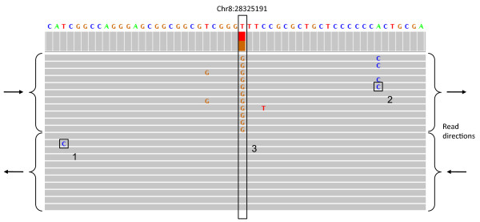
reference genome
Some other strain/individual we are comparing to the reference genome
reference genome
G
G
G
Some other strain/individual we are comparing to the reference genome
T
T
T
Reads from one individual, aligned to a reference genome

Slide 6
Identifying genomic variants
EACCR2 Genomics 2019

Slide 7
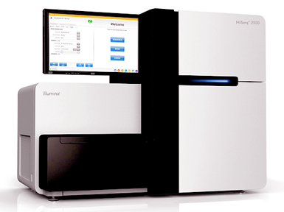
Fastq output format
Illumina:
Technology of choice for genome re-sequencing (of populations)
Widely used for small de novo genome assemblies, RNA-seq (sequencing transcriptomes), chip-seq, 3C, metagenomics
Next/3rd gen sequencer all produce sequence ‘reads’
Reads are encoded in ‘fastq’ format
  Bases and a measure of the quality of each base
Quality scores enable users to check the quality their reads, and get rid of bad quality data
Information about the fastq format and Phred-scores at:
http://en.wikipedia.org/wiki/FASTQ_format
http://en.wikipedia.org/wiki/Phred_quality_score

Slide 8
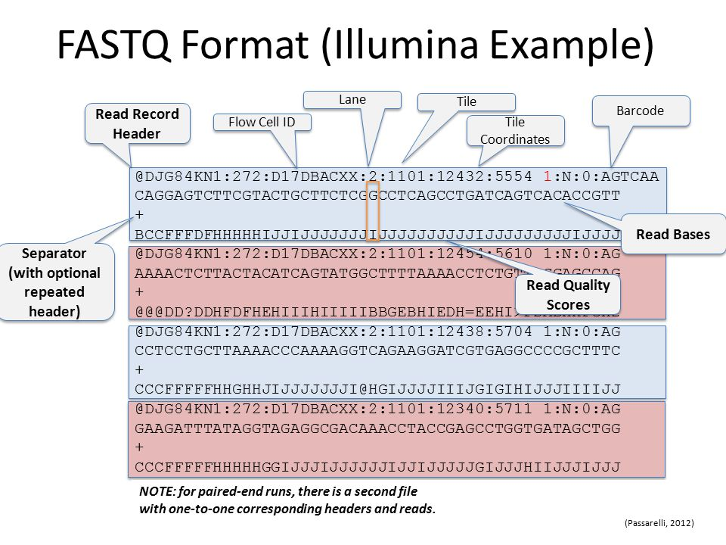
Fastq file ‘anatomy’
NB: Each ASCI letter is assigned a phred score, see here: https://support.illumina.com/help/BaseSpace_OLH_009008/Content/Source/Informatics/BS/QualityScoreEncoding_swBS.htm

Slide 9
Using read data to find genetic variants
Fastq files (reads) are not useful by themselves.
They are generally either used for:
de novo assembly:
  reads are assembled (joined together) into longer sequences, using the short sub-sequences that match.
  This is less common with short reads
Mapping to a reference genome
A reference genome is a completed, annotated genome
For analysis of genetic diversity
For analysis of transcriptomes (called RNA-seq)
For many many other things.
These analyses often need multiple steps (’pipelines’) to get to the biologically-relevant data. The next slide shows one such pipeline, for analysis of genetic diversity.

Slide 10
Using read data to find genetic variants
Check average
quality statistics
FastQC
Clean/trim
sequences
cutadapt, Reaper, Trimmotomatic
Fastq files
(reads)
de novo assembly
SGA
Velvet
CLCbio
Compare to other sequences/genomes
BLAST, Cactus Genome-alignment
Annotate (locate and mark up the genes)
Augustus
Align to a
reference genome or
transcriptome
BWA
NextGenMap
Novoalign
Structural variant ‘calling’
Delly, GenomeSTRiP, Lumpy
Remove
PCR
Duplicates
Picardtools
Samtools
SNP and indel ‘calling’
GATK, Samtools, Freebayes
Make vcf files (variant call format)
Makes a sam or bam file
Sam: sequence alignment map
Bam: a binary sam
VCF filtering
vcftools, GATK
Biological analysis
vcftools, Admixture
Many, many others

Slide 11
Using read data to find genetic variants
Population re-sequencing
Usually used to collect information about diversity within a species (other uses also possible)
Mapping/aligning to an existing reference genome
Computationally easier than de novo assembly
Much cheaper than de novo assembly
In workshops and group projects we will use some population sequencing data from the parasite Leishmania donovani from Ethiopia
Read about this species here: https://en.wikipedia.org/wiki/Leishmania_infantum

Slide 12
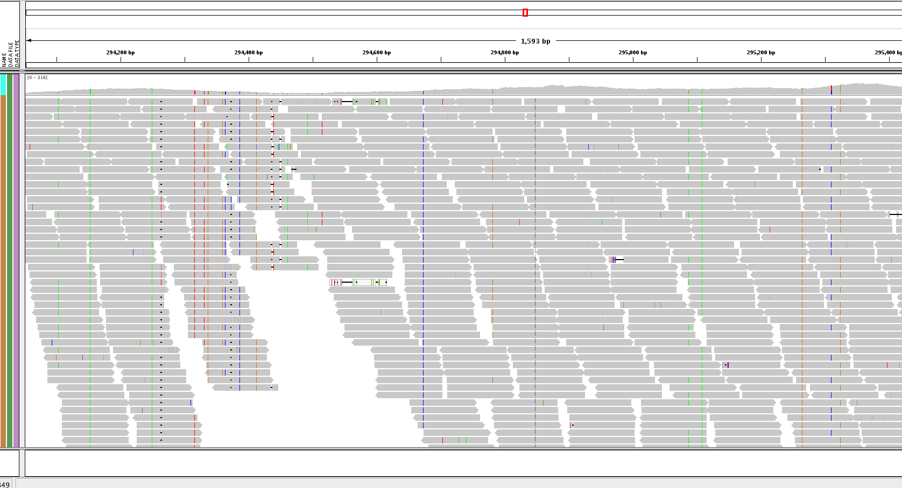
Using read data to find genetic variants
When it goes well

Slide 13
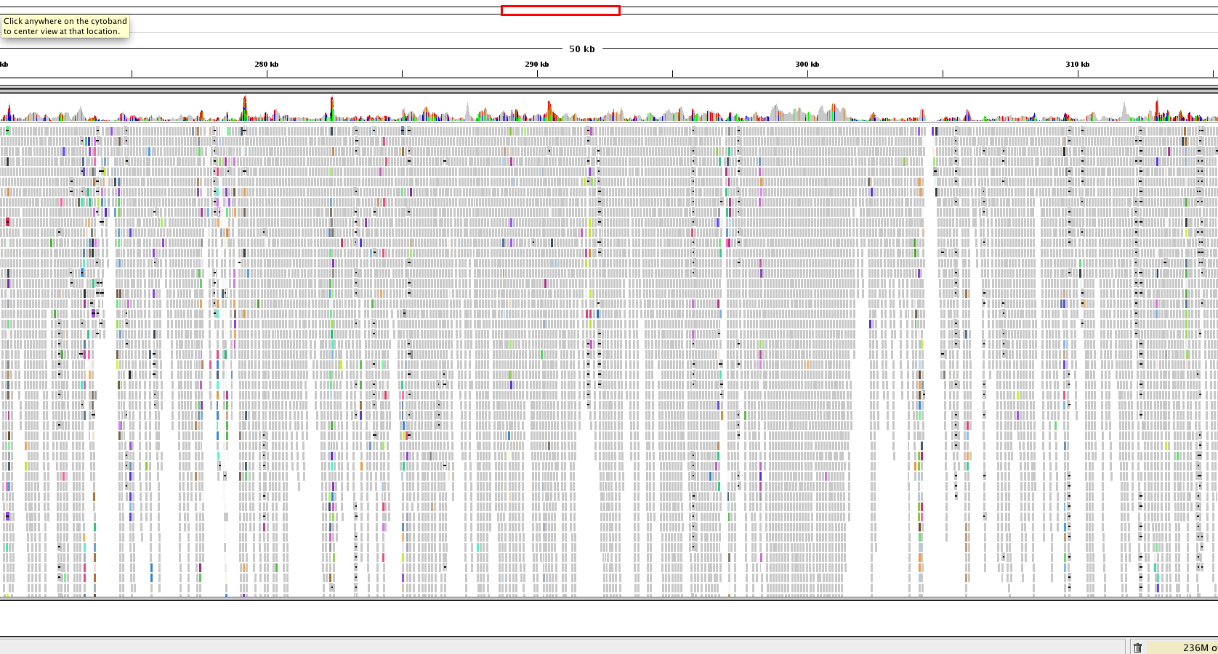
Using read data to find genetic variants
When it goes badly
Why?

Slide 14
Using read data to find genetic variants
Many aligners available
  BWA: for less divergent sequences (fast)
  NextGenMap: for more divergent sequences
SAM: Sequence Alignment/Map format
BAM (binary, compressed SAM)
The SAM file format
See: https://samtools.github.io/hts-specs/SAMv1.pdf

Slide 15
@SQ SN:chr1 LN:278268
@SQ SN:chr2 LN:356299
@SQ SN:chr3 LN:389660
@SQ SN:chr4 LN:466506
@SQ SN:chr5 LN:467711
@SQ SN:chr6 LN:525234
@SQ SN:chr7 LN:592865
@SQ SN:chr8 LN:515744
@SQ SN:chr9 LN:581921
@SQ SN:chr10 LN:588571
@SQ SN:chr11 LN:568610
@SQ SN:chr12 LN:593479
@SQ SN:chr13 LN:659809
@SQ SN:chr14 LN:656122
@SQ SN:chr15 LN:650312
@SQ SN:chr16 LN:688194
@SQ SN:chr17 LN:690898
@SQ SN:chr18 LN:720421
@SQ SN:chr19 LN:706116
@SQ SN:chr20 LN:731246
@SQ SN:chr21 LN:764851
@SQ SN:chr22 LN:782138
@SQ SN:chr23 LN:786675
@SQ SN:chr24 LN:863800
@SQ SN:chr25 LN:895070
@SQ SN:chr26 LN:1055294
@SQ SN:chr27 LN:1175405
@SQ SN:chr28 LN:1205018
@SQ SN:chr29 LN:1272412
@SQ SN:chr30 LN:1353282
@SQ SN:chr31 LN:1529233
@SQ SN:chr32 LN:1544753
@SQ SN:chr33 LN:1532280
@SQ SN:chr34 LN:1852060
@SQ SN:chr35 LN:2019666
@SQ SN:chr36 LN:2743046
@RG ID:S3 SM: S3 PL:Illumina
@PG ID:bwa PN:bwa VN:0.7.17-r1188 CL:bwa mem -t 2 -R @RG\tID:S3\tSM: S3\tPL:Illumina LinJ_cbm_v1.fasta Sample3_R1_fastq.q20.gz Sample3_R2_fastq.q20.gz
J00125:7:HJ772BBXX:5:1101:3437:1332 83 chr31 361505 0 151M = 361476 -180 TCACCCACGACGCCACACCGCATCGCGTCCACTCGGTAGGAAGAGGGAGAGACGCAAGGGGGAGGGGGGAGGCGGCGAGGAAGGGAGGACACCGGGCGCAAGAGACGACGCAGAAGATAAGCCACAAACAAGAGGGAGAGAGGAGGAGNAG 7AJAF<FFFJJJFJJJ<JJJJJJJJJJJJFFAFJJFJJJJJJJJJFJJJJJJJJJJJJJJJJJJJJJJJJFJJJAFJJJAJJJJJJJJJAJJJJJJFF<JJJJJJJJJJJJJJJJJJJJJJJJJJJJJJJJJJJJJJJJFFF7JFJFF#AA NM:i:1 MD:Z:148G2 MC:Z:151M AS:i:149 XS:i:149 RG:Z:S3 XA:Z:chr31,-353856,151M,1;chr31,-369151,151M,1;
J00125:7:HJ772BBXX:5:1101:3437:1332 163 chr31 361476 0 151M = 361505 180 CTCGGCGTGATTGCGTTTGCTCCGTCCCTTCACCCACGACGCCACACCGCATCGCGTCCACTCGGTAGGAAGAGGGAGAGACGCAAGGGGGAGGGGGGAGGCGGCGAGGAAGGGAGGACACCGGGCGCAAGAGACGACGCAGAAGATAAGC AAFFFJ<AJJJJJJJJJJJJJJJJJJFJJJJJJJJJJJJJJJJJJJJJJJJJJJJJJJJJJJJJJJJJJJJFFJ-FJFFJJJFFJJJ7F<FAFAJF-<A<JFFAAAJJJJ<FJ<AA-AAJAAF--<-<JJJJ-F-AF7-7AAAFJJ<FJ-7 NM:i:0 MD:Z:151 MC:Z:151M AS:i:151 XS:i:151 RG:Z:S3 XA:Z:chr31,+353827,151M,0;chr31,+369122,151M,0;
J00125:7:HJ772BBXX:5:1101:5203:1332 99 chr22 572045 60 150M = 572202 307 AANCCGGAAGGCAGTGTATGGACGAAGCACCTGAGCTGTCGAGTAGGTACAGAGAAAGACAGACACACAGAGGGCGGAGGGAAGGGGGAGGCACGCGCGTGCTGTTGCTGATTATACCGCCTTTGTTTTCTGGCTTCTCTTATTCGCTTT AA#FFJJJJJJJJJJJJJJJJJJJJJJJJJJJJJJJJJJJJJJJJJJJJJJJJJJJJJJJJJJJJJJJJJJJJJJJFJJJJJJJJJFFJJJJJJFFJJJJJJJJJJJJJJJJJJJFJAAFFFFJJJJJJJJAAA7FJFFFFJFFA<F7<F NM:i:1 MD:Z:2G147 MC:Z:150M AS:i:148 XS:i:0 RG:Z:S3
J00125:7:HJ772BBXX:5:1101:5203:1332 147 chr22 572202 60 150M = 572045 -307 GTTGTTTGATGTGCGTGTGTGCTTGTGCGGCTCCCGGCATGTGCCACCGTGATAATGGTGGTGGTAGTGGTGGTACGTGCGAAGAGCAGCACCGACGAACGTGTACGGATGTCAAGAGGGCAAGAAAAGGGAAGCGATGGAGGGGATAGG 7JJJFAJA-)JFFAJFFA-<A-F-A-7))<AF<FJJFJFJJF<)))FFJAJJJJJJJJJJJFFJJJJJJJJJJJJJJJJJJJJJJJJJJ<JJJJJFJJJFJJJJJJJJJJJJJJJJJJJJFJJJJJJJJJJJJJJJJJJJJJJJJFFFAA NM:i:0 MD:Z:150 MC:Z:150M AS:i:150 XS:i:20 RG:Z:S3
J00125:7:HJ772BBXX:5:1101:30492:1332 99 chr10 189007 0 72M79S = 189006 75 GANCGGCCCGCTCGCGGATGCCGGGAAGCCGCAGATCAGCATCTTCGTGTCTGCCGCGCTGCAGGCCATCACATGAGATCGGAAGAGCACACGTCTGAACTCCAGTCACATTCAGAAATCTCGTATGCCGTCTTCTGCTTGAAAAAAAAAA <A#FFJAFJJJJAAJJF<JJJJJJJJJJJJJJJJFJJJJJF7FFAJJJJFAAJ<JJJJJJJFAJFFJ-<FAJ-AJJ<--FJJFAF7JJJJFJFJJFFF<F7<AAFFFFJJ<<JFJF<A-AAA<AFF<F-7)A)-77AJ--<F-7<A----< NM:i:1 MD:Z:2A69 MC:Z:75S76M AS:i:70 XS:i:70 RG:Z:S3 XA:Z:chr10,+182916,72M79S,1;chr10,+168748,72M79S,1;chr10,+174884,72M79S,1;chr10,+162463,64M87S,1;
J00125:7:HJ772BBXX:5:1101:30492:1332 147 chr10 189006 0 75S76M = 189007 -75 TTTTTTAATGATCCGGCGACCACCGAGATCTACACCCTATCCTACACTCTTTCCCTACACGACGCTCTTCCGATCTGAACGGCCCGCTCGCGGATGCCGGGAAGCCGCAGATCAGCATCTTCGTGTCTGCCGCGCTGCAGGCCATCACCTG JJFFA--JFA7))7-)A77FA)7A-7A<<--<7<FFA7-FAFA7--F7FFA<FAF7JA-A77JJFAJA<FAFJFFFFF-F7AJJJ7JJJJJJJAFJF<JJAFJJJJJAF<<FJJJJJJJFJJJJJ<JJJJJJJJJJJJJAJJFAF7-FAAA NM:i:0 MD:Z:76 MC:Z:72M79S AS:i:76 XS:i:76 RG:Z:S3 XA:Z:chr10,-182915,75S76M,0;chr10,-168747,75S76M,0;chr10,-174883,75S76M,0;chr10,-162462,75S76M,2;
J00125:7:HJ772BBXX:5:1101:1783:1349 83 chr36 331249 60 11S140M = 331249 -140 TCTTCCGATCTCAGCGCAGAAGTCTGCCAATGCACCAGGCACGGGAGGAGCTGGTGAAGCTCATTCGCGACAATCGCGTGGTGATCATTGTGGGTGAGACCGGATCGGGCAAGACGACGCAGCTGCTTCAGTATCTCTATGAGGAGGGCTT <FFAJF<<7<JA--AFJFAJJFFJAFJFF7)JFJJJJJJFJJJJJJJJAAFFFFFJJJJJJJFFJJJAFFFFJFAAJAJAJFAAJJJFJJJFJJJJ<A-JJJ<JJJJFJJJJA<<FFFFJAF<JJJJJJJFJFFJJ7JJJFJJJJAFFFAA NM:i:0 MD:Z:140 MC:Z:140M11S AS:i:140 XS:i:0 RG:Z:S3

Slide 16
@SQ SN:chr1 LN:278268
@SQ SN:chr2 LN:356299
@SQ SN:chr3 LN:389660
@SQ SN:chr4 LN:466506
@SQ SN:chr5 LN:467711
@SQ SN:chr6 LN:525234
@SQ SN:chr7 LN:592865
@SQ SN:chr8 LN:515744
@SQ SN:chr9 LN:581921
@SQ SN:chr10 LN:588571
@SQ SN:chr11 LN:568610
@SQ SN:chr12 LN:593479
@SQ SN:chr13 LN:659809
@SQ SN:chr14 LN:656122
@SQ SN:chr15 LN:650312
@SQ SN:chr16 LN:688194
@SQ SN:chr17 LN:690898
@SQ SN:chr18 LN:720421
@SQ SN:chr19 LN:706116
@SQ SN:chr20 LN:731246
@SQ SN:chr21 LN:764851
@SQ SN:chr22 LN:782138
@SQ SN:chr23 LN:786675
@SQ SN:chr24 LN:863800
@SQ SN:chr25 LN:895070
@SQ SN:chr26 LN:1055294
@SQ SN:chr27 LN:1175405
@SQ SN:chr28 LN:1205018
@SQ SN:chr29 LN:1272412
@SQ SN:chr30 LN:1353282
@SQ SN:chr31 LN:1529233
@SQ SN:chr32 LN:1544753
@SQ SN:chr33 LN:1532280
@SQ SN:chr34 LN:1852060
@SQ SN:chr35 LN:2019666
@SQ SN:chr36 LN:2743046
@RG ID:S3 SM: S3 PL:Illumina
@PG ID:bwa PN:bwa VN:0.7.17-r1188 CL:bwa mem -t 2 -R @RG\tID:S3\tSM: S3\tPL:Illumina LinJ_cbm_v1.fasta Sample3_R1_fastq.q20.gz Sample3_R2_fastq.q20.gz
J00125:7:HJ772BBXX:5:1101:3437:1332 83 chr31 361505 0 151M = 361476 -180 TCACCCACGACGCCACACCGCATCGCGTCCACTCGGTAGGAAGAGGGAGAGACGCAAGGGGGAGGGGGGAGGCGGCGAGGAAGGGAGGACACCGGGCGCAAGAGACGACGCAGAAGATAAGCCACAAACAAGAGGGAGAGAGGAGGAGNAG 7AJAF<FFFJJJFJJJ<JJJJJJJJJJJJFFAFJJFJJJJJJJJJFJJJJJJJJJJJJJJJJJJJJJJJJFJJJAFJJJAJJJJJJJJJAJJJJJJFF<JJJJJJJJJJJJJJJJJJJJJJJJJJJJJJJJJJJJJJJJFFF7JFJFF#AA NM:i:1 MD:Z:148G2 MC:Z:151M AS:i:149 XS:i:149 RG:Z:S3 XA:Z:chr31,-353856,151M,1;chr31,-369151,151M,1;
J00125:7:HJ772BBXX:5:1101:3437:1332 163 chr31 361476 0 151M = 361505 180 CTCGGCGTGATTGCGTTTGCTCCGTCCCTTCACCCACGACGCCACACCGCATCGCGTCCACTCGGTAGGAAGAGGGAGAGACGCAAGGGGGAGGGGGGAGGCGGCGAGGAAGGGAGGACACCGGGCGCAAGAGACGACGCAGAAGATAAGC AAFFFJ<AJJJJJJJJJJJJJJJJJJFJJJJJJJJJJJJJJJJJJJJJJJJJJJJJJJJJJJJJJJJJJJJFFJ-FJFFJJJFFJJJ7F<FAFAJF-<A<JFFAAAJJJJ<FJ<AA-AAJAAF--<-<JJJJ-F-AF7-7AAAFJJ<FJ-7 NM:i:0 MD:Z:151 MC:Z:151M AS:i:151 XS:i:151 RG:Z:S3 XA:Z:chr31,+353827,151M,0;chr31,+369122,151M,0;
J00125:7:HJ772BBXX:5:1101:5203:1332 99 chr22 572045 60 150M = 572202 307 AANCCGGAAGGCAGTGTATGGACGAAGCACCTGAGCTGTCGAGTAGGTACAGAGAAAGACAGACACACAGAGGGCGGAGGGAAGGGGGAGGCACGCGCGTGCTGTTGCTGATTATACCGCCTTTGTTTTCTGGCTTCTCTTATTCGCTTT AA#FFJJJJJJJJJJJJJJJJJJJJJJJJJJJJJJJJJJJJJJJJJJJJJJJJJJJJJJJJJJJJJJJJJJJJJJJFJJJJJJJJJFFJJJJJJFFJJJJJJJJJJJJJJJJJJJFJAAFFFFJJJJJJJJAAA7FJFFFFJFFA<F7<F NM:i:1 MD:Z:2G147 MC:Z:150M AS:i:148 XS:i:0 RG:Z:S3
J00125:7:HJ772BBXX:5:1101:5203:1332 147 chr22 572202 60 150M = 572045 -307 GTTGTTTGATGTGCGTGTGTGCTTGTGCGGCTCCCGGCATGTGCCACCGTGATAATGGTGGTGGTAGTGGTGGTACGTGCGAAGAGCAGCACCGACGAACGTGTACGGATGTCAAGAGGGCAAGAAAAGGGAAGCGATGGAGGGGATAGG 7JJJFAJA-)JFFAJFFA-<A-F-A-7))<AF<FJJFJFJJF<)))FFJAJJJJJJJJJJJFFJJJJJJJJJJJJJJJJJJJJJJJJJJ<JJJJJFJJJFJJJJJJJJJJJJJJJJJJJJFJJJJJJJJJJJJJJJJJJJJJJJJFFFAA NM:i:0 MD:Z:150 MC:Z:150M AS:i:150 XS:i:20 RG:Z:S3
J00125:7:HJ772BBXX:5:1101:30492:1332 99 chr10 189007 0 72M79S = 189006 75 GANCGGCCCGCTCGCGGATGCCGGGAAGCCGCAGATCAGCATCTTCGTGTCTGCCGCGCTGCAGGCCATCACATGAGATCGGAAGAGCACACGTCTGAACTCCAGTCACATTCAGAAATCTCGTATGCCGTCTTCTGCTTGAAAAAAAAAA <A#FFJAFJJJJAAJJF<JJJJJJJJJJJJJJJJFJJJJJF7FFAJJJJFAAJ<JJJJJJJFAJFFJ-<FAJ-AJJ<--FJJFAF7JJJJFJFJJFFF<F7<AAFFFFJJ<<JFJF<A-AAA<AFF<F-7)A)-77AJ--<F-7<A----< NM:i:1 MD:Z:2A69 MC:Z:75S76M AS:i:70 XS:i:70 RG:Z:S3 XA:Z:chr10,+182916,72M79S,1;chr10,+168748,72M79S,1;chr10,+174884,72M79S,1;chr10,+162463,64M87S,1;
J00125:7:HJ772BBXX:5:1101:30492:1332 147 chr10 189006 0 75S76M = 189007 -75 TTTTTTAATGATCCGGCGACCACCGAGATCTACACCCTATCCTACACTCTTTCCCTACACGACGCTCTTCCGATCTGAACGGCCCGCTCGCGGATGCCGGGAAGCCGCAGATCAGCATCTTCGTGTCTGCCGCGCTGCAGGCCATCACCTG JJFFA--JFA7))7-)A77FA)7A-7A<<--<7<FFA7-FAFA7--F7FFA<FAF7JA-A77JJFAJA<FAFJFFFFF-F7AJJJ7JJJJJJJAFJF<JJAFJJJJJAF<<FJJJJJJJFJJJJJ<JJJJJJJJJJJJJAJJFAF7-FAAA NM:i:0 MD:Z:76 MC:Z:72M79S AS:i:76 XS:i:76 RG:Z:S3 XA:Z:chr10,-182915,75S76M,0;chr10,-168747,75S76M,0;chr10,-174883,75S76M,0;chr10,-162462,75S76M,2;
J00125:7:HJ772BBXX:5:1101:1783:1349 83 chr36 331249 60 11S140M = 331249 -140 TCTTCCGATCTCAGCGCAGAAGTCTGCCAATGCACCAGGCACGGGAGGAGCTGGTGAAGCTCATTCGCGACAATCGCGTGGTGATCATTGTGGGTGAGACCGGATCGGGCAAGACGACGCAGCTGCTTCAGTATCTCTATGAGGAGGGCTT <FFAJF<<7<JA--AFJFAJJFFJAFJFF7)JFJJJJJJFJJJJJJJJAAFFFFFJJJJJJJFFJJJAFFFFJFAAJAJAJFAAJJJFJJJFJJJJ<A-JJJ<JJJJFJJJJA<<FFFFJAF<JJJJJJJFJFFJJ7JJJFJJJJAFFFAA NM:i:0 MD:Z:140 MC:Z:140M11S AS:i:140 XS:i:0 RG:Z:S3
General information about the mapping proceedure

Slide 17
@SQ SN:chr1 LN:278268
@SQ SN:chr2 LN:356299
@SQ SN:chr3 LN:389660
@SQ SN:chr4 LN:466506
@SQ SN:chr5 LN:467711
@SQ SN:chr6 LN:525234
@SQ SN:chr7 LN:592865
@SQ SN:chr8 LN:515744
@SQ SN:chr9 LN:581921
@SQ SN:chr10 LN:588571
@SQ SN:chr11 LN:568610
@SQ SN:chr12 LN:593479
@SQ SN:chr13 LN:659809
@SQ SN:chr14 LN:656122
@SQ SN:chr15 LN:650312
@SQ SN:chr16 LN:688194
@SQ SN:chr17 LN:690898
@SQ SN:chr18 LN:720421
@SQ SN:chr19 LN:706116
@SQ SN:chr20 LN:731246
@SQ SN:chr21 LN:764851
@SQ SN:chr22 LN:782138
@SQ SN:chr23 LN:786675
@SQ SN:chr24 LN:863800
@SQ SN:chr25 LN:895070
@SQ SN:chr26 LN:1055294
@SQ SN:chr27 LN:1175405
@SQ SN:chr28 LN:1205018
@SQ SN:chr29 LN:1272412
@SQ SN:chr30 LN:1353282
@SQ SN:chr31 LN:1529233
@SQ SN:chr32 LN:1544753
@SQ SN:chr33 LN:1532280
@SQ SN:chr34 LN:1852060
@SQ SN:chr35 LN:2019666
@SQ SN:chr36 LN:2743046
@RG ID:S3 SM: S3 PL:Illumina
@PG ID:bwa PN:bwa VN:0.7.17-r1188 CL:bwa mem -t 2 -R @RG\tID:S3\tSM: S3\tPL:Illumina LinJ_cbm_v1.fasta Sample3_R1_fastq.q20.gz Sample3_R2_fastq.q20.gz
J00125:7:HJ772BBXX:5:1101:3437:1332 83 chr31 361505 0 151M = 361476 -180 TCACCCACGACGCCACACCGCATCGCGTCCACTCGGTAGGAAGAGGGAGAGACGCAAGGGGGAGGGGGGAGGCGGCGAGGAAGGGAGGACACCGGGCGCAAGAGACGACGCAGAAGATAAGCCACAAACAAGAGGGAGAGAGGAGGAGNAG 7AJAF<FFFJJJFJJJ<JJJJJJJJJJJJFFAFJJFJJJJJJJJJFJJJJJJJJJJJJJJJJJJJJJJJJFJJJAFJJJAJJJJJJJJJAJJJJJJFF<JJJJJJJJJJJJJJJJJJJJJJJJJJJJJJJJJJJJJJJJFFF7JFJFF#AA NM:i:1 MD:Z:148G2 MC:Z:151M AS:i:149 XS:i:149 RG:Z:S3 XA:Z:chr31,-353856,151M,1;chr31,-369151,151M,1;
J00125:7:HJ772BBXX:5:1101:3437:1332 163 chr31 361476 0 151M = 361505 180 CTCGGCGTGATTGCGTTTGCTCCGTCCCTTCACCCACGACGCCACACCGCATCGCGTCCACTCGGTAGGAAGAGGGAGAGACGCAAGGGGGAGGGGGGAGGCGGCGAGGAAGGGAGGACACCGGGCGCAAGAGACGACGCAGAAGATAAGC AAFFFJ<AJJJJJJJJJJJJJJJJJJFJJJJJJJJJJJJJJJJJJJJJJJJJJJJJJJJJJJJJJJJJJJJFFJ-FJFFJJJFFJJJ7F<FAFAJF-<A<JFFAAAJJJJ<FJ<AA-AAJAAF--<-<JJJJ-F-AF7-7AAAFJJ<FJ-7 NM:i:0 MD:Z:151 MC:Z:151M AS:i:151 XS:i:151 RG:Z:S3 XA:Z:chr31,+353827,151M,0;chr31,+369122,151M,0;
J00125:7:HJ772BBXX:5:1101:5203:1332 99 chr22 572045 60 150M = 572202 307 AANCCGGAAGGCAGTGTATGGACGAAGCACCTGAGCTGTCGAGTAGGTACAGAGAAAGACAGACACACAGAGGGCGGAGGGAAGGGGGAGGCACGCGCGTGCTGTTGCTGATTATACCGCCTTTGTTTTCTGGCTTCTCTTATTCGCTTT AA#FFJJJJJJJJJJJJJJJJJJJJJJJJJJJJJJJJJJJJJJJJJJJJJJJJJJJJJJJJJJJJJJJJJJJJJJJFJJJJJJJJJFFJJJJJJFFJJJJJJJJJJJJJJJJJJJFJAAFFFFJJJJJJJJAAA7FJFFFFJFFA<F7<F NM:i:1 MD:Z:2G147 MC:Z:150M AS:i:148 XS:i:0 RG:Z:S3
J00125:7:HJ772BBXX:5:1101:5203:1332 147 chr22 572202 60 150M = 572045 -307 GTTGTTTGATGTGCGTGTGTGCTTGTGCGGCTCCCGGCATGTGCCACCGTGATAATGGTGGTGGTAGTGGTGGTACGTGCGAAGAGCAGCACCGACGAACGTGTACGGATGTCAAGAGGGCAAGAAAAGGGAAGCGATGGAGGGGATAGG 7JJJFAJA-)JFFAJFFA-<A-F-A-7))<AF<FJJFJFJJF<)))FFJAJJJJJJJJJJJFFJJJJJJJJJJJJJJJJJJJJJJJJJJ<JJJJJFJJJFJJJJJJJJJJJJJJJJJJJJFJJJJJJJJJJJJJJJJJJJJJJJJFFFAA NM:i:0 MD:Z:150 MC:Z:150M AS:i:150 XS:i:20 RG:Z:S3
J00125:7:HJ772BBXX:5:1101:30492:1332 99 chr10 189007 0 72M79S = 189006 75 GANCGGCCCGCTCGCGGATGCCGGGAAGCCGCAGATCAGCATCTTCGTGTCTGCCGCGCTGCAGGCCATCACATGAGATCGGAAGAGCACACGTCTGAACTCCAGTCACATTCAGAAATCTCGTATGCCGTCTTCTGCTTGAAAAAAAAAA <A#FFJAFJJJJAAJJF<JJJJJJJJJJJJJJJJFJJJJJF7FFAJJJJFAAJ<JJJJJJJFAJFFJ-<FAJ-AJJ<--FJJFAF7JJJJFJFJJFFF<F7<AAFFFFJJ<<JFJF<A-AAA<AFF<F-7)A)-77AJ--<F-7<A----< NM:i:1 MD:Z:2A69 MC:Z:75S76M AS:i:70 XS:i:70 RG:Z:S3 XA:Z:chr10,+182916,72M79S,1;chr10,+168748,72M79S,1;chr10,+174884,72M79S,1;chr10,+162463,64M87S,1;
J00125:7:HJ772BBXX:5:1101:30492:1332 147 chr10 189006 0 75S76M = 189007 -75 TTTTTTAATGATCCGGCGACCACCGAGATCTACACCCTATCCTACACTCTTTCCCTACACGACGCTCTTCCGATCTGAACGGCCCGCTCGCGGATGCCGGGAAGCCGCAGATCAGCATCTTCGTGTCTGCCGCGCTGCAGGCCATCACCTG JJFFA--JFA7))7-)A77FA)7A-7A<<--<7<FFA7-FAFA7--F7FFA<FAF7JA-A77JJFAJA<FAFJFFFFF-F7AJJJ7JJJJJJJAFJF<JJAFJJJJJAF<<FJJJJJJJFJJJJJ<JJJJJJJJJJJJJAJJFAF7-FAAA NM:i:0 MD:Z:76 MC:Z:72M79S AS:i:76 XS:i:76 RG:Z:S3 XA:Z:chr10,-182915,75S76M,0;chr10,-168747,75S76M,0;chr10,-174883,75S76M,0;chr10,-162462,75S76M,2;
J00125:7:HJ772BBXX:5:1101:1783:1349 83 chr36 331249 60 11S140M = 331249 -140 TCTTCCGATCTCAGCGCAGAAGTCTGCCAATGCACCAGGCACGGGAGGAGCTGGTGAAGCTCATTCGCGACAATCGCGTGGTGATCATTGTGGGTGAGACCGGATCGGGCAAGACGACGCAGCTGCTTCAGTATCTCTATGAGGAGGGCTT <FFAJF<<7<JA--AFJFAJJFFJAFJFF7)JFJJJJJJFJJJJJJJJAAFFFFFJJJJJJJFFJJJAFFFFJFAAJAJAJFAAJJJFJJJFJJJJ<A-JJJ<JJJJFJJJJA<<FFFFJAF<JJJJJJJFJFFJJ7JJJFJJJJAFFFAA NM:i:0 MD:Z:140 MC:Z:140M11S AS:i:140 XS:i:0 RG:Z:S3
Information about the mapping (placement) of one read

Slide 18
@SQ SN:chr1 LN:278268
@SQ SN:chr2 LN:356299
@SQ SN:chr3 LN:389660
@SQ SN:chr4 LN:466506
@SQ SN:chr5 LN:467711
@SQ SN:chr6 LN:525234
@SQ SN:chr7 LN:592865
@SQ SN:chr8 LN:515744
@SQ SN:chr9 LN:581921
@SQ SN:chr10 LN:588571
@SQ SN:chr11 LN:568610
@SQ SN:chr12 LN:593479
@SQ SN:chr13 LN:659809
@SQ SN:chr14 LN:656122
@SQ SN:chr15 LN:650312
@SQ SN:chr16 LN:688194
@SQ SN:chr17 LN:690898
@SQ SN:chr18 LN:720421
@SQ SN:chr19 LN:706116
@SQ SN:chr20 LN:731246
@SQ SN:chr21 LN:764851
@SQ SN:chr22 LN:782138
@SQ SN:chr23 LN:786675
@SQ SN:chr24 LN:863800
@SQ SN:chr25 LN:895070
@SQ SN:chr26 LN:1055294
@SQ SN:chr27 LN:1175405
@SQ SN:chr28 LN:1205018
@SQ SN:chr29 LN:1272412
@SQ SN:chr30 LN:1353282
@SQ SN:chr31 LN:1529233
@SQ SN:chr32 LN:1544753
@SQ SN:chr33 LN:1532280
@SQ SN:chr34 LN:1852060
@SQ SN:chr35 LN:2019666
@SQ SN:chr36 LN:2743046
@RG ID:S3 SM: S3 PL:Illumina
@PG ID:bwa PN:bwa VN:0.7.17-r1188 CL:bwa mem -t 2 -R @RG\tID:S3\tSM: S3\tPL:Illumina LinJ_cbm_v1.fasta Sample3_R1_fastq.q20.gz Sample3_R2_fastq.q20.gz
J00125:7:HJ772BBXX:5:1101:3437:1332 83 chr31 361505 0 151M = 361476 -180 TCACCCACGACGCCACACCGCATCGCGTCCACTCGGTAGGAAGAGGGAGAGACGCAAGGGGGAGGGGGGAGGCGGCGAGGAAGGGAGGACACCGGGCGCAAGAGACGACGCAGAAGATAAGCCACAAACAAGAGGGAGAGAGGAGGAGNAG 7AJAF<FFFJJJFJJJ<JJJJJJJJJJJJFFAFJJFJJJJJJJJJFJJJJJJJJJJJJJJJJJJJJJJJJFJJJAFJJJAJJJJJJJJJAJJJJJJFF<JJJJJJJJJJJJJJJJJJJJJJJJJJJJJJJJJJJJJJJJFFF7JFJFF#AA NM:i:1 MD:Z:148G2 MC:Z:151M AS:i:149 XS:i:149 RG:Z:S3 XA:Z:chr31,-353856,151M,1;chr31,-369151,151M,1;
J00125:7:HJ772BBXX:5:1101:3437:1332 163 chr31 361476 0 151M = 361505 180 CTCGGCGTGATTGCGTTTGCTCCGTCCCTTCACCCACGACGCCACACCGCATCGCGTCCACTCGGTAGGAAGAGGGAGAGACGCAAGGGGGAGGGGGGAGGCGGCGAGGAAGGGAGGACACCGGGCGCAAGAGACGACGCAGAAGATAAGC AAFFFJ<AJJJJJJJJJJJJJJJJJJFJJJJJJJJJJJJJJJJJJJJJJJJJJJJJJJJJJJJJJJJJJJJFFJ-FJFFJJJFFJJJ7F<FAFAJF-<A<JFFAAAJJJJ<FJ<AA-AAJAAF--<-<JJJJ-F-AF7-7AAAFJJ<FJ-7 NM:i:0 MD:Z:151 MC:Z:151M AS:i:151 XS:i:151 RG:Z:S3 XA:Z:chr31,+353827,151M,0;chr31,+369122,151M,0;
J00125:7:HJ772BBXX:5:1101:5203:1332 99 chr22 572045 60 150M = 572202 307 AANCCGGAAGGCAGTGTATGGACGAAGCACCTGAGCTGTCGAGTAGGTACAGAGAAAGACAGACACACAGAGGGCGGAGGGAAGGGGGAGGCACGCGCGTGCTGTTGCTGATTATACCGCCTTTGTTTTCTGGCTTCTCTTATTCGCTTT AA#FFJJJJJJJJJJJJJJJJJJJJJJJJJJJJJJJJJJJJJJJJJJJJJJJJJJJJJJJJJJJJJJJJJJJJJJJFJJJJJJJJJFFJJJJJJFFJJJJJJJJJJJJJJJJJJJFJAAFFFFJJJJJJJJAAA7FJFFFFJFFA<F7<F NM:i:1 MD:Z:2G147 MC:Z:150M AS:i:148 XS:i:0 RG:Z:S3
J00125:7:HJ772BBXX:5:1101:5203:1332 147 chr22 572202 60 150M = 572045 -307 GTTGTTTGATGTGCGTGTGTGCTTGTGCGGCTCCCGGCATGTGCCACCGTGATAATGGTGGTGGTAGTGGTGGTACGTGCGAAGAGCAGCACCGACGAACGTGTACGGATGTCAAGAGGGCAAGAAAAGGGAAGCGATGGAGGGGATAGG 7JJJFAJA-)JFFAJFFA-<A-F-A-7))<AF<FJJFJFJJF<)))FFJAJJJJJJJJJJJFFJJJJJJJJJJJJJJJJJJJJJJJJJJ<JJJJJFJJJFJJJJJJJJJJJJJJJJJJJJFJJJJJJJJJJJJJJJJJJJJJJJJFFFAA NM:i:0 MD:Z:150 MC:Z:150M AS:i:150 XS:i:20 RG:Z:S3
J00125:7:HJ772BBXX:5:1101:30492:1332 99 chr10 189007 0 72M79S = 189006 75 GANCGGCCCGCTCGCGGATGCCGGGAAGCCGCAGATCAGCATCTTCGTGTCTGCCGCGCTGCAGGCCATCACATGAGATCGGAAGAGCACACGTCTGAACTCCAGTCACATTCAGAAATCTCGTATGCCGTCTTCTGCTTGAAAAAAAAAA <A#FFJAFJJJJAAJJF<JJJJJJJJJJJJJJJJFJJJJJF7FFAJJJJFAAJ<JJJJJJJFAJFFJ-<FAJ-AJJ<--FJJFAF7JJJJFJFJJFFF<F7<AAFFFFJJ<<JFJF<A-AAA<AFF<F-7)A)-77AJ--<F-7<A----< NM:i:1 MD:Z:2A69 MC:Z:75S76M AS:i:70 XS:i:70 RG:Z:S3 XA:Z:chr10,+182916,72M79S,1;chr10,+168748,72M79S,1;chr10,+174884,72M79S,1;chr10,+162463,64M87S,1;
J00125:7:HJ772BBXX:5:1101:30492:1332 147 chr10 189006 0 75S76M = 189007 -75 TTTTTTAATGATCCGGCGACCACCGAGATCTACACCCTATCCTACACTCTTTCCCTACACGACGCTCTTCCGATCTGAACGGCCCGCTCGCGGATGCCGGGAAGCCGCAGATCAGCATCTTCGTGTCTGCCGCGCTGCAGGCCATCACCTG JJFFA--JFA7))7-)A77FA)7A-7A<<--<7<FFA7-FAFA7--F7FFA<FAF7JA-A77JJFAJA<FAFJFFFFF-F7AJJJ7JJJJJJJAFJF<JJAFJJJJJAF<<FJJJJJJJFJJJJJ<JJJJJJJJJJJJJAJJFAF7-FAAA NM:i:0 MD:Z:76 MC:Z:72M79S AS:i:76 XS:i:76 RG:Z:S3 XA:Z:chr10,-182915,75S76M,0;chr10,-168747,75S76M,0;chr10,-174883,75S76M,0;chr10,-162462,75S76M,2;
J00125:7:HJ772BBXX:5:1101:1783:1349 83 chr36 331249 60 11S140M = 331249 -140 TCTTCCGATCTCAGCGCAGAAGTCTGCCAATGCACCAGGCACGGGAGGAGCTGGTGAAGCTCATTCGCGACAATCGCGTGGTGATCATTGTGGGTGAGACCGGATCGGGCAAGACGACGCAGCTGCTTCAGTATCTCTATGAGGAGGGCTT <FFAJF<<7<JA--AFJFAJJFFJAFJFF7)JFJJJJJJFJJJJJJJJAAFFFFFJJJJJJJFFJJJAFFFFJFAAJAJAJFAAJJJFJJJFJJJJ<A-JJJ<JJJJFJJJJA<<FFFFJAF<JJJJJJJFJFFJJ7JJJFJJJJAFFFAA NM:i:0 MD:Z:140 MC:Z:140M11S AS:i:140 XS:i:0 RG:Z:S3
Mapping score, chromosome, and position that read maps

Slide 19
@SQ SN:chr1 LN:278268
@SQ SN:chr2 LN:356299
@SQ SN:chr3 LN:389660
@SQ SN:chr4 LN:466506
@SQ SN:chr5 LN:467711
@SQ SN:chr6 LN:525234
@SQ SN:chr7 LN:592865
@SQ SN:chr8 LN:515744
@SQ SN:chr9 LN:581921
@SQ SN:chr10 LN:588571
@SQ SN:chr11 LN:568610
@SQ SN:chr12 LN:593479
@SQ SN:chr13 LN:659809
@SQ SN:chr14 LN:656122
@SQ SN:chr15 LN:650312
@SQ SN:chr16 LN:688194
@SQ SN:chr17 LN:690898
@SQ SN:chr18 LN:720421
@SQ SN:chr19 LN:706116
@SQ SN:chr20 LN:731246
@SQ SN:chr21 LN:764851
@SQ SN:chr22 LN:782138
@SQ SN:chr23 LN:786675
@SQ SN:chr24 LN:863800
@SQ SN:chr25 LN:895070
@SQ SN:chr26 LN:1055294
@SQ SN:chr27 LN:1175405
@SQ SN:chr28 LN:1205018
@SQ SN:chr29 LN:1272412
@SQ SN:chr30 LN:1353282
@SQ SN:chr31 LN:1529233
@SQ SN:chr32 LN:1544753
@SQ SN:chr33 LN:1532280
@SQ SN:chr34 LN:1852060
@SQ SN:chr35 LN:2019666
@SQ SN:chr36 LN:2743046
@RG ID:S3 SM: S3 PL:Illumina
@PG ID:bwa PN:bwa VN:0.7.17-r1188 CL:bwa mem -t 2 -R @RG\tID:S3\tSM: S3\tPL:Illumina LinJ_cbm_v1.fasta Sample3_R1_fastq.q20.gz Sample3_R2_fastq.q20.gz
J00125:7:HJ772BBXX:5:1101:3437:1332 83 chr31 361505 0 151M = 361476 -180 TCACCCACGACGCCACACCGCATCGCGTCCACTCGGTAGGAAGAGGGAGAGACGCAAGGGGGAGGGGGGAGGCGGCGAGGAAGGGAGGACACCGGGCGCAAGAGACGACGCAGAAGATAAGCCACAAACAAGAGGGAGAGAGGAGGAGNAG 7AJAF<FFFJJJFJJJ<JJJJJJJJJJJJFFAFJJFJJJJJJJJJFJJJJJJJJJJJJJJJJJJJJJJJJFJJJAFJJJAJJJJJJJJJAJJJJJJFF<JJJJJJJJJJJJJJJJJJJJJJJJJJJJJJJJJJJJJJJJFFF7JFJFF#AA NM:i:1 MD:Z:148G2 MC:Z:151M AS:i:149 XS:i:149 RG:Z:S3 XA:Z:chr31,-353856,151M,1;chr31,-369151,151M,1;
J00125:7:HJ772BBXX:5:1101:3437:1332 163 chr31 361476 0 151M = 361505 180 CTCGGCGTGATTGCGTTTGCTCCGTCCCTTCACCCACGACGCCACACCGCATCGCGTCCACTCGGTAGGAAGAGGGAGAGACGCAAGGGGGAGGGGGGAGGCGGCGAGGAAGGGAGGACACCGGGCGCAAGAGACGACGCAGAAGATAAGC AAFFFJ<AJJJJJJJJJJJJJJJJJJFJJJJJJJJJJJJJJJJJJJJJJJJJJJJJJJJJJJJJJJJJJJJFFJ-FJFFJJJFFJJJ7F<FAFAJF-<A<JFFAAAJJJJ<FJ<AA-AAJAAF--<-<JJJJ-F-AF7-7AAAFJJ<FJ-7 NM:i:0 MD:Z:151 MC:Z:151M AS:i:151 XS:i:151 RG:Z:S3 XA:Z:chr31,+353827,151M,0;chr31,+369122,151M,0;
J00125:7:HJ772BBXX:5:1101:5203:1332 99 chr22 572045 60 150M = 572202 307 AANCCGGAAGGCAGTGTATGGACGAAGCACCTGAGCTGTCGAGTAGGTACAGAGAAAGACAGACACACAGAGGGCGGAGGGAAGGGGGAGGCACGCGCGTGCTGTTGCTGATTATACCGCCTTTGTTTTCTGGCTTCTCTTATTCGCTTT AA#FFJJJJJJJJJJJJJJJJJJJJJJJJJJJJJJJJJJJJJJJJJJJJJJJJJJJJJJJJJJJJJJJJJJJJJJJFJJJJJJJJJFFJJJJJJFFJJJJJJJJJJJJJJJJJJJFJAAFFFFJJJJJJJJAAA7FJFFFFJFFA<F7<F NM:i:1 MD:Z:2G147 MC:Z:150M AS:i:148 XS:i:0 RG:Z:S3
J00125:7:HJ772BBXX:5:1101:5203:1332 147 chr22 572202 60 150M = 572045 -307 GTTGTTTGATGTGCGTGTGTGCTTGTGCGGCTCCCGGCATGTGCCACCGTGATAATGGTGGTGGTAGTGGTGGTACGTGCGAAGAGCAGCACCGACGAACGTGTACGGATGTCAAGAGGGCAAGAAAAGGGAAGCGATGGAGGGGATAGG 7JJJFAJA-)JFFAJFFA-<A-F-A-7))<AF<FJJFJFJJF<)))FFJAJJJJJJJJJJJFFJJJJJJJJJJJJJJJJJJJJJJJJJJ<JJJJJFJJJFJJJJJJJJJJJJJJJJJJJJFJJJJJJJJJJJJJJJJJJJJJJJJFFFAA NM:i:0 MD:Z:150 MC:Z:150M AS:i:150 XS:i:20 RG:Z:S3
J00125:7:HJ772BBXX:5:1101:30492:1332 99 chr10 189007 0 72M79S = 189006 75 GANCGGCCCGCTCGCGGATGCCGGGAAGCCGCAGATCAGCATCTTCGTGTCTGCCGCGCTGCAGGCCATCACATGAGATCGGAAGAGCACACGTCTGAACTCCAGTCACATTCAGAAATCTCGTATGCCGTCTTCTGCTTGAAAAAAAAAA <A#FFJAFJJJJAAJJF<JJJJJJJJJJJJJJJJFJJJJJF7FFAJJJJFAAJ<JJJJJJJFAJFFJ-<FAJ-AJJ<--FJJFAF7JJJJFJFJJFFF<F7<AAFFFFJJ<<JFJF<A-AAA<AFF<F-7)A)-77AJ--<F-7<A----< NM:i:1 MD:Z:2A69 MC:Z:75S76M AS:i:70 XS:i:70 RG:Z:S3 XA:Z:chr10,+182916,72M79S,1;chr10,+168748,72M79S,1;chr10,+174884,72M79S,1;chr10,+162463,64M87S,1;
J00125:7:HJ772BBXX:5:1101:30492:1332 147 chr10 189006 0 75S76M = 189007 -75 TTTTTTAATGATCCGGCGACCACCGAGATCTACACCCTATCCTACACTCTTTCCCTACACGACGCTCTTCCGATCTGAACGGCCCGCTCGCGGATGCCGGGAAGCCGCAGATCAGCATCTTCGTGTCTGCCGCGCTGCAGGCCATCACCTG JJFFA--JFA7))7-)A77FA)7A-7A<<--<7<FFA7-FAFA7--F7FFA<FAF7JA-A77JJFAJA<FAFJFFFFF-F7AJJJ7JJJJJJJAFJF<JJAFJJJJJAF<<FJJJJJJJFJJJJJ<JJJJJJJJJJJJJAJJFAF7-FAAA NM:i:0 MD:Z:76 MC:Z:72M79S AS:i:76 XS:i:76 RG:Z:S3 XA:Z:chr10,-182915,75S76M,0;chr10,-168747,75S76M,0;chr10,-174883,75S76M,0;chr10,-162462,75S76M,2;
J00125:7:HJ772BBXX:5:1101:1783:1349 83 chr36 331249 60 11S140M = 331249 -140 TCTTCCGATCTCAGCGCAGAAGTCTGCCAATGCACCAGGCACGGGAGGAGCTGGTGAAGCTCATTCGCGACAATCGCGTGGTGATCATTGTGGGTGAGACCGGATCGGGCAAGACGACGCAGCTGCTTCAGTATCTCTATGAGGAGGGCTT <FFAJF<<7<JA--AFJFAJJFFJAFJFF7)JFJJJJJJFJJJJJJJJAAFFFFFJJJJJJJFFJJJAFFFFJFAAJAJAJFAAJJJFJJJFJJJJ<A-JJJ<JJJJFJJJJA<<FFFFJAF<JJJJJJJFJFFJJ7JJJFJJJJAFFFAA NM:i:0 MD:Z:140 MC:Z:140M11S AS:i:140 XS:i:0 RG:Z:S3
Sequence of read, quality scores of read, flags, ‘read group’

Slide 20
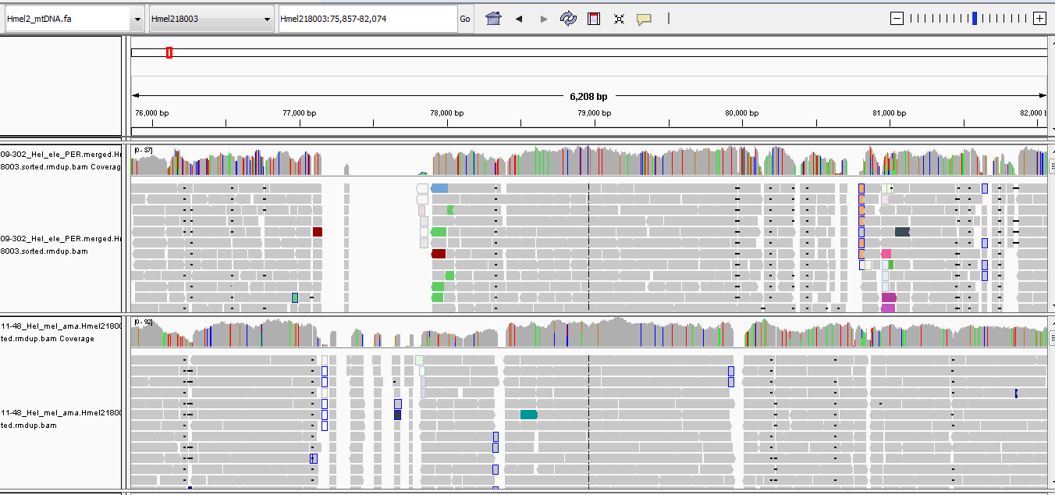
IGV: Integrated Genome Viewer
IGV is a simple browser that you can run locally/on a server.
Most browsers are hosted on a website.
Good for viewing the quality of your alignments to a genome
http://software.broadinstitute.org/software/igv/home

Slide 21
Questions?
EACCR2 Genomics 2019

