Slide 1
Thales UWS Software Engineering Placement Year
Oliver Dixon
Department of Computer Science
University of York
Tuesday, 23rd September 2025

Slide 2
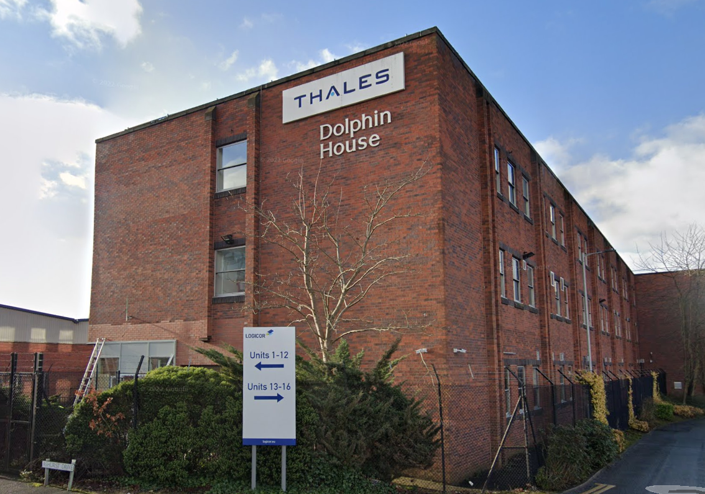
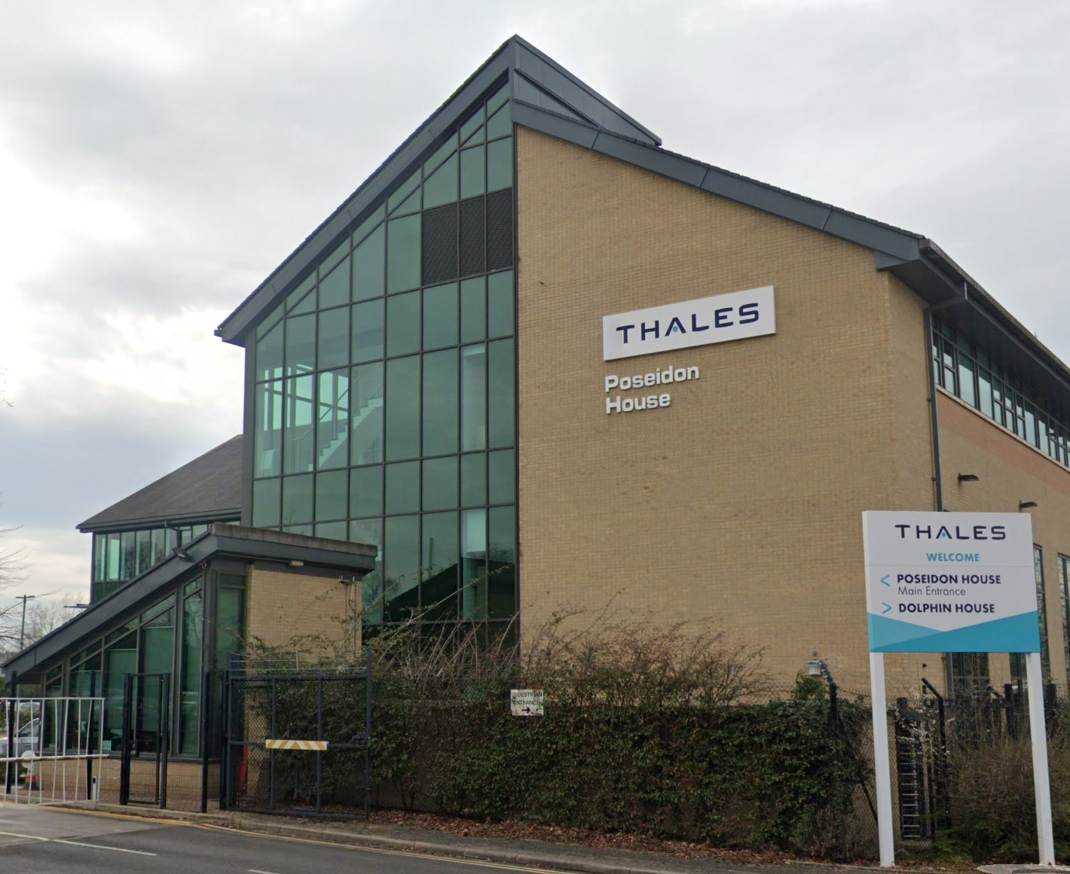
Role Summary
Based in Cheadle Heath, Stockport, Greater Manchester
Full-time (37.5 hours weekly), working half-days on Fridays
Mostly on-site due to project requirements
Worked with cross-functional teams across two large-budget projects
Primarily interacted with software engineers
Also worked closely with Systems, Hardware, Firmware, and Networking

Slide 3
Project A
Collaborated with a small team of engineers from July 2024 to February 2025
Worked alongside software and systems engineers on a quality-control application for an R&D project
Technology stack consisted of C++, Java, and Python on Windows making use of modern SW engineering techniques
Sprint-based agile workflow with daily stand-ups
Undertook multiple business trips across the UK
  Met with project stakeholders and Thales executives to represent UK SW engineering
  Investigated low-level technical problems that could not be replicated remotely

Slide 4
Project B
Worked in a larger team of ~10 engineers from February to August 2025
Regularly worked with colleagues from Systems Engineering, Network Engineering, Hardware Engineering, and Firmware Engineering
Technology stack consisted of C++, Docker, Kubernetes, and lots of mature in-house SW libraries and frameworks
Worked daily on real industrial equipment situated in on-site laboratories
Highly varied work
  Programming
  Architecture design
  Authoring technical documentation
  Testing
  Point-of-contact for those outside the SW team

