Slide 1
Thales UWS Software Engineering Placement Year
Oliver Dixon
Department of Computer Science
University of York
Saturday, 12th September 2026

Slide 2
Application Process & Induction
Straightforward; managed by the CS Placements Team
CVs were sifted to form an interview shortlist
If selected, a single in-person interview followed
Interviews were on-campus, about 30/40 minutes in duration
  10 minutes to present a previous personal project
  10-15 minutes of follow-up discussion
  10-15 minutes of typical interview questions (technical and behavioural)
Interviews take place by technical staff who will be interested in your experience and competencies
Induction is comprehensive: Thales provide everything required and IT support will provision (almost) any equipment you request!

Slide 3
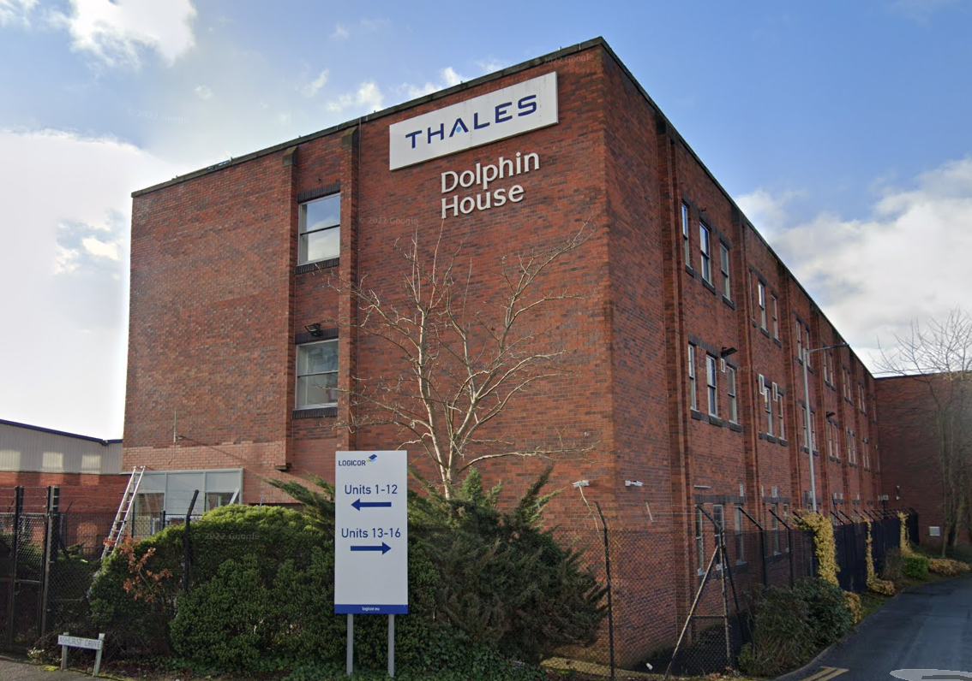
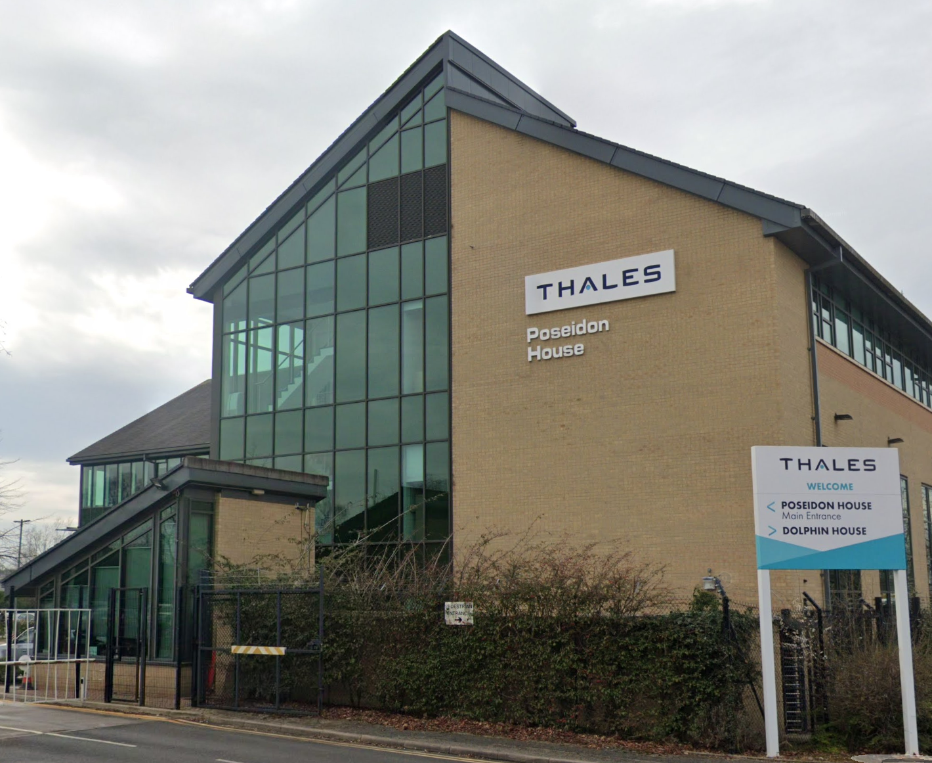
Company & Role
Based in Cheadle Heath, Stockport, Greater Manchester
World leaders in sonar array and related digital signal processing technologies
On-site full-time, working half-days on Fridays
Worked with cross-functional teams across two large-budget projects
Primarily interacted with software engineers
Also worked closely with Systems, Hardware, Firmware, and Networking

Slide 4
Project A
Collaborated with a small team of engineers from July 2024 to February 2025
Worked alongside software and systems engineers on a quality-control application for an R&D project
Technology stack consisted of C++, Java, and Python on Windows making use of modern SW engineering techniques
Sprint-based agile workflow with daily stand-ups
Undertook multiple business trips across the UK
  Met with project stakeholders and Thales executives to represent UK SW engineering
  Investigated low-level technical problems that could not be replicated remotely

Slide 5
Project B
Worked in a larger team of ~10 engineers from February to August 2025
Regularly worked with colleagues from Systems Engineering, Network Engineering, Hardware Engineering, and Firmware Engineering
Technology stack consisted of C++, Docker, Kubernetes, and lots of mature in-house SW libraries and frameworks
Worked daily on real industrial equipment situated in on-site laboratories
Highly varied work
  Programming
  Architecture design
  Authoring technical documentation
  Testing
  Point-of-contact for those outside the SW team

Slide 6
Social Aspects & Post-Grad Prospects
Thales typically takes two or three interns, so you won’t be alone
Stockport is a desirable city with affordable housing and excellent transport links
  Lots of private housing available for year-long tenancies
  Between £800 and £1100 pcm for somewhere central
  Sub-10-minute train journey to central Manchester
Thales recruitment places a heavy emphasis on graduates
  Most interns receive a return offer, which can be held for two years (for those on M. Eng. / M. Math. programmes).
  Clear route to ‘climbing the ladder’. You can become very senior as a tech lead without being forced into managerial roles.

